Slide 1
Educating Creatives about IP: Provenance
The Nottingham
Creative Intellectual Property Project
Janice Denoncourt
10 March 2016

Slide 2
The Nottingham Creative Intellectual Property Project

Slide 3
A multidisciplinary collaboration:
Led by the Nottingham Law School
Legal Advice Centre
IP Research Group
The Hive
School of Art & Design

Slide 4
NLS Legal Advice Centre, Chaucer Building
Companies and graduates with business ideas were offered the opportunity to benefit from pro bono legal advice clinics.
These were delivered by students of Nottingham Law School Legal Advice Centre, guided by experienced IP lawyers and NTU staff.

Slide 5
The Nottingham Intellectual Property
Guide for Creatives
Denoncourt, J. Paley, E., Jarman, J. Johnson, N., Davison, C. and Clarke, P.
(May 2015) Nottingham Trent University Publications

Slide 6
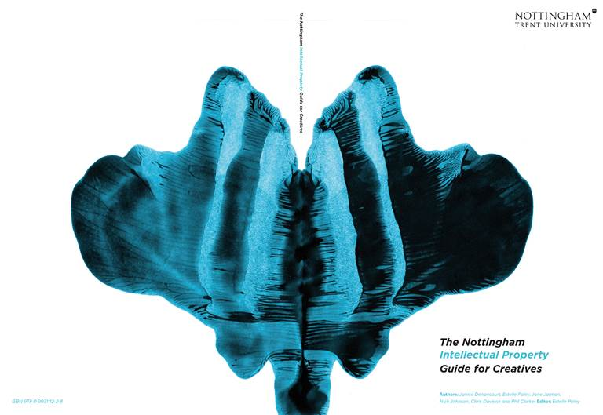

Slide 7
The Nottingham Intellectual Property
Guide for Creatives
For FREE a free copy or E-copy of the publication,
please click on:
http://www.ntu.ac.uk/services_for_business/support/creative_intellectual_property_project.html

Slide 8
In May 2015,
The Nottingham Law School received an
Award for Excellence in IP Education
in the Acquisition International IP Awards
Acquisition International put forward a selection of candidates who they believe to be industry leaders. Additionally the voting forms were sent out to the 108,000 subscribers of AI Magazine along with 27,000 IP specialists.

Slide 9
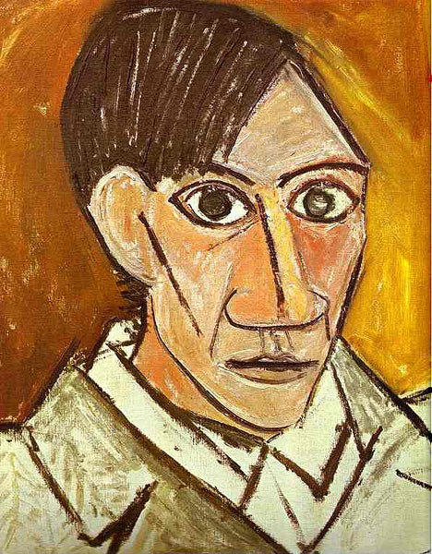
Who is the copyright author/artist?
Provenance
The author is the person who creates the work.
If you have collaborated with another artist, it may be a work of joint authorship with both artists sharing the rights.
05/04/2016
9

Slide 10
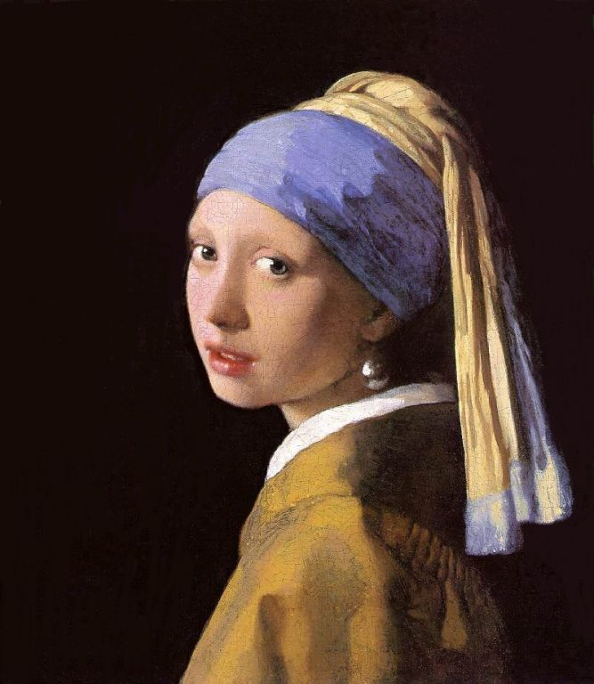
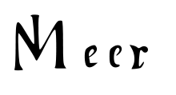
Protect yourself…
Sign, date and mark your work
Johannes Vermeer (1632-1675) Dutch Painter
05/04/2016
10

Slide 11
Establishing Provenance / Copyright
It’s important to establish the origin or ‘provenance’ of your work.
To establish copyright one needs to identify a WORK and an AUTHOR/CREATOR.
A full provenance provides a documented history so an artist or designer can prove OWNERSHIP and establish the works’ AUTHENTICITY.
In the long term, this will assist to create VALUE in the work and provide important LEGAL PROTECTION.
05/04/2016
11

Slide 12
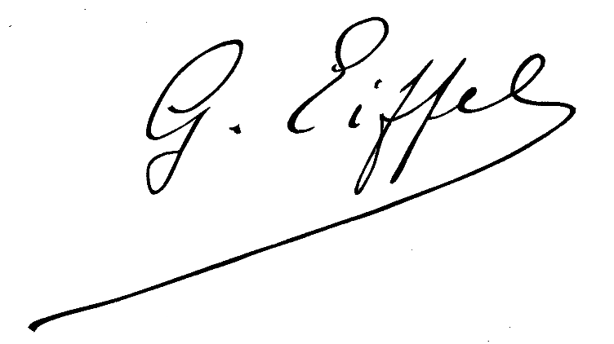
How to Sign your Work
Sign EACH artwork, design document or sketch and mark your products/pieces.
No matter how your signature looks, what form it takes or where you put it, no work is complete without it!
When someone see your work for the first time at your degree show and wants to know more about the artist or designer, your signature helps them find you.
When you’re not around to identify your work, your signature identifies it for you.
05/04/2016
12

Slide 13
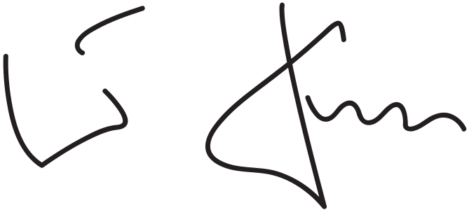
Look at this signature
Can you read it? Whose signature is it?
05/04/2016
13

Slide 14
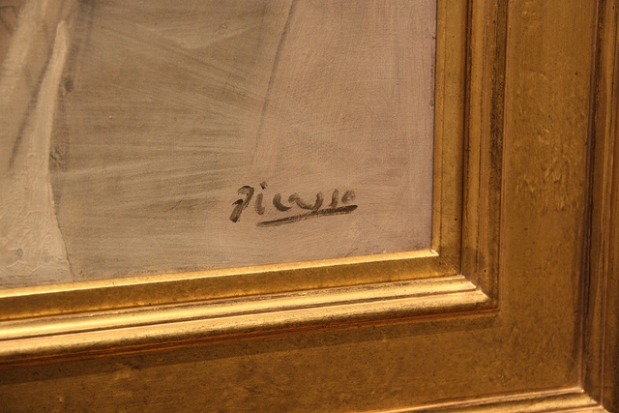
The following signature is instantly recognized
05/04/2016
14

Slide 15
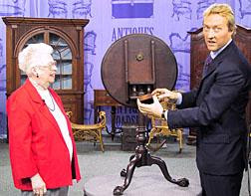
Don’t jeopardize your creative works’ identity by not signing it
People buy creative work and seldom mention the artist or designer.
They misplace their receipts.
They move, sell and give away their work.
Creative work can loses its identity when it changes hands through death, inheritance, divorce, and as gifts.
If the work is unidentified, in copyright law it becomes known as an ‘orphan work’.
It also becomes easier to copy and to forge.
05/04/2016
15

Slide 16
Tips for signing, dating and marking your work
Don’t scribble - sign legibly
Have a unique and instantly memorable signature
Use your full name or a nickname or a first name and surname combination.
Your actual name is preferable to initials, or a symbol, which are easier to copy.
Whichever you use, use it consistently.
Sign or mark on the front, back, side or edges.
Try to sign your artwork in the same medium in which you create it.
Eventually you can register your signature as a TRADE MARK with the UK Intellectual Property Office
05/04/2016
16

Slide 17
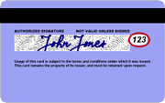
Tips for signing, dating and marking your work
Use a special signature for your creative work – not what you usually use to open a bank account (to avoid identity theft).
05/04/2016
17

Slide 18
Tips for signing, dating and marking your work
Sign all your creative work in the same way.
Think about consistency in:
SIZE
COLOUR
LOCATION
STYLE
This way the creative work you’ve produced over your entire career will be able to be recognised and identified as belonging to you!
05/04/2016
18

Slide 19
Tips for signing, dating and marking your work
Date your creative work.
The better known you become the more important dates are for anyone interested in your evolution as an artist or designer.
05/04/2016
19

Slide 20
Tips for signing, dating and marking your work
If your creative work is on paper, try using an embossing stamp or a fingerprint, which are more difficult to reproduce.
05/04/2016
20

Slide 21
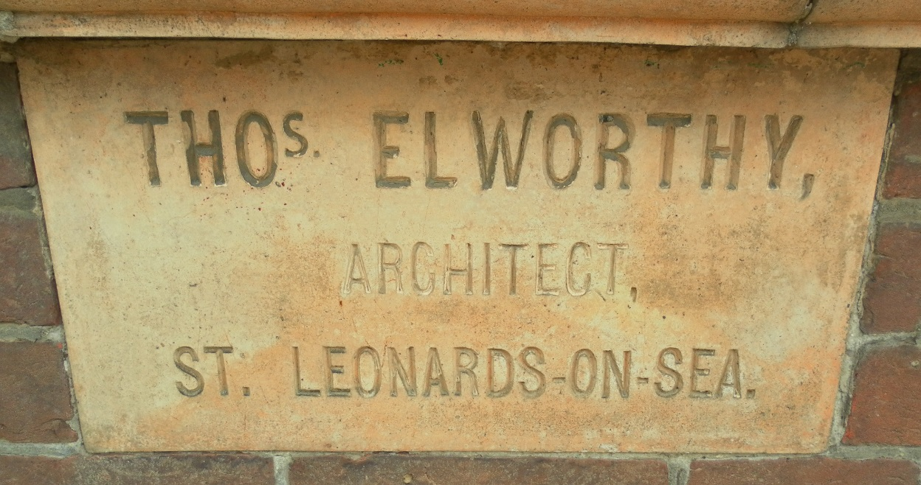
Tips for signing, dating and marking your work
Use Aa plaque / name plate.
05/04/2016
21

Slide 22
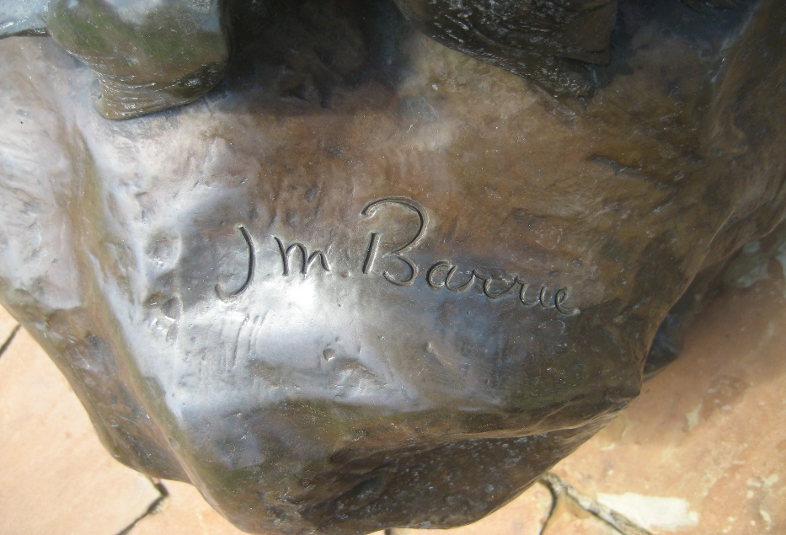
Tips for signing, dating and marking your work
Sign as soon as the work is done, preferably while the paint, clay or other material is still pliable.
Don’t sign on top of a varnished painting or completed sculpture because it may look like it was added later.
05/04/2016
22

Slide 23
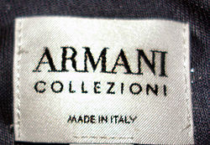
Tips for signing, dating and marking your work
Your signature should blend with, rather than contrast or interfere with your work.
If a signature is not appropriate for your type of creative work mark, label or identify the work as yours. your lifetime plus 70 years
Copyright lasts for. You won’t always be there to vouch for it personally.
05/04/2016
23

Slide 24
Who is the copyright owner?
The author is first owner of copyright under s11(1) CDPA 1988.
Exceptions:
If work is created by employee in the course of employment, then the employer is the owner: s11(2) CDPA 1988.
If the art was commissioned, the contract may specify that the person who commissioned the art is the owner.
BUT YOU HAVE FREEDOM TO AGREE OTHERWISE
05/04/2016
24

Slide 25
Copyright gives the artist
the following EXCLUSIVE rights:
Reproduce the work
Issue copies of the work to the public
Rent or lend the work to the public; and
Authorise others to carry out any of these eg grant licences.
05/04/2016
25

Slide 26
Is artwork on the Internet protected by copyright?
Yes. Material on the internet or stored on web servers is generally protected in the same way as material in other media.
It is a fallacy that once material is posted on the internet it somehow enters the public domain.
05/04/2016
26

Slide 27
Copyright symbol ©
It is wise to include a copyright notice in a prominent place on your work.
© 2015 Janice Denoncourt + contact details.
Keep good records of all your work.
05/04/2016
27

Slide 28
Copyright prevents ‘free-riding’
Allows artists to make ££ from their labour.
Prevents others from taking their work for free without a ‘licence to use’ (ie theft, stealing)
Prevents people altering the work without permission. (moral rights)
05/04/2016
28

Slide 29
What is copyright infringement?
DIRECT INFRINGEMENT IS:
Copying the work in any material form (including digital form)
Issuing copies to the public
Renting or lending the work
Showing the work in public
Making an adaptation of the work (changing form eg converting literary book to a picture book)
INDIRECT INFRINGEMENT is commercially dealing in infringing copies.
05/04/2016
29

Slide 30
What is the legal test for
copyright infringement?
In the case of artistic works, copying requires a causal link between the content of the claimant’s work and the defendant’s work.
Independent creation that results in the same features being present is not copying.
The chain of causation can be indirect.
The unlawful taking must be a SUBSTANTIAL PART of the work.
This is assessed qualitatively not quantitatively.
05/04/2016
30

Slide 31
What is the legal test for
copyright infringement?
The more abstract and general the things taken, the less likely they are to amount to a substantial part of the artist’s skill, labour and judgement.
05/04/2016
31

Slide 32
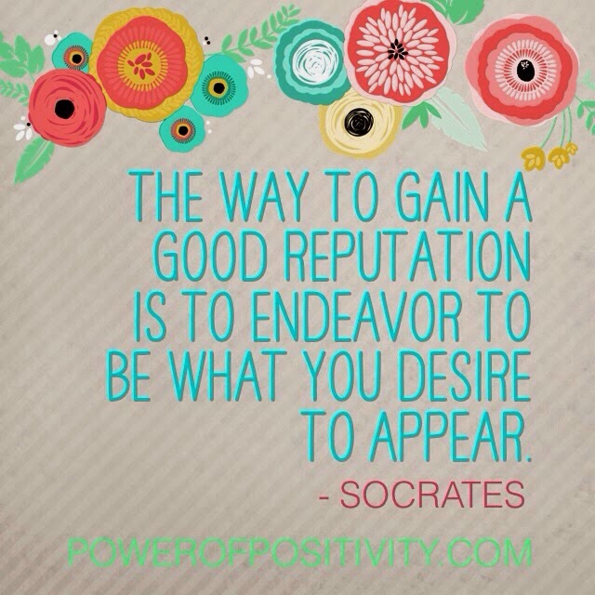
What are an artist’s moral rights?
Copyright protects ECONOMIC rights
Moral rights protect REPUTATION
All visual works are protected against moral rights infringement, as long as they are 'artistic works' as defined by the copyright laws.
The creator of the artistic work has the moral rights not the owner.
05/04/2016
32

Slide 33
What are an artist’s moral rights?
Right of ATTRIBUTION
Right to be identified as author;
Whenever the work is published commercially, exhibited in public, televised (broadcast, cable or satellite), included in a film shown in public or in copies of such a film issued to the public
Identification must always be clear and reasonably prominent;
Must be in a manner likely to catch the attention of any person acquiring a copy, seeing the exhibition or television programme; on a building, it must be visible to people entering or approaching.
05/04/2016
33

Slide 34
What are an artist’s moral rights?
Right to object to DEROGATORY treatment whenever the work is subjected to any:
addition
deletion
alteration
adaptation
if such treatment distorts, mutilates or is otherwise prejudicial to the 'honour or reputation' of the artist.
Right to prevent FALSE ATTRIBUTION of authorship
05/04/2016
34

Slide 35
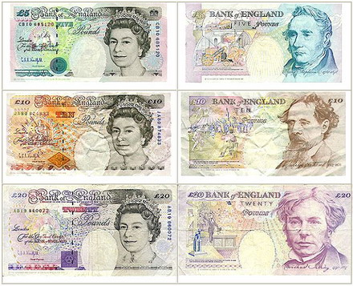
The artists’ resale right
ARTISTS’ RESALE RIGHT
Authors of original works of art are entitled to a royalty each time one of their works is resold through an art market professional.
The right to this royalty lasts for the same period as copyright
05/04/2016
35

Slide 36
Some sales are exempt
For example, where the work being resold was bought directly from the artist less than three years previously and it is being resold for €10,000 or less.
This is generally known as the ‘bought as stock exception’.
Sales between private individuals, without the use of an art market professional, or to public, non-profit making museums do not attract royalty payments
05/04/2016
36

Slide 37
Calculation of royalties
The ARR derives from a European Directive and came into force in the UK in 2006.
The right only applies when the sale price reaches or exceeds the sterling equivalent of €1,000 and is calculated on a sliding scale.
Royalty Resale Price
4% up to €50,000
3% €50,000.01 – €200,000
1% €200,000.01 – €350,000
.5% €350,000.01 – €500,000
.25% in excess of €500,000
05/04/2016
37

Slide 38
Collection of royalties
Resale right in the UK is managed by collecting societies who then distribute the royalty to the artists.
Individual artists cannot request payments directly from the art market professionals involved in the sale.
For more information about the administration of artists’ rights you can contact the Design and Artists Copyright Society (DACS) or Artists Collecting Society (ACS).
Frequently asked questions on ARR are answered on the DACS.
05/04/2016
38

Slide 39
But, moral rights MUST be asserted
Assertion can be dealt with by artists endorsing their works with a unique written provenance
eg. signed by them and stating their authorship, date of completion, copyright by-line and the reservation of all rights
05/04/2016
39

Slide 40
Summary: steps to evaluate your IP
Step 1 IDENTIFY YOUR IP
Step 2 EXERCISE YOUR MORAL RIGHT OF ATTRIBUTION
Step 2 KEEP GOOD RECORDS
eg. date of creation and inspiration as contemporaneous evidence that it is your original creation.
You may need this one day.
05/04/2016
40

Slide 41
More free IP Resources
www.ukipo.gov.uk
www.epo.org
www.wipo.org
www.artquest.org.uk
05/04/2016
41

Slide 42
Nottingham Creative Intellectual Property Project
Thank you!
Janice Denoncourt
Twitter: @JanDenoncourt
Janice.denoncourt@ntu.ac.uk
ResearchGate
Notes:
Project has, however, also given some really useful pointers as to ways in which we can develop other aspects of the law school’s work, both in the Centre and within curriculum.
Creative IP, effectively, a public legal education project. PLE high on the agenda in the pre-crash years as a way of meeting unmet legal need. Genn et al (1999) Paths to Justice highlighted the potential of a “coordinated programme of public education to better understand that matters that are fundamental to citizenship” in both schools and more widely as a way of addressing the fact that around 50% of legal problems go unresolved. PLE Taskforce report in 2007 recommended establishment of a PLE Centre. Even more topical now given the shrinking of State assistance.
Centre already doing these projects (e.g. Streetlaw in schools, Prison Education Project, FGM project developing with a group of BPTC students). Difference here is that with Creative IP project, we’re giving assistance to, say, a fashion designer whose designs are being ripped off by manufacturers in the Far East rather than a prisoner on the verge of release who needs to know what convictions he has to disclose. Social and economic benefit as creative industries now 5% of the overall UK economy employing in 2013 2.62 million people many of whom are self-employed. Areas of law we can cover as educators unlimited – e.g resources a school might want on sexual offences as part of their PSHE porgramme -
Hosting “the book” on the Centre’s website a start – the publication can become part of a series of resources in different areas of law. Resources developed by students as part of a module (under staff supervision) – those which “work” uploaded to the website or offered to community groups as part of the Centre;’s business
Website can also host/publicise materials which the public can use (MOOCs, non-credit bearing modules – free and paid for) which enable participants to address specific issues.

