Slide 1
Weekday effects in the lead-lag relationship
Author: Thong Dao
Co-authors: Frank McGroarty, Andrew Urquhart
Affiliation: University of Southampton, UK

Slide 2
1. Introduction
- Definition of lead-lag relationship
- Motivation: findings of weekday effects in return correlation
+ Blandon (2008): Friday – Monday autocorrelation
+ Chandra (2006) and Osborn et al (2008): Thursday correlation
- Contribution
+ cross-correlation
+ high-frequency context
+ large dataset

Slide 3
2. Literature review
- Relevant literature: weekday effects in return correlation
Return correlation
Autocorrelation of the same time series
Correlation between two time series
Fri-Mon
Other days

Slide 4
- Autocorrelation
+ high for Friday-Monday (e.g. Cross, 1973; Tong, 2000)
+ Friday – Monday autocorrelation weakens in the 1990s (Gu, 2004).
+ international markets: Brazil (Madureira and Leal, 2001); 23 countries (Tong, 2000); Spain, France and Germany (Blandon, 2008)
+ other weekdays: low or negative
+ cause: non-synchronous trading (e.g. Blandon, 2008)
- Correlation between time series: limited and mixed
+ Monday, Tuesday and Thursday effects (Chandra, 2006; Osborn et al, 2008)

Slide 5
3. Data
- S&P500 index and its tracking ETFs (i.e. SPY and IVV)
+ Period: August 2014 – July 2015
+ Data type: tick value and transaction price
- Number of observations: > 20 million
4. Methodology
4.1. Estimation of the lead-lag relationship
- Non-synchronous time series
+ Hayashi and Yoshida (2005): contemporaneous correlation
+ Hoffmann et al (2013): cross-correlation

Slide 6

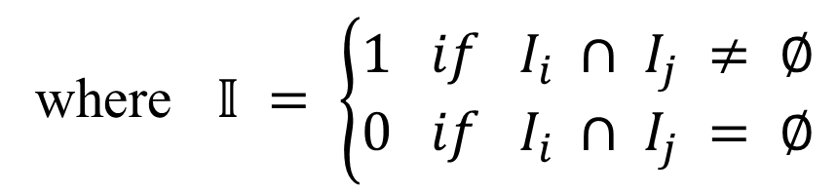


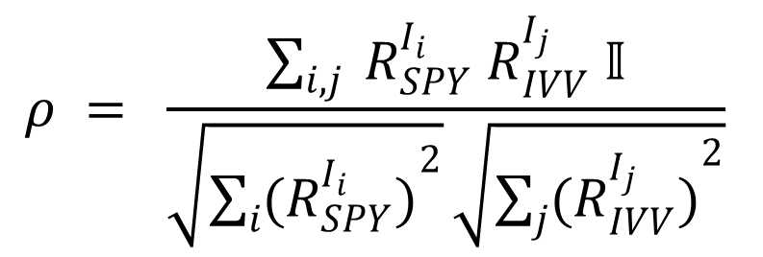







Contemporaneous correlation
$$I_{1}$$
$$I_{2}$$
SPY
Time
$$t_{1}$$
$$t_{2}$$
$$t_{3}$$
$$t_{1}$$
$$t_{2}$$
$$t_{3}$$
IVV
Time
$$I_{1}$$
$$I_{2}$$
$$ρ = \frac{\sum_{i, j}{ R_{SPY}^{I_{i}} R_{IVV}^{I_{j}} 𝕀}}{\sqrt{\sum_{i}{{(R_{SPY}^{I_{i}})}^{2}}}\sqrt{\sum_{j}{{(R_{IVV}^{I_{j}})}^{2}}}}$$
where $𝕀 = \left\{\begin{aligned}1 if I_{i} ∩ I_{j} ≠ ∅ \\ 0 if I_{i} ∩ I_{j} = ∅\end{aligned}\right.$

Slide 7


















Cross-correlation
SPY
Time
$$t_{1}$$
$$I_{1}$$
$$t_{2}$$
$$I_{2}$$
$$t_{3}$$
$$t_{1}$$
$$I_{1}$$
$$t_{2}$$
$$I_{2}$$
$$t_{3}$$
IVV
Time
$$∆t$$
$$∆t$$
$$∆t$$
IVV’
Time
$$t_{1}^{′}$$
$$I_{1}^{′}$$
$$t_{2}^{′}$$
$$I_{2}^{′}$$
$$t_{3}^{′}$$

Slide 8


Correlation curve
$$ρ$$
Lead-lag correlation
0
$$∆t$$
Lead-lag time
Lags
Leads

Slide 9
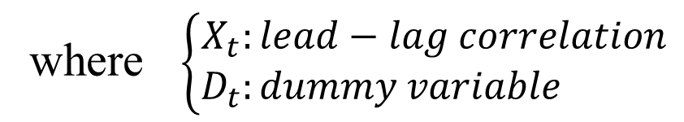
4.2. Weekday effects in the lead-lag relationship
- Quantity of interest: lead-lag correlation
- Methods:
+ Test of mean equality: Monday vs non-Monday, etc
+ Regression: $X_{t} = α+ β.D_{t}+ ε_{t}$
where $\left\{\begin{aligned}X_{t}:lead−lag correlation \\ D_{t}:dummy variable \end{aligned}\right.$

Slide 10
5. Results
General lead-lag relationship
 | Lead-lag correlation | Lead-lag time (ms)
S&P500 – IVV | 0.1943 | 10
S&P500 – SPY | 0.1886 | 30
IVV – SPY | 0.2370 | 20
- Moderate correlation
- Short lead-lag time
- Index leads ETFs

Slide 11
Weekday effects in the lead-lag correlation
- Similar pattern
- S&P500 – IVV: Monday
- IVV – SPY: Wednesday and Thursday
Monday
Tuesday
Wednesday
Thursday
Friday

Slide 12
6. Conclusion
- Moderate correlation
- Index leads ETFs
- Lead-lag correlations show a similar intraweek pattern.
- S&P500 – IVV: Monday, IVV – SPY: Wednesday and Thursday
- Future studies should pay attention
- Future research:
+ Weekday effects in the lead-lag time
+ Intraday effects

Slide 13
References
BLANDÓN, J. G. 2008. Return autocorrelation anomalies and the importance of non-trading periods: Evidence from Spain, France and Germany. Quantitative Finance, 8, 341-349.
CHANDRA, M. 2006. The day-of-the-week effect in conditional correlation. Review of Quantitative Finance & Accounting, 27, 297.
CROSS, F. 1973. The Behavior of Stock Prices on Fridays and Mondays. Financial Analysts Journal, 29, 67.
GU, A. Y. 2004. The Reversing Weekend Effect: Evidence from the U.S. Equity Markets. Review of Quantitative Finance & Accounting, 22, 5.
HAYASHI, T. & YOSHIDA, N. 2005. On Covariance Estimation of Non-Synchronously Observed Diffusion Processes. Bernoulli, 11, 359-379.
HOFFMANN, M., ROSENBAUM, M. & YOSHIDA, N. 2013. Estimation of the lead-lag parameter from non-synchronous data. Bernoulli, 19, 426-461.
MADUREIRA, L. L. & LEAL, R. P. C. 2001. Elusive anomalies in the Brazilian stock market. International Review of Financial Analysis, 10, 123-134.
OSBORN, D. R., SAVVA, C. S. & GILL, L. 2008. Periodic Dynamic Conditional Correlations between Stock Markets in Europe and the US. Journal of Financial Econometrics, 6, 307.
TONG, W. 2000. International Evidence on Weekend Anomalies. Journal of Financial Research, 23, 495-522.

