Slide 1
A risky process ? The efficacy of Integrated Risk Management Plans in Fire and Rescue Services
Katarzyna Lakoma and Pete Murphy
Nottingham Trent University
JUC Annual Conference 2019
Northumbria University
17 September 2019

Slide 2
Integrated Risk Management Plans and the National Frameworks
A local IRMP sets out the authority’s strategy, in collaboration with other agencies, for reducing the commercial, economic and social impact of fires and other emergency incidents
IRMPs have been mandatory since the Fire and Rescue Services Act 2004
Underpinned 5 National Frameworks (2004, 2006, 2008, 2012, 2018)
Inform strategic decision-making as well as operational service delivery
Despite this crucial strategic role – no systematic review of content, currency or fitness for purpose (or suggestion of it from government).
HMICFRS reviewing whether activities and services reflect the risks identified in the IRMP – not evaluating IRMPs themselves.

Slide 3
IRMP requirements
Reflect up to date risk analyses including an assessment of all foreseeable fire and rescue related risks that could affect the area of the authority;
Demonstrate how prevention, protection and response activities will best be used to prevent fires and other incidents and mitigate the impact of identified risks on its communities, through authorities working either individually or collectively, in a way that makes best use of available resources;
Outline required service delivery outcomes including the allocation of resources for the mitigation of risks;
Set out its management strategy and risk-based programme for enforcing the provisions of the Regulatory Reform (Fire Safety) Order 2005 in accordance with the principles of better regulation set out in the Statutory Code of Compliance for Regulators, and the Enforcement Concordat;
Cover at least a three-year time span and be reviewed and revised as often as it is necessary to ensure that the authority is able to deliver the requirements set out in this Framework;
Reflect effective consultation throughout its development and at all review stages with the community, its workforce and representative bodies and partners; and
Be easily accessible and publicly available.

Slide 4
IRMP requirements
Reflect up to date risk analyses including an assessment of all foreseeable fire and rescue related risks that could affect the area of the authority;
Demonstrate how prevention, protection and response activities will best be used to prevent fires and other incidents and mitigate the impact of identified risks on its communities, through authorities working either individually or collectively, in a way that makes best use of available resources;
Outline required service delivery outcomes including the allocation of resources for the mitigation of risks;
Set out its management strategy and risk-based programme for enforcing the provisions of the Regulatory Reform (Fire Safety) Order 2005 in accordance with the principles of better regulation set out in the Statutory Code of Compliance for Regulators, and the Enforcement Concordat;
Cover at least a three-year time span and be reviewed and revised as often as it is necessary to ensure that the authority is able to deliver the requirements set out in this Framework;
Reflect effective consultation throughout its development and at all review stages with the community, its workforce and representative bodies and partners; and
Be easily accessible and publicly available.

Slide 5
Methods
Stage 1: Accessibility and Public Reporting
43 FRS out of 45 (not the Isle of Wight or Isles of Scilly)
Public accessibility of IRMPs - a manual search of FRSs’ websites
Stage 2: Protection and Prevention
Sample - 6 FRSs (2x county, combined, and Met across 6 regions)
Data collection of IRMPs was conducted in October 2018
In-depth document analysis of protection and prevention activities
Was information fit for purpose reflecting current good practice?

Slide 6
Stage 1: Accessibility and Public Reporting
FRS | a. IRMP produced | b. Integrated or standalone | c. Ease of access | d. Minimum three-year time span | e. Latest reporting period
FRS1 | Yes | Integrated | Yes | No (2017) | No
FRS2 | Yes | Standalone | Yes | Yes (2015 – 2018) | Yes
FRS3 | Yes | Standalone | Yes | Yes (2017 – 2020) | Yes
FRS4 | Yes | Standalone | Yes | Yes (2017 – 2020) | Yes
FRS5 | Yes | Integrated | Yes | Yes (2017 – 2020) | Yes
FRS6 | Yes | Integrated | Yes | Yes (2018 – 2021) | Yes
FRS7 | Yes | Integrated | Yes | Yes (2015 – 2020) | Yes
FRS8 | Yes | Standalone | Yes | Yes (2016 – 2020) | Yes
FRS9 | Yes | Integrated | Yes | Yes (2017 – 2022) | Yes
FRS10 | Yes | Integrated | Yes | Yes (2018 – 2022) | Yes
FRS11 | Yes | Integrated | Yes | Yes (2015 – 2020) | Yes
FRS12 | Yes | Standalone | Yes | Yes (2017 – 2020) | Yes
FRS13 | Yes | Standalone | Yes | Yes (2016 – 2020) | Yes
FRS14 | Yes | Integrated | No | No (2018) | Yes
FRS15 | Yes | Integrated | Yes | Yes (2015 – 2019) | Yes
FRS16 | Yes | Standalone | Yes | Yes (2014 – 2018) | Yes
FRS17 | Yes | Integrated | Yes | Yes (2018/19 – 2020/21) | Yes
FRS18 | Yes | Standalone | Yes | Yes (2018 – 2021) | Yes
FRS19 | Yes | Integrated | Yes | Yes (2016/17 - 2020/21) | Yes
FRS20 | Yes | Standalone | Yes | No (2018 – 2019) | Yes
FRS21 | Yes | Standalone | Yes | Yes (2017 – 2022) | Yes
FRS22 | Yes | Standalone | Yes | Yes (2015 – 2019) | Yes
FRS23 | Yes | Standalone | Yes | Yes (2017 – 2020) | Yes
FRS24 | Yes | Standalone | Yes | Yes (2016 – 2020) | Yes
FRS25 | Yes | Standalone | Yes | Yes (2017 – 2021) | Yes
FRS26 | Yes | Standalone | Yes | Yes (2016 – 2020) | Yes
FRS27 | Yes | Standalone | Yes | Yes (2014 – 2019) | Yes
FRS28 | Yes | Standalone | Yes | Yes (2014 – 2020) | Yes
FRS29 | Yes | Integrated | No | Yes (2015 – 2020) | Yes
FRS30 | Yes | Standalone | No | Yes (2017 – 2020) | Yes
FRS31 | No | - | - | - | -
FRS32 | Yes | Standalone | Yes | Yes (2018 – 2021) | Yes
FRS33 | Yes | Standalone | Yes | Yes (2017 – 2022) | Yes
FRS34 | Yes | Standalone | No | Yes (2016 – 2025) | Yes
FRS35 | Yes | Standalone | Yes | Yes (2018 – 2022) | Yes
FRS36 | Yes | Standalone | No | Yes (2017 – 2021) | Yes
FRS37 | Yes | Standalone | Yes | Yes (2016 – 2020) | Yes
FRS38 | Yes | Standalone | Yes | Yes (2014 – 2018) | Yes
FRS39 | Yes | Standalone | Yes | Yes (2016 – 2020) | Yes
FRS40 | Yes | Standalone | Yes | Yes (2015 – 2018) | Yes
FRS41 | Yes | Standalone | Yes | Yes (2016 – 2020) | Yes
FRS42 | Yes | Standalone | Yes | Yes (2017 – 2020) | Yes
FRS43 | Yes | Standalone | Yes | Yes (2017 – 2020) | Yes
1. Is the IRMP publicly available on the FRS website?
42 FRSs out of 43 provided an IRMP document on their websites
2. Is it a standalone document or does it incorporate the IRMP?
30 standalone documents, 12 integrated documents
3. Is the IRMP easily accessible?
37 IRMPs were discoverable through the search function on websites, whilst 5 others required a manual search for reports and publications within the respective FRSs’ websites
4. Does the IRMP cover at least three-year time span?
A variety of reporting periods (1 to 9 years)
5. Is the latest reporting period available?
41 FRSs published their IRMPs for the latest reporting period (2018), one service provided an IRMP for the 2017 reporting period as their latest iteration

Slide 7
Stage 2: protection and prevention
Protection – aims, objectives and outcomes
Safeguarding the culture, heritage and environmental assets | 4 out of 6 FRSs
Risk-based approach | 1 out of 6 FRSs
Environment – water pollution | 1 out of 6 FRSs
Environment – flooding | 2 out of 6 FRSs
Environment – air quality | 1 out of 6 FRSs
Flu pandemic | 1 out of 6 FRSs
Protection - actions
Working with businesses to help them thrive | 6 out of 6 FRSs
Assessing high risk buildings | 4 out of 6 FRSs
Securing legislative compliance (enforcement action) | 5 out of 6 FRSs
Carrying out fire safety audits | 2 out of 6 FRSs
Sprinkler systems encouragement | 3 out of 6 FRSs
Business continuity planning | 3 out of 6 FRSs
Prevention – aims, objectives and outcomes
Reducing the number of people killed or injured in dwelling fires | 3 out of 6 FRSs
Arson reduction | 3 out of 6 FRSs
Reducing anti-social behaviour | 3 out of 6 FRSs
Tackling the root causes of inequality | 1 out of 6 FRSs
Prevention - actions
Carrying out home fire safety checks | 5 out of 6 FRSs
Working in partnership | 4 out of 6 FRSs
Providing fire safety education | 5 out of 6 FRSs
Improving road safety | 5 out of 6 FRSs
Engaging with young people | 5 out of 6 FRSs
Business intelligence and data analysis | 2 out of 6 FRSs
Free smoke alarms | 2 out of 6 FRSs
FRSs provided varied levels of detail on prevention and protection activities in their IRMPs
IRMPs tend to include protection and prevention actions (short-term), rather than aims, objectives and outcomes (medium or long-term).
The results do not show any apparent differentiation across either authority types (county, combined or metropolitan), or across different regions.
Notes:
The activities reported could essentially be differentiated into two categories. The first could be interpreted as being expressions of aims, objectives and/or outcomes, for the service. These by their nature tended to be medium or long term in perspective. The second was identification of various ‘actions’. These by their nature tended to be more short term in focus and be input or output focused.

Slide 8
Findings
FRSs acknowledge the importance of the IRMP its regular review and public reporting
Most of the FRSs are aware of the long-term risks to people and property in their areas
A minority do not provide the documents that assess current and future risks to their local communities
FRSs tend use different names for IRMPs. -reflects the absence of national guidance on templates or standard formats for IRMPs.

Slide 9
Definition of a National Framework or Performance Regime
“The context, the parameters, the agencies and the relationships operating within the three domains of policy development, service delivery and public assurance in public services”
(Murphy and Lakoma 2018)

Slide 10
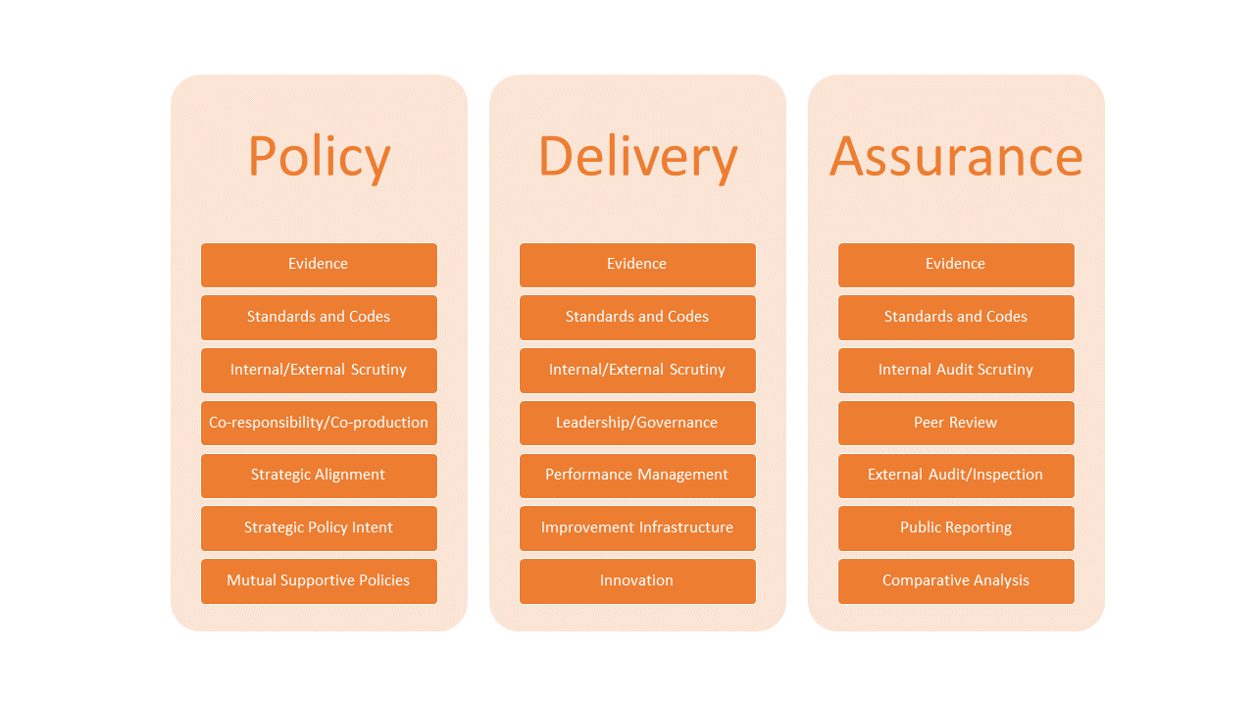
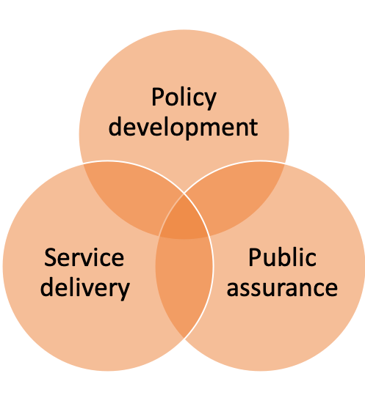
Where do standards and evidence fit into a national framework?

Slide 11
The relationshi between IRMP and National Standards
FBU – rejects the inconsistency and local variations of IRMPs in favour of national standards of fire cover
Prosser – the loss of national standards means the number of resources attending incidents and the consequential capabilities of those reduced resources can differ according to postcode as well as managing expectations between neighbouring services.
Murphy - Whether or not it leads to national standards or benchmarks of response – it is clear there is too much ‘unwarranted’ variation and they need better data and better quality assurance

Slide 12
National Standards or Postcode Lottery?
NFCC – Review of Community Risk Methodologies (Phase 1, 2019).
NTU – “there is a growing realisation we also need a fundamental and comprehensive review of IRMP process and outcomes” (June 2019)
“there is too much variation in how fire and rescue services operate, resulting in a postcode lottery in the standards of service the public receives” HM Inspector of Fire and Rescue Services (July 2019)
“it is clear that a comprehensive review of the IRMP process and outcome is long overdue” FIRE (July 2019)
“That a standard template for producing an IRMP has never been produced is disappointing and astounding” (Andrew Lynch Editor and FSG Board Member 2019)

Slide 13
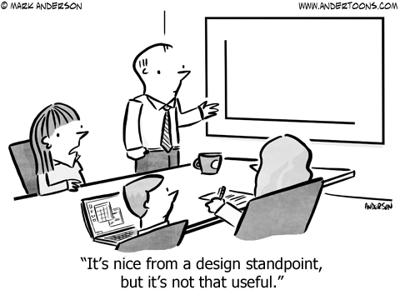
The evidence base in Fire and Rescue
Insufficient amount of evidence
Insufficient quality of evidence
Inadequate analytical tools
Insufficiently transparent analysis of evidence
Inadequate accountability

Slide 14
The evidence base - Quality, Quantity, Analysis and Transparency
Data
poor
Data
Rich
Intelligent
Data
Self-
Regulation
Little or no data and intelligence and predominantly hoc in nature
Quality assurance of the information processes and systems is variable and poor/unfit for purpose
Lack of benchmarks and standards mean comparability is difficult, impractical or impossible
No overall national perspective or national framework
A mixture of qualitative and qualitative data and intelligence exists
Subjective and objective measures, with both absolute and relative measurements available
A mixture of input, output and outcome indicators and/or measures and a degree of internal and external quality assurance
The data is primarily operationally or organizationally focused
Sector or system-wide real time data and intelligence available at a publically accessible single depository (web based)
Sector-wide, quality assured and standards based objective and subjective metrics and measurements
Robust, sophisticated, public and freely available, interrogative, analytical and interpretive tools
Detailed and comparable short medium and long term data on trends and comparisons both national and international
Facilitates and promotes international, academic, professional and operational research
Sector wide identification and dissemination of good practice, learning and innovation
Independent, quality assured, open and transparent international ‘host’ for a comprehensive database
Built in improvement and quality assurance as fundamental to its purpose

Slide 15
Conclusion from our wider Research
Any performance regime/national framework that seeks to be comprehensive has to cover policy development, service delivery and public assurance and be cognisant of their interrelationships and interdependencies
Policy, service delivery and public assurance are all dependent, inter alia, on robust, reliable evidence and appropriate interrogatory mechanisms.
In England these have been disintegrating and deteriorating and government have effectively abandoned evidence based policy development and service delivery

Slide 16
Any questions?
peter.murphy@ntu.ac.uk
katarzyna.lakoma@ntu.ac.uk

