Slide 1
Public Management after Covid: Will things ever be the same again?
The central/local government interface
Accountability and Assurance for Public Services.
Pete Murphy
Nottingham Business School; Nottingham Trent University

Slide 2
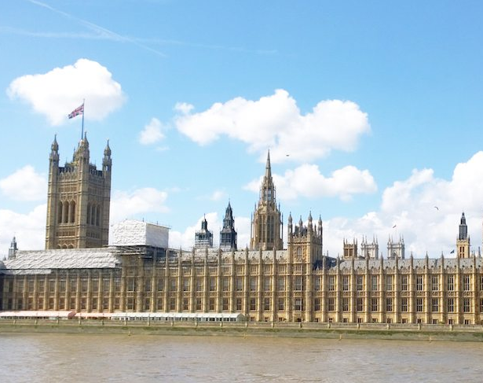
Central/Local Relations Accountability & Assurance
Trust and Integrity
The auditors adage
Expectation gaps
The current administration
Public policy making
Public service delivery
Assurance

