Slide 1
Criminal Justice Inequality: Reducing disproportionality in reoffending
Reducing Reoffending, Partnerships & Accommodation Directorate
Ian Mahoney (NTU), Rahmanara Chowdhury (NTU), & Laura Emmerson (HMPPS)

Slide 2
Project summary
Developing Academic Policy Engagement (DAPE) initiative with Nottingham Trent University*
Exploring issues surrounding disproportionality in reoffending rates
Key themes:
Addressing systemic bias and discrimination
The appropriateness of interventions and barriers to engagement
The role of family in providing support
The need for community engagement
The need to embed holistic support
*For the full report see Mahoney and Chowdhury (2021)

Slide 3
The problem
27% of prisoners identify as Black, Asian, or Minority Ethnic (Yasin and Sturge 2020) vs 13% of the general population (ONS 2012)
Those identifying as Black in prison is 13% vs 3% of the general population (MoJ 2020)
51% of children in youth custody identify as Black, Asian, or Minority Ethnic (MoJ 2020)
Black men spend more of their original sentence in prison than men from other ethnic groups (MoJ 2020)

Slide 4
Black men and youths remain the most likely to re-offend (Uhrig 2016, MoJ 2020)
White adults and youths are more likely to have a higher volume of reoffences (MoJ 2020)
Asian and ‘Other ethnicities’ have consistently lower rates of reoffending (Uhrig 2016, MoJ 2020)
Existing studies do not provide satisfactory explanations for this variation (Shingler and Pope 2018)

Slide 5
Overarching concerns
Addressing disadvantage, bias and discrimination
Holistic
Empowerment
Language
Inclusive
Culturally appropriate
Family and community focused
Needs based

Slide 6
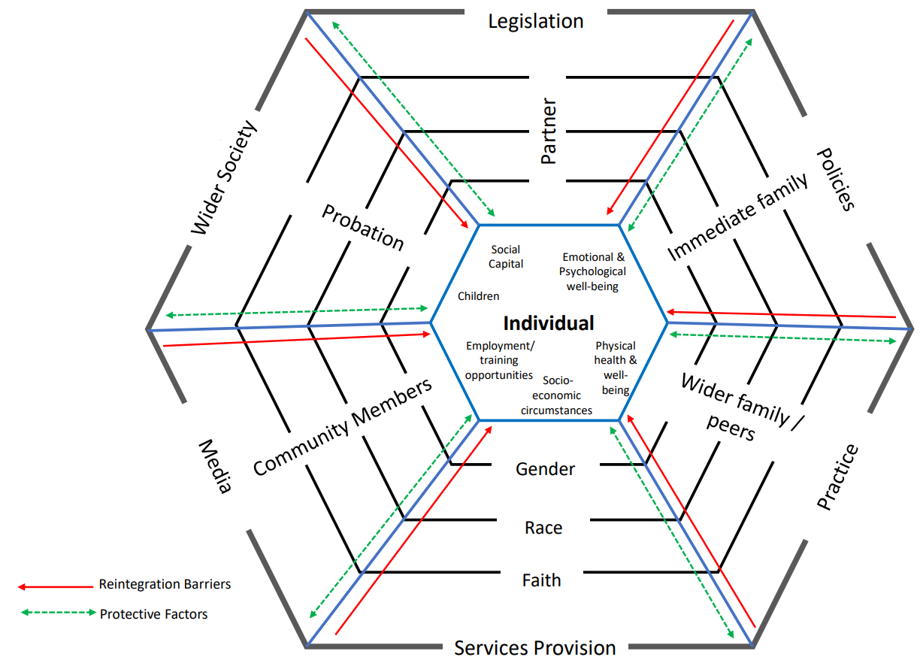
Visualising holistic support
Web model of Reintegration Framework for minority communities (Chowdhury 2021). Adapted from Web Model of DVA, © Chowdhury, 2021

Slide 7
Key themes
Overcoming barriers to engagement
Developing the role of family
Promoting community engagement
Embedding holistic support

Slide 8
Overcoming barriers to engagement
Minority populations are underrepresented throughout treatment programmes and interventions
Barriers to engagement:
Fear of judgement and alienation (Hunter et al. 2019)
A sense of being misunderstood (Brookes et al. 2012)
Concerns over racism and/or discrimination (Mason et al. 2009)
Cultural relevance (Brookes et al. 2012)
Therapy as a ‘White’ concept (Shingler and Pope 2018)

Slide 9
Appropriate programme design:
Address training needs: programmes should be culturally aware and delivered by culturally sensitive staff;
Some service users may benefit from working with staff from similar ethnic backgrounds;
Provide a sense of choice and control over the speed of delivery and the nature of the content being covered;
Avoid overly complex, diagnostic, or treatment-focused terminology.

Slide 10
The role of family
Family play an important role in reducing reoffending and supporting reintegration (Chapski 2019)
Visits from family and significant others are key to reintegration (Farmer 2017, 2019)
Family contact is important throughout the experience of incarceration and beyond for:
Financial support and employment opportunities (Strickland 2016, Cherney and Fitzgerald 2016)
(Re)developing informal networks and social capital (Palmer and Christian 2019)

Slide 11
Important family focused considerations
The stigma of conviction affects the family as well as the perpetrator (SCCJR 2015)
It is important to continue supporting families – they should not be left to shoulder the responsibilities of the state (Hall et al. 2018)

Slide 12
Family Support Recommendations
Engage family to support people in prison
Address family needs
Address the stigma of conviction upon families
Assist families in supporting prison leavers

Slide 13
The need to engage communities
Prison leavers return to the community after they have served the custodial element of their sentence
Minority communities are most likely to experience greater levels of deprivation and disadvantage (Williams and Durrance 2018)
People from impoverished communities often lack the capital and resources to break out of the poverty cycle
These challenges are compounded for those with a criminal record

Slide 14
The importance of communities
The community is where interactions with others are shaped
Stigma affects the prison leaver and their family (SCCJR 2015)
Communities are vital to the (re)development of social capital
The community is the site of desistance
Culturally aware organisations are embedded in local communities

Slide 15
Community Engagement Recommendations
Invest in minority and other disadvantaged communities
Support and engage culturally aware organisations already embedded in the local community
Address the community stigmatisation of prison leavers and their families
Support communities and families to develop social capital
Use culturally relevant social prescribing to help reintegrate people back into communities

Slide 16
The need to embed holistic support
More culturally sensitive resources and interventions will benefit all, regardless of ethnicity or minority status
Holistic support offers space for personalisation of responses
Core elements include:
Developing positive, pro-social narratives
Focusing upon the individual’s strengths, abilities, and attributes
Promoting desistance
Prioritising an individual’s needs rather than the risks that they pose
(see Terrill and Chowdhury 2020, Hall et al. 2018)

Slide 17
Embedding holistic support
Focus on the strengths and positive aspects of the prison leaver’s skills and identity
Collaborate with the prison leaver, families, community organisations, and practitioners
Promote long-term wellbeing and development of skills, relationships, and capacity to promote desistance and reintegration
Place the prison leaver at the heart of any programme

Slide 18
Visualising holistic support
Web model of Reintegration Framework for minority communities (Chowdhury 2021). Adapted from Web Model of DVA, © Chowdhury 2021

Slide 19
Kirkham Family Connectors Model
Focus upon identifying and developing strengths of person in prison:
Building positive relationships
Developing resettlement capital
Promoting familial cohesion
Hope for the future
Positive feedback from all stakeholders
See Hall et al. (2018)

Slide 20
Needs-based model of holistic support
6. Self-transcendence
5. Self-actualisation
4. Esteem
3. Love & Belonging
2. Safety
1. Physiological Needs
Transcendental Fulfilment
Personal Fulfilment
Personal development
Individualised support (through structured support circles and mentoring from key community members)
Personal and Social Intimacy and belonging
Maslow’s Hierarchy of Needs
Areas for Development
Recommendations (for former prisoner & family)
Health
Employment
Personal security
Housing
Basic needs
Soft specialist services (addictions, domestic violence, healthy relationships, conflict resolution, healthy parenting)
Specialist services (housing, welfare, employment, legal)
Individualised psychological support
Support networks (social capital through enhancement of family relationships & community-specific services)
Adapted from Terrill and Chowdhury (2020)

Slide 21
References
Brookes, M., Glynn, M., and Wilson, D. (2012) Black men, therapeutic communities and HMP Grendon. Therapeutic Communities: The International Journal of Therapeutic Communities, 33(1), 16–26. https://doi.org/10.1108/09641861211286294
Chapski, A. M. (2019) Family contact in prison and post-release family social support: Does gender affect the relationship? Master’s thesis. Bowling Green State University, Ohio, USA. http://rave.ohiolink.edu/etdc/view?acc_num=bgsu1566313186304724
Cherney, A. and Fitzgerald, R. (2016) Finding and keeping a job: The value and meaning of employment for parolees. International Journal of Offender Therapy and Comparative Criminology, 60(1), 21–37. https://doi.org/10.1177/0306624X14548858
Chowdhury, R. (2021). Promoting health and wellbeing through alleviating domestic violence: Addressing domestic violence and abuse in the UK Muslim population. PhD thesis (in preparation). Brunel University, London.
Farmer, M. (2017) Importance of strengthening prisoners’ family ties to prevent reoffending and reduce intergenerational crime. London: Ministry of Justice. https://www.gov.uk/government/publications/importance-of-strengthening-prisoners-family-ties-to-prevent-reoffending-and-reduce-intergenerational-crime [Accessed 17 March 2021]
Farmer, M. (2019) Importance of strengthening female offenders’ family and other relationships to prevent reoffending and reduce intergenerational crime. London: Ministry of Justice. https://www.gov.uk/government/publications/farmer-review-for-women [Accessed 17 March 2021]
Hall, L. J., Best, D., Ogden-Webb, C., Dixon, J., and Heslop, R. (2018) Building bridges to the community: the Kirkham Family Connectors (KFC) Prison Programme. Howard Journal of Crime and Justice, 57(4), 518–536. https://doi.org/10.1111/hojo.12289
Hunter, S., Craig, E., and Shaw, J. (2019) ‘Give it a Try’: Experiences of Black, Asian and Minority Ethnic young men in a prison-based offender personality disorder service. Journal of Forensic Practice, 21(1), 14–26. https://doi.org/10.1108/JFP-07-2018-0026
Mahoney, I. and Chowdhury, R. (2021) Criminal Justice Inequality: Reducing disproportionality in reoffending. Nottingham Trent University.
Mason, P., Hughes, N., Hek, R., Spalek, B., and Ward, N. (2009) Access to justice: A review of existing evidence of the experiences of minority groups based on ethnicity, identity and sexuality. Ministry of Justice Research Series 7/09. London: Ministry of Justice.
Ministry of Justice (2020) Proven reoffending statistics: October to December 2018. https://www.gov.uk/government/statistics/proven-reoffending-statistics-october-to-december-2018 [Accessed 18th March 2021]

Slide 22
References
Office for National Statistics (2012) Ethnicity and national identity in England and Wales: 2011. https://www.ons.gov.uk/peoplepopulationandcommunity/culturalidentity/ethnicity/articles/ethnicityandnationalidentityinenglandandwales/2012-12-11 [Accessed 15 March 2021].
Palmer, C. and Christian, J. (2019) Work matters: Formerly incarcerated men’s resiliency in reentry. Equality, Diversity and Inclusion: An International Journal, 38(5), 583–598. https://doi.org/10.1108/EDI-10-2018-0177
SCCJR (2015) Impact of punishment: Families of people in prison. Glasgow: The Scottish Centre for Crime and Justice Research. https://www.sccjr.ac.uk/wp-content/uploads/2015/10/SCCJR-Impact-of-crime-prisoners-families.pdf [Accessed 18 March 2021]
Shingler, J. and Pope, S. (2018) The effectiveness of rehabilitative services for Black, Asian and Minority Ethnic people: A rapid evidence assessment. London: Ministry of Justice. https://www.gov.uk/government/publications/the-effectiveness-of-rehabilitative-services-for-black-asian-and-minority-ethnic-people-a-rapid-evidence-assessment [Accessed 17 March 2021]
Strickland, J. (2016) Building social capital for stable employment: The postprison experiences of Black male exprisoners. Journal of Offender Rehabilitation, 55(3), 129–147. https://doi.org/10.1080/10509674.2015.1128506
Terrill, D. J. and Chowdhury, R. (2020) Empowerment in action: A psychological wellbeing strategy for male Muslim former prisoners. Capacity-building document. Forensic Mental Health Conference. Brunel University
Uhrig, N. (2016) Black, Asian and Minority Ethnic disproportionality in the Criminal Justice System in England and Wales. London: Ministry of Justice. https://www.gov.uk/government/publications/black-asian-and-minority-ethnic-disproportionality-in-the-criminal-justice-system-in-england-and-wales [Accessed 17 March 2021]
Williams, P. and Durrance, P. (2018) ‘Resisting effective approaches for BAME offenders: The triumph of inertia’, in P. Ugwudike, P. Raynor, and J. Annison (eds.), Evidence-based skills in criminal justice: International perspectives on effective practice. Bristol: Policy Press.
Yasin, B. and Sturge, G. (2020) Ethnicity and the criminal justice system: What does recent data say on over-representation. https://commonslibrary.parliament.uk/ethnicity-and-the-criminal-justice-system-what-does-recent-data-say/ [Accessed 15 March 2021]

