Slide 1
Embedding SDGs in Universities DNA
Dr Petra Molthan-Hill
Professor of Sustainable Management and Education for Sustainable Development and Co-Chair UN PRME Working Group on Climate Change & the Environment, former Lead of NTU’s Green Academy, Nottingham Trent University

Slide 2
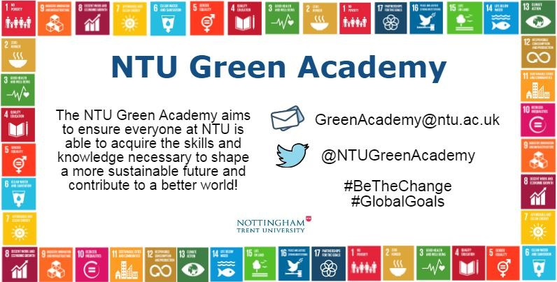
WILLATS, J., ERLANDSSON, L., MOLTHAN-HILL, P., DHARMASASMITA, A. and SIMMONS, E., 2018. A university wide approach to integrating the sustainable development goals in the curriculum – a case study from the Nottingham Trent University Green Academy. In: W. LEAL FILHO, ed., Implementing sustainability in the curriculum of universities: approaches, methods and projects. World sustainability . Berlin: Springer, pp. 63-78.

Slide 3
The Sustainable Development Goals at Nottingham Trent University integrated since 2016
Curriculum Refresh
The SDGs were embedded in the university-wide course evaluation process Curriculum Refresh in 2016.
NTU and SDG 13
CLT-ECOS
Student Outreach
Seeking feedback from students on how they would like to embed the SDGs in their courses
Future Thinking Learning Room
An online resource library containing resources, estate and community case studies and examples of good practice, all linked to the SDGs
Staff development
Online course for staff on how to embed and teach the SDGs
Sustainability in Practice
Getting students to reflect on interdisciplinary collaboration using the SDGs

Slide 4
Transformative Education to Address All the SDGs
What kind of education do we need to address the SDGs?
A focus on learners values orientation, skills development and motivation.
Preparing learners to take transformative actions in both formal and informal educational settings.
One that recognises educations importance to bring about a planetary response to climate and ecological breakdown.
Including not only transforming the learners to respond to the crisis's but examines and transforms the frames in which education institutions currently exist within.
Odell V., Molthan-Hill P., Martin S., Sterling S., (2019) Transformative Education to Address All Sustainable Development Goals

Slide 5
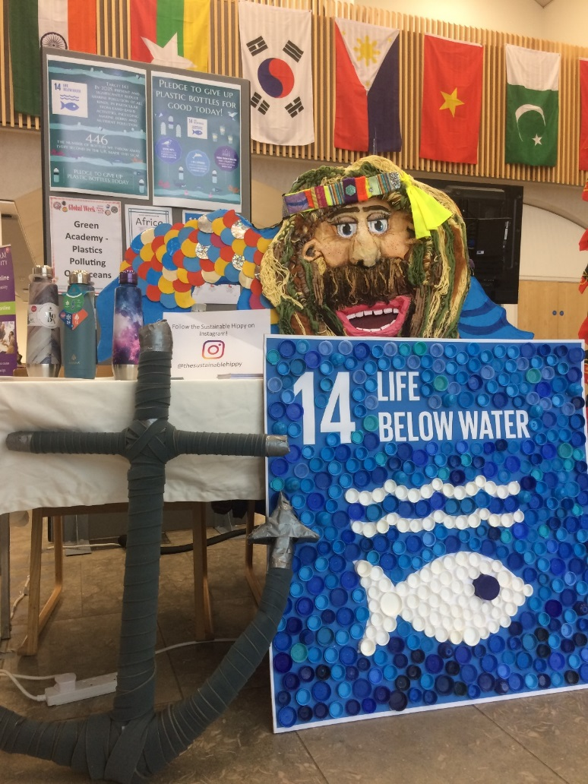
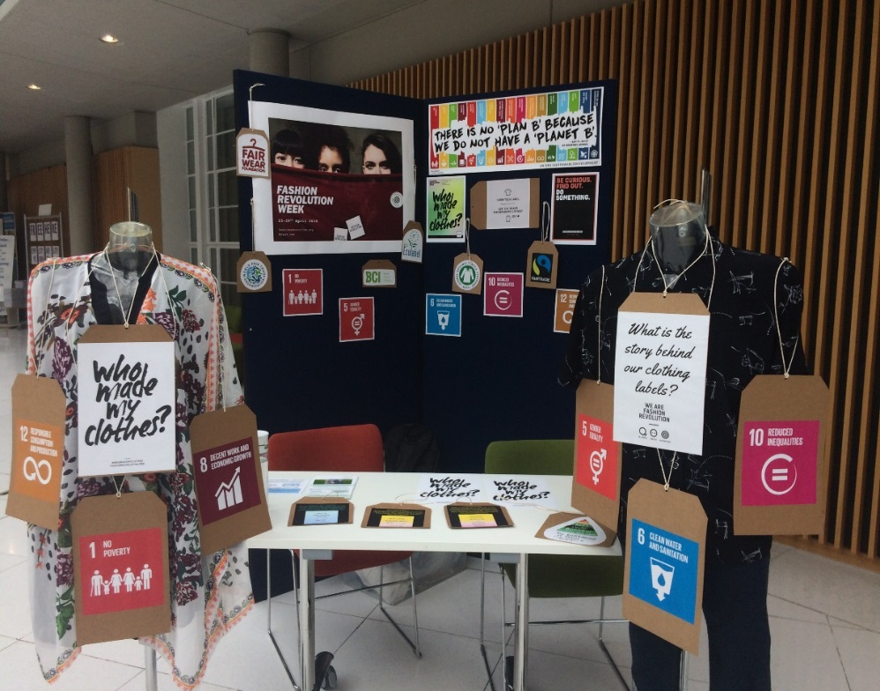
Visual Displays of the SDGs on Campus
NTU Global Week: SDG 14 and Ocean Plastic
Fashion Revolution week: the SDGs and our clothing impact
ODELL, V., MOLTHAN-HILL, P., ERLANDSSON, L. and SEXTON, E., 2019. Visual displays of the sustainable development goals in the curricular and extra-curricular activities at Nottingham Trent University - a case study.

Slide 6
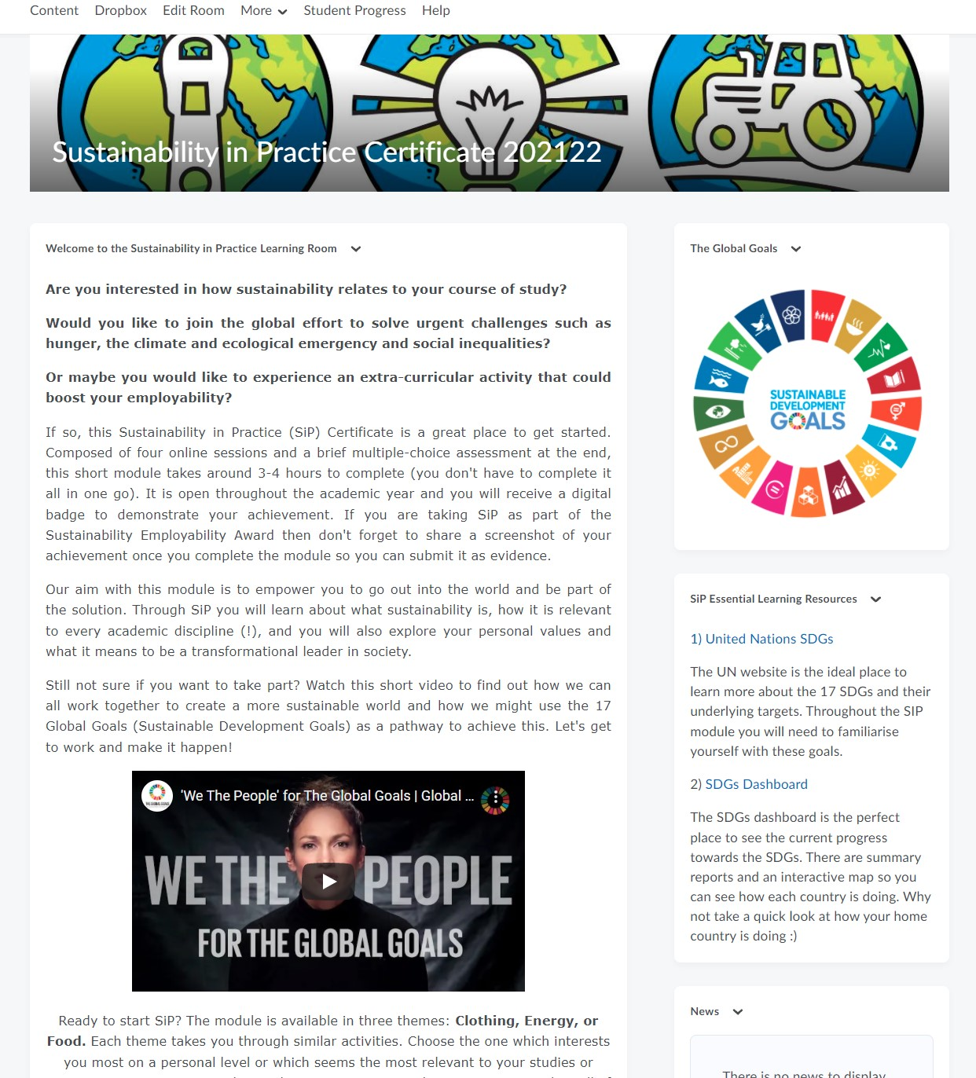
Sustainability in Practice (SiP) online
Short online module available to all our students and staff through our VLE since 2013
Provides a foundational knowledge of sustainability and the climate and ecological emergency
Three themes: Clothing, Energy or Food
4 online sessions (2-4 hours in total)
Upon completion: certificate and (Undergraduate students only) HEAR entry and Bronze Sustainability Employability Award.

Slide 7
SiP Structure
 | Topic | Aim | Activities and reflection
Session one | Student experience of sustainability | Engage students on a personal level | Sustainability skills inventory, exploring personal values, thematic issues (clothing, energy, food), and the climate & ecological emergency. Flipgrid video activity (optional)
Session two | Sustainability and the academic disciplines | Facilitate disciplinary understanding of sustainability | Planetary boundaries, discipline specific resources, place-based learning activity to explore SDG progress in home nation / hometown.
Session three | Connections between disciplines; systems thinking and identifying challenges | Facilitate interdisciplinary and holistic understanding of sustainability | Product life cycles, Long-term thinking, indigenous wisdoms, exploring mindsets, multiple choice quiz on SDGs and SiP theme.
Session four | Global and local solutions, individual agency | Identify disciplinary/ interdisciplinary solutions to sustainability challenges and explore own agency. | Linear and circular systems, doughnut economics, interconnectedness, leadership styles, local and global sustainability solutions, Flipgrid video activity (optional), sustainability skills inventory.
End Assessment: Multiple-Choice Assessment Optional extras: Accompanying workbook to explore personal values, mindsets and leadership styles; ‘Sustainable Solutions’ video competition (Session 4).

Slide 8
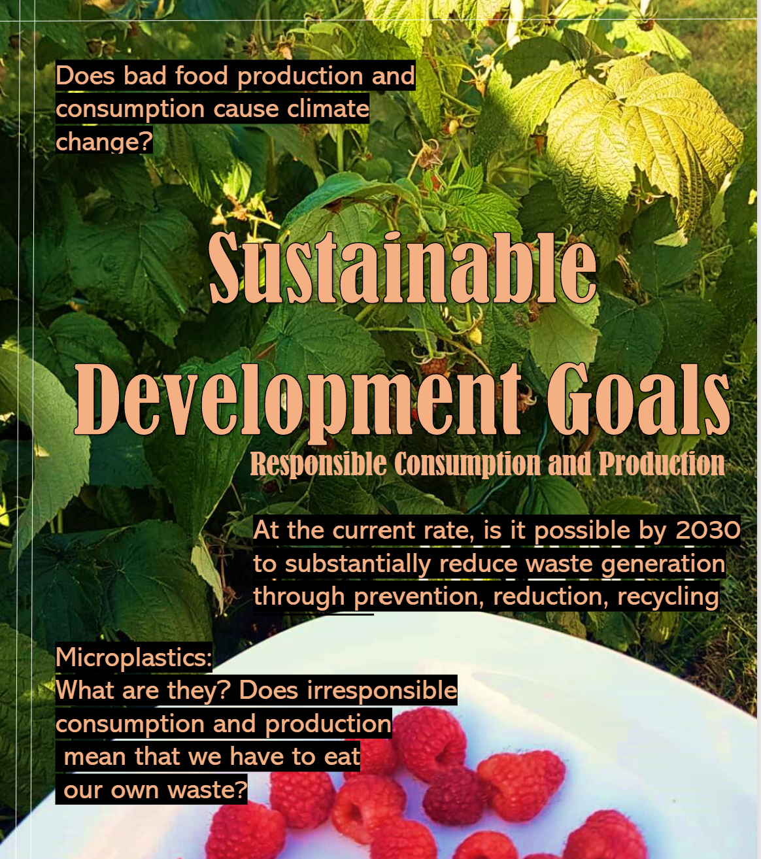
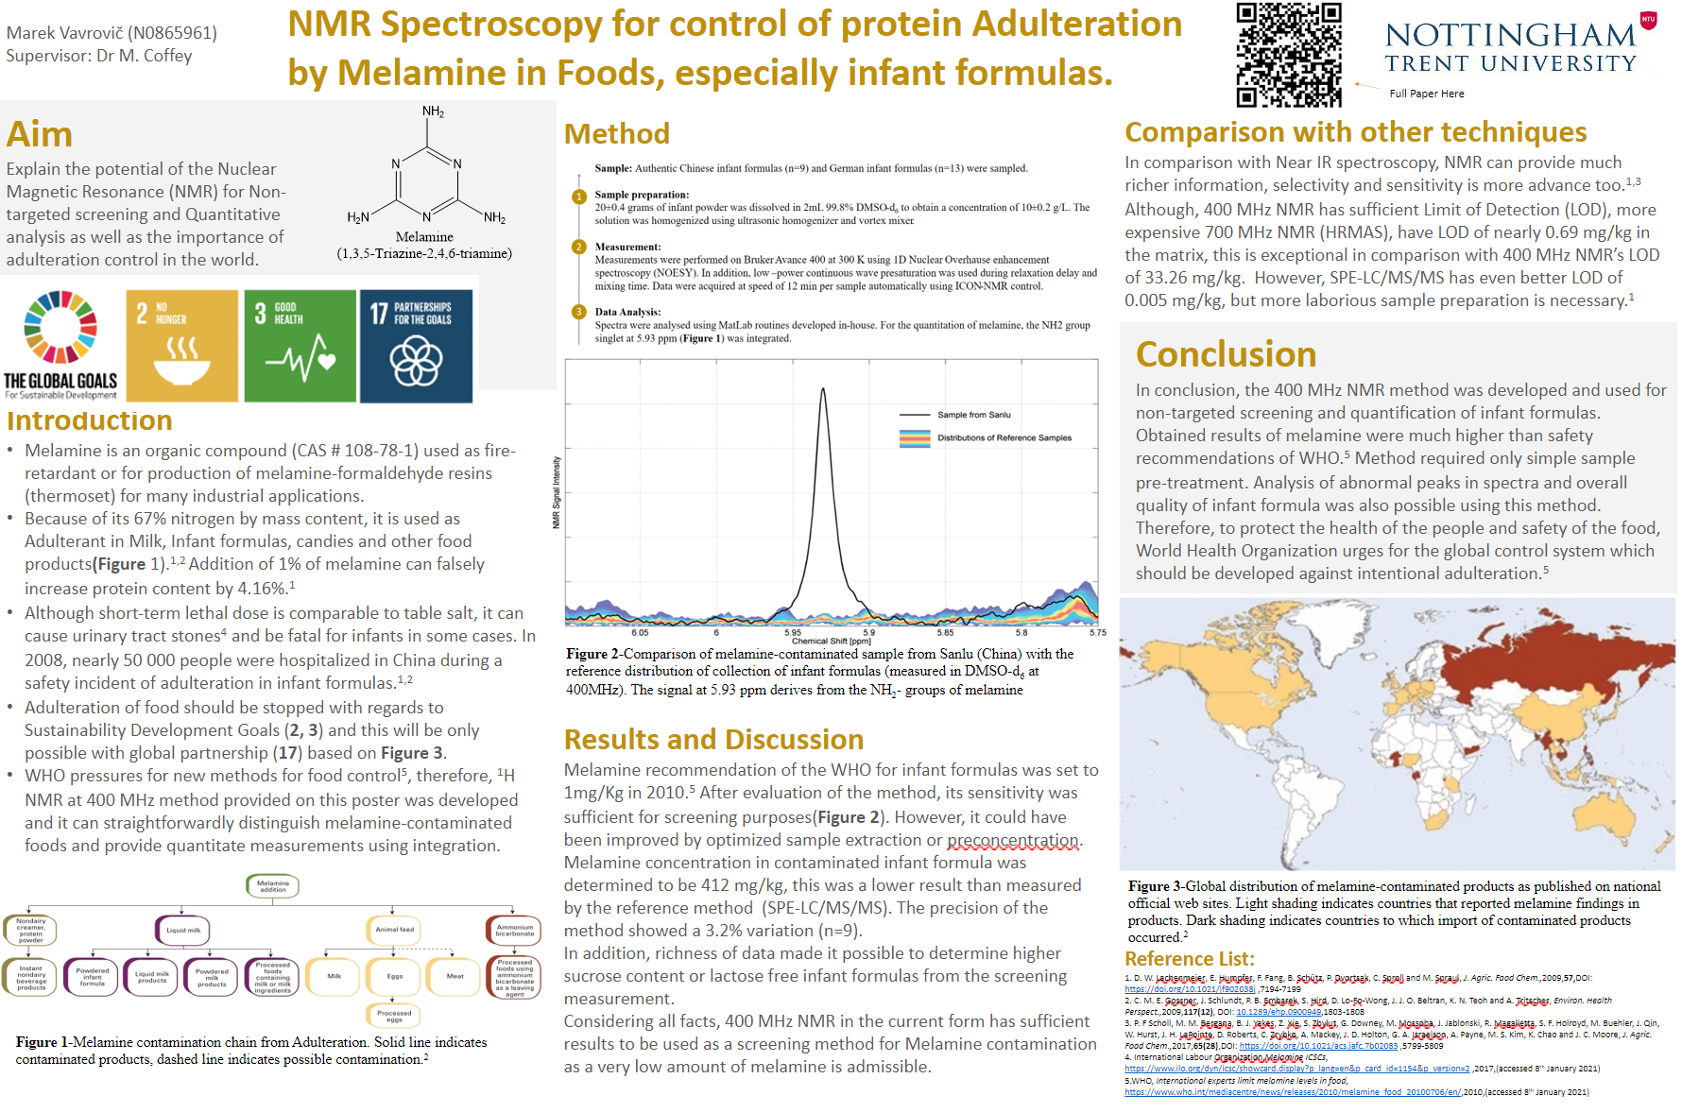
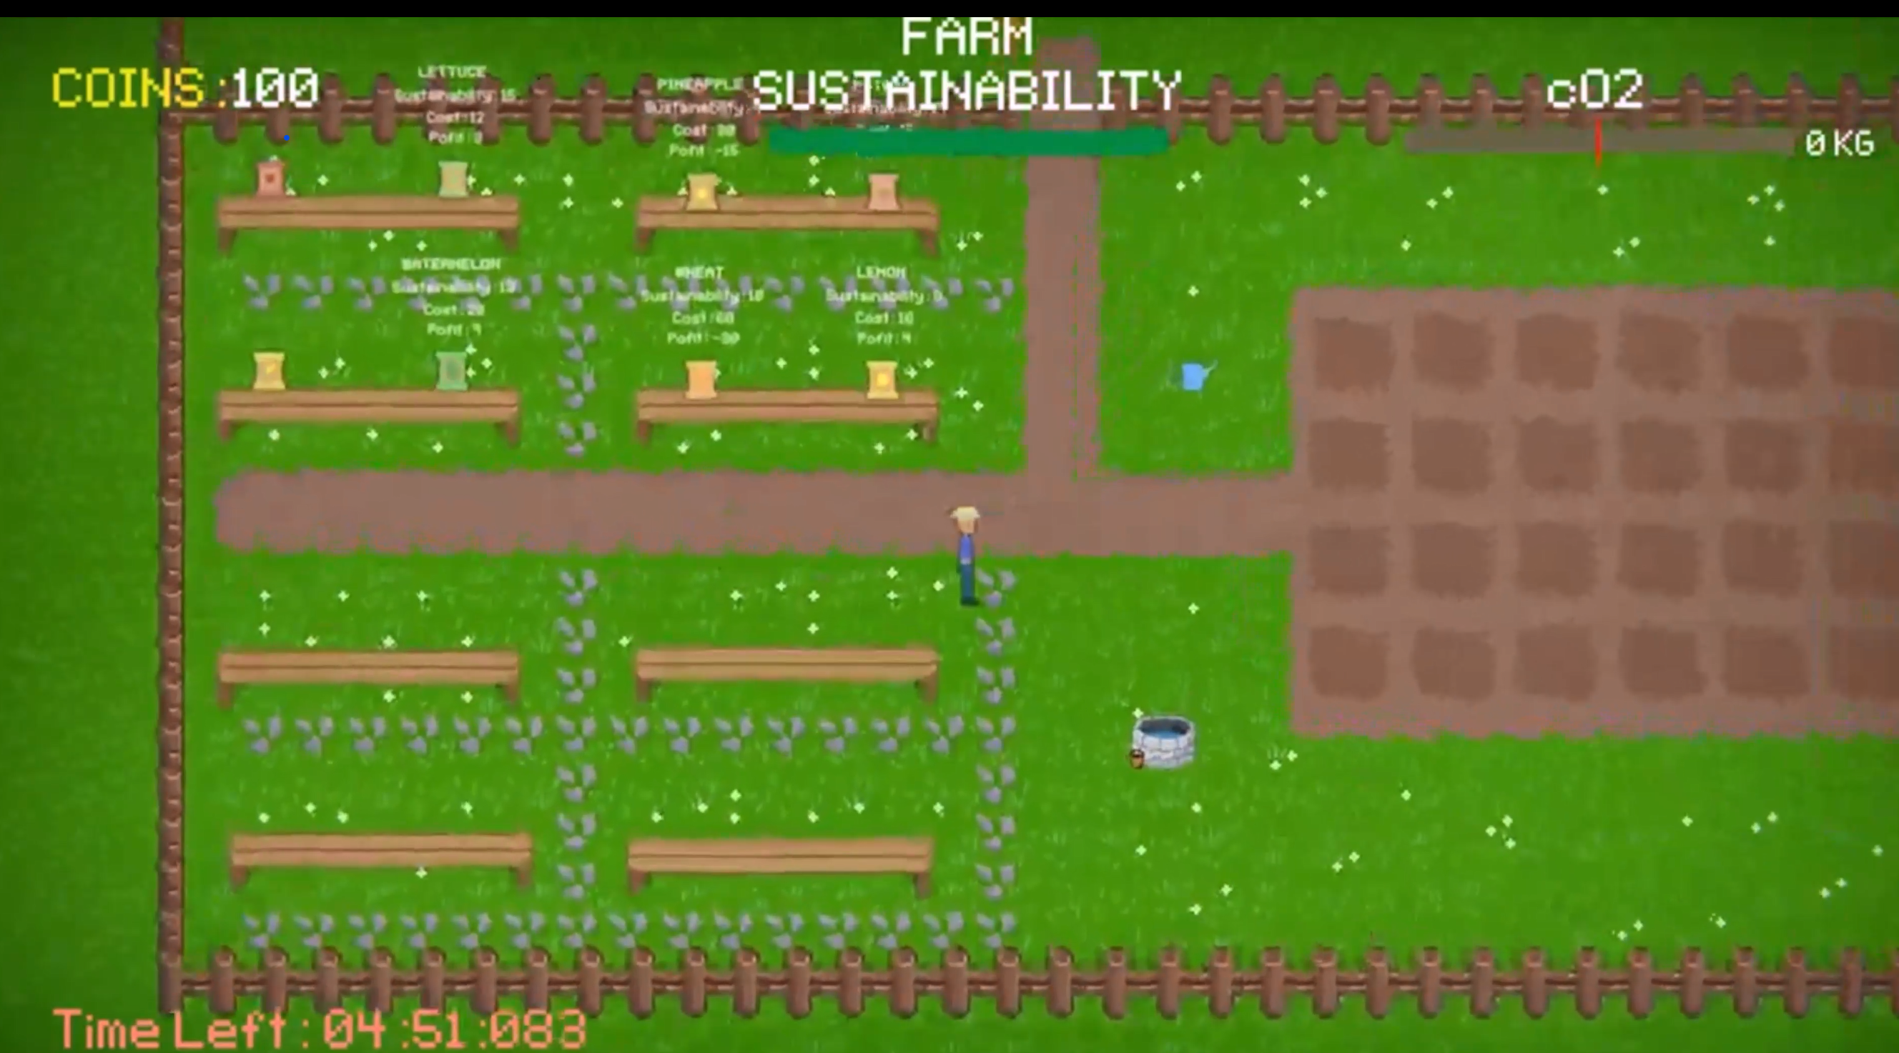
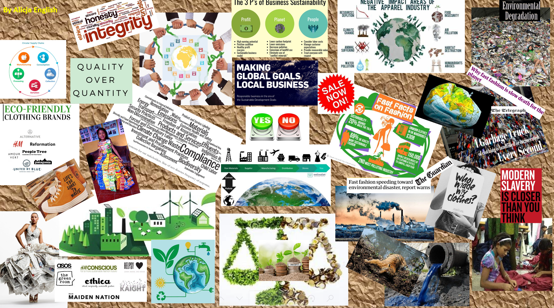
SiP Student Outputs
Artefact
Research Poster
Video
Flipbook
Moodboard
36-hour Game Jam

Slide 9
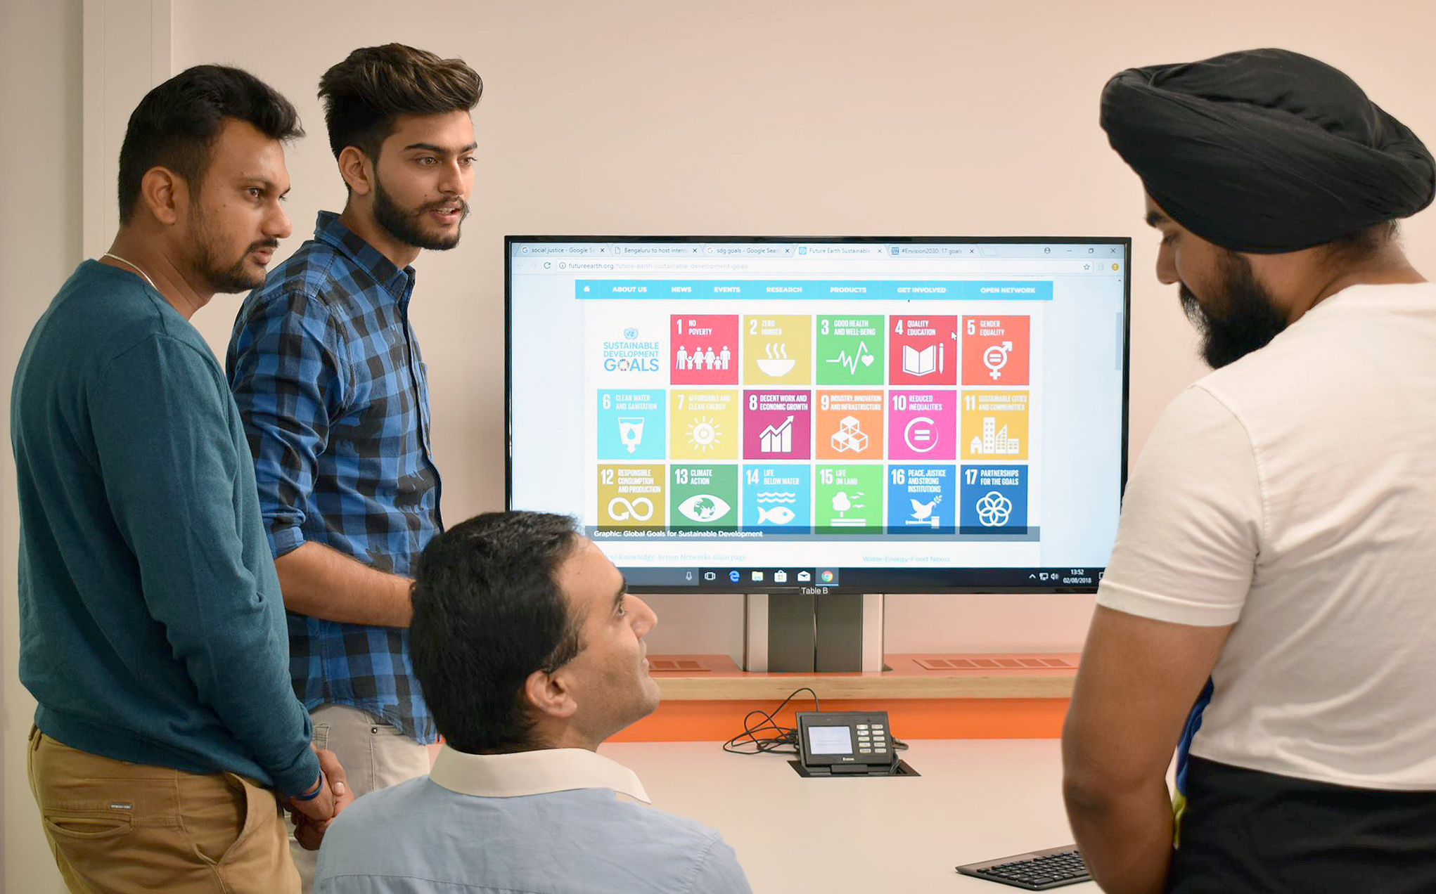
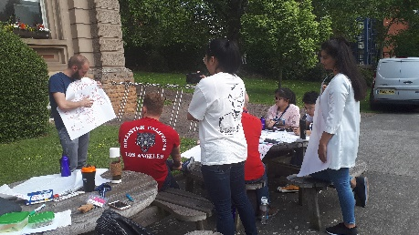
Sustainability and Global Citizenship
SiP Global Mobility
Global Summer School – Transformational Leader and the SDGs
1-week online course on the SDGs and leadership competencies.
SiP for students on overseas placements

Slide 10
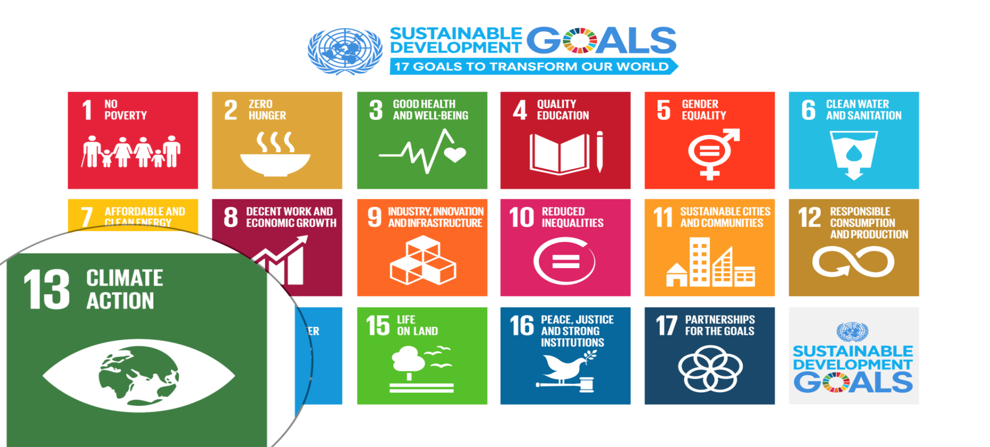
UN Sustainable Development Goals
Notes:
Carbon Dioxide equivalent gives us a level playing field to understand the effects of various activities

Slide 11
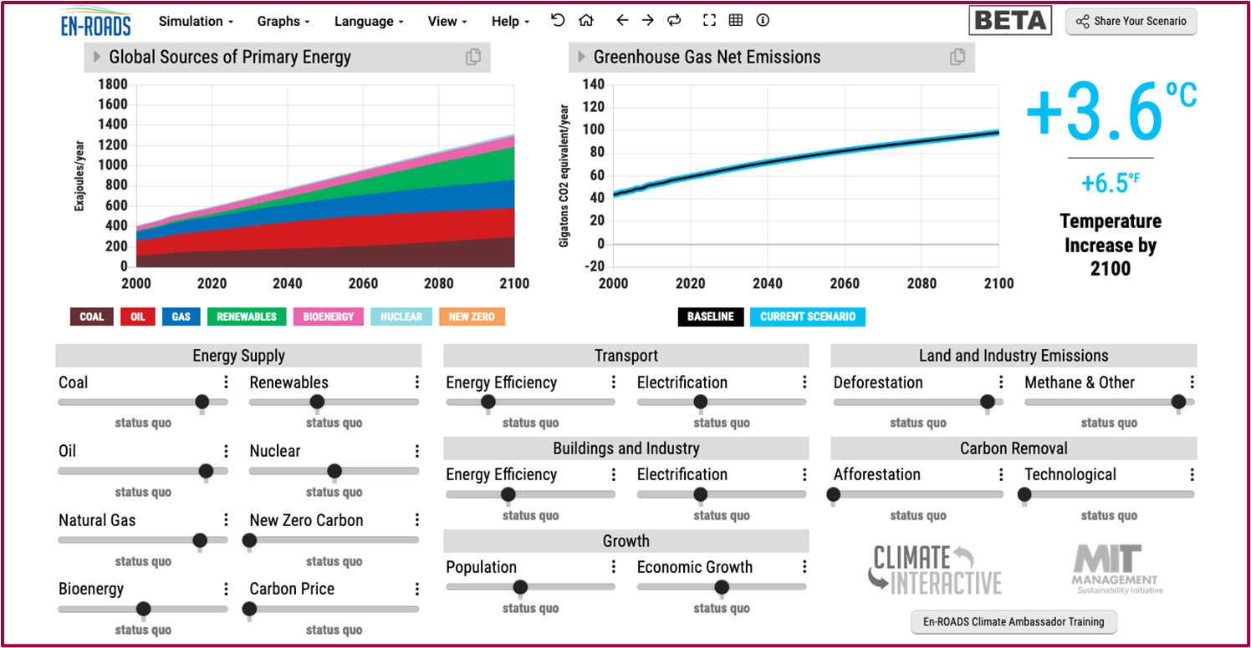
Our key challenge: How to get to 1.5°C?
En-ROADS is a cutting-edge simulation model used to test climate solutions and generate climate scenarios for the future.
Notes:
This is our current situation as demonstrated by En-ROADS which was developed by MIT Climate Interactive so that everyone can understand the high impact solutions and which impact they would have. Run with this group as interactive activity…

Slide 12
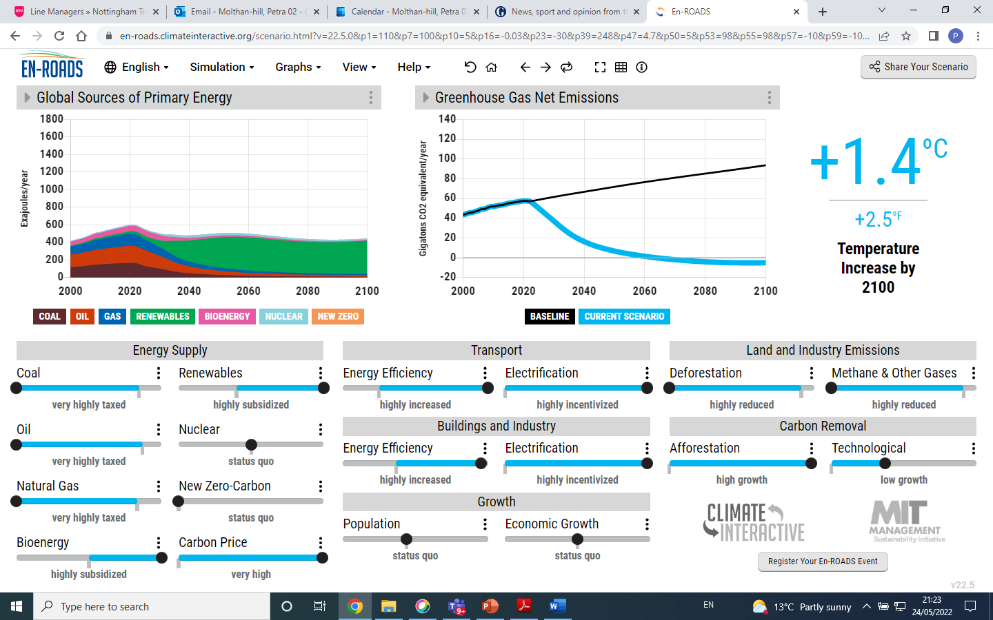

Slide 13
Climate Change Mitigation Education into the core curriculum of every discipline
Developing values, knowledge and skills required to make choices and decisions that minimize the use of natural resources, emissions, waste and pollution; while contributing to the development of new solutions to the climate crisis (e.g., rethinking the way we live, buy and consume, how our daily lives are organized, how we socialize, exchange, share, educate and build identities).
Taking individual and/or collective action with the potential to have immediate, direct impact (e.g., reducing energy consumption, using non-polluting and renewable energy sources, environmental conservation, re-forestation and re-greening).
Contributing to policy development with long-term positive impact on societal behaviour by examining economic systems, social structures, cultural patterns, lifestyle expectations, consumerism, wealth distribution, aspirations and value systems and their underlying responsibility for excessive greenhouse gas production.
Table published in: Molthan-Hill, P et al (2021), Climate change education at universities: Relevance and strategies for every discipline. in: Handbook of Climate Change Adaptation and Mitigation (3rd edition), Springer: Cham, Switzerland. Adapted from definitions provided by Mochizuki Y, Bryan A (2015) Climate change education in the context of education for sustainable development: Rationale and principles. Research 9(1): 4-26.
Notes:
The second one is Climate Change Mitigation Education: Every Graduate needs to know how to best mitigate climate change- what are the best strategies and tools in operations, supply chain management, economics, investment to reduce carbon emissions?

Slide 14
Five Practices for systemic climate leadership
Practice 1: Get the Truth
Practice 2: Assess the Risks
Practice 3: Weigh the Stakes
Practice 4: Define the Business of Business
Practice 5: Engage Global Leadership
André R (2020) Lead for the Planet. Five practices for confronting climate change, University of Toronto Press

Slide 15
Carbon Literacy Training for Business Schools
What if every recruit into corporations from the world’s business schools was qualified as Carbon Literate?
This training was developed by Nottingham Business School (Nottingham Trent University) in collaboration with the UN PRME Champions, Oikos International and the Carbon Literacy Project.
The aim of this project is to get academics, students and others Carbon Literate within a short time frame and to get as many people as possible actively involved in embedding climate solutions in their own life and work. In order to do so we have chosen a train-the-trainer approach, so we will offer regional events inviting all the universities and business schools in the vicinity to train academics and students there so that they can become trainers in their own institution and/or get involved in training others in other regions of the world.
Notes:
In our Carbon Literacy Training for Business Schools we have a strong focus on these high impact solutions so that everyone in a business school, whether in teaching, research or operations would know the best actions to take.

Slide 16
Climate Literacy Training for Educators, Communities, Organizations and Students (CLT-ECOS)
Climate change mitigation focused on solutions
Interactive virtual teaching material
MIT Sloan & Climate Interactive Simulation tool
Certificates for you and your students
Please contact petra.molthan-hill@ntu.ac.uk for more info on this or the more specific training for business schools mentioned earlier.
www.ntu.ac.uk
Notes:
And if you are interested in the wider perspective on how to get everyone in the university carbon literate, NTU has made one of the two open-source tool kits for all staff and students at universities.

Slide 17
Training during CoP26

Slide 18
Embodied carbon/carbon footprint of a car
25 tonnes CO₂e Range Rover Sport HSE
(an SUV)
Calculation by Mike Berners-Lee (2020) How bad are bananas? Page 145
Image: https://www.flickr.com/photos/juanelo242/5125149242/

Slide 19
25 tonnes when buying a car is not much, or?
High emitting countries:
Australia used 15.48 tonnes of CO₂ emissions per capita
Canada 15.50
China 7.35
EU 6.42
Qatar 32.42
US 15.24
Some of the most vulnerable countries and their emissions:
Bangladesh at 0.51 tonnes of CO₂ emissions per capita
Brazil 2.04
Kenya 0.36
Rwanda 0.09
Solomon Islands at 0.57
Data from The World Bank (2018), CO₂ emissions (metric tonnes per capita):
https://data.worldbank.org/indicator/EN.ATM.CO2E.PC

Slide 20
Flight from London to Hong Kong return (5,973 miles or 9,612 km)
Turn this into a solution, can you:
Replace long distance flights with Zoom meetings?
Attend a conference virtually?
Combine meetings in one country?
3.5 tonnes CO₂e economy class
10.0 tonnes CO₂e business class
13.9 tonnes CO₂e first class

Slide 21
Climate Action (SDG 13): Students changing organisations as part of the core curriculum
Guardian Award 2015
MOLTHAN-HILL, P., ROBINSON, Z.P., HOPE, A., DHARMASASMITA, A. and MCMANUS, E., 2020. Reducing carbon emissions in business through Responsible Management Education: influence at the micro-, meso- and macro-levels. International Journal of Management Education, 18 (1): 100328. ISSN 1472-8117
https://www.theguardian.com/higher-education-network/gallery/2015/mar/19/guardian-university-awards-2015-winners-in-pictures

Slide 22
Sustainability in Enterprise
The Sustainability in Enterprise (SiE) programme provides fully funded support and grants to reduce the carbon emissions of eligible Nottingham small and medium-sized enterprises (SMEs). SiE will help businesses improve their environmental performance across four key areas: People, Products, Processes and Premises.
This project is part-funded by the European Regional Development Fund (ERDF).

Slide 23
International work-related experience
Global
Take part in a virtual international work-related experience. This opportunity is open to XXX to take part in Carbon Literacy training and work with XXXX As a part of this project you’ll learn about adapting to the culture in XXX in order to do this work and about climate solutions in general and especially for this part of the world. You’ll be fully trained as Carbon Literacy Trainers and receive an external work experience certificate by eduCCate Global https://www.educcateglobal.org/. If you decide to do the assessment form afterwards and pass it, you will also get an external Certificate by the Carbon Literacy Project in Manchester. Time Commitment: Takes place end of November – mid-December (you need to be available every Monday from 15.30-18.00 GMT on 30 November, 7 December, 14 December, 21 December) to take part in the actual virtual delivery to the teachers in XXX and every Thursday from 15.00-17.00 GMT to prepare the session virtually and to reflect on cultural diversity and different approaches (26 November, 3 December, 10 December 17 December). You might need 1-3 hours to prepare yourself in your own time depending on which task you choose as your responsibility. Total: Hours: 5 – 8 hours per week (over 4 weeks) Support: The Green Academy Team at NTU and NBS Professor Petra Molthan-Hill (an experienced Carbon Literacy Trainer) will support you as well as the CEO of eduCCate Global - Melanie Harwood. https://www.educcateglobal.org/ and https://www.ntu.ac.uk/about-us/sustainability/sustainability-in-education/carbon-literacy-training XXX Contact person if you are interested: GreenAcademy@ntu.ac.uk

Slide 24
Read about the Carbon Literacy Training
https://link.springer.com/referenceworkentry/10.1007/978-1-4614-6431-0_154-1

Slide 25
To get you started….
Find ideas in:
The Handbook of Carbon Management: A step-by-step guide to high-impact climate solutions for every manager in every function
By Petra Molthan-Hill, Fiona Winfield, Richard Howarth and Muhammad Mazhar
Coming soon by Routledge
Take our free virtual Climate Literacy & Action Training in November:
On behalf of the UN PRME Working Group on Climate Change & Environment, we would like to invite you to join our upcoming Climate Literacy & Action Training CLT-ECOS.
The training will take place on the following Wednesdays: 9,16, 23, 30 November 11:00 am - 1:00 pm ET (NYC)
Please register here: https://www.unprme.org/carbon-literacry-training

Slide 26
Pass it on

Slide 27
Any further questions? Please contact:
Dr Petra Molthan-Hill petra.molthan-hill@ntu.ac.uk

