Slide 1
Towards sustainable transatlantic international partnerships Research evidence from British Council research
Vangelis Tsiligkiris, Ph.D.
Associate Professor, Founder TNE Hub
Nottingham Business School
Lisdey Espinoza Pedraza, Ph.D.
Head of the Americas Higher Education and Insights Hub
British Council, Americas

Slide 2
Research objectives TNE and MRQ in the Americas: Brazil, Mexico and Peru
The research by the British Council aimed to establish the benefits of internationalisation of higher education (IHE), especially in relation to Transnational Education (TNE) and the role of Mutual Recognition of Qualifications (MRQ) agreements in facilitating these. The research studied the following:
The international engagement in higher education between the UK and Latin America
The international higher education landscape in Brazil, Mexico and Peru
The regulatory policies for TNE in Brazil, Mexico and Peru
The benefits and challenges for TNE partnerships as perceived by higher education and government stakeholders in Brazil, Mexico and Peru
The perceived importance of MRQ agreements for IHE cooperation and, in particular, TNE growth

Slide 3
Research methodology
The study was designed using mixed methods and approaches including:
Desk research on the regulatory and international higher education landscape in Brazil, Mexico and Peru
B. Primary data research
B.1 Semi-structured in-depth interviews with 24 local HEIs and national agencies
Brazil – 9 HEIs and national agencies
Mexico – 8 HEIs and national agencies
Peru - 7 HEIs and national agencies
B.2 Online survey with HEIs in Brazil, Mexico and Peru – ongoing at the time of this presentation. The survey received 84 response, of which 77 met the participation criteria
Brazil – 37 HEIs
Mexico – 36 HEIs
Peru – 4 HEIs
Source: British Council and Education Insight, 2023

Slide 4
Research findings: The state of international higher education engagement between the UK and Brazil, Mexico, and Peru
International student mobility: There has been little mobility between Latin America and the UK over the past two decades. Latin America accounted for approximately 1 per cent of the internationally mobile students in the UK.
International research collaborations: There is an active research collaboration between the UK and Brazil, Mexico and Peru. Bibliometric analysis (Scival/Scopus) shows that the UK is amongst the top 4 research partners for the three countries and accounts for between 4 per cent to 6 per cent of their collaborative research output.
Transnational education: Compared to the rest of the world, TNE partnerships between the UK and Latin America remain limited. The dominant TNE delivery mechanism for UK programmes is distance learning and online education. It accounted for 100 per cent of the UK TNE in Peru, 84 per cent in Brazil and 52 per cent in Mexico. This shows limited UK/LATAM TNE partnerships outside the provision of distance learning and online education.
Source: British Council and Education Insight, 2023

Slide 5
Research findings: International HE Priorities in LatAm
Source: British Council and Education Insight, 2023

Slide 6
Research findings: International HE Priorities in LatAm
Overall sequence of priorities
(on average across all countries)
Study abroad and exchange
International research collaboration
International (TNE) partnerships
Internationalisation at home
General observation
The prioritisation sequence mirrors the development patterns of HEI commonly found globally.
Country level observations
Brazil
TNE partnerships and internationalization at home are similarly prioritized as research collaborations.
Over 60% of institutions prioritize international student recruitment.
Mexico and Peru
International student recruitment is not a top priority.
Source: British Council and Education Insight, 2023

Slide 7
Research findings: Challenges of TNE as perceived by higher education and government stakeholders in Brazil, Mexico and Peru
Regulatory
TNE not in government policy agenda which leads to regulatory gaps that hinder partnership development
Cost of TNE
Partnerships with HEIs face significant cost challenges due to higher tuition fees, which are rarely waived.
English language
is a challenge across the three countries. Often English language proficiency is correlated with family wealth, suggesting that TNE, predominantly in English, may disadvantage socio-economically deprived students.
Institutional capacity
constraints, marked by limited resources and high staff turnover, challenged TNE management, especially with numerous individual agreements. Staff training for TNE engagement is an institutional development need.
Lack of knowledge
Limited awareness of TNE benefits existed, with stakeholders often confusing it with study abroad, and a scarcity of TNE programmes in universities resulted in minimal sector-wide knowledge.
Source: British Council and Education Insight, 2023

Slide 8
Research recommendations: Policymakers
Need for greater government-to-government cooperation between the UK, Brazil, Mexico and Peru
Develop a shared understanding of TNE activities and value
Bilateral and multilateral incentives to support TNE activities
Leveraging existing research networks to foster priority TNE partnerships through collaborative funding efforts.
Addressing barriers to MRQs' effectiveness in Mexico and Peru and exploring alternative recognition routes in Brazil.
Promoting collaboration between Agencies and HEIs to develop TNE Engagement guidelines
Source: British Council and Education Insight, 2023

Slide 9
Research findings: Value of TNE as perceived by higher education and government stakeholders in Brazil, Mexico and Peru
In all three countries, universities perceive TNE partnerships as an important way to internationalise higher education and increase its quality.
Additional benefits included the socio-economic development of regions and local communities. More specifically, TNE:
made a valuable contribution to the provision of courses that did not exist in regions,
strengthened links and capacity building for the local market
Led to the retention of talent and prevention of brain drain (because students settled where they graduated).
Source: British Council and Education Insight, 2023

Slide 10
Research recommendations: Higher Education Institutions
HEIs show strong interest in international collaborations, yet TNE understanding remains limited in Latin America, highlighting a need for education on its benefits.
Greater awareness across the institution about TNE and its potential value
Institutional internationalisation strategies which include TNE as a component alongside research collaborations and student and staff mobility
Build institution-wide support for TNE engagement to ensure that it can be appropriately staffed and resourced as part of institutions’ core resource allocation
Develop and share “know-how” between institutions, including examples of successful models and operational practice
Source: British Council and Education Insight, 2023

Slide 11
Research recommendations: UK Stakeholders
The UK higher education sector needs to strengthen its engagement with some of the world’s largest HE systems located in Latin America.
Government Support for UK-Latin America TNE Engagement
Collaborative efforts with the three countries' governments are needed for jointly funded incentives, as evidence shows government funding aids in building beneficial and lasting partnerships.
Local Language TNE Provision for Wider Access
To enhance accessibility and local relevance, UK HEIs should explore delivering TNE in Latin America's local languages. Such adaptation, coupled with improved language proficiency of UK faculty, strengthens teaching partnerships and meets regional skills demand.
Virtual COIL Projects for Collaborative Engagement
UK HEIs should initiate collaborative virtual COIL platforms with Latin America to foster student mobility and inter-institution collaboration. This approach can reinforce existing partnerships and cultivate new ones.

Slide 12
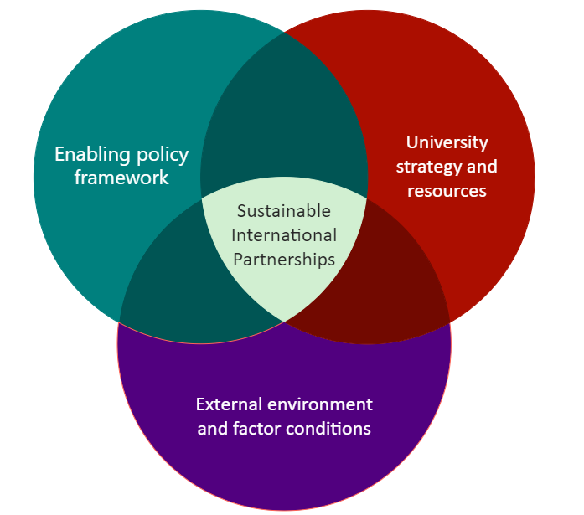
A framework for the development of transatlantic sustainable international partnerships

