Slide 1
Transnational Education: Impactful Collaborations, Meaningful Student Experience and Achieving Sustainability and Equity.
Vangelis Tsiligkiris, Ph.D.
Associate Professor, Founder TNE Hub
Nottingham Business School

Slide 2
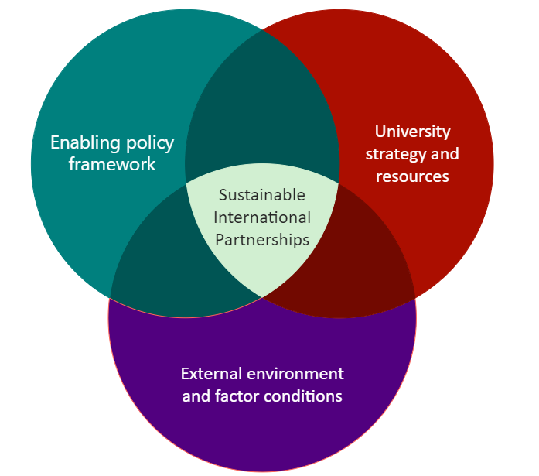
A framework for the development of sustainable international partnerships
Operation, licensing and quality assurance of TNE
Global vs. local
Recognition of qualifications (e.g. MRQs)
Financial, human, physical, intellectual resources
Demand and supply of HE in partner countries
Quality of human capital, infrastructure, innovation index

Slide 3
TNE LIFECYCLE
STAGES, MOTIVES AND OPPORTUNITIES
EARLY
DEVELOPED
MATURE
EMERGING
SUPPLY GAP
QUALITY GAP
INTERGRATION
MULTI-DIMENSIONAL
Early stage TNE comes to fill the supply of HE gap in a host country.
At this stage, the emphasis is on teaching partnership, primarily in the form of Franchising and validation.
The main motive is financial.
As the supply in a host country develops and the gap closes, there is a shift towards TNE activities that come to cover niche, high-value, cutting-edge subject areas. Also, there are opportunities to cover possible quality gaps that exist in the local HE.
The main motive remains financial
TNE becomes integrated in the HE system of the country. This implies opportunities for physical presence and degree awarding powers (in some instances). Also, it requires additional quality assurance compliance.
The motive extents to include global presence and reputation, collaboration and pipeline for international student recruitment
There is an array of trends that shape the emerging model of TNE. These include: 1) drive for equitable forms of partnerships; 2) emphasis on financial returns as well as impact; 3) vision to create collaboration across different levels/dimensions
The motive serves a cohesive Global Engagement strategy

Slide 4
THE 4Ds FOR SUCCESSFUL AND IMPACTFUL TNE COLLABORATIONS
Design
Plan for the local context, consider impact and dedicate resources
Deliver
From risk management to value creation
Student experience and graduate employability
Decide
What is the objective of your TNE engagement?
Use data and evidence to target where and what to do
Define

