Slide 1
Monitoring or Intervention How the government responds to financial, service and corporate failings in local authorities
Professor Pete Murphy
Nottingham Business School
Nottingham Trent University

Slide 2
Historical Antecedents
Financial Irregularities – Internal and External Audit, (Independent Auditors and District Audit established in 1868), Public Interest Reports (PIRs), Corporate Failures and near misses e.g.,
Rate capping rebellion in 1985
LB Hammersmith and Fulham 1982 (Ultra-Vires speculating on stock market)
Islandic Banks (108 Local Authorities lost £1billion in 2008)
Service Scandals and Corporate Failures –, External Service Inspections (HMI Schools 1839, HMI Constabulary 1856,) Performance Audit (Audit Commission 1983) and Improvement and Development Agency Peer reviews (1998).

Slide 3
21st Century approaches
Pre-1997 - External Audit, Public Interest Reports and External service inspections of some LA services (Education (HMI Schools) Police (HMIC) and Social Services (SSI) – partial coverage with weak intervention powers.
1997 – 2010. Best Value, continuous improvement, Comprehensive Performance Assessments and Area Assessments. Inspection covered all services and activities with an early warning system of national performance indicators and strong intervention powers. After 3 pilots, and the publication of the first CPA results there were 13 cases of intervention by the government.
2010-2018 The Audit Commission was abolished, sector led improvement meant inspections were limited, despite strong intervention powers they were used almost entirely following service scandals (Doncaster 2010, Rochdale 2011, Birmingham 2014, Rotherham 2014, Tower Hamlets 2015, Kensington & Chelsea 2017).
2018 – 2023. Limited inspections, strong intervention powers but used almost entirely for financial issues as there is now a partial and weak evidence base for service or non-financial intervention and 144 notices. Northamptonshire, Nottingham, Croydon, Slough, Thurrock, Woking, Northumberland, Birmingham). Many others reported to be considering 114s e.g., Middlesborough, Coventry, Somerset, Hasting)

Slide 4
Legislative basis
The Local Government Act 1999 introduced
The duty to achieve ‘Best Value’
A new requirement to facilitate the continuous improvement of all services and activities.
External Best Value Inspections
Interventions (following service and corporate failings) were piloted in 2002, a number were challenged under Judicial Review, but all challenges failed.
Local Government Act 2003 (Part 8 sections 99 and 100) clarified both performance categories and the exercise of powers in relation to performance.
All subsequent interventions have been based on a failure to achieve or be achieving Best Value.
In July 2023 the government issued a consultation on “Best Value, Standards and Intervention”).

Slide 5
Government intervention under CPA
CPA and its interventions were based on rigorous and robust evidence
It supported all ‘poor’ authorities to recover asap
It enjoyed active all-party political support
It was inherently collaborative (including the government)
In practise larger authorities found it easier to recover than smaller districts
The devolved administrations in Scotland and Wales continued developing their response based upon the principles of Public Value and New Public Governance
After 2010 the UK government and England reverted to New Public Management and ‘Reducing the State’ policies

Slide 6
Government intervention under CPA (cont)
The nature and philosophy behind the government’s response – strategic turnaround and recovery “we will not reward failure, but we will support progress and success”.
You need to deal with both corporate and service performance as well as governance (political), managerial and community leadership inadequacies (administrators) – with all-party support and party-political involvement.
It included formal intervention and more informal (but heavy) monitoring with an excellent and improving evidence base (147 National reports and 7000+ inspections) which also became an excellent early warning system over time.
Criteria for coming out of intervention – clear bespoke benchmarks for individual cases and robust positive trajectory of improvement, validated though performance indicators and inspection reports.

Slide 7
The approach since 2010 Changes to Financial reporting and external audit
In 2010 the new government abolished the Audit Commission, abandoned external assessments and inspections, (in favour of sector-led improvement), and significantly reduced the evidence base available.
In 2014 the Local Audit and Accountability Act – outsourced Local Public Audit, abolished the audit regime, and reduced the scope of audit, and the reporting requirements for Local Public audit. (Short-term purely financial reports).
In 2019 Sir Tony Redmond was appointed to produce an
“Independent Review into the Oversight of Local Audit and the Transparency of Local Authority Financial Reporting”

Slide 8
By 2018 it is clear the problem is significant, will continue and there will be more 114s
In his evidence to the 2019 Spending Review inquiry, Sir Amyas Morse of the NAO said “a combination of reduced funding and higher demand has meant that a growing number of authorities have not managed within their service budgets and have relied on reserves to balance their books. These trends are not financially sustainable over the medium term”
Institute for Fiscal Studies (Ogden & Phillips 2020) brought the analysis up to-date fully assessed the 2021/22 Local Government Finance Statement (LGFS) plans for both core funding and top-ups for ongoing COVID-19 related costs.
In simple terms, these sources all indicate that the scale of the problem is significant, will continue to increase and the number of councils under financial stress will almost inevitably rise (Northamptonshire CC issued the first 114 notices in 20 years).

Slide 9
Section 114 Notices
In the UK local authorities cannot go bankrupt. A section 114 notice indicates that, in the opinion of the Statutory Section 151 officer the council’s forecast income is insufficient to meet its forecast expenditure in the next financial year.
The current and forecast allocations for service delivery and other activity must continue to meet the statutory requirements needed to attain Best Value
The earlier in the year that a 114 is issued is generally an indication the level of seriousness but not all 114s have led to monitoring or intervention.
Between 2020 and 2021 government provided some temporary additional funding to all LAs in the UK for Covid-related impacts as the number of reports about possible 114s rocketed.

Slide 10
Birmingham City Council The background and the ‘trigger’
Long-term background
Long-term real fall in LAs Spending power (31%) due to reductions in central government grants
Demand for services increasing as a result of austerity particularly Adult and Childrens' social care.
More recently - rises in inflation
Trigger
“On 5 September 2023, BCC issued a ‘section 114 notice’… as the council anticipated a gap of £87 million between income and expenditure for the (current) 2023/24 financial year. In addition to this gap, the council estimated that it would have to pay £650 million to £760 million in backdated equal pay claims, following a court judgment in 2012.
The media reported Birmingham as having ‘gone bankrupt’. However, UK local authorities cannot go bankrupt. A section 114 notice simply indicates that the council’s forecast income is insufficient to meet its forecast expenditure for the next year.”
(House of Commons Library: Sept 2023)

Slide 11
Birmingham City Council Section 114 Report (5th Sept)
The Section 151 Officer is of the opinion that:
The Council is currently in a negative General Fund position. That is because of the cost of providing for Equal Pay claims, that the Council is now legally obligated to recognise, will result in exceeding the financial resources available to the Council. This means that spend due within that period exceeded the financial resources available to the Council in that same period.
The Council has insufficient resources to meet that expenditure and the Council is not currently able to agree a solution that will allow suitable funding or financing to be obtained for this liability

Slide 12
Section 151 officers report (continued)
The purpose of this Section 114 report is to make it clear to elected members of the Council that immediate steps must be taken to mitigate the financial consequences of Equal Pay claims.
This means agreeing a plan which provides a route to bringing the General Fund back to a positive position and assurance that this will be successfully delivered. This should include:
An appropriate savings plan;
Full assessment of the capital programme (including delaying existing projects and reviewing assets for sale); and,
Engagement with Central Government via the Department for Levelling Up, Housing and Communities (DLUHC), resulting in a formal request for Exceptional Financial Support (EFS).

Slide 13
Government appoints external commissioners (15th Sept)
6 Commissioners! led by Max Caller with 2 political advisers “to support the BCC leaders as they take difficult decisions”
Leader of the Council Cllr Cotton and CEO Deborah Cadman (both relatively new to their positions) vowed to work constructively and collaboratively with the commissioners
Likely response required from BCC
Sales of Assets
Raising the level of Council Tax to the ‘CT cap’
Reductions in services or the quality of statutory services.
Withdrawal of discretionary services (and potentially statutory services)
Dismissing Political Leaders and Senior Officials
and as the last resort borrowing from Central Government.

Slide 14
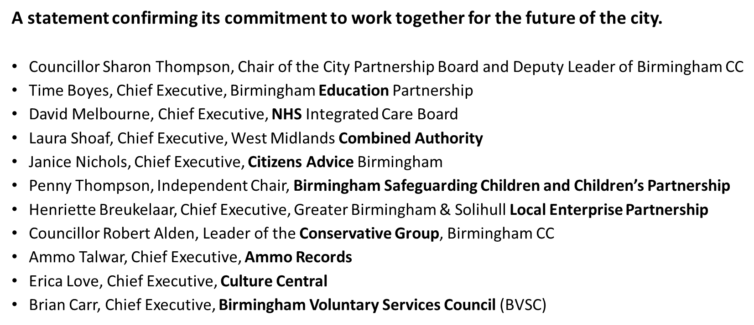
Joint statement from Birmingham City Partnership Board (17th Sept)

Slide 15
Some interesting aspects
Austerity has applied to all LAs in the UK but there have been no section 114 notices in Scotland, Wales or Northern Ireland (yet!)
The first step in any improvement journey is to cease ‘denial’ of the problem/causes and work with the intervention board.
In Birmingham there is unlikely to be a local government re-organisation (as in Northamptonshire or Cumbria).
July 2023, the Office for Local Government (Oflog), a new local government performance body for England was announced.
As a result of recent cases Sector-led improvement is likely to be toughened if not replaced.

Slide 16
Questions? Contact: peter.murphy@ntu.ac.uk

