Slide 1
Experiential Learning

Slide 2
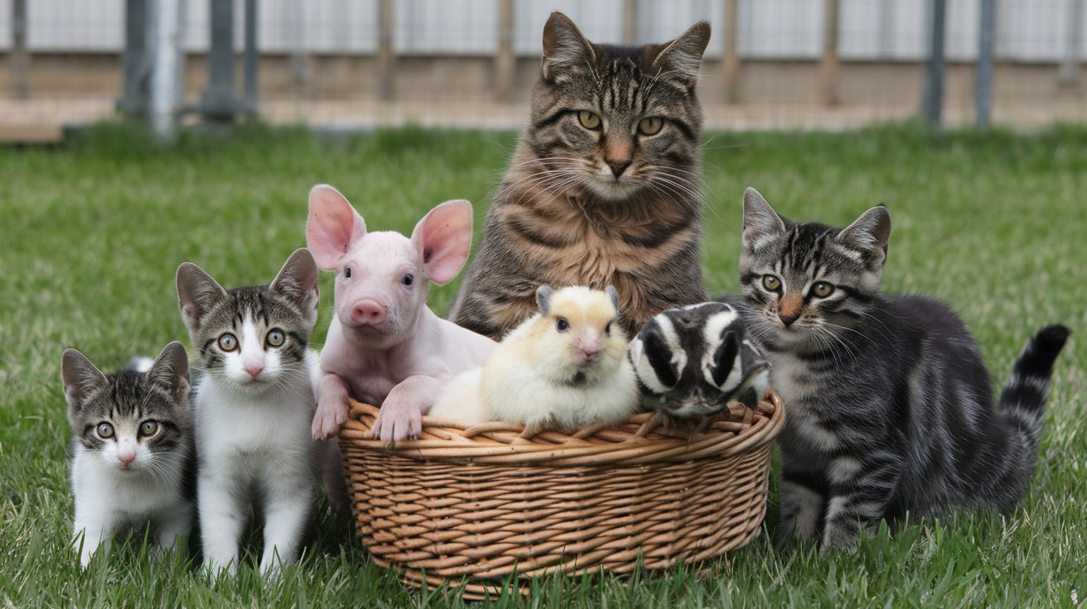
Inclusion & Hybridization

Slide 3
Setting the Scene

Slide 4
Multidisciplinary Loop

Slide 5
Remote Collaboration

Slide 6
Initiatives Success

Slide 7
Transformative Learning

Slide 8
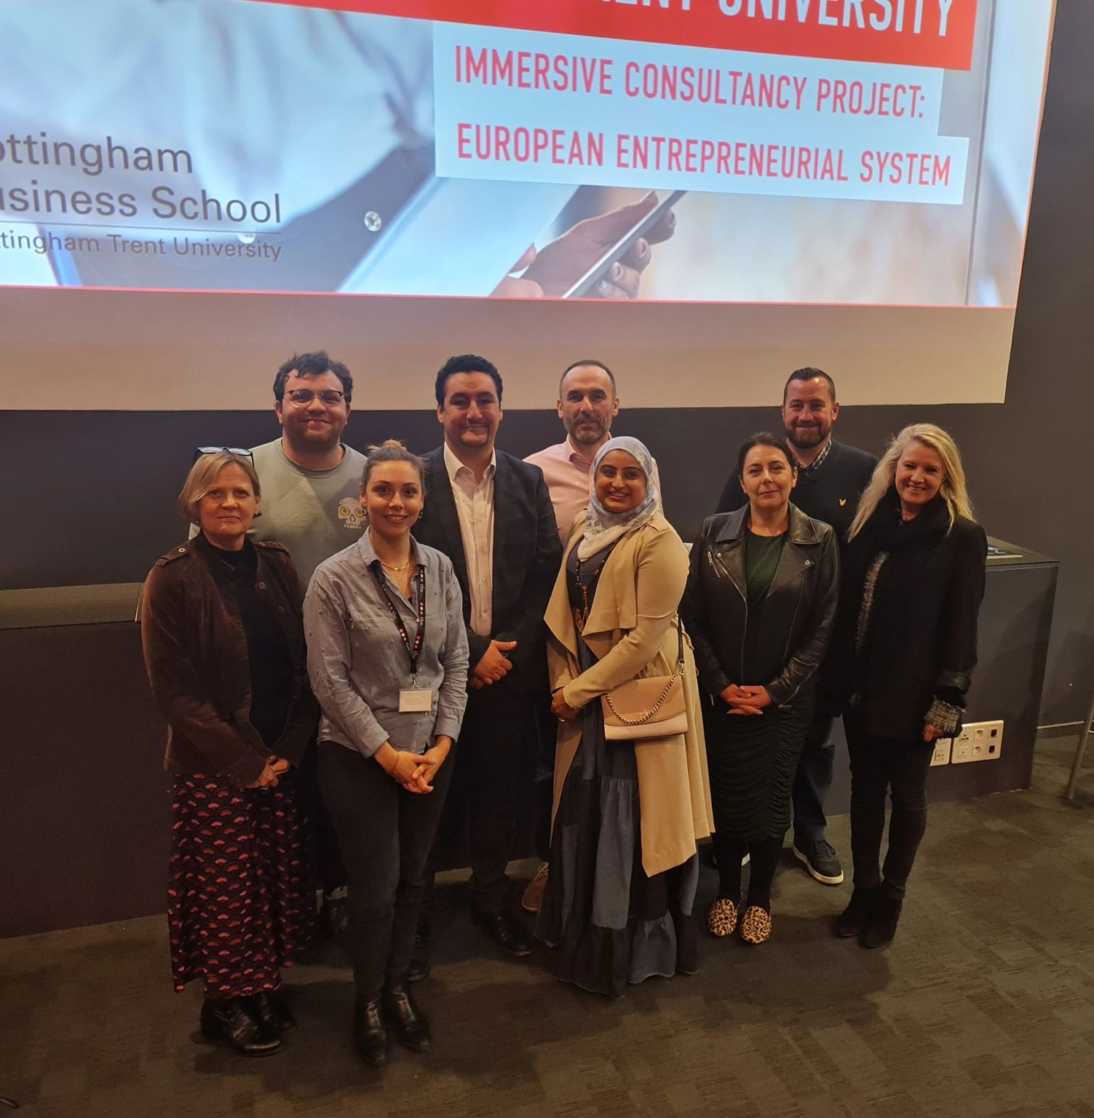
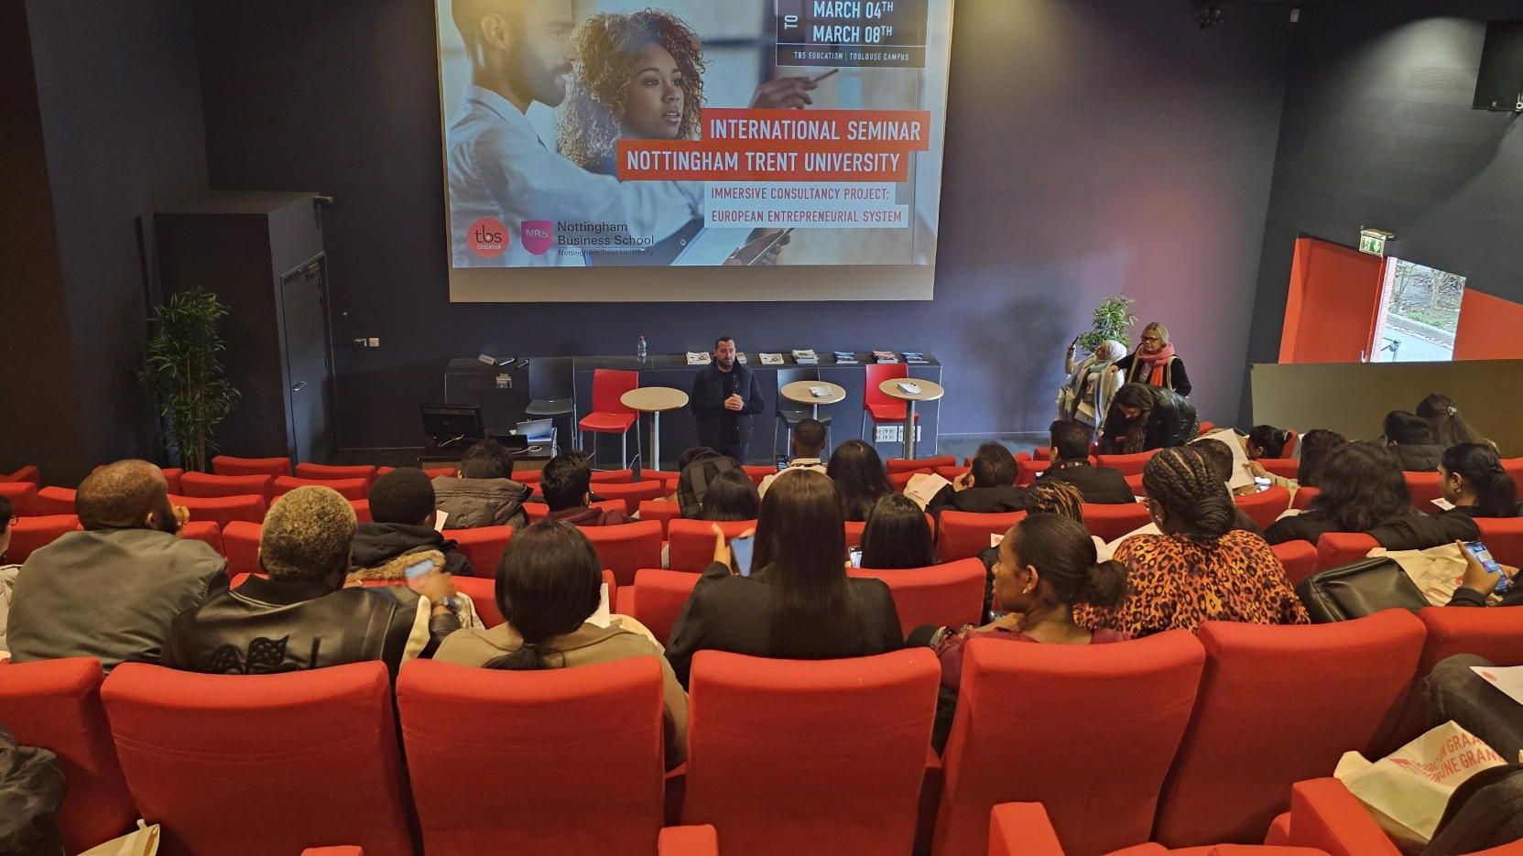
Program Takeaways

