Slide 1
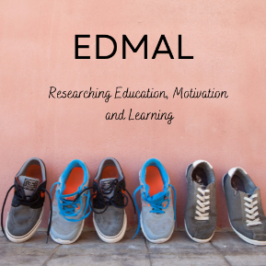
Under pressure: Individual differences in student motivation and engagement across four contexts.
The Education, Motivation and Learning Research Group (EDMAL)
Twitter: @rremediosva, @EDMAL_NTU
Nottingham Trent University
Wednesday, 14th September, 2022

Slide 2

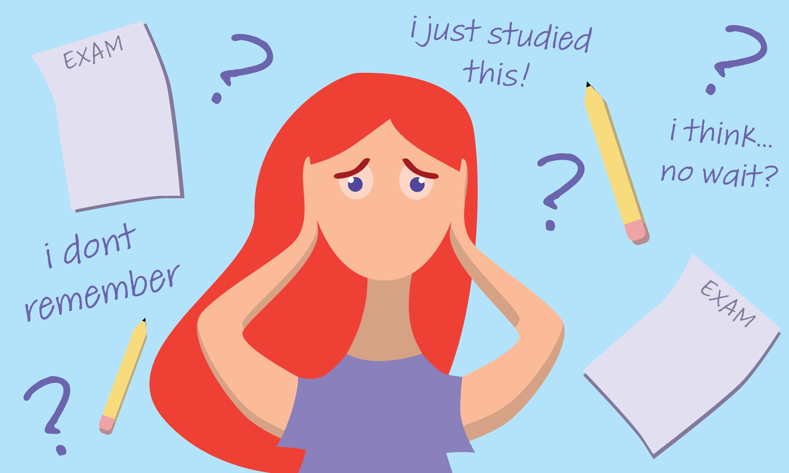


Four contexts

Slide 3
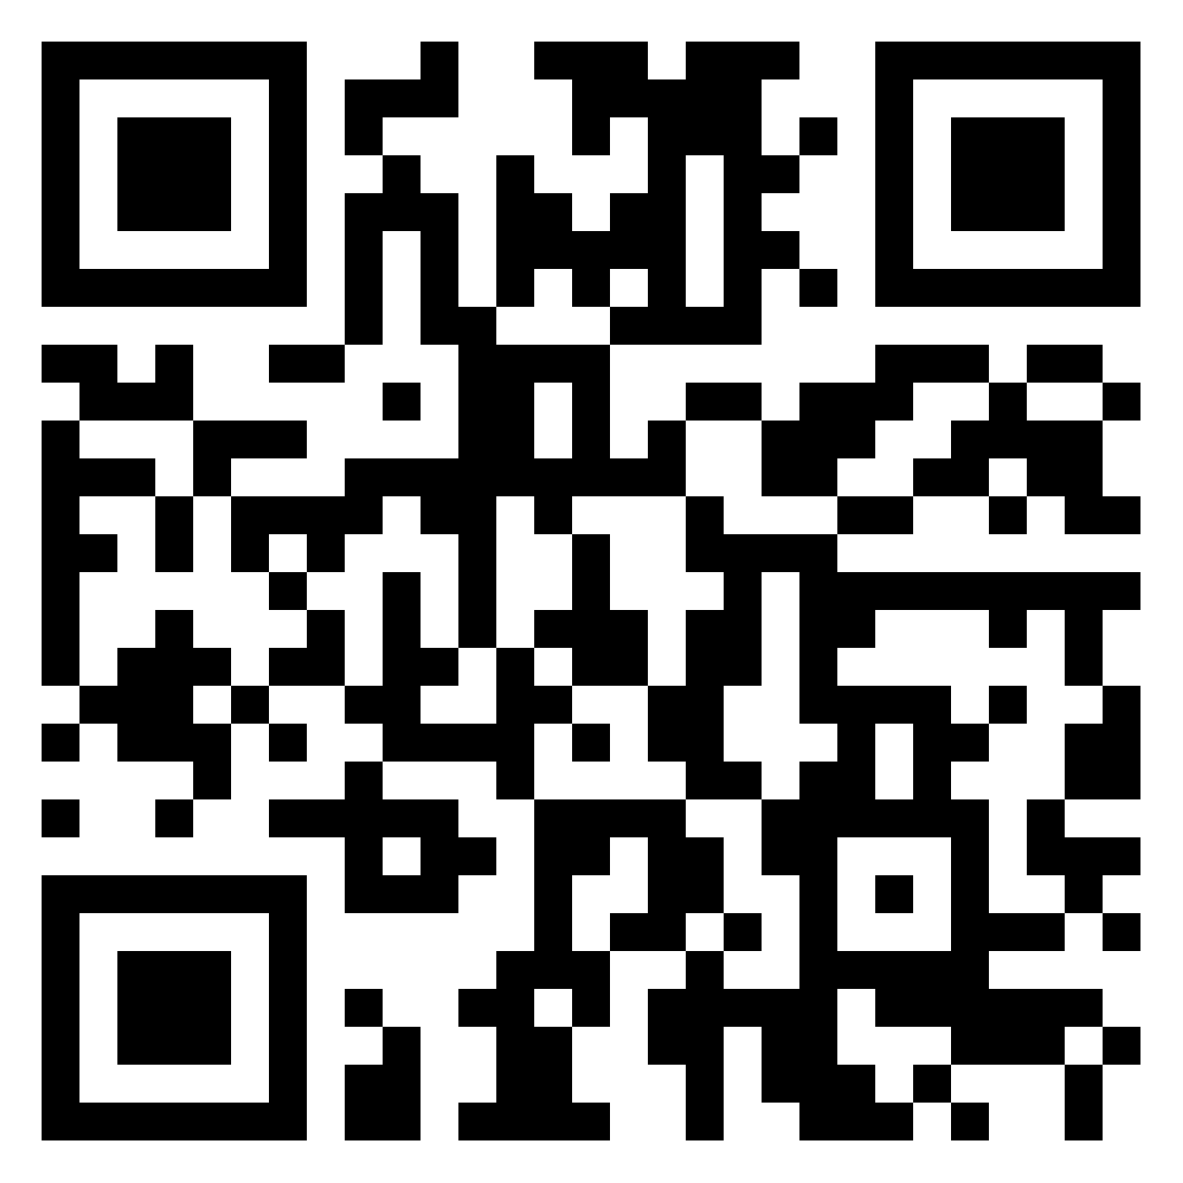

Symposium structure
Talk (15 minutes)
Post your questions via this padlet

Slide 4

Our Discussant
Discussant: Laura Nicholson (Edge Hill University) will address as many issues as she can in 5 minutes

Slide 5

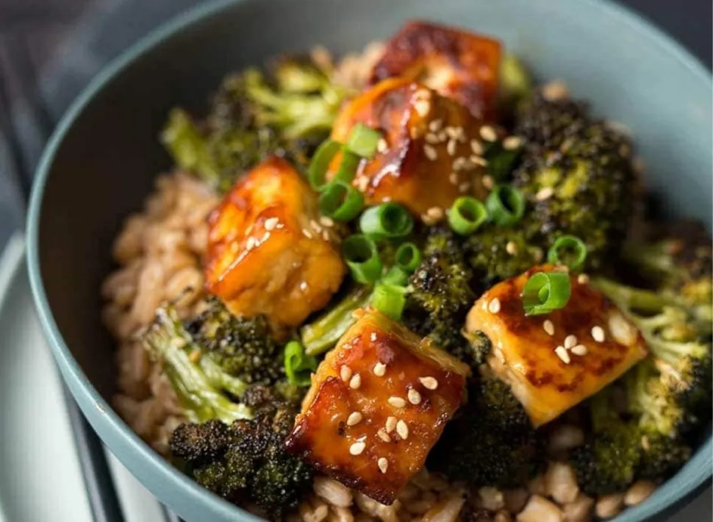
After the symposium

Slide 6
Worrying or Motivating? Students’ experiences of their parents’ motivational messages
Richard Remedios, Assistant Professor in Student Motivation and Engagement

Slide 7



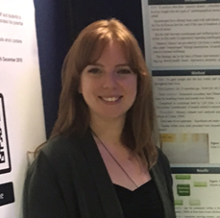


Research Team
Richard Remedios (PI)
Beccie Davis-Yates
Co-PI – Schools Outreach
Michelle Cunliffe
RA – Schools Outreach
Lucy Justice
Co-PI – Statistics
Our partners

Slide 8
Background

Slide 9
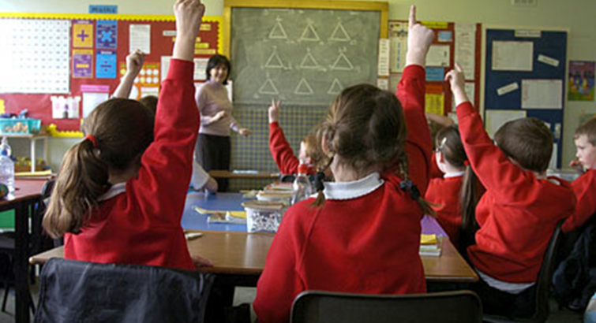
Fear Appeals in Education during times of high-stakes testing e.g., GCSEs, A levels.
If you don’t work hard, you won’t get into college
Putwain, D. W., Symes, W., Laura J. Nicholson, L. J., and Remedios, R. (2020). Teacher motivational messages used prior to examinations: What are they, how are they evaluated, and what are their educational outcomes? Advances in Motivation Science, Elsevier. https://doi.org/10.1016/bs.adms.2020.01.001.

Slide 10

Parents Motivational Messages
If you don’t work hard, you won’t get into college

Slide 11
Methods

Slide 12
Study Methods
Design: Cross-sectional correlational study
Participants: N=1157, Females 874, Males 228, Non-binary = 39, prefer not to say = 16, Mean Age 17.07 (SD 0.73)
Materials: Parental Motivational Messages Scale (Remedios & Putwain, in prep.), Self-efficacy (3 items), Test Anxiety (4 items), Mastery (6 items) (taken from Motivational Strategies of Learning questionnaire, Pintrich & Degroot, 1990).

Slide 13
Parental Motivational Messages
Please think about what your parent(s) or carer(s) tell you about your A-levels and circle the number that indicates your opinion. (5-point scale; Never = 1, Most of the time = 5)
Consequence: How often did your parents tell you that you need good A-level results help to be able have a good life in the future?
Reassurance: How often did your parents tell you that A-level results are not the be all and end all?
Pride: Did you want to try hard to do well in your A-level so your whole family will be pleased with you?
Changing Behaviour: When your parents reminded you to revise for upcoming A-levels, did it make you want to stop doing your schoolwork?

Slide 14
Self-Efficacy, Test Anxiety,
Mastery (Intrinsic motivation)
The following questions are about how your experiences studying for your A-levels. They apply to your experiences across all your A-levels in general. (5-point scale; Strongly Disagree = 1, Strongly Agree = 5)
Self Efficacy (3 items): e.g., Compared with other students doing their A-levels I expect to do well.
Test Anxiety (5 items): e.g., When I take a test I think about how poorly I am doing
Mastery (6 items): e.g., I think that what I am learning in my A- levels is useful for me to know.

Slide 15


Procedure – Qualtrics Survey
Recruitment via two sources
Beccie Davis-Yates
Co-PI – Schools Outreach

Slide 16
Types of research questions addressed
How do PMM relate to self-efficacy, anxiety and mastery?
Are there differences in personality and experiences by gender and postcode?

Slide 17
How do PMM relate to self-efficacy, anxiety and mastery?

Slide 18
Curious case of Pride
Pride was negatively related to Reassurance.
In other words, the LESS you experience Reassurance from your parents → the MORE this makes you want to make them proud.
Descriptive statistics, bivariate correlations, and internal reliabilities. (all n’s > 1300)
Variables | Pride | Reass | Behav. | Cons. | Self-E. | Anxiety | Mastery | Exp.G.
1. Pride | --
2. Reassurance | -.17** | --
3. Changing Behaviour | .03 | .05 | --
4. Consequence | .42** | -.27** | .35** | --
5. Self-efficacy (3 items) | .03 | .02 | -.32** | -.04 | --
6. Anxiety (4 items) | .25** | .09** | -.28** | -.14** | -.34** | --
7. Mastery (6 items) | .11** | .06** | -.26** | -.05 | .47** | -.12** | --
8. Expected Grade | .17** | -.18** | -.24** | .02 | .52** | -19** | .25** | --
Mean | 3.71 | 2.48 | 2.56 | 3.20 | 3.16 | 3.72 | 4.00
Standard Deviation | 1.02 | 1.07 | 1.11 | 1.23 | 1.13 | 1.06 | 0.57
Cronbach’s α | .82 | .71 | .83 | .84 | .89 | .85 | .80
* p < .05, ** p < .01 Means out of 5 except for Expected grade which was out of 7

Slide 19
Pride and Consequence
Descriptive statistics, bivariate correlations, and internal reliabilities. (all n’s > 1300)
Variables | Pride | Reass | Behav. | Cons. | Self-E. | Anxiety | Mastery | Exp.G.
1. Pride | --
2. Reassurance | -.17** | --
3. Changing Behaviour | .03 | .05 | --
4. Consequence | .42** | -.27** | .35** | --
5. Self-efficacy (3 items) | .03 | .02 | -.32** | -.04 | --
6. Anxiety (4 items) | .25** | .09** | -.28** | -.14** | -.34** | --
7. Mastery (6 items) | .11** | .06** | -.26** | -.05 | .47** | -.12** | --
8. Expected Grade | .17** | -.18** | -.24** | .02 | .52** | -19** | .25** | --
Mean | 3.71 | 2.48 | 2.56 | 3.20 | 3.16 | 3.72 | 4.00
Standard Deviation | 1.02 | 1.07 | 1.11 | 1.23 | 1.13 | 1.06 | 0.57
Cronbach’s α | .82 | .71 | .83 | .84 | .89 | .85 | .80
Pride positively related to Consequence.
We think of consequence as pressurizing; Pride is acting in the same way(?)
* p < .05, ** p < .01 Means out of 5 except for Expected grade which was out of 7

Slide 20
Pride and Anxiety
Descriptive statistics, bivariate correlations, and internal reliabilities. (all n’s > 1300)
Variables | Pride | Reass | Behav. | Cons. | Self-E. | Anxiety | Mastery | Exp.G.
1. Pride | --
2. Reassurance | -.17** | --
3. Changing Behaviour | .03 | .05 | --
4. Consequence | .42** | -.27** | .35** | --
5. Self-efficacy (3 items) | .03 | .02 | -.32** | -.04 | --
6. Anxiety (4 items) | .25** | .09** | -.28** | -.14** | -.34** | --
7. Mastery (6 items) | .11** | .06** | -.26** | -.05 | .47** | -.12** | --
8. Expected Grade | .17** | -.18** | -.24** | .02 | .52** | -19** | .25** | --
Mean | 3.71 | 2.48 | 2.56 | 3.20 | 3.16 | 3.72 | 4.00
Standard Deviation | 1.02 | 1.07 | 1.11 | 1.23 | 1.13 | 1.06 | 0.57
Cronbach’s α | .82 | .71 | .83 | .84 | .89 | .85 | .80
And now the third item highlighted makes more sense - Pride positively related to Anxiety.
* p < .05, ** p < .01 Means out of 5 except for Expected grade which was out of 7

Slide 21
Question: Is it good to want to make your parents proud?

Slide 22
Bi-directional relationship
I really want to make my parents proud
If you don’t work hard, you won’t get into college

Slide 23
Other findings briefly
Females significantly MORE anxious than males and significantly higher in pride. [Method below].
No differences for any PMM construct based on postcode analysis (n=319).
Anxiety positively predicted Consequence and (surprisingly) Reassurance*.
Self-efficacy and Mastery negatively predicted Behaviour; test anxiety positive predictor of behaviour.*
Mastery and Anxiety positive predictors of Pride.*
* Controlling for Gender
Method: Multilevel linear model to understand if there were differences in scale scores by gender. Scale scores were entered as the outcome variable with the scale name, gender and their interaction included as predictors. A random intercept of participant was included to account for multiple responses from individuals.

Slide 24
Conclusions

Slide 25
Conclusions
PMM operate in a similar way to teacher motivational messages.
Pride is a particularly complex construct, strongly related to anxiety. The construct needs a lot more research and theoretical examination.
More work is needed on the Reassurance construct.
We are not finding differences in messages by social class measure of postcode. Compare this to Caroline’s findings later.

Slide 26
Further research

Slide 27
Studies keen to do
More international studies, especially in contexts where there is evidence of specific types of parenting practices.
More international studies, especially in contexts where there is evidence of specific types of EDUCATIONAL practices e.g., more and less high-stakes testing.
More studies with students in higher education.
More QUALITATIVE studies e.g., to understand more about the experience of pride.
Studies with parents e.g., how do they monitor the effects of their motivational messages?

Slide 28



