Slide 1
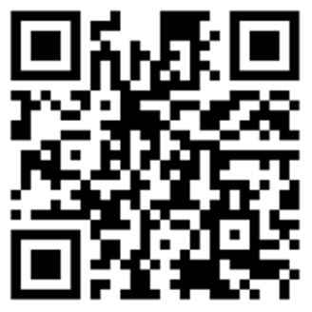
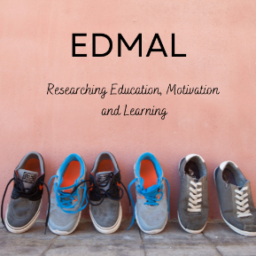
Student experiences in new contexts in HE
The Education, Motivation and Learning Research Group (EDMAL)
https://www.ntu.ac.uk/research/groups-and-centres/groups/education,-motivation-and-learning-research-group
Twitter: @EDMAL_NTU
Nottingham Trent University
Thursday, 14th September, 2023

Slide 2
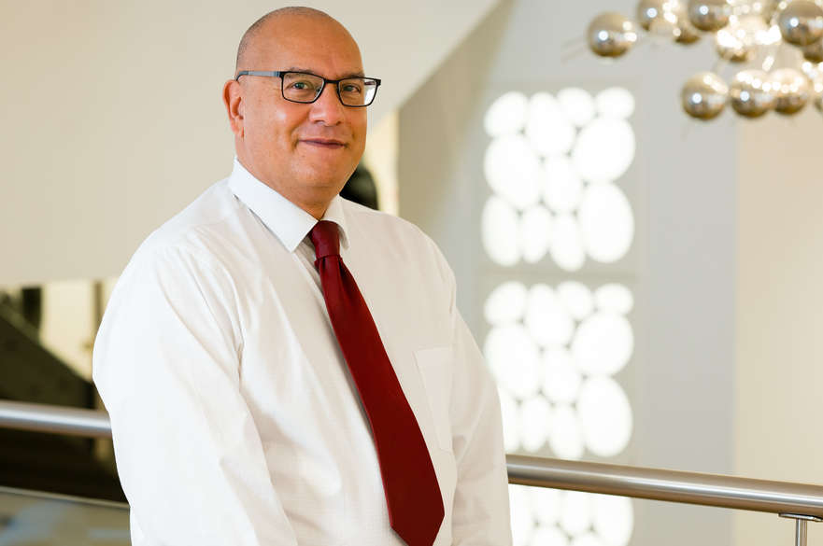


Out of sight, out of mind: Individual differences in students’ experiences of their parents’ motivational messages in higher education. (Richard Remedios & Violeta Baikousi)
Parents Motivational Messages in Higher Education
Associate Professor in Student Motivation and Engagement
Email: richard.remedios@ntu.ac.uk
Violeta Baikousi
Research fellow and PhD candidate
Email: violeta.baikousi@ntu.ac.uk

Slide 3
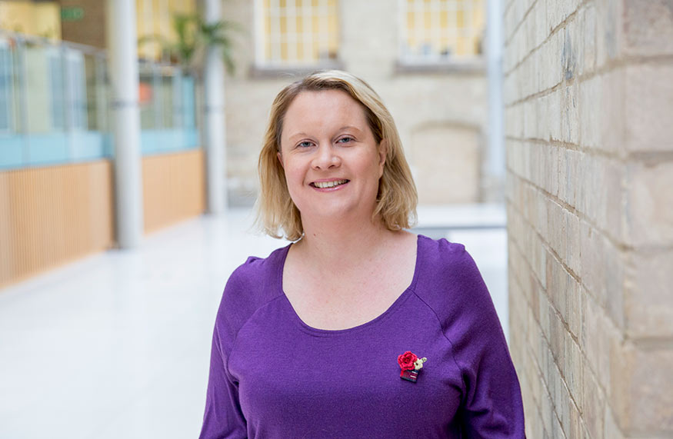

Hy Flex: taking teaching and learning into a new era of flexibility (Sarah Buglass, Russell Turk, Lucy Justice, Darel Cookson, Maria Kontogianni, Sarah Gardner, Chloe Ryding, Jens Roeser, Peter Williams).
Flexible learning in Higher Education
Principal Lecturer
NTU Psychology
Email: sarah.buglass@ntu.ac.uk

Slide 4


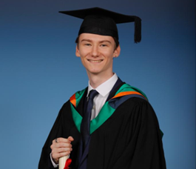
Academic Buoyancy and Statistics Anxiety: A study of first- and second-year psychology university students studying statistics. (Caroline Ford, Brandon Outten, & Richard Remedios.)
Statistics anxiety in Year 1 at University
Caroline Ford
Senior Lecturer, NTU Psychology
Email: caroline.ford@ntu.ac.uk
Brandon Outten
Postgraduate Researcher
brandonoutten@outlook.com

Slide 5
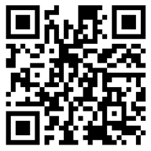

Symposium structure
Talk (15 minutes)
Post your questions via this padlet

Slide 6
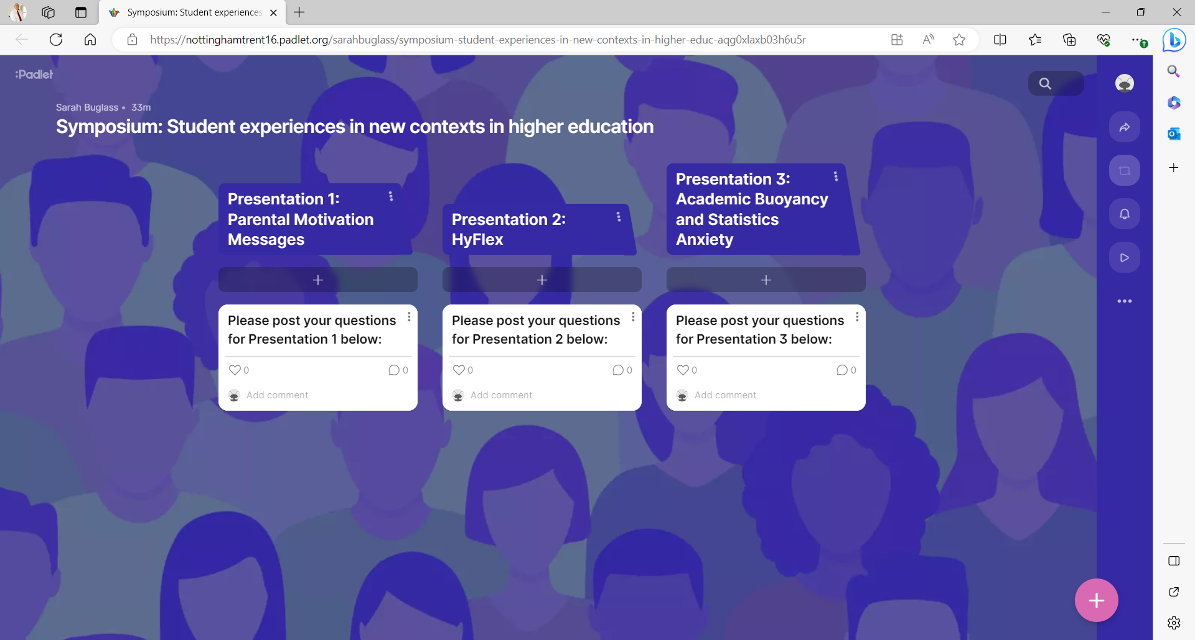
https://nottinghamtrent16.padlet.org/sarahbuglass/symposium-student-experiences-in-new-contexts-in-higher-educ-aqg0xlaxb03h6u5r

Slide 7
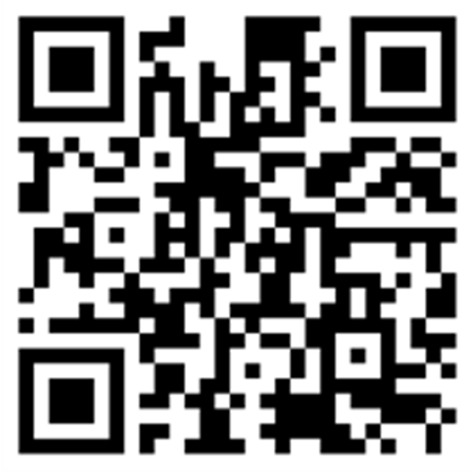

Our Chair
Chair: Laura Nicholson (Edge Hill University) will chair the session based on your questions

Slide 8

After the symposium

Slide 9
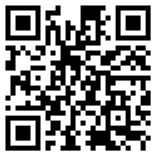
Out of sight, out of mind: Individual differences in students’ experiences of their parents’ motivational messages in higher education.
Richard Remedios, Assistant Professor in Student Motivation and Engagement.
Violeta Baikousi, Research Fellow, NTU Psychology.

Slide 10
Background

Slide 11
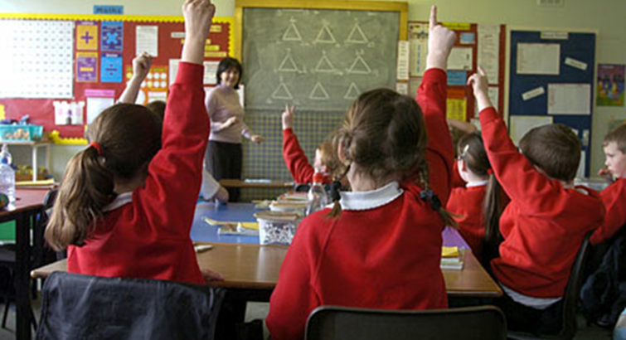
Fear Appeals in Education during times of high-stakes testing e.g., GCSEs, A levels.
If you don’t work hard, you won’t get into college
Putwain, D. W., Symes, W., Nicholson, L. J., and Remedios, R. (2020). Teacher motivational messages used prior to examinations: What are they, how are they evaluated, and what are their educational outcomes? Advances in Motivation Science, Elsevier. https://doi.org/10.1016/bs.adms.2020.01.001.

Slide 12

Parents Motivational Messages
in High School
If you don’t work hard, you won’t get into college
Remedios, R., Putwain, D. W., & Symes, W. (in prep.). The effect of parent motivational messages on student motivation and performance.

Slide 13



Out of sight
If you don’t work hard, you won’t get the degree/job you wanted

Slide 14
Some research questions
What types of motivational messages are students experiencing from their parents when they enter higher education?
How do students experience these messages. For example, are these messages relevant to students?

Slide 15
Methods

Slide 16
Study Methods
Design: Semi-structured interviews
Participants: N=13 (3 x Y1, 4 x Y2, 6 x Y3)
Recruitment: SONA, social media, advertisement on campus
(£15 shopping voucher)
Interview procedure: Online (30min – 1h)

Slide 17
Participants
Year | Age | Nationality
1 | 19 | British
1 | 20 | British
1 | 20 | British
2 | 20 | British
2 | 20 | British
2 | 20 | Indian
2 | 20 | British
3 | 22 | British
3 | 22 | German
3 | 26 | British
3 | 22 | British
3 | 21 | British
3 | 21 | British

Slide 18
Questions asked in the interviews (Open)
Have you kept in regular contact with your parent(s)/Carer(s) since leaving home / attending University?
Tell me about the types of things your parents/caregivers say to motivate you at university?
In what ways, if any, are these messages different to the ones you received when you studied for your GCSEs or A-levels?
How do your parents feel about you studying at the university? Why do you think they feel that way?
Do you find getting high grades in your course assignments of high importance for you? Why is that?
Who or what else motivates you at the university? PROMPTS: Peers, lecturers?

Slide 19
Mapping questions against PMM questionnaire constructs (Specific)
To what extent do you think you want to do well to make your parents proud? Can you say more about your answer? [Construct = Pride]
When your parents motivate you, to what extent do their messages make you want to change your (study) behaviour? [Construct = Changing behaviour]
Have your parents ever told you that you don’t need to worry over your degree? If they have, how does this make you feel? If they haven’t, why do you think this is? [Construct = Reassurance]
Do your parents tell you that you need to get a good degree classification to be able to have a good job in the future? [Construct = Consequence]

Slide 20
Analytic Methods
Inductive Thematic Analysis (Braun & Clarke, 2006)
6 steps key-themes identification

Slide 21
Key themes identified

Slide 22
Key themes and findings
Parental focus on utility value of degree
Student focus on utility value of degree
Parental concern about student mental health
Parents messages experienced as stress-relieving
Students as self-motivated
Students less likely to be influenced by parents’ messages if parents did not go to university themselves**

Slide 23
Key themes and findings
Parental focus on utility value of degree
Student focus on utility value of degree
Parental concern about student mental health
Parents messages experienced as stress-relieving
Students as self-motivated
Students less likely to be influenced by parents’ messages if parents did not go to university themselves**

Slide 24
Parental concern about student mental health
Quotes:
"they do tell me that I don't have to stress myself, you know, like excessively stress myself out to do well"
"she'll just drop me an email with, like, a link she's found to like, ‘’ways to stay motivated’’ or ‘’things that can help you with statistics and stuff’’ and she just, she goes out of her way to sort of send me help"
"she always gave me tips on how to get the day like to go for a walk or get out of the house and do something, make some food and just get out my room really and the flat because that's obviously a big thing"

Slide 25
Parents messages experienced as stress-relieving
Quotes:
"It's really reassuring to know that If I don't go down a certain path, or if I do almost anything that she should support me and be proud of me, so it's a bit of like relaxing"
"They just make you feel comforted. It makes you feel at ease"

Slide 26
Students less likely to be influenced by parents’ messages if parents did not go to university themselves**
Quotes:
"now is a topic which he doesn't know anything about It's harder for him to do so. I think he doesn't instruct me as much anymore"
"they don't know what a degree is, I believe they don't know the true value of it and the effort that goes into attaining a degree, so I think they can’t, I think they don't have the knowledge and experience to tell me "
" it's not like they would say something by themselves kind of like because they never went through University they don't really know what it entails"

Slide 27
Further research
Value placed on advice

Slide 28
New construct
How often do you listen to your parent’s advice regarding your education?
How often do you go to your parents for advice regarding your higher education?
How often would you say you trust your parent’s advice on your education?
How often do you ask for help from your parent’s before making a decision that will affect your education?

Slide 29
Table 1: Factor loadings for 20-item, 5-construct Parental Motivational Messages scale (highest secondary loadings in italics > .20).
Principal Components analysis with varimax with kaiser normalization as the rotation method.
Barlett’s test of sphericity = X² (190) = 1043.06, p < .001
Kaiser-Meyer-Olkin (KMO) = 0.82

Slide 30
Summary
Students are definitely still aware of their caregivers motivational messages and these messages are often reassuring.
Caregivers’ messages can help buffer students from issues related to their mental health.
HOWEVER – it seems clear that whether the parent has experienced a university degree is a determinant of the value of the messages that are received.

Slide 31
Conclusions and further research
How parents’ motivational messages are processed in HE seems an important issue to research.
There is good evidence that there may be distinct construct about the “perceived value of the message.”
We are really at the start of this research so looking more specifically at different types of cultural relationships we think could be valuable.
Email richard.remedios@ntu.ac.uk if you are interested in collaborative work.

Slide 32
If you haven’t done so, please post your questions

