Slide 1
European Intellectual Property Teachers’ Network
8th Annual Workshop, University of Latvia, Riga 2015
Educating Creatives about IP:
The Nottingham Creative Intellectual Property Project
Beautiful law: how visualisation
can make IP law useful and even fascinating
Janice Denoncourt
29-30 June 2015

Slide 2
The Nottingham Creative Intellectual Property Project

Slide 3
A multidisciplinary collaboration:
Led by the Nottingham Law School
Legal Advice Centre
IP Research Group
The Hive
School of Art & Design

Slide 4
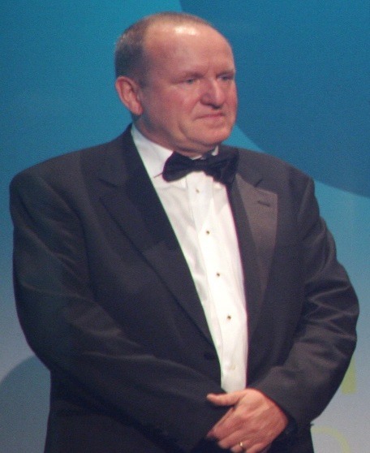
The importance of the Creative Industries to the UK
“It always amazes me that wherever you travel, the impact of the UK’s creativity in music, literature, theatre, film, television, video games, fashion and design is enjoyed by people of different nationalities and cultures. However, beyond giving immeasurable pleasure and enjoyment, the creative industries are vital to our economic success. They are an important driver of growth, investment and tourism. They provide 1.7 million jobs and contribute £76.9bn to the economy – that’s £8.8m an hour or £146,000 every minute. It’s also a very dynamic sector, currently growing three times faster than other industry sectors.”
Ian Livingtstone CBE
Co-founder Games Workshop
English Fantasy Author & Entrepreneur
Foreword, Nottingham Intellectual Property
Guide for Creatives
May 2015

Slide 5
UKIPO Fast Forward 2014 Competition
“£750,000 available to fund new ways to raise IP awareness and turn innovative ideas into reality”
NLS awarded £69,000

Slide 6
A Series of Five Creative IP Workshops
Design June 2014 : Product, textiles/fashion and graphics
Performance October 2014 : Music, theatre, dance, circus and comedy
Moving Images & Broadcasting
November 2014 : Film, TV and Radio
Interactive Media and Writing
January 2015: Games, web, mobile, software, literature and journalism
Art and Image February 2015: Photography, fine art, decorative arts and architecture

Slide 7
About the Nottingham Creative IP Project
Designed for businesses and students in the creative industries.
Aim is to equip them with a better understanding of how to more effectively protect, manage and exploit ideas and intellectual property (IP).
Provide practical client contact experience to NLS students
Through a series of themed workshops, industry experts, experienced lawyers, entrepreneurs and Nottinghamshire creative businesses were invited to share their knowledge and experience on the challenges, pitfalls and opportunities of working in the creative sector.

Slide 8
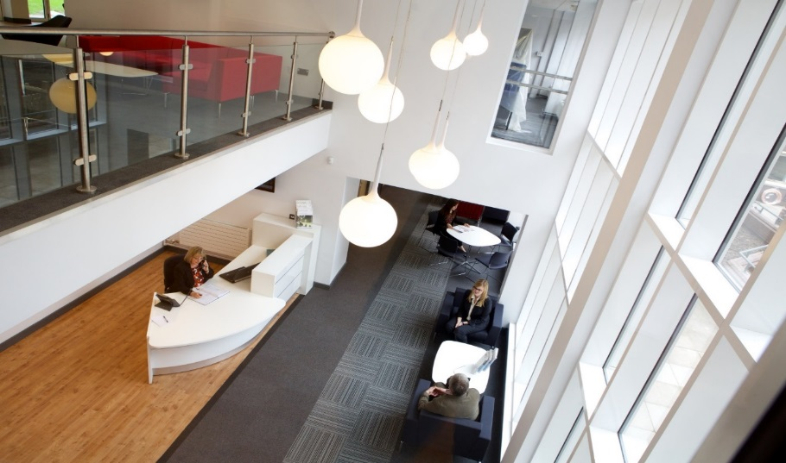
NLS Legal Advice Centre, Chaucer Building
Companies and graduates with business ideas were offered the opportunity to benefit from pro bono legal advice clinics.
These were delivered by students of Nottingham Law School Legal Advice Centre, guided by experienced IP lawyers and NTU staff.

Slide 9
The Nottingham Creative IP Project highlighted….
The lack of IP knowledge, not only for those involved in the creative industries who need a basic awareness of how to identify, protect and exploit IP
BUT
also amongst art, design AND law students
who were often unaware of its importance as a form of property

Slide 10
The Nottingham Intellectual Property
Guide for Creatives
Denoncourt, J. Paley, E., Jarman, J. Johnson, N., Davison, C. and Clarke, P.
(may 2015) Nottingham Trent University Publications
We exercised our IMAGINATION!
Beautiful law: how visualisation
can make IP law useful and even fascinating

Slide 12
The Nottingham Intellectual Property
Guide for Creatives
Our approach: Who’s IP law for?
We’ve taken IP law, often complex and impenetrable,
a written tangle of words,
and turned it into something different.
We took black letter IP law and gave it a huge
MAKEOVER!

Slide 13
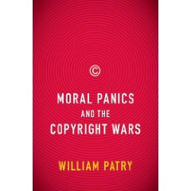
The Nottingham Intellectual Property
Guide for Creatives
BEFORE AFTER

Slide 14
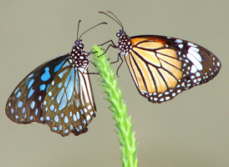
The Nottingham Intellectual Property
Guide for Creatives
Designed to have high production values to specifically target ‘Creatives’ (who are otherwise not attracted to law as a subject).

Slide 15
Nottingham Intellectual Property
Guide for Creatives
Launched on 27 May 2015
Draws from events to provide simple and accessible understanding of IP to help creatives safeguard their ideas and businesses.
Demonstrates how IP applies in the creative industries context through case studies.
Provides advice about how to prepare when entering a collaborative project or meeting a lawyer.

Slide 16
The Nottingham Intellectual Property
Guide for Creatives
New approach to IP law education: re-frames the IP content around the USER.
Designed attract “creatives” not lawyers or business people.
Striking images, graphics and text fuse naturally and is good educational design.
Visually appealing format draws in “Creatives” – it does not resemble a textbook.
Does not divide the topics into types of IP e.g. copyright, patents, trade marks, rather by the IP law specific to creative sectors.
Opens up the IP law space to those people directly affected by IP law in their creative work and lives.

Slide 17
The Nottingham Intellectual Property
Guide for Creatives
We are all IP Law Designers ☺
But… we need to design to better communicate IP law concept
See Margaret Hagan’s
Law by Design: Making Law People-Friendly
Stanford University Design School
http://www.openlawlab.com/2013/12/23/law-design-consumer-law-pop-class-d-school/

Slide 18
The Nottingham Intellectual Property
Guide for Creatives
User experience should be at the centre.
Includes a series of inspiring, real-life case studies about successful creatives.
Documents the positive impact of IPR on a variety of creative work produced in the East Midlands, UK.
Cuts across a range of creative industries including photography, music, blogging, video games, architecture, fashion design and art – where there is less exposure to IP as a valuable commercial asset.

Slide 19
The Nottingham Intellectual Property
Guide for Creatives
The case studies cut across a range of creative industries including:
Fashion design;
Live Performance Venues
Photography;
Blogging;
Video games; and
Art,
where there is less exposure to IP as a valuable commercial asset.

Slide 20
The Nottingham Intellectual Property
Guide for Creatives
Real-life Creative IP Case Studies:
Susie Henson - Eternal Spirits
Mark Tughan - The Glee Club
Martin Shakeshaft – Freelance photojournalist
Alastair Clark - Wellington Films
Lauren Knifton – www.theladyinwaiting.org
Emma Ball – Emma Ball Ltd.

Slide 21
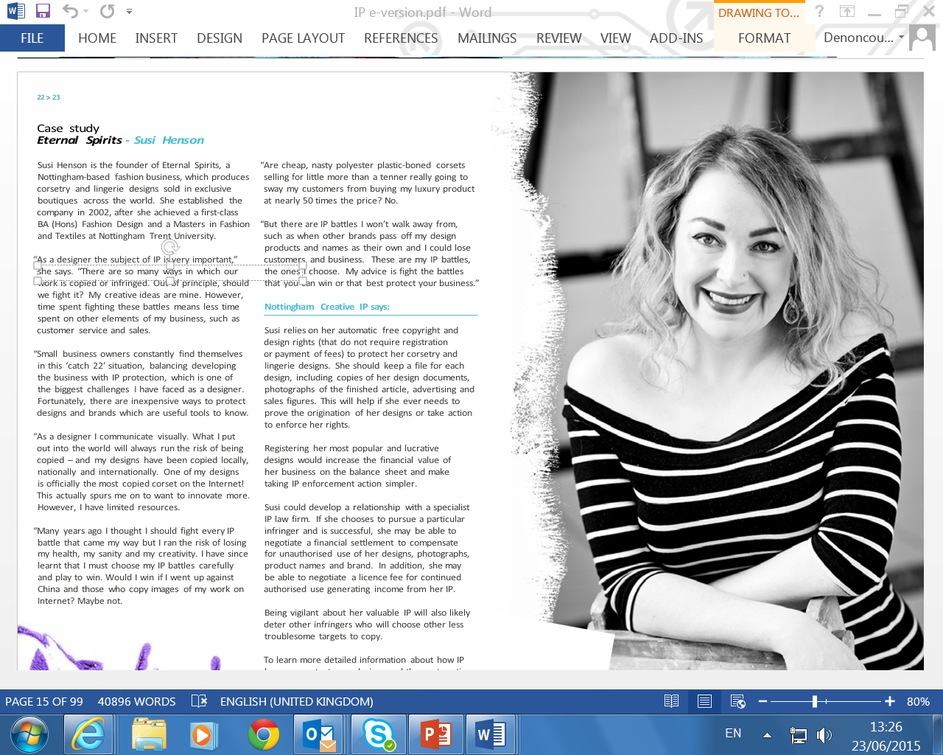

Slide 22
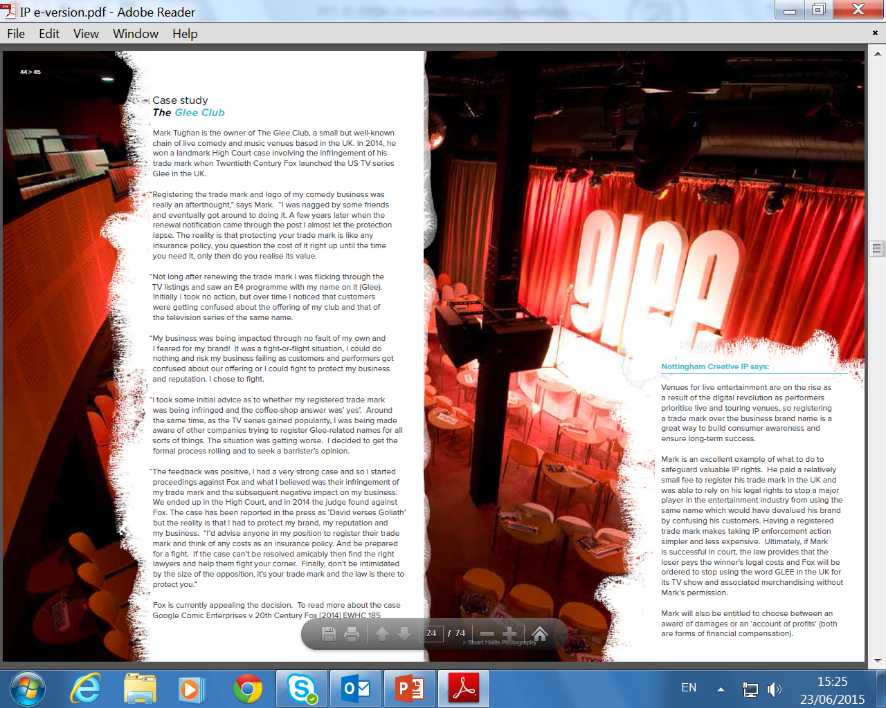

Slide 23
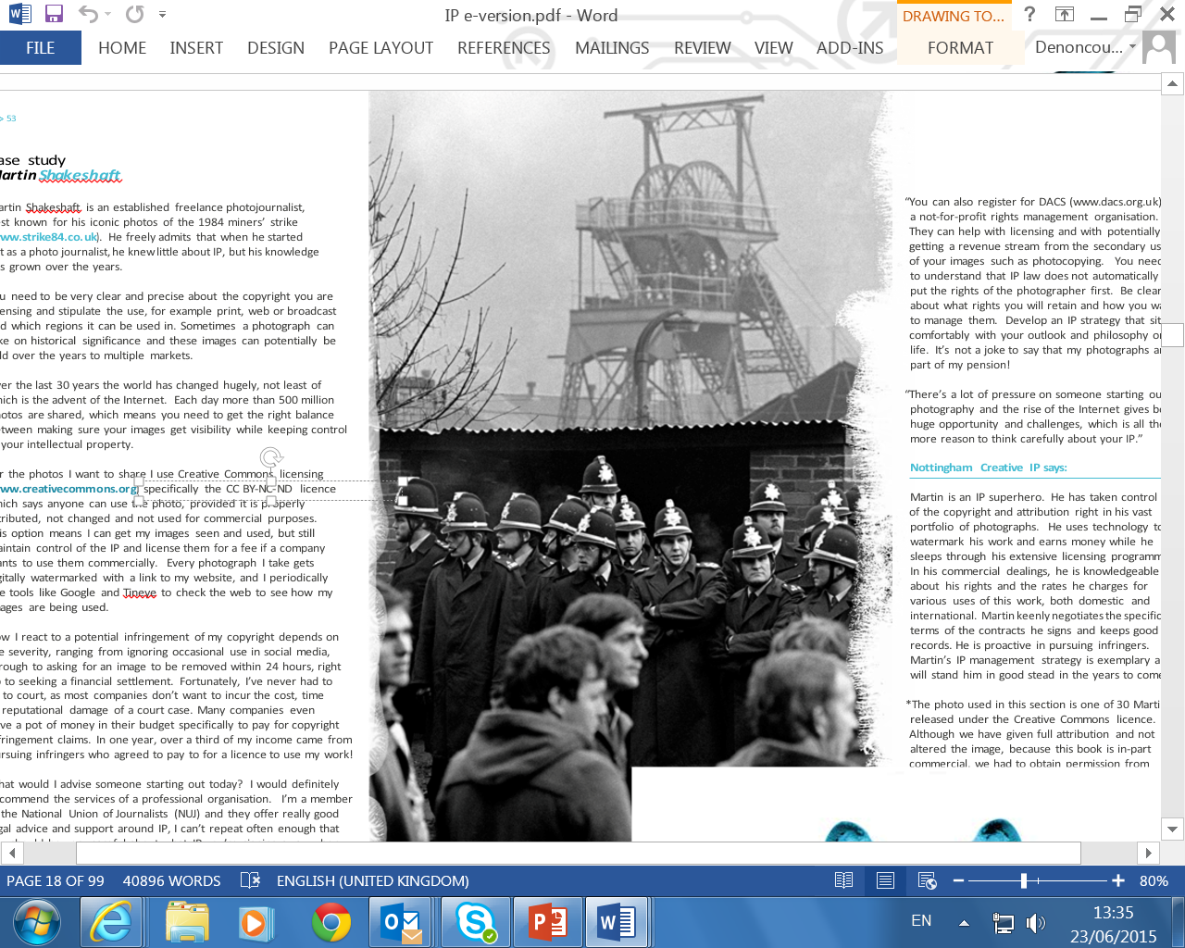

Slide 24
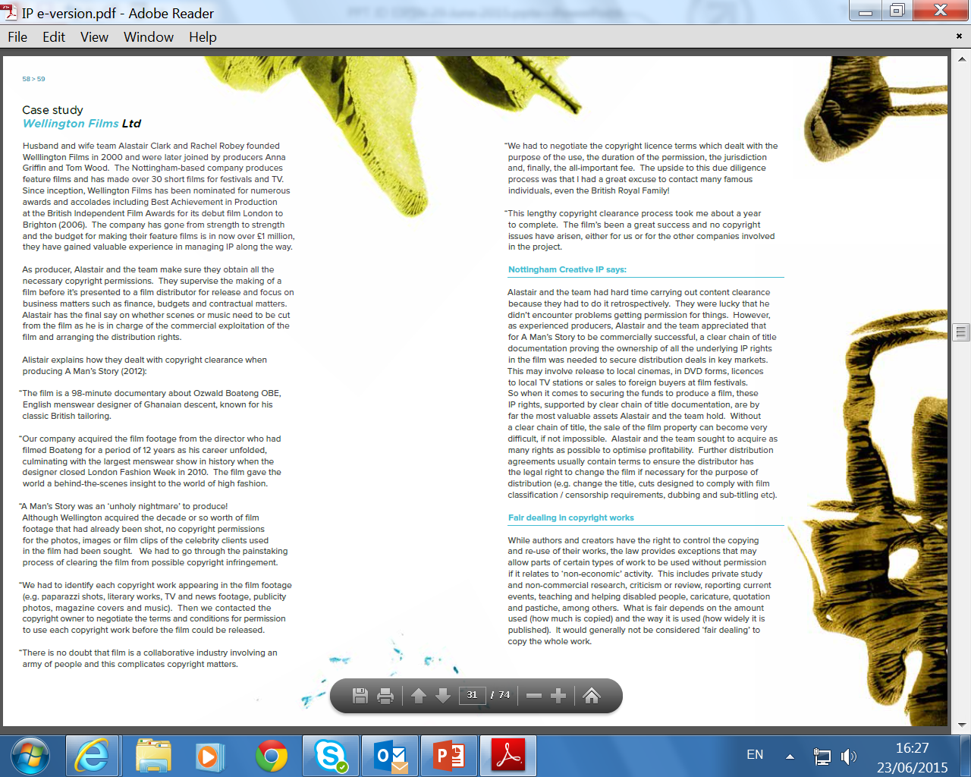

Slide 25
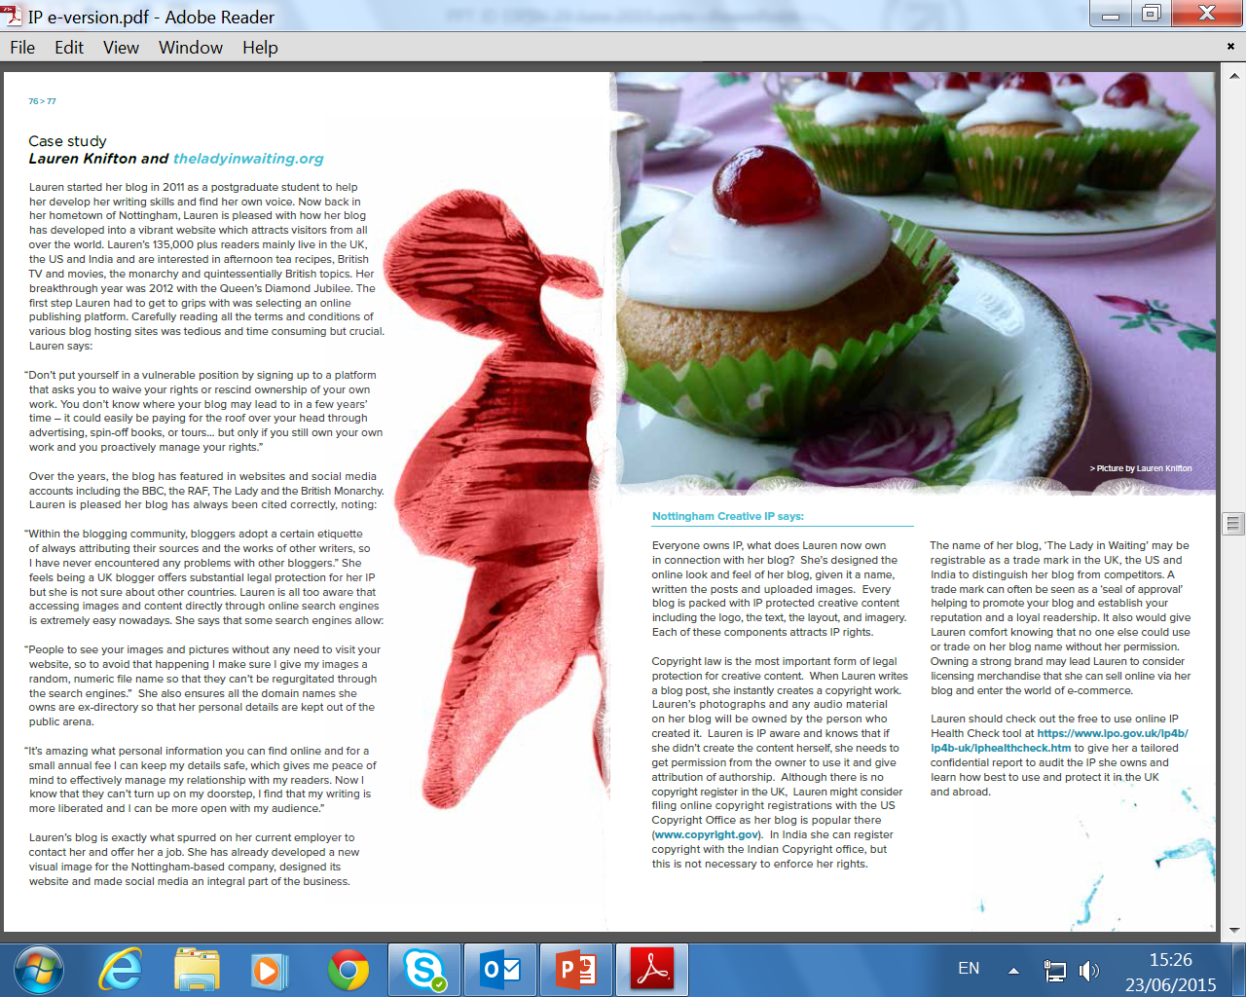

Slide 26
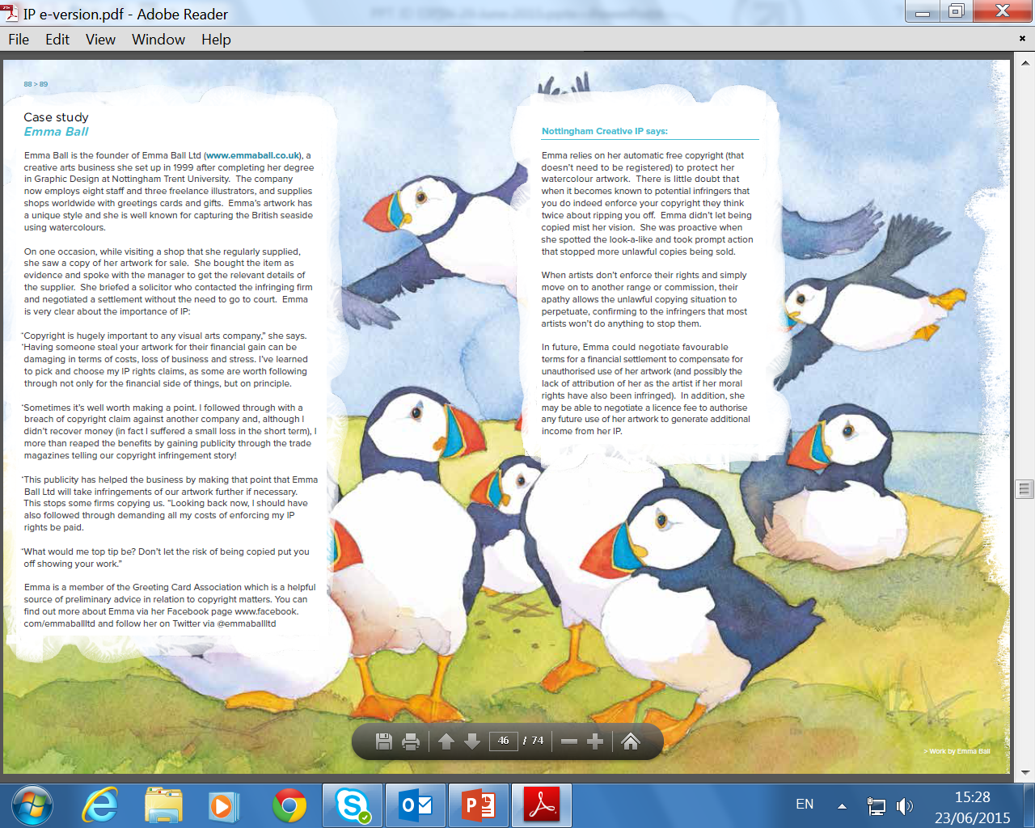

Slide 27
The Nottingham Intellectual Property
Guide for Creatives
Our message:
By harnessing the power of your valuable IP
you can be a
Successful, Entrepreneurial “Creative”

Slide 28
The Nottingham Intellectual Property
Guide for Creatives
These IP savvy creatives are in a position to “influence” and “bring about change” within their creative fields.
They pass on their knowledge and experience to equip a new generation of creatives with the right skills, knowledge and understanding of IPR in order to achieve real change.

Slide 29
The Nottingham Intellectual Property
Guide for Creatives
For FREE a free copy or E-copy of the publication,
please email:
Estelle.paley@ntu.ac.uk
Or
Janice.denoncourt@ntu.ac.uk

Slide 30
Nottingham Creative Intellectual Property Project
Scope for further dissemination and development
The Guide – publication on the NLS IP Research Group webpages as well as the Legal Advice Centre website as well as printed.
An article has been accepted for publication in the WIPO Magazine.
An article has been accepted for publication in Managing IP.
Article submission to international academic legal education journal.
Notes:
Project has, however, also given some really useful pointers as to ways in which we can develop other aspects of the law school’s work, both in the Centre and within curriculum.
Creative IP, effectively, a public legal education project. PLE high on the agenda in the pre-crash years as a way of meeting unmet legal need. Genn et al (1999) Paths to Justice highlighted the potential of a “coordinated programme of public education to better understand that matters that are fundamental to citizenship” in both schools and more widely as a way of addressing the fact that around 50% of legal problems go unresolved. PLE Taskforce report in 2007 recommended establishment of a PLE Centre. Even more topical now given the shrinking of State assistance.
Centre already doing these projects (e.g. Streetlaw in schools, Prison Education Project, FGM project developing with a group of BPTC students). Difference here is that with Creative IP project, we’re giving assistance to, say, a fashion designer whose designs are being ripped off by manufacturers in the Far East rather than a prisoner on the verge of release who needs to know what convictions he has to disclose. Social and economic benefit as creative industries now 5% of the overall UK economy employing in 2013 2.62 million people many of whom are self-employed. Areas of law we can cover as educators unlimited – e.g resources a school might want on sexual offences as part of their PSHE porgramme -
Hosting “the book” on the Centre’s website a start – the publication can become part of a series of resources in different areas of law. Resources developed by students as part of a module (under staff supervision) – those which “work” uploaded to the website or offered to community groups as part of the Centre;’s business
Website can also host/publicise materials which the public can use (MOOCs, non-credit bearing modules – free and paid for) which enable participants to address specific issues.

Slide 31
Led to a second project:
UK Intellectual Property Office
StudentshIP Enterprise Awards 2015
NLS awarded £24,980

Slide 32
In May 2015,
The Nottingham Law School received an
Award for Excellence in IP Education
in the Acquisition International IP Awards
Acquisition International put forward a selection of candidates who they believe to be industry leaders. Additionally the voting forms were sent out to the 108,000 subscribers of AI Magazine along with 27,000 IP specialists.

Slide 33
Nottingham Creative Intellectual Property Project
Thank you!
Janice Denoncourt
Twitter: @JanDenoncourt
Janice.denoncourt@ntu.ac.uk
ResearchGate
Notes:
Project has, however, also given some really useful pointers as to ways in which we can develop other aspects of the law school’s work, both in the Centre and within curriculum.
Creative IP, effectively, a public legal education project. PLE high on the agenda in the pre-crash years as a way of meeting unmet legal need. Genn et al (1999) Paths to Justice highlighted the potential of a “coordinated programme of public education to better understand that matters that are fundamental to citizenship” in both schools and more widely as a way of addressing the fact that around 50% of legal problems go unresolved. PLE Taskforce report in 2007 recommended establishment of a PLE Centre. Even more topical now given the shrinking of State assistance.
Centre already doing these projects (e.g. Streetlaw in schools, Prison Education Project, FGM project developing with a group of BPTC students). Difference here is that with Creative IP project, we’re giving assistance to, say, a fashion designer whose designs are being ripped off by manufacturers in the Far East rather than a prisoner on the verge of release who needs to know what convictions he has to disclose. Social and economic benefit as creative industries now 5% of the overall UK economy employing in 2013 2.62 million people many of whom are self-employed. Areas of law we can cover as educators unlimited – e.g resources a school might want on sexual offences as part of their PSHE porgramme -
Hosting “the book” on the Centre’s website a start – the publication can become part of a series of resources in different areas of law. Resources developed by students as part of a module (under staff supervision) – those which “work” uploaded to the website or offered to community groups as part of the Centre;’s business
Website can also host/publicise materials which the public can use (MOOCs, non-credit bearing modules – free and paid for) which enable participants to address specific issues.

