Slide 1
Integrating Climate Change Education into Responsible Management Education? Carbon Literacy Training in Coronation Street AND Integration of SDGs esp. SDG 13 at NTU
13th November 2018
Dr Petra Molthan-Hill, Nottingham Business School/Nottingham Trent University

Slide 2
Overview
Short intro to work of NTU’s Green Academy
Climate Change –should we do something?
‘Coronation Street’ Research Project:
Background
Research questions
Achievements in Coronation Street
First insights on the factors why the Carbon Literacy Project in Coronation Street was so successful

Slide 3
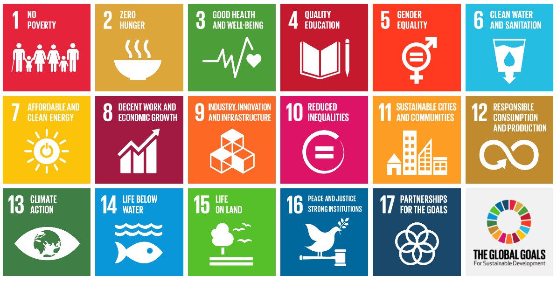
NTU is embedding THE GLOBAL GOALS For Sustainable Development

Slide 4
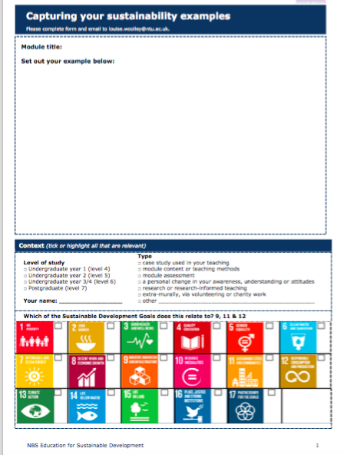
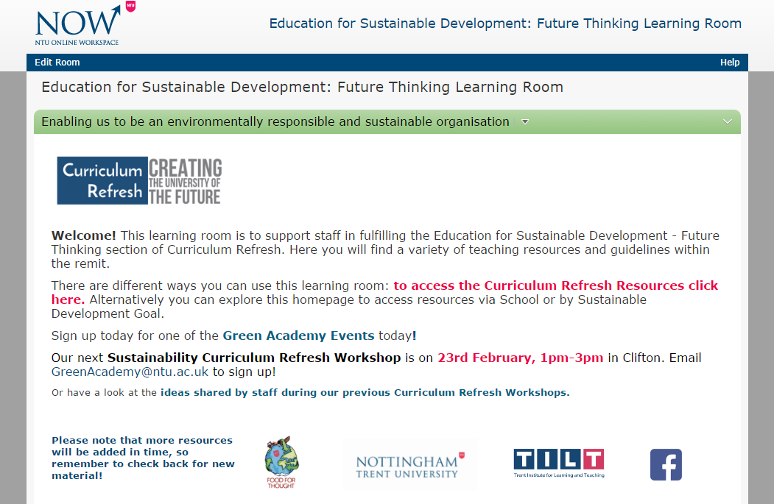
Support offered

Slide 5
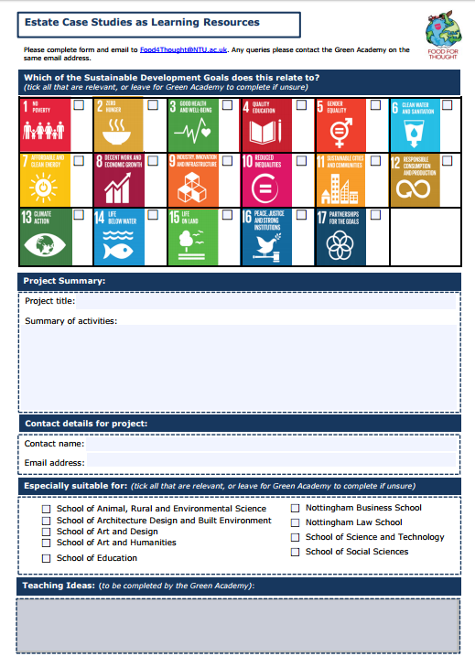
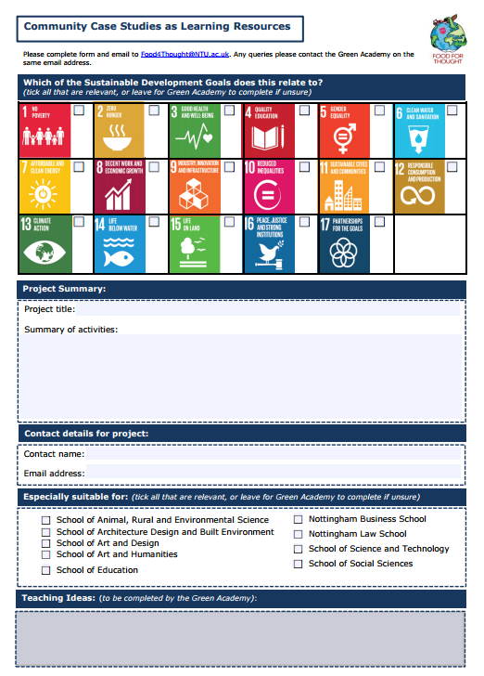
Community and Estate Case Studies
Notes:
Community and Estate case studies - The Green Academy coordinated a project initiated by the TILT (The Trent Institute for Learning and Teaching) Education for Sustainable Futures group to create case studies focusing on both community volunteering projects and innovative environmental work happening on the NTU estate. Each of the case studies shows how the project relates to the various SDGs. The resources are multi-disciplinary and are intended for use across a wide range of courses, throughout all 8 schools.

Slide 6
The SDGs in the Sustainability in Practice (SiP) Certificate
3 versions of the SiP: Energy, Food and Clothing
Notes:
The SDGs are introduced in the third session of the Sustainability in Practice certificate that focuses on giving students an interdisciplinary understanding of the sustainability concept and realising the importance of collaboration to overcome global issues. The goals are used as an example of how various disciplines and subject areas can work together to address sustainability issues. Students are also asked to reflect on their own role in realising the SDGs and how to work with other disciplines and sectors in order to achieve this. In many cases, this is the students first contact with the SDGs and judging by the feedback, this is something they can relate to on both a personal level and in their future professional lives.

Slide 7
The Sustainable Development Goals at Nottingham Trent University
Curriculum Refresh
The SDGs are embedded in the university-wide course evaluation process Curriculum Refresh
NTU and the Sustainable Development Goals blog
www.ntu-sdgs.blog
Student Outreach
Seeking feedback from students on how they would like to embed the SDGs in their courses
Future Thinking Learning Room
An online resource library containing resources, estate and community case studies and examples of good practice, all linked to the SDGs
Staff development
The SDGs are introduced in staff workshop to clarify the sustainable development concept
Sustainability in Practice
Getting students to reflect on interdisciplinary collaboration using the SDGs

Slide 8
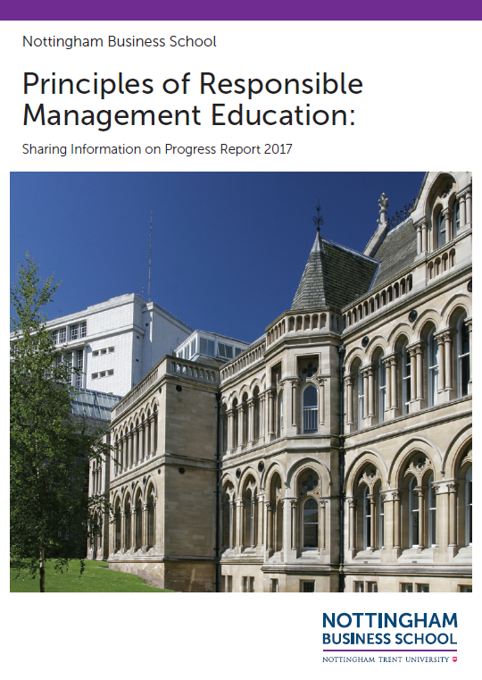
Nottingham Business School
NBS PRME report
http://www4.ntu.ac.uk/nbs/document_uploads/193908.pdf

Slide 9
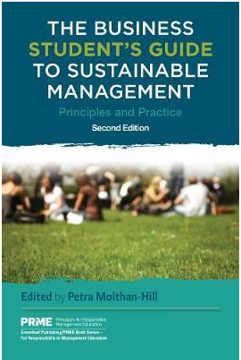
More teaching ideas: The Business Student's Guide to Sustainable Management
https://www.routledge.com/The-Business-Students-Guide-to-Sustainable-Management-Principles-and/Molthan-Hill-Molthan-Hill/p/book/9781783533190

Slide 10
TILT Education for Sustainable Futures
The effect of cultural and socioeconomic factors on sustainability engagement.
Environmental Behaviours
Sub-group looking into environmental behaviour of students.

Slide 11
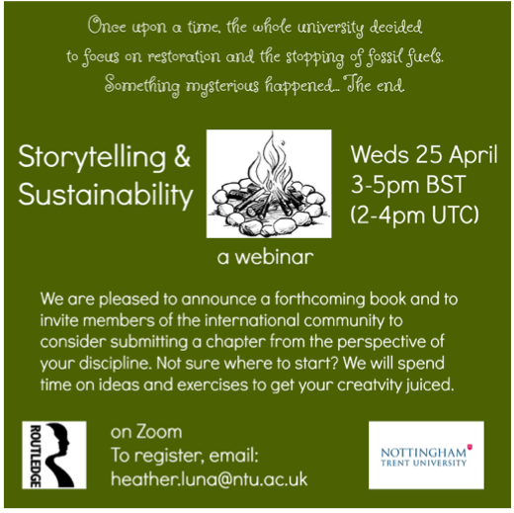

Slide 12
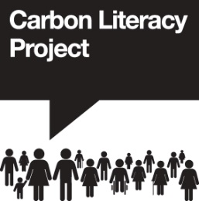
Section 2:
The challenge of climate change
1. Scene setting
2. The challenge of climate change
3. What we are already doing and the impact
4. What others are doing
5. Taking action
6. Close

Slide 13
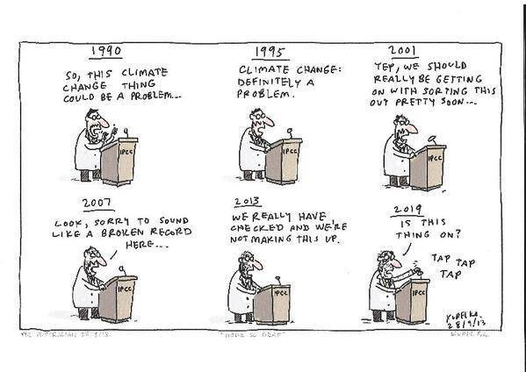

Slide 14
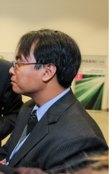
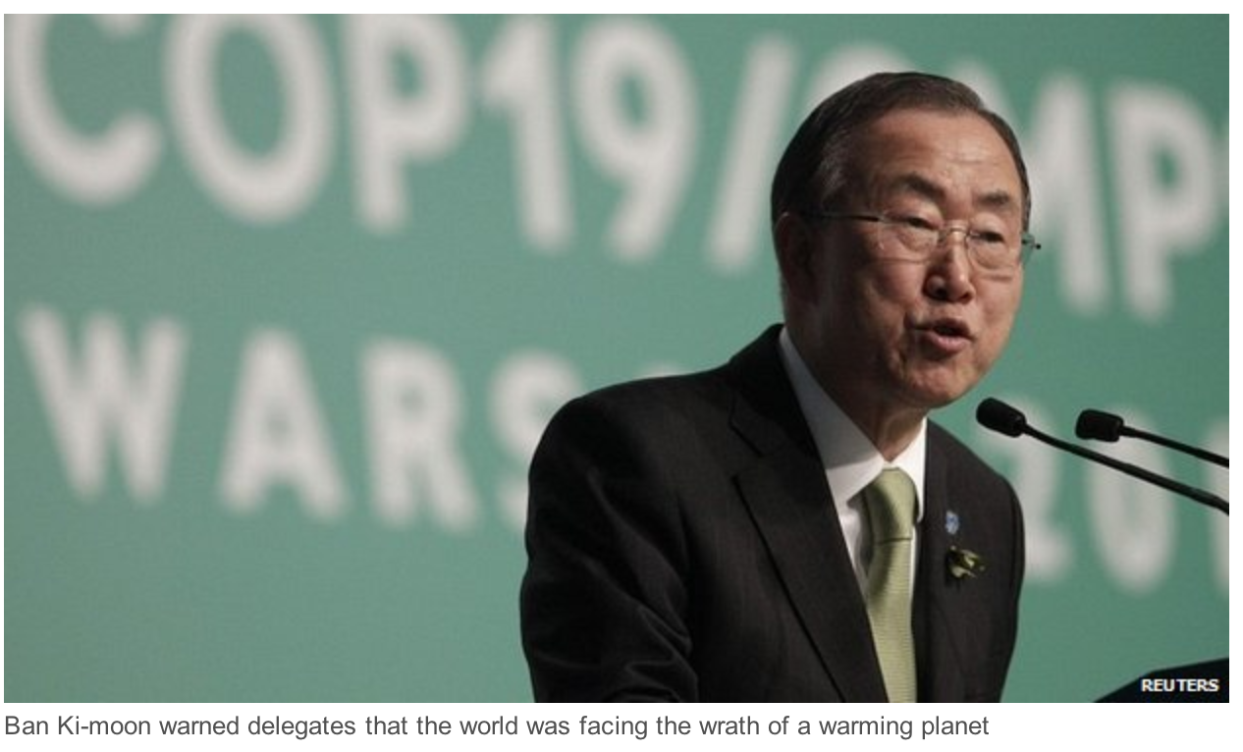
“Who will take legal responsibility for the loss and damage caused by climate change?”
Naradev 'Yeb' Sano, Head of the Filipino Climate Delegation
Ban Ki-moon Secretary-General of United Nations
"We can fix this. We can solve this madness. I ask of all of us here, if not us, then who?

Slide 15
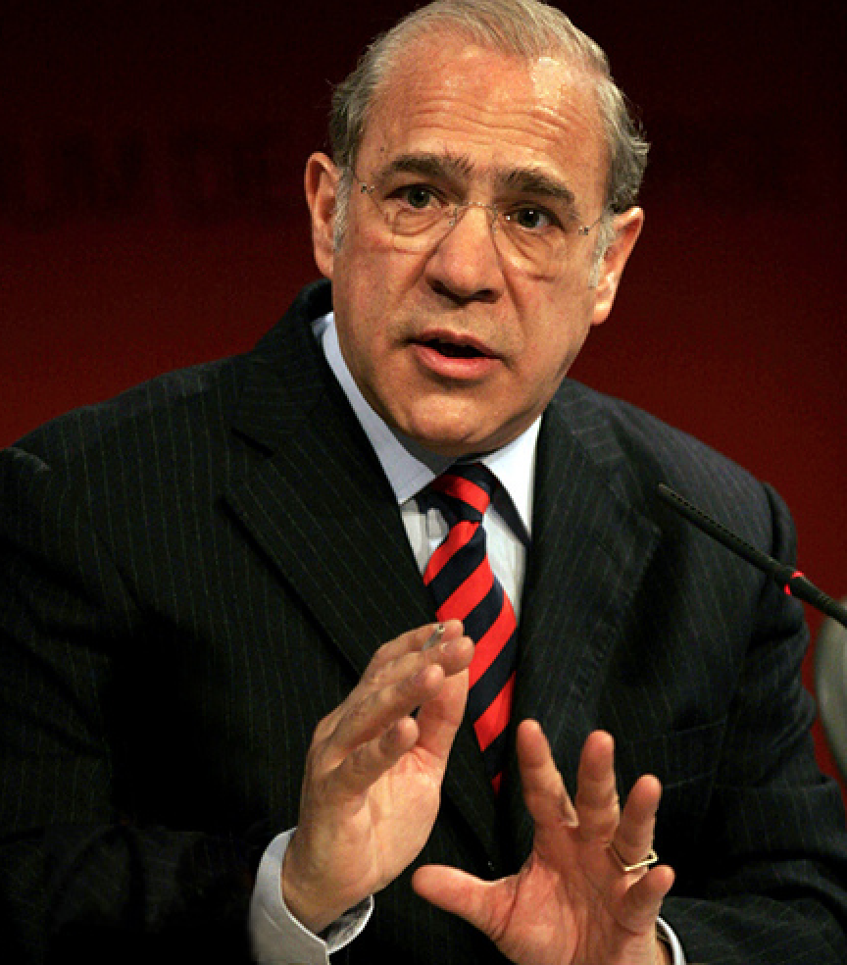
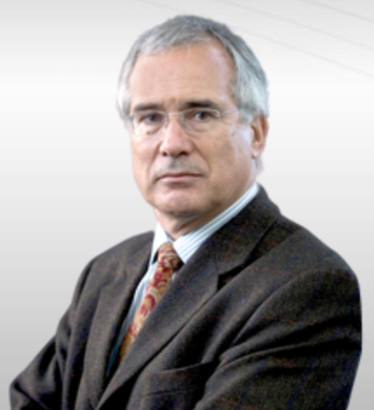
“Unlike the financial crisis, we do not have a climate bail out up our sleeves”
“It would be absurd to underestimate climate change risks”
Angel Gurria -
Head of the Organisation for Economic Co-operation and Development (OECD).
Lord Stern, Economist and author of the Stern Review

Slide 16
Business Students’ demand for climate change education (Yale Study 2016)
96% think businesses should be leading efforts to address climate change
64% want environmental sustainability integrated into both core curricula and career services/counselling at business schools
79% of students say they feel only “moderately” to “not at all” knowledgeable about how to make business more environmentally sustainable
Yale, CBE, GNAM, WBCSD, 2016. Rising Leaders on Environmental Sustainability and Climate Change: A Global Survey of Business Students. Available online at
http://cbey.yale.edu/files/Rising%20Leaders%20on%20Environmental%20Sustainability%20and%20Climate%20Change%20Nov_2015.pdf

Slide 17
Carbon Literacy Training for Business Schools (CL4BS)
1.‘Climate Change, Business and You’: General module introducing the science behind climate change and the relevance of business to climate change.
2. ‘Application to function’ will be newly developed for this project: Carbon Literate Accounting, Design Entrepreneurship, Economics, Marketing, Operations and Organizational Behaviour.
3.‘Carbon Literate Action’ will be designed in a way that it will be applicable to all disciplines.

Slide 18
Carbon Literacy Training for Business Schools- ‘Carbon Literate Executive Leadership’
‘Carbon Literate Executive Leadership’ will be designed as a three hour version but also encompasses the three step approach:
Intro to Climate Change and the relevance of the business sector to climate change;
A specific module focused on best practice for executive leaders of business schools and
A commitment section outlining the actions to be taken.

Slide 19
Module 1 Development Day with oikos international
Thursday 05.07.2018
9-10.00 Focus Group: Business Students' perception of climate change
10.00-13.00 Training with Emma Charlotte Richards, Project Coordinator, The Carbon Literacy Project 14.00-15.00 Focus Group: Business Students' perception of climate change after training
15.00-16.00 Development of new business school adapted version with Dan Jackson (Former Production Manager, Coronation Street, now producing sustainable stories as freelance writer/producer)
17.00-19.00 TILT event
Friday 06.07.2018
9.00-10.00: Climate Change Songs with Glenn Fosbraey, University of Winchester
10.00-13.00 Development of new Climate Change training for Business schools with oikos international and NBS students and Dan Jackson and Glenn Fosbraey

Slide 20
Carbon Literacy Training-Origins
More info: www.carbonliteracy.com
Non profit, Manchester based, over 8000 certificates issued
Recognised as globally unique at COP21
Applicable to any industry
CL is a certified framework for a day’s worth of action based climate change learning
Whole University Approach: CL at MMU paid for by their Environment Education Fund - which is paid for by uni energy saving and pegged to overseas students’ air miles

Slide 21
Research with ‘Coronation Street’ about their Carbon Literacy Training

Slide 22
TV’s greenest show….
O3.07.2015 Coronation Street named TV's greenest show
The ITV soap was praised for their recycling and using electronic scripts as they picked up the prize in the Film and Television Industry category at the Observer Ethical Awards…..
“Coronation street aims to be the first carbon literate television programme in the world and we are training all our cast and crew in carbon literacy to understand what it’s all about and how they can take control at work and at home. Our sustainability work is an ongoing journey and now an integral part of the day to day workings of the programme.”
https://www.manchestereveningnews.co.uk/whats-on/film-and-tv/coronation-street-named-tvs-greenest-9577170

Slide 23
Coronation Street Hosts First Carbon Literate Organisation Awards (2016)
As many of you may already know, we held our inaugural Carbon Literate Organisation Awards in November – in Nick’s Bistro on the set of Coronation Street – as hosted by ITV Studios. Even if we do say so ourselves the awards were an absolutely fantastic success, with the Project accrediting no less than fourteen organisations as Carbon Literate Organisations (CLOs)….. They include Manchester Museum, engineering firm Jacobs, Peel Media, Northwards Housing, BBC Children’s and the Coronation Street production team.
(http://www.carbonliteracy.com/carbon-literate-organisation-awards/)

Slide 24
ALBERT (http://wearealbert.org/about/what-is-albert)
Albert exists to support the UK production and broadcast industry’s transition to environmental sustainability, working in collaboration to accelerate the adoption of best practice.
albert is a collaborative BAFTA, indie and broadcaster backed project that provides the film and TV industries with the necessary expertise and opportunities to take action on environmental sustainability. The project aims for all UK screen content to be made in a way that benefits individuals, industry organisations and the planet. Delivered against the following objectives
to reduce the environmental impact of the production process
to enable industry organisations to realise the environmental aspect of their stated vision and its implication for audience engagement

Slide 25
ALBERT: Calculator (https://calc.wearealbert.org/uk/)

Slide 26
ALBERT: Certification (http://wearealbert.org/certification#endeavor-series-5)
A growing number of productions have gone through the albert certification scheme. They are listed below with a summary of their greatest achievements.
These production achieved a three star albert certification rating (***)
Endeavor (series 5)
With environmental posters in front and behind the camera, the Endeavour team put in a mammoth effort to mitigate their impact with material donation, sustainable catering and travel reductions.

Slide 27
ALBERT: Carbon Literacy Training (http://wearealbert.org/help/get-trained)
A national training scheme, Carbon Literacy provides the TV + film industries with the skills and tools to mount a non-political, optimistic, science-based response to climate change. Delegates will be presented with
a detailed introduction climate change and its personal and professional implications
an opportunity to explore the environmental impact of professional and personal activity
a summary of the roles of government, businesses and communities
examples of good practice, tools and practical solutions to support positive action
the skills to appraise performance and the inspiration to take further action
Training for leaders, producers, technologists, on request, get in touch.
Training for those in production, date available:

Slide 28
Research questions
A) How has carbon literacy training been effectively embedded in the responsible management education within ‘Coronation Street’?
B) Looking at carbon literacy as a whole, which part of the training did the managers/employees perceive as influential on their behavioural change?
C) Which components of the carbon literacy project were therefore the most influential on the learning of the managers/employee?

Slide 29
Methodology
Analysis of the teaching material provided by Cooler Projects CIC, BBC and ITV
Interviews with the creators of the training; participation in the training
Interviews with all Heads of Departments (Editorial, Production and Post Production) in the production unit of ‘Coronation Street’
Interviews with one Actor
Observing Carbon Literacy Training

Slide 30
Impact
“We have 300 to 400 people working here, and drama by its nature has always been transitory, so it’s about working right across the production to change,” says Sandison, “whether that be the art department or recycling old sets [Corrie has achieved an impressive 90% recycling rate for its waste streams] or making sure that new wood is from sustainable resources. We also have an allotment and we’re growing some of our veg on site here, too.” (https://www.theguardian.com/environment/2015/jul/02/observer-ethical-awards-2015-winners-coronation-street)
Storyline: Bag for life

Slide 31
Finding 1: Important elements
First part ‘Introduction to Climate Change’ introducing the science behind climate change and its relevance to television industry
Second part ‘Application to function’ addressing the challenges within a costumes or lighting department in ‘Production Module’ but also ‘Executive Team Module’ exists
Third part ‘Commitment’: Action taken in private life and in work context

Slide 32
Findings 2 The following parts of the training were seen as most influential:
Peer-to-peer training
Social learning
Shift in locus of control
Best practice/Action strategies
Active commitment

Slide 33
Literature used for first paper
Social learning theory :
strands of social learning as conceptualised by Keen et al (2005)
locus of control (Peyton and Miller 1980)
self-efficacy (Bandura 1977)

Slide 34
Strands of social learning (Keen et al. 2005)
Strand: Reflection through sharing of experiences, ideas and environments with others. Reflexivity leads to new learning in a number of learning cycles.
Strand: Adoptions of system orientation and systems thinking to understand “the larger whole” and the relationship between parts.
Strand: Concepts of integration and synthesis and requires holistic frameworks which enable the analysis of the complexity of the world rather than to compartmentalise and divide.
Strand: Notion of negotiation and collaboration. Wals (2007): Collective goals and shared vision, space for alternative visions and dissonance.

Slide 35
Strands of social learning (Keen et al 2005) cont.
5. Strand: Notion of collaboration and participation processes.
Learning enabled through a range of participation types.
Single, double and triple loop learning.
Triple loop learning: Change in values and norms leading to change in assumptions.
Participatory approaches combined with multiple loop learning.

Slide 36
References
Bandura, A. (1977). Self-efficacy: Towards a Unifying Theory of Behavioural Change, Psychological Review Vol 84, No.2, 191-215
Keen, M., Brown, V. A., and Dyball, R. (2005). Social learning in environmental management: Towards a sustainable future, Routledge.
Peyton, R. B. and Miller, B. A. (1980) Developing an internal locus of control as a prerequisite to environmental action taking. In: Current Issues VI: The Yearbook of Environmental Education and Environmental Studies (Ed, Sacks, A. B.) Clearinghouse for Science, Mathematics, and Environmental Education, Columbus, Ohio, pp. 173-192.
Wals, A. E. (2007). Social learning towards a sustainable world: Principles, perspectives, and praxis. Academic Pub, Wageningen.

Slide 37
Song ‘Pass it on’
https://www.youtube.com/watch?v=VwgbFjb6Ado

Slide 38
Contact:
Dr Petra Molthan-Hill: petra.molthan-hill@ntu.ac.uk

