Slide 1
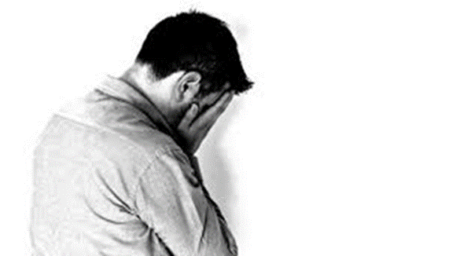
Understanding the Impact of Restrictive Punishment Regimes on Self-Harm Behaviours
Dr Karen Slade
Associate Professor in Applied Forensic Psychology
Karen.slade@ntu.ac.uk

Slide 2
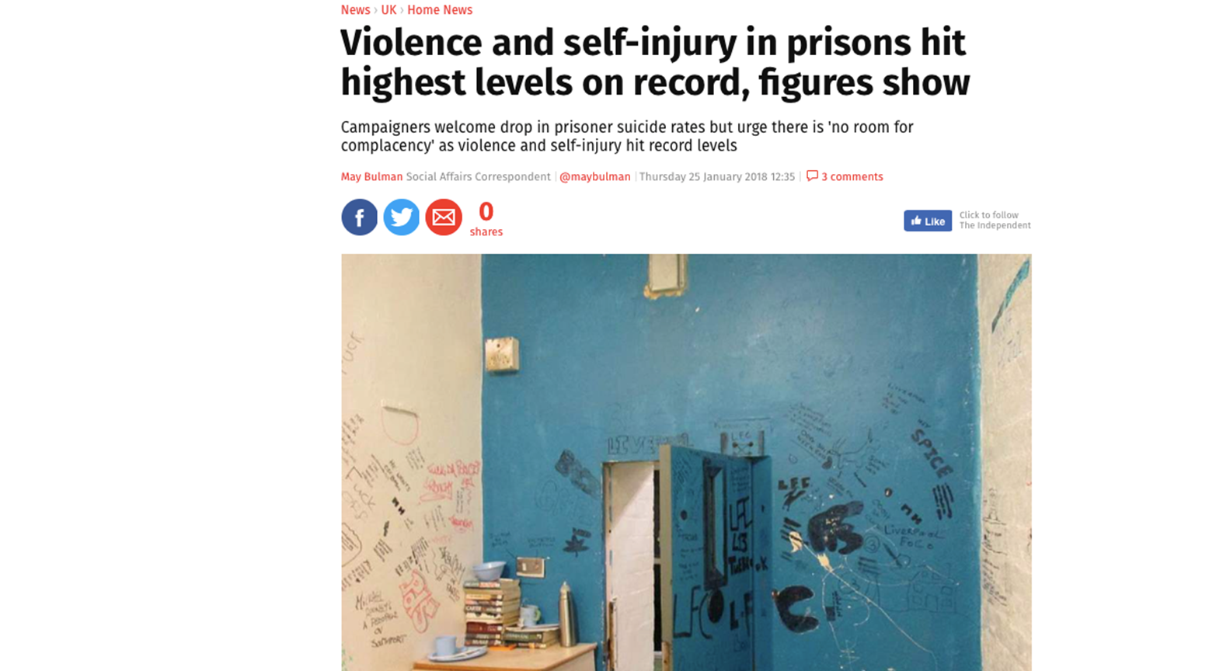
In most prison settings, violence and misconduct towards others is dealt with by punishment and control to ensure the protection of others, whereas self-harm (with or without suicide intent) elicits care and compassion, to protect the person and reduce the risk they present to themselves (Slade, 2018).
This distinction mirrors the wider departmental separation that usually occurs between the justice (or correctional) sector and the health sector.
However, as our understanding of these behavioural entities has started to change, so does the need to reconsider existing strategies.

Slide 3
Restrictive (Punishment) regimes

Slide 4
Basic regime
Segregation

Slide 5
Segregation
We will consider two practices used within prison settings.
Segregation, for example, is often used as a form of punishment, whereby a person is separated from the wider prison community, usually within a small unit under high restriction.
However it is also recognised as a high-risk area for suicide (Prison and Probation Ombudsmen, 2015) which has led to some screening and safeguards being implemented (e.g. fitness assessments; those at suicide risk under exceptional circumstance only).
In the USA, people who harm themselves are far more likely to be currently or have been previously held in segregation (Kaba, Lewis, Glowa-Kollisch, Hadler, Lee, (…) , 2014; Lanes, 2010).

Slide 6
Basic regime
Meanwhile, within the prison estate in England and Wales, the Incentives and Earned Privileges Scheme uses a number of levels, across which privileges are removed when behaviour is poor, and returned when it improves.
The resulting restrictions on movement, activities and interactions within the prison are meant to have a beneficial effect on levels of poor behaviour.
However they may also have a harmful effect on suicide risk and general mental wellbeing because they do not take into account the dual nature of violence and self harm amongst many people (Prison and Probation Ombudsman, 2018; Prison Reform Trust, undated) .
There are no current safeguards or screening for vulnerabilities in place for Basic Regime.

Slide 7
Hypotheses
Those with greater experience of RR will have a greater number of self-harm events (both under RR and overall).
The experience of restrictive regimes increases the risk of the use of lethal SH methods.
Those who dual harm (both self-harm and violence) account for the majority of experience of RR in the self-harm sample

Slide 8
Setting
Setting
Male prison in England
Medium secure (Cat B) ‘Local’
Sample as resident on 1 November 2017
Conviction status
35% remand
52% determinate sentence
2% indeterminate/life sentence
11% licence recall

Slide 9
Method
Data: Routinely gathered detailed incident, location and demographic data from prison PNOMIS electronic database system from 2010 – 2017.
Each participant (N = 965) had demographic, current offence, incident dates and incident types, dates of segregation and placement on basic regime recorded.
Further details on method and severity of self-harm behaviour was also gathered, if applicable.
All times in prison and segregation/Basic regime were included since 2010
Time in prison and under segregation/basic were calculated removing any periods in the community.

Slide 10
Sample
175 (18.13%) of the sample had an incident of self-harm recorded in prison
ANOVA confirms that the men who SH in prison had spent more years in prison compared with men who did not SH
SH sample: M = 3.72 ( SD = 2.5 )
non-SH sample (M = 1.52 (SD= 2.37)
(F = 121.53; p <.001)
And were of a younger current age
SH sample: M = 31.3 (SD = 8.12)
non-SH sample: M = 35.82 (SD = 12.6)
(F = 23.114; p<.001)

Slide 11
Results

Slide 12
Relationship between RR and self-harm
Of the 175 in the sample, 96.1% (151) had experienced either regime.
There were a high number of RR experiences for those who had self-harmed in prison ; Md = 7 (28% had 1-2; 72% had 3+).
41% (62) had self-harmed whilst under one or both regimes with 11.5% of all self-harm occurring whilst under a RR.
Nearly one-quarter (24%) had their first ever recorded prison SH whilst under their first RR.
Pearson correlations confirmed that:
There was a strong relationship between #of SH under RR and both the # of RR experiences (p<.001; r = .661) and time spent under RR (p<.01; r = .511)
There was only a moderate relationship between overall # of SH events (both in and out of RR) and both the # of RR experiences (p < .01; r = .243) and time under RR (p<.05; r = .183)

Slide 13
Lethal self-harm methods
Of those with RR experience:
One quarter had used ligature as their first ever recorded SH.
With almost half (43%) of these first ligatures occurring whilst under earliest RR experiences.
Of those without RR experience:
Only one in twenty had used ligature as their first recorded SH.
Logistic regression confirmed a significant relationship between the first ever SH occurring under RR and this first SH using a ligature (versus non-lethal method) p < .05, Exp (B) = 2.039, 95% CI –1 -4.15.
What does this mean?
That if the first self harm occurs under either segregation or basic regime, it is twice as likely to be using a ligature.

Slide 14
The impact of dual harm

Slide 18
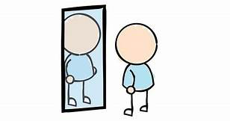
Reflections
Most prisoners who self-harm in prison will experience RR on multiple occasions.
The greater number or the longer time spent under RR, the more self-harm behaviours will occur.
Of concern regarding the damaging potential of any RR experience, there is a relationship with early engagement with lethal methods of SH.
Overall, men in the dual harm group spent, on average, 2-3 times as many days under both regimes than those either in the assault or self-harm group.

Slide 19
There is conflict between the systems with significant numbers of men who self-harm experiencing punishment regimes which include a reduced level of social contact, support, coping resources and protective factors.
Men who are repeatedly placed under restrictive punishment have less access to positive influences and community supports which we would see as important for suicide and self-harm prevention.
If utilised, the need for greater safeguards around Basic Regime is clearly important (e.g. identifying current vulnerabilities around suicide, mental health concerns or support needs) due to the increased risk on earliest experience and the cumulative effects.
Those who dual harm are clearly at greatest risk. The growing body of knowledge about dual harm supports moves to consider effective alternatives to restrictive regimes or in adapting existing models to be more responsive and especially health and justice colleagues not separating self-harm from violence in their approaches.

Slide 20
Published Papers
Slade, K. (2017) Dual Harm: An exploration of the presence and characteristics for dual violence and self-harm behaviour in prison. Journal of Criminal Psychology, 8(2): 97–111.
Slade, K., Forrester, A. and Baguley, T, (under review) Co-existing violence and self-harm: dual harm in an early-stage male prison population, Legal and Criminological Psychology
Please contact me if you’d like the slides, papers or interested in research or practice avenues: karen.slade@ntu.ac.uk

