Slide 1
Public Administration Committee Northumbria University September 16th -18th 2019
A generic evaluative model for performance regimes and national frameworks in the public sector.
Pete Murphy
Nottingham Trent University

Slide 2
National Frameworks The context, the parameters, the agencies and the relationships operating within the three domains of policy development, service delivery and public assurance in public services
Central Government (Spending Reviews and PSAs)
Local Authorities (Best Value, CPA, CAA, SLI)
Schools and Education (Ofsted inspections CPA Safeguarding)
Health and Social Care (Standards 4 Better Health; World Class Commissioning, NHS operating mandate)
National Parks (National Assessments and Peer Reviews)
Regional Development Agencies
Criminal Justice HMIC; HMIP; HMIP; HMI Courts; CPS and HMICFRS
Universities REF 2021

Slide 3
The purposes of the model
Identify the underlying principles and assumptions of working in and operationalising the delivery of public services in the public interest
Helps to identify the situational or contextual constraints which may be short term parameters to action (although they may be variable in the medium to long term)
Illustrates the relationships between different parts of a performance regime and helps understand any dependencies and reciprocities
Facilitates the evaluation, analyses and comparison of individual performance regimes or national frameworks

Slide 4
A model for national frameworks and performance regimes
Principles of Public Service
7 ‘Nolan’ Principles
Situational or contextual constraints
Legislative framework
Resource Envelope
Organisational Landscape
Core areas or domains
Policy development,
Service delivery
Public assurance

Slide 5
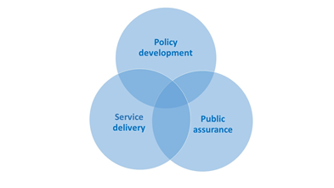
Details of the core areas

Slide 6
The evaluative and analytical ‘lens’
The duty to facilitate continuous improvement in the services and activities provided by public authorities
A redefinition of Value for Money to be measure by a combination of economy, efficiency and effectiveness (equality and sustainability)
Where appropriate encourage partnership or collaborative working and adopt the legal concept of multiple and several organisational responsibility for addressing wicked problems or issues

Slide 7
The evidence base Quality, Quantity, Analysis and Transparency
Data
poor
Data
Rich
Intelligent
Data
Self-
Regulation
Little or no data and intelligence and predominantly hoc in nature
Quality assurance of the information processes and systems is variable and poor/unfit for purpose
Lack of benchmarks and standards mean comparability is difficult, impractical or impossible
No overall national perspective or national framework
A mixture of qualitative and qualitative data and intelligence exists
Subjective and objective measures, with both absolute and relative measurements available
A mixture of input, output and outcome indicators and/or measures and a degree of internal and external quality assurance
The data is primarily operationally or organizationally focused
Sector or system-wide real time data and intelligence available at a publically accessible single depository (web based)
Sector-wide, quality assured and standards based objective and subjective metrics and measurements
Robust, sophisticated, public and freely available, interrogative, analytical and interpretive tools
Detailed and comparable short medium and long term data on trends and comparisons both national and international
Facilitates and promotes international, academic, professional and operational research
Sector wide identification and dissemination of good practice, learning and innovation
Independent, quality assured, open and transparent international ‘host’ for a comprehensive database
Built in improvement and quality assurance as fundamental to its purpose

Slide 8
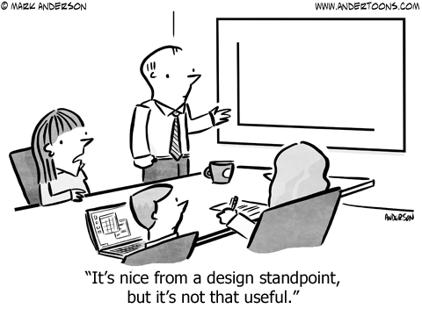
The evidence base in Fire and Rescue
Insufficient amount of evidence
Insufficient quality of evidence
Inadequate analytical tools
Insufficiently transparent analysis of evidence
Inadequate accountability

Slide 9
The 5 National Frameworks since 2004
2004
Modernisation and an implementation plan for the 2004 Acts?
2006
People, communities and fire safety - the development of a longer term perspective.
2012
Austerity-Localism, cutback management and abdication of central government responsibility
2008
Collaborative place making as the new strategic intent with a more focused and strategic plan
2018
Revisionism - mea culpa (T. May) but is it as comprehensive or fit for purpose as it claims?

Slide 10
How do they compare?
2004 - 2006
Strengths | Weaknesses
New paradigm and strategic intent | The regional agenda/Regional Management Boards
Introduced Integrated Risk Management Planning | The evidence base and weak external scrutiny
Co-production and collective responsibility | Implementation and HRM issues
2006 - 2008
Strengths | Weaknesses
Long-Term vision with whole sector buy-in | The regional agenda and Regional Management Boards
Alignment of local priorities and objectives | The evidence base (improving but not strong)
External support and improvement infrastructure | Rapidly changing strategic and operational landscape

Slide 11
2008 - 2011
Strengths | Weaknesses
One Place agenda | Drafted during economic and political changes
Prevention, protection and local priorities prominent | Equality and Diversity (lack of)
Performance, evidence and scrutiny arrangements | Interrelationship with Comprehensive Area Assessment
2012 - 2017
Strengths | Weaknesses
Addressed new challenges and risks (terrorism, ageing population, climate change) | Abdication of leadership and management by central government (DCLG)
More flexibility for Fire Authorities | Increased demand and reduced resources
 | Short-termism cutback management/austerity localism
 | Little evidence or support

Slide 12
The 2018 Framework
Strengths | Weaknesses
New national bodies (NFCC, Standards Board) | Lack of central government engagement, leadership responsibility
Attempts to address performance inadequacies | Resource reduction still the key strategic intent
Re-introduces external inspection | No inspection of governance or strategic decision making
New duty to collaborate with other emergency services | Duty limited to emergency services
Promises of improved evidence | Promises undelivered or under-delivered
Potential new governance arrangements | No response to Grenfell or Hackitt included

Slide 13
Conclusion 1 Any performance regime of national framework that seeks to be comprehensive has to cover policy development, service delivery and public assurance and be cognisant of their interrelationships and interdependencies
Why?
Key partners and collaborative stakeholders, particularly those in multi-agency and joint and collectively responsible operating environments (such as local authorities and the NHS in their respective sectors; or the Police, Fire and Ambulance Services), need this information and assurance if they are to continually improve their respective services and meet their individual and collective responsibilities to the public.

Slide 14
Conclusion 2 Even when brought together and clearly articulated in robust performance management regimes this is insufficient, of itself, to guarantee or ensure that improvements in these areas always follows
Why?
Policy development, service delivery and public assurance systems are all dependent for their economy, efficiency and effectiveness, inter alia, on robust, reliable evidence and appropriate interrogatory mechanisms. In England these have been disintegrating and deteriorating and government have effectively abandoned evidence based policy development and service delivery

Slide 15
And A consistent feature of recent governments and their advisers is their failure to learn from (or in some case even acknowledge) notable or good practice from alternative or previous regimes and frameworks, or from experience in other services or sectors. They demonstrate a regrettable insularity to innovations, and initiatives from previous administrations and from international practice.
As a result
Conclusion 3
From 2010, the performance management arrangements in England were not delivering joined up policy development; service delivery was sub-optimal and public assurance was deteriorating.

Slide 16
Any Questions?

