Slide 1


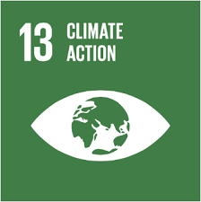




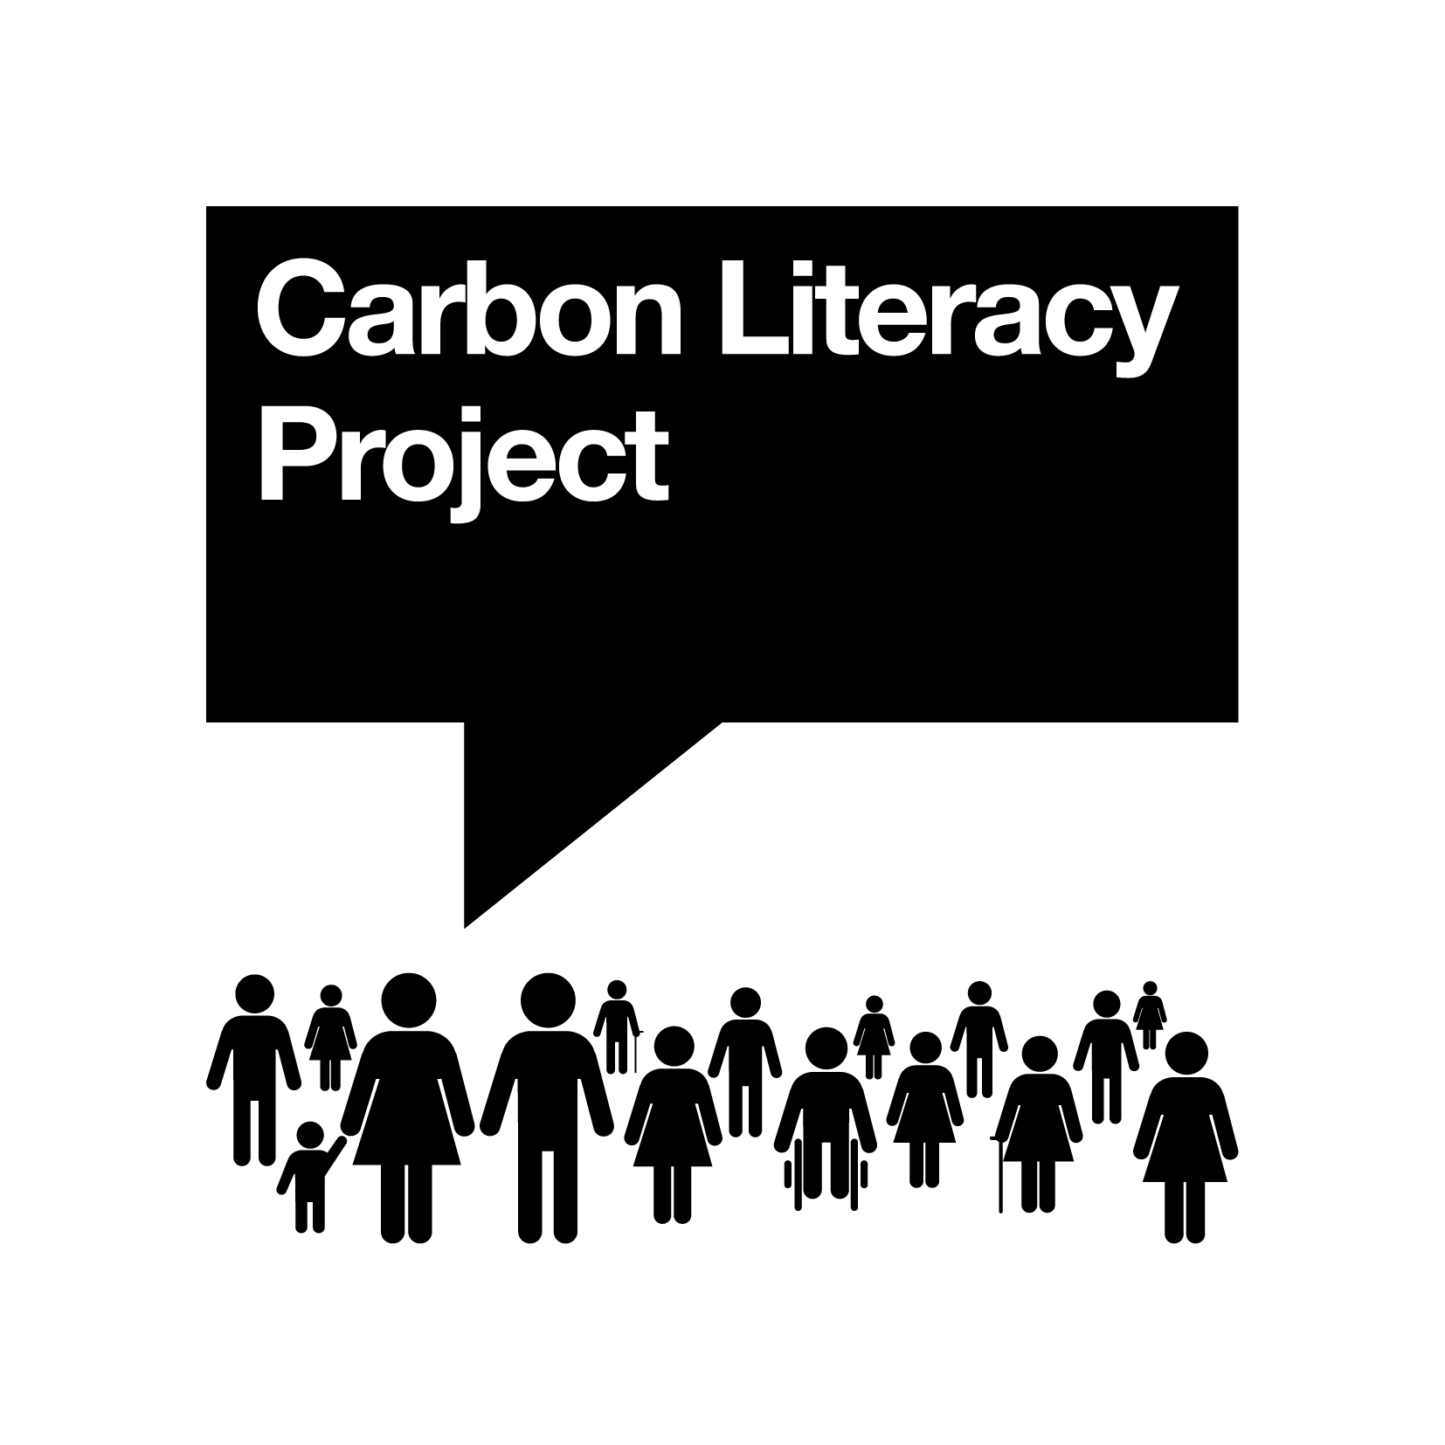

Carbon Literacy Project for Business Schools (CLP4BS)
Focus ‘Carbon Literacy in Accounting and Reporting’
What is Carbon Literacy?
Innovative Intellectual Outputs
Opportunities for Corporate Organisations
“An awareness of the carbon dioxide impacts and costs of everyday activities, and the ability and motivation to reduce emissions on an individual, community and organisational level”.
Work together to document the tools used in carbon accounting
Set up a KTP for example to develop best practice tools with organizations and provide overview on research projects around this topic globally
We can prepare work-based training material in the public and private sector as an integral part of this project.
We can offer to prepare best practice into case studies and provide training for employees.
Successful participants and their organisations are accredited by The Carbon Literacy Project.
O1 ‘Climate Change, Business and You’ Toolkit
O2 ‘Carbon Literate Accounting’ Toolkit
O3 ‘Carbon Literate Design Entrepreneurship’ Toolkit
O4 ‘Carbon Literate Economics’ Toolkit
O5 ‘Carbon Literate Marketing’ Toolkit
O6 ‘Carbon Literate Operations’ Toolkit
O7 ‘Carbon Literate Organisational Behaviour’ Toolkit
O8 ‘Carbon Literate Action’ Toolkit
O9 ‘Carbon Literate Executive Leadership’ Toolkit
Training packages available via ABIS and PRME networks!
Who is it for?
79% of business students feel ‘moderately’ to ‘not at all’ knowledgeable regarding environmental sustainability
64% want environmental sustainability to be integrated into the curriculum
61% want more faculty and staff with expertise in sustainability (Yale Study, 2016)
Barriers= Skills shortage, lack of knowledge
Action= Training required for academic staff and students
CARBON ACCOUNTING MODULE
Opportunities for Academics and Universities
Methodology
Part 1: Climate Change, Business and You
Part 2: Application to Functions
Contributions of business disciplines to climate change
Six modules will be developed, best practices shared
Part 3:
Commitment
Staff and student action
Action Plan to integrate climate change education
Provide academics with action activity for students
Involving industry experts and international students
Applicable to all core business disciplines
Peer-to-peer development and training process
Innovative material
Climate change science and relevance to businesses
Material offered as a toolkit
What is carbon accounting? How far have we come?
The context and drivers for carbon accounting
Regulatory and compliance requirements for organisations
Best practice in carbon accounting and reporting
Understanding emissions trading scheme
Understanding emission reduction and management strategies
Collaboration with experts in carbon accounting to design it with us and share best practice teaching tools
Project Partners
Contact:
Caroline A. Pontoppidan,Ph.D.
Academic Director PRME, CBS
Email: cap.acc@cbs.dk
Lavinia Iosif-Lazar
Project Lead PRME, CBS
Email: li.edu@cbs.dk
If interested in our other CLP4BS modules e.g. operations please contact Dr. Petra Molthan-Hill, email: petra.molthan-hill@ntu.ac.uk

