Slide 1
The 24th Annual IRSPM Conference 20th - 23rd April 2021 , Public Management, Governance, and Policy in Extraordinary Times: Challenges and Opportunities Emergency Services Panel P07
How did the fire and rescue services in England respond to the COVID-19 pandemic?
Pete Murphy, and Katarzyna Lakoma
Nottingham Business School, Nottingham Trent University.

Slide 2
Introduction and Background
Legislation
The Civil Contingencies Act 2004 and “declaration of an emergency”
Public Health (Control of Disease) Act 1984 and the new Coronavirus Act 2020.
Reasons
2004 has stricter procedures for control of the government by parliament
The devolved administrations (Scotland, Wales, N. Ireland) are responsible for their areas and can follow different strategies – wasn’t important as they took a short term view.

Slide 3
Purpose of the Paper
Explore how the 45 FRS in England responded to the COVID-19 pandemic
Examine their collaborations with the police, ambulance and other core services that comprise Local Resilience Forums (LRFs)
Undertake an interim evaluation of the first phase of the pandemic
Bring together lessons learned to disseminate and inform policy and practice going forward.

Slide 4
Evidence, Data and Intelligence
The quality and quantity of data on FRS performance declined significantly between 2010-2018
Study draws on 3 primary sources of evidence,
An independent survey commissioned by the NFCC (March and September}
COVID-19 ‘themed’ virtual inspections from HMICFRs (September and November)
C19 National Foresight Group - a cross-government and multi-agency 10 month task and finish group to provide ”informed evidence rooted in practical strategy” for the long-term”
All 45 FRS co-operated in all three initiatives but all surveyed Key stakeholders

Slide 5
Findings A critical appraisal of the output of the 3 initiatives has been synthesised under 5 headings
Collaborative or collective actions across emergency responders
FRSs’ response and their response services
Prevention and Protection services
Support Services and support actions
The COVID-19 ‘Tripartite’ agreement

Slide 6
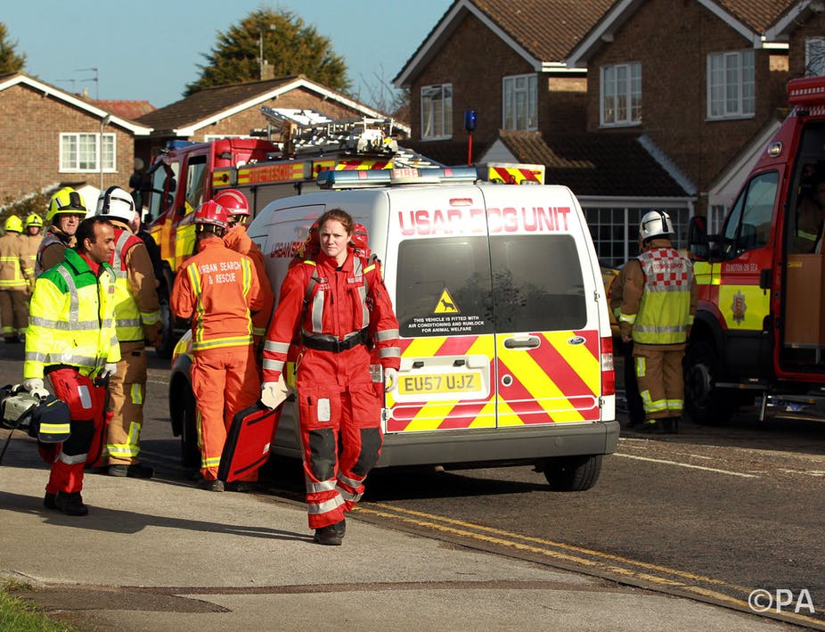
1. Collaborative actions
Strongly positive findings
LRF activity worked in a co-ordinated way, and LRF members effectively supported their communities
Strategic Coordinating Groups
Health chaired SCS
FRS often took the Tactical Co-ordinating Group lead
Weaknesses or inadequacies (NFG)
Inadequate data/information/intelligence -to inform the decision makers at all levels.
Asymmetric imbalance in vertical power and communication flows

Slide 7
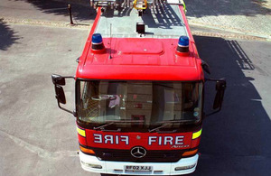
2. FRSs’ response and their response services
Strongly positive findings
“All services maintained their ability to respond to fires and other emergencies”
Weaknesses or inadequacies (NFG)
Inadequate data/information/intelligence -to inform the decision makers at all levels.
Asymmetric imbalance in vertical power and communication flows

Slide 8
3. Prevention and Protection Services
Strongly positive findings
Innovation and collaboration surged –as it got longer so did the number scope scale of innovative and creative systems, processes, activities and services wanted to contribute
Safe and Well clinic in the waiting area of vaccination hubs
Weaknesses or inadequacies (NFG)
Business as usual impossible/P&P severely curtailed or stopped
Early days some self-imposed over-reaction

Slide 9
4. Support Services and support actions
Strongly positive findings
Successful transition to working from home
Local digital transformation, procurement and the role of NFCC.
Protection of staff from COVID-19 absenteeism reduced while presenteeism diminished
Weaknesses or inadequacies (NFG)
Progress on national reforms virtually ceased
Friction with emergency systems/structures becoming embedded

Slide 10
5. The COVID-19 ‘Tripartite’ agreement
Strong positive findings
Early rapid response initiative “helpful nationally saved a lot of effort”
14 areas agreed by May
Weaknesses or inadequacies (NFG)
Only 2/3 (disputed) after June until agreement ended in Jan 2021.
Unfitness for purpose not recognised early enough
Inflexible and counter productive towards the end

Slide 11
Conclusions…. and next steps
LRF and local SCS worked well, national leadership poor
Historical inadequacies meant data, information and intelligence poor at national and local level
Communications experienced asymmetrical flows - horizontal communications excellent vertical were very poor
Local delivery (working from home) and support services worked very well (digital transformation, procurement, innovation in P&P)
Tripartite Agreement outlived its usefulness
Next steps the vaccination phase

Slide 12
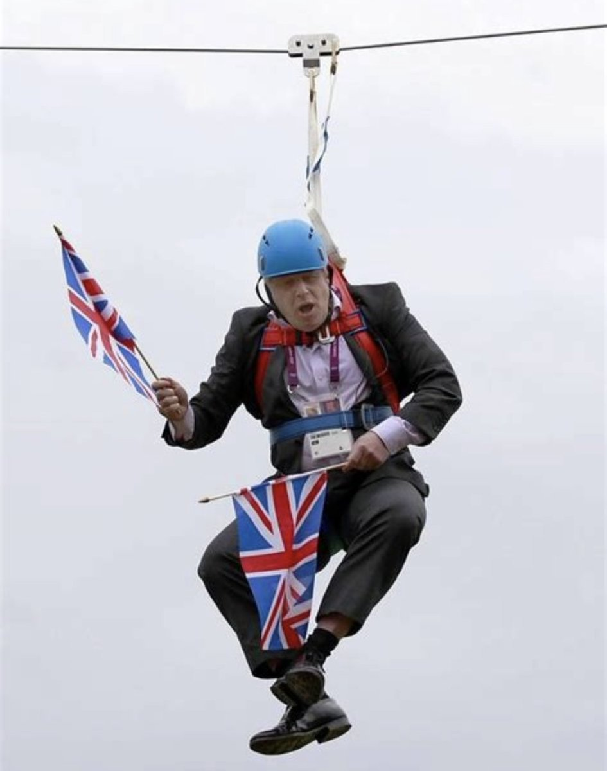
Thankyou for listening
Questions?

