Slide 1
Evaluating ‘Safe and Well Visits’ in Fire and Rescue Services in England
The 24th Annual IRSPM Conference Public Management, Governance, and Policy in Extraordinary Times: Challenges and Opportunities
20th - 23rd April 2021
Nottingham Trent University, Nottingham Business School
Katarzyna Lakoma and Pete Murphy
Notes:
Delete Prof

Slide 2
Background
Key FRS areas
Response – operational response to incidents (speed and quality of response)
Prevention – reducing the number of incidents occurring within people’s homes and communities (risk reduction)
Protection – ensuring public safety in the wider built environment (non-domestic buildings)
Statutory duties for FRSs with the introduction of the Fire and Rescue Services Act 2004
Over the last decade, the level of resources directed into prevention and protection activities has disproportionately declined
Notes:
Move 2004 after Act
Disproportionately declined

Slide 3
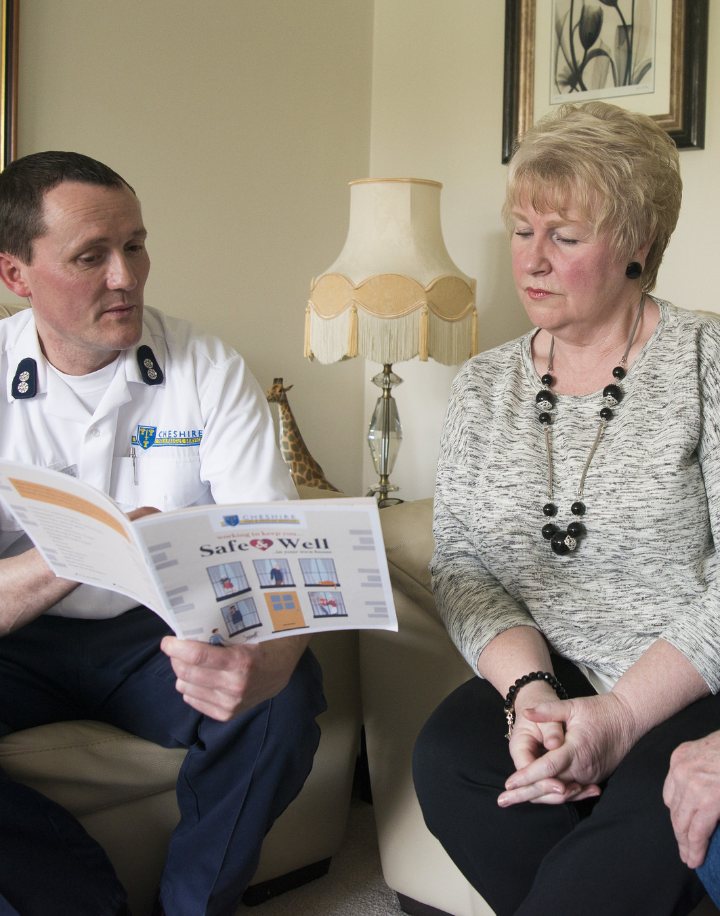
Prevention
Home Fire Safety Checks
Identification and raising awareness of potential fire risks,
Informing residents of potential actions to reduce or prevent these risks and ensure working smoke alarms are installed, and
Advise on an appropriate escape plan in case fire does break out
Safe and Well Visits
Build on existing good practice of Home Fire Safety Checks
Target the most vulnerable members of the community
Offer fire safety advice based on their household and lifestyle
Falls risk assessment
Smoking cessation
Cold homes and fuel poverty
Dementia
Social isolation
Responsibility to signpost and refer to partners
Home Fire Safety Checks (since 2004)
Safe and Well Visits (since 2018)
Notes:
Responsibility to signpost and refer to partners (have greater range of risks to be aware of)

Slide 4
Rationale behind the project
The ‘expanded’ assessments represent a change to the traditional delivery model
Each FRS has taken the Safe and Well Visits forward in its own way (HMICFRS 2020)
Considerable variation between the models and evaluations of the Safe and Well programme across English FRSs
No overall national strategy on how the fire sector uses data
“Nottinghamshire FRS has no performance management in place to ensure staff are making Safe and Well checks effectively… Nottinghamshire FRS has no targets for the completion of these checks, and the number carried out by each station varies considerably.”
(HMICFRS 2019, p.12)
Reduced capacity and capability for research and evaluation of FRS activities due to the central government funding cuts since 2008
Notes:
They had made some improvements in capturing data and actions since the inspection/COVID inspection and NFCC survey both been relatively positive to NFRS - wanted a critical friend to check, endorse targets and objectives and make sure if they weren’t missing anything

Slide 5
Research aim
Nottingham Trent University’s contribution to the academic assessment of the Safe and Well programme (Arch and Thurston 2013, Williams and Manning 2016, Yannitell and Chatsiou 2019, Clarke 2020, Mahmood et al. 2020)
Evaluating the Safe and Well Visits initiative to perform an assessment of the social and economic value/social return on investment of Safe and Well Visits
Drawing upon existing literature on vulnerabilities in the emergency services context to understand how Nottinghamshire FRS identifies vulnerable people (evaluation of CHARLIE profile)
Notes:
Should it mention that we were asked to check the use of CHARLIE? Profile (could be separate bullet point above)
This is not all they had to do because they wasn’t integrated into other systems and processes most notably there was no performance management system to integrate and drive the organisation

Slide 6
Data and the alternative evaluative techniques
Cost Benefit Analysis
Cost Effectiveness Analysis
Social Return on Investment
NHS Quality Adjusted Life Years
HMT Value of a Prevented Fatality
Notes:
Why SROI and not CBA, CEA and QALY?

Slide 7
We tested Social Return on Investment model
Key stakeholders | Outcome | Indicator | Data collection | Possible proxies
Recipients of Safe and Well visits | Increased awareness of fire risk at home and improved quality of life | Number of fire incidents experienced by participants after the visit, QALY | Evaluation and feedback survey (NFRS Safe and Well Visit Survey 2019/20 Report) | Cost of visiting private doctor clinic Cost of health insurance
Nottinghamshire Fire and Rescue Service | A reduction of fire risk and drop in demand for FRSs | Number of home fires, Number of deaths and injuries from accidental fires at home | Home Office/NFRS data | Value of a prevented fatality, Value of a serious injury, Value of a slight injury
Partner agencies (e.g. the NHS) | Increased number of identified vulnerabilities that become apparent during the visits | A number of referrals from and to partner agencies | Home Office/NFRS data
Local communities and central government | Safer communities, improved perception of the local area | Number of home fires , Number of deaths and injuries from accidental fires at home, Community Safety reports | Home Office/NFRS data Community Safety reports | Community Safety reports, Change in property prices, Amount spent on home improvements
Notes:
A social return on investment assessment was initially attractive to NFRS but because of long standing issues relating to the quality and availability of data at national and local levels (Levin at al. 2021, HMICFRS 2018, 2019, 2020, Murphy and Greenhalgh 2011, Murphy et al. 2019, 2020) together with the number and limitations of key assumptions that would have to be used it was decided to adhere to the BATNEEC principle of using the ‘Best Available Technique Not Entailing Excessive Cost’ and apply a Cost Effectiveness Analysis.
Spell out SROI
We tested a potential SROI analysis

Slide 8
Findings from the cost effectiveness evaluation
Safe and Well Visits are the most resource intensive when completed by Response Delivery Team (at least 5 members of staff in a fire appliance, average £124.26 per visit) in comparison to the visits conducted by Prevention Team (1 member of staff, average £36.09 per visit)
Prevention specialists allocated the most challenging visits
 | 2017/2018 |  | 2018/2019 |  | 2019/2020
Wholetime Crews | 2636 | 69.7% | 3192 | 75.7% | 5270 | 68%
On-Call | 26 | 0.7% | 338 | 8.0% | 1441 | 19%
Prevention | 1122 | 29.7% | 689 | 16.3% | 1041 | 13%
Total | 3784 | 100% | 4219 | 100% | 7752 | 100%
Notes:
Prevention specialists allocated the most challenging visits
Nevertheless Clear room for improvement in resource allocation and case mix allocations to improve service delivery

Slide 9
Lessons for the future
Optimise resource inputs to case mix
Quality assured delivery of Safe and Well Visits
Pre and post intervention risk assessments
Safe and Well targets for all stations based on delivery team type
Pro-actively quality assurance of partner referrals
Regular review of performance data to understand how prevention activities can be more focused
Work with others to facilitate robust SROI model
Notes:
Pro-active quality assurance of partner referrals
Optimise resource inputs to case mix (Clear room for improvement in resource allocation to improve service delivery )
Work with others to facilitate robust SROI model

Slide 10
Vulnerable groups
“Those at greatest risk from fire” but also individuals with “wider vulnerabilities and exposure to risks beyond fire”
(Home Office 2018, p. 6)
“People less able to help themselves in case of an emergency, for example people with mobility problems, people with mental health difficulties, and children”
(HMICFRS 2021)
Overlapping definitions being used by three emergency services (Addidle and Liddle 2021),
Vulnerability to fire increases as people age (Kose 2000, Fernandez-Vigil and Echeverrıa Trueba 2019) and increases further by living alone.
People who are elderly, disabled, and those with mental health and neurological problems are more vulnerable to fire (Taylor et al. 2019, 2021)
Faulty or misuded electrical items can be a factor increasing risk of fire (Elder et al. 1996)
Importance of common arenas for cross-sector collaboration for fire risk prevention that go beyond the boundaries of FRS (Halvorsen et al. 2017)
Dynamic change with regard to the COVID-19 pandemic and targeted cyber crime
Notes:
The challenge is dynamic – perhaps mention targeted cyber crime and scams during the pandemic

Slide 11
Identifying vulnerable people by NFRS
Partner organisations (CHARLIE matrix, which stands for Care and support, Hoarding, Alcohol, Reduced mobility, lives alone, Inappropriate smoking, Elderly)
Referrals from members of the public for themselves, friends and families (sifted using the CHARLIE profile)
Direct engagements (data-led process)
Notes:
Include what ‘CHARLIE’ stands for
It is fit for purpose but could be refined further
NFRS instigated direct engagements since inspections

Slide 12
Lessons for the future
Target the most vulnerable people – the elderly, the disabled and those with mental health and neurological conditions.
Address imbalance between ethnic groups receiving Safe and Well Visits
Examine the patterns across fire fatalities victims and fire injuries at home in Nottinghamshire
Continue working with partners to identify vulnerable people
Incorporate the following data into the model:
long-term health problems
disability
mental health data from NHS Digital,
living alone data
All referrals from external organisations should meet the service’s targeting profile
Notes:
First box into two boxes – gives us six boxes – could be 3 boxes on bottom row two on second row and one on top
We are asking them to revisit a number of targets including externals referrals this could be final box on top –
First 3 boxes about data and information Second row of two boxes (Address imbalance and examine patterns) with pinnacle box – review of objectives and targets such as target for referrals meeting profile

Slide 13
Summary conclusions
Regular review of performance data, including the pattern of fire fatalities, to understand how prevention activities can be more focused (NFRS and other services)
Balancing response to incidents with prevention and protection (all FRS)
SROI analysis to benchmark against other services (NFCC)
Long-term economic and social impact of the Covid-19 pandemic on the future demand for emergency services (core emergency services)
Importance of partnership working in identifying vulnerabilities (wider emergency services)
Notes:
Review case mix within resource envelope available – this is not just finances
SROI both feasible and highly desirable but requires development data and multi-FRS buy-in (NFCC)
All FRS need to balance…
NFRS (and other services) ….
NFCC and HMICFRS or groups of FRS….
The wider emergency service sector needs to recognise….
Core –fire ambulance police emergency services …COVID-19
Reorder from NFRS to all FRS
Questions?

