Slide 1
The Research-Practice gap in Emergency Services in England: Expanding or Contracting? Pete Murphy, Paresh Wankhade, Katarzyna Lakoma
JUC PAC Annual Conference 2021 How Place Matters? Leadership, Governance and Public Administration De Montfort University Leicester 7th-8th September 2021

Slide 2
This we hold to be self-evident
“Conducting research that has a meaningful impact is paramount in the field of emergency services and disaster management because practical change and assistance is often more acutely required than new theoretical frameworks or analytical tools”.
“Reaching out across the Theory-Practice Divide? Impact, Participation and Change in Post Disaster reconstruction”
(Lin, Kelemen and Hamilton 2019)

Slide 3
10th Anniversary International Journal of Emergency Services
Opening editorial: “Bridging the theory and practise gap in emergency services research: the case for a new journal” IJES 2012 Vol 1 (1) pp. 4-9.
Context: Police/Criminal Justice better served by journals than the two smaller blue-light services, but the interrelationships and interdependencies between the services made its exclusion from the core purposes of the journal illogical.
Purpose of the paper is to revisit the alleged gap between academic research and professional practice in the three emergency services – not to review the journal’s coverage of the issue.

Slide 4
Some contextual changes
Austerity and sustained reductions in Public Investment – both in emergency services and in HEIs
Devolution, decentralisation (and Brexit?) in the UK has made the organisational landscape more complex
In HEI context, how effective or relevant academic research is to practice is becoming more rather than less important (International Accreditations; Research Excellence Frameworks; Research Grant Funding Government Policy)
In the emergency services, there has been an increased need for multi-agency cooperation or “interoperability” between the 3 services and their collaborators
‘Evidenced based’ policy making and practice in the UK has declined at national government level which traditionally has been a strong characteristic of emergency services

Slide 5
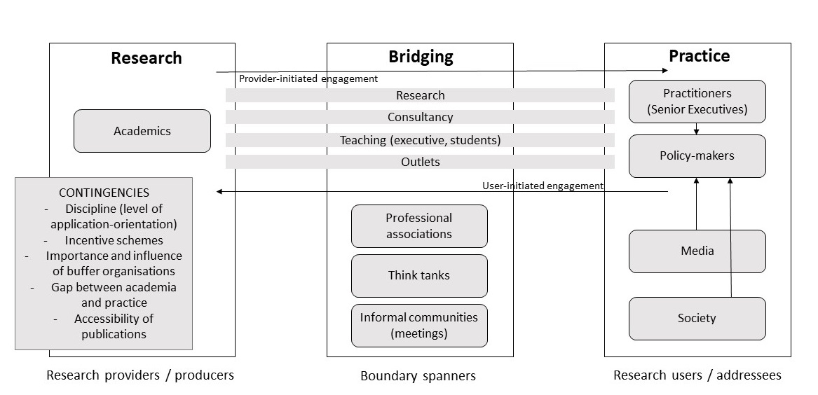
A Conceptual Model
Figure 1. Adapted from “The research practice gap on accounting in the public services” (Dudau et al., 2015)

Slide 6
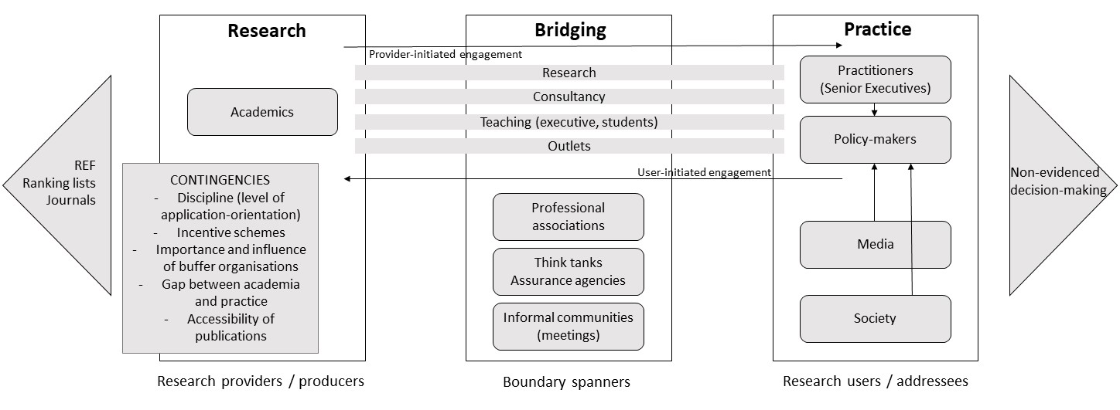
The model as refined for this paper
Notes:
(The next sections slides will attempt to apply the model to each of the three blue-light services as at 2010 and at 2020 immediately prior to the onset of the pandemic in the UK).

Slide 7
Fire and Rescue Services - 2010
Research
No of publishing academics
Conference panels
UG/PG courses
Discourse dominated by HR/Industrial Relations, Fire Engineering and Resistant Materials
International research
Bridging
Audit Commission
Fire & Emergency Planning Colleges
All Party Parliamentary Interest Group
Ad hoc Fire Sector Interest Groups
Strong Fire Brigade Union (FBU)
Practice
Strong but insular service culture
Standards and evidence based
Co-production of policy and delivery
Strong public support
Friendly or benign media coverage

Slide 8
Fire and Rescue Services - 2020
Research
No of publishing academics has increased (marginally)
Conferences and panels have increased
UG/PG courses reduced
Management and interdisciplinary research has been added
Bridging
HMICFRS/NFCC/ Home Office
Fire Sector Federation
Fire Standards Board
All Party
Weaker Fire Brigade Union (FBU) Parliamentary Interest Group and Home Affairs Select Committee
Practice
More collaborative culture within the service
Standards and evidence based
Policy, delivery and assurance more siloed
Strong public support
Generally still benign media coverage

Slide 9
Ambulance Services - 2010
Research
No of publishing academics, conferences and panels were small and static
Limited UG/PG courses?
Medical and clinical issues dominated – little management, interdisciplinary or international research
Few grants to research about AS
Fewer journal articles
Limited management, non-clinical journals (e.g. IJES)
Bridging
NHS culture favours research- practice nexus
AACE and NHS Confederation (Ambulance service group)
CCG and NICE
Weak professional associations
Strong trade union (UNISON)
College of Paramedics
Practice
Command and control culture
Service very insular oriented
Response time dominated performance regime
Blame culture within the service
Operational orientation over strategic vision
Policy, delivery and assurance not a priority
Standards and evidence based
Strong public support
Very benign media coverage, restricted to negative outcomes

Slide 10
Ambulance Services - 2020
Research
No of publishing academics static?
Conference panels have increased
UG/PG courses increased (flurry of courses)
New PhD research avenues
Management and interdisciplinary research has been added
Ambulance related research now published in top management journals
Still fewer management journals but a few on ABS list now-e,g, IJES)
Bridging
NHS culture still favours research- practice nexus, but under more pressure
Agencies and agents static
AACE and NHS Confederation
CCG and NICE
Few think tanks- Larrey Society
College of Paramedics- forefront of reform of practice ( seeking Chartered status)
Practice
Constant organisational and cultural change within the service
Standards and evidence-based practice
Reforms in targets-based performance regime- more balanced approach
Exponential rise in AS PhD research (150+)
NHS policy, delivery and assurance more integrated
Strong public support
New frontline staff led social media presence
Popularity of TV programmes, leading to positive public opinion

Slide 11
Police Services - 2010
Research
Significant number of publishing academics, conferences and panels
UG/PG courses increasing in law and criminal justice
Multiple Journals (including journals on the ABS List.
Benefitted by criminal justice/policing overlap
Bridging
Home Office Research Unit
Audit Commission, National Police Improvement Agency, HMIC/IPCC
National databases and systems
Multiple think tanks and professional/staff associations
Practice
Evidence and more open culture within the service (collaboration improving)
Integration of policy, delivery and assurance improving
Improving public support and confidence
Significant media coverage

Slide 12
Police Services - 2020
Research
No of publishing academics increasing
Conference panels have increased
UG/PG courses (law, criminal justice, forensic sciences increasing
Management and interdisciplinary research has been added
Inter-disciplinary and international research increasing as nature ‘crime’ changes
Bridging
College of Policing/ Independent Office for Police Conduct
PCCs introduced (?)
National databases and systems
Increase number of think tanks and professional associations
Practice
Cultural becoming more defensive and embattled with weakened assurance
Service delivery and modernisation agenda impacted by budgetary cuts and political influence
Declining standards and evidence based action
Police policy, delivery and assurance less integrated
Reducing public support/increased political polarisation
Generally still neutral media coverage

Slide 13
Next Steps
Slides 7-12 very much represent an ‘aunt sally’ in the sense that it is set up as a target for disagreement or attack
Wish to test these views on the wider communities of interest (survey/focus groups/interviews)

