Slide 1
High impact climate solutions: We can do it!
Dr Petra Molthan-Hill
Professor of Sustainable Management and Education for Sustainable Development and Co-Chair UN PRME Working Group on Climate Change & the Environment,
Nottingham Business School, Nottingham Trent University, UK

Slide 2
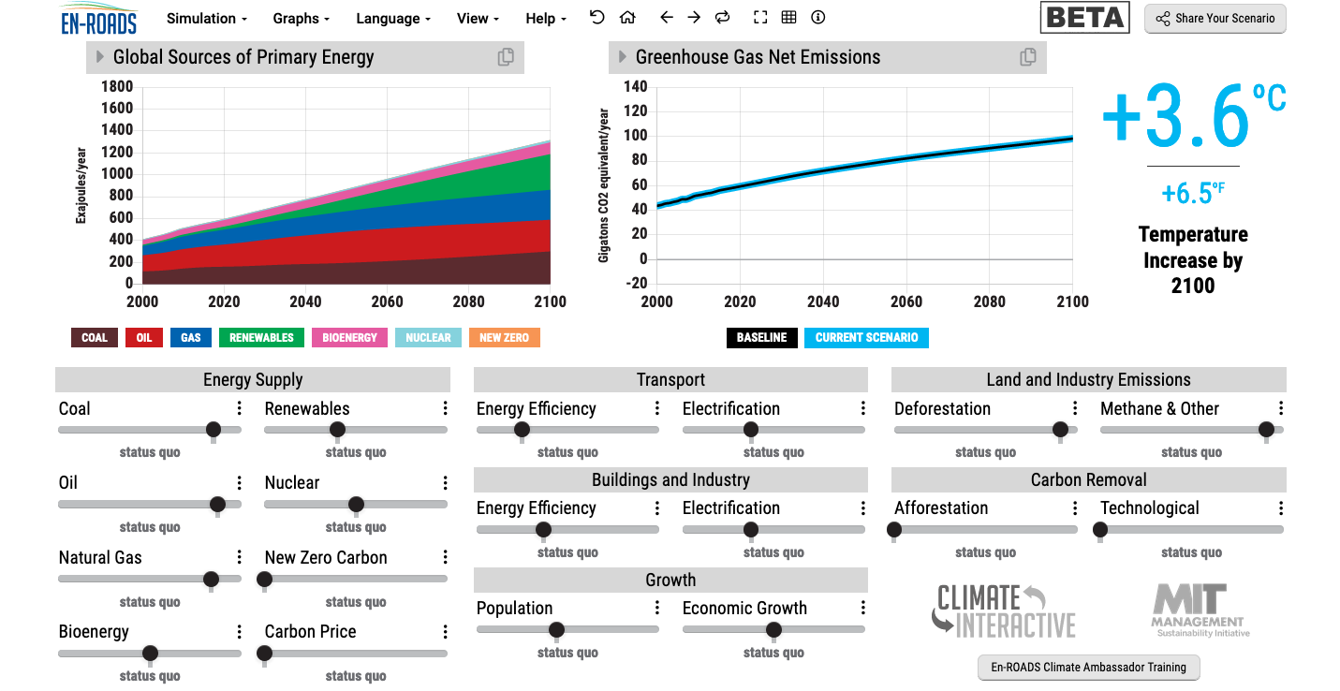
En-ROADS is a cutting-edge simulation model used to test climate solutions and generate climate scenarios for the future.
Notes:
This is our current situation as demonstrated by En-ROADS which was developed by MIT Climate Interactive so that everyone can understand the high impact solutions and which impact they would have.

Slide 3
Solutions: A lot to know…
https://profilebooks.com/how-bad-are-bananas.html
https://www.drawdown.org/
Notes:
Knowing these climate change mitigation tools and strategies will allow them to judge, whether Bill Gates is suggesting good solutions in his new book or whether Mark Carney got it right.

Slide 4
Inspired by Carbon Literacy Training in:
Chapple, W., Molthan-Hill, P., Welton, R., Hewitt, M.
Lights Off, Spot On: Carbon Literacy Training Crossing Boundaries in the Television Industry.
J Bus Ethics 162, 813–834 (2020).
https://doi.org/10.1007/s10551-019-04363-w

Slide 5
Carbon Literacy Training for Business Schools
What if every recruit into corporations from the world’s business schools was qualified as Carbon Literate?
This training was developed by Nottingham Business School (Nottingham Trent University) in collaboration with the UN PRME Champions, Oikos International and the Carbon Literacy Project.
The aim of this project is to get academics, students and others Carbon Literate within a short time frame and to get as many people as possible actively involved in embedding climate solutions in their own life and work. In order to do so we have chosen a train-the-trainer approach, so we will offer regional events inviting all the universities and business schools in the vicinity to train academics and students there so that they can become trainers in their own institution and/or get involved in training others in other regions of the world.
Notes:
In our Carbon Literacy Training for Business Schools we have a strong focus on these high impact solutions so that everyone in a business school, whether in teaching, research or operations would know the best actions to take.

Slide 6
1. Climate Change Science Education
Knowledge and understanding of a broad range of scientific concepts and processes related to climate change (e.g. climate, deforestation, habitat loss, water cycle, soil erosion, air pollution), its causes and its consequences, ecologically, socially, economically and politically.
Knowledge and understanding of the dynamics of climate change impact across time and space (e.g. delayed consequences, reducing the quality of life, security and development options of future generations).
Awareness of strategies and technologies to address the negative impacts of climate change (e.g., reducing carbon consumption, encouraging low-carbon development, reducing deforestation through sustainable forest management, improving water and waste management).
Ability to distinguish critically between certainties, uncertainties, projections and risks associated with climate change, and evaluate messages about and public interpretations of climate change science.
This table will be published in: Molthan-Hill, P et al (2021), Climate change education at universities: Relevance and strategies for every discipline. in: Handbook of Climate Change Adaptation and Mitigation (3rd edition), Springer: Cham, Switzerland, forthcoming. Adapted from definitions provided by Mochizuki Y, Bryan A (2015) Climate change education in the context of education for sustainable development: Rationale and principles. Research 9(1): 4-26.
Notes:
We need to distinguish between three areas of climate change education, the first one is the science: Every Graduate need to understand the climate change science enough to make informed decisions and integrate high impact solutions into their life and work. This basic understanding is also necessary for anyone studying business.

Slide 7
2. Climate Change Mitigation Education
Developing values, knowledge and skills required to make choices and decisions that minimize the use of natural resources, emissions, waste and pollution; while contributing to the development of new solutions to the climate crisis (e.g., rethinking the way we live, buy and consume, how our daily lives are organized, how we socialize, exchange, share, educate and build identities).
Taking individual and/or collective action with the potential to have immediate, direct impact (e.g., reducing energy consumption, using non-polluting and renewable energy sources, environmental conservation, re-forestation and re-greening).
Contributing to policy development with long-term positive impact on societal behaviour by examining economic systems, social structures, cultural patterns, lifestyle expectations, consumerism, wealth distribution, aspirations and value systems and their underlying responsibility for excessive greenhouse gas production.
This table will be published in: Molthan-Hill, P et al (2021), Climate change education at universities: Relevance and strategies for every discipline. in: Handbook of Climate Change Adaptation and Mitigation (3rd edition), Springer: Cham, Switzerland, forthcoming. Adapted from definitions provided by Mochizuki Y, Bryan A (2015) Climate change education in the context of education for sustainable development: Rationale and principles. Research 9(1): 4-26.
Notes:
The second one is Climate Change Mitigation Education: Every Graduate needs to know how to best mitigate climate change- what are the best strategies and tools in operations, supply chain management, economics, investment to reduce carbon emissions?

Slide 8
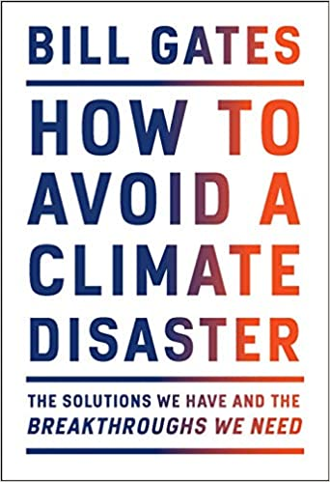
Just published
Notes:
Knowing these climate change mitigation tools and strategies will allow them to judge, whether Bill Gates is suggesting good solutions in his new book or whether Mark Carney got it right.

Slide 9
3. Climate Change Adaptation Education
Building capacity to apply these strategies in future situations, when the delayed impacts of climate change make themselves felt.
Knowledge and understanding of tools and methodologies to respond promptly and effectively in areas that have been negatively impacted by climate change, including Disaster Risk Reduction (DRR) strategies such as community disaster committees, community evacuation and rescue plans, and local first-aid training.
Knowledge and understanding of tools and methodologies to rebuild and restore areas that have been negatively impacted by climate change (e.g., seashores, flood prevention measures).
Implementing measures that reduce the vulnerability of natural and human systems to the impacts of climate change.
Advocating for appropriate channelling of resources at a global level to protect negatively affected natural and human systems in a just and equitable way.
This table will be published in: Molthan-Hill, P et al (2021), Climate change education at universities: Relevance and strategies for every discipline. in: Handbook of Climate Change Adaptation and Mitigation (3rd edition), Springer: Cham, Switzerland, forthcoming. Adapted from definitions provided by Mochizuki Y, Bryan A (2015) Climate change education in the context of education for sustainable development: Rationale and principles. Research 9(1): 4-26.
Notes:
In many countries Graduates need to learn how to adapt to climate change now, however in the UK and other high emitting countries the focus should be on mitigation: Is it not better to mitigate against the flooding of London so that major floods will not happen in the near future than to build higher flood defences now?

Slide 10
NTU Carbon Literacy Training Course
Climate change mitigation focused on solutions
Interactive teaching material
MIT Sloan & Climate Interactive Simulation tool
Certificates for you and your students
Please contact petra.molthan-hill@ntu.ac.uk for more info on this or the more specific training for business schools mentioned earlier.
www.ntu.ac.uk
Notes:
And if you are interested in the wider perspective on how to get everyone in the university carbon literate, NTU has made one of the two open-source tool kits for all staff and students at universities.

Slide 11
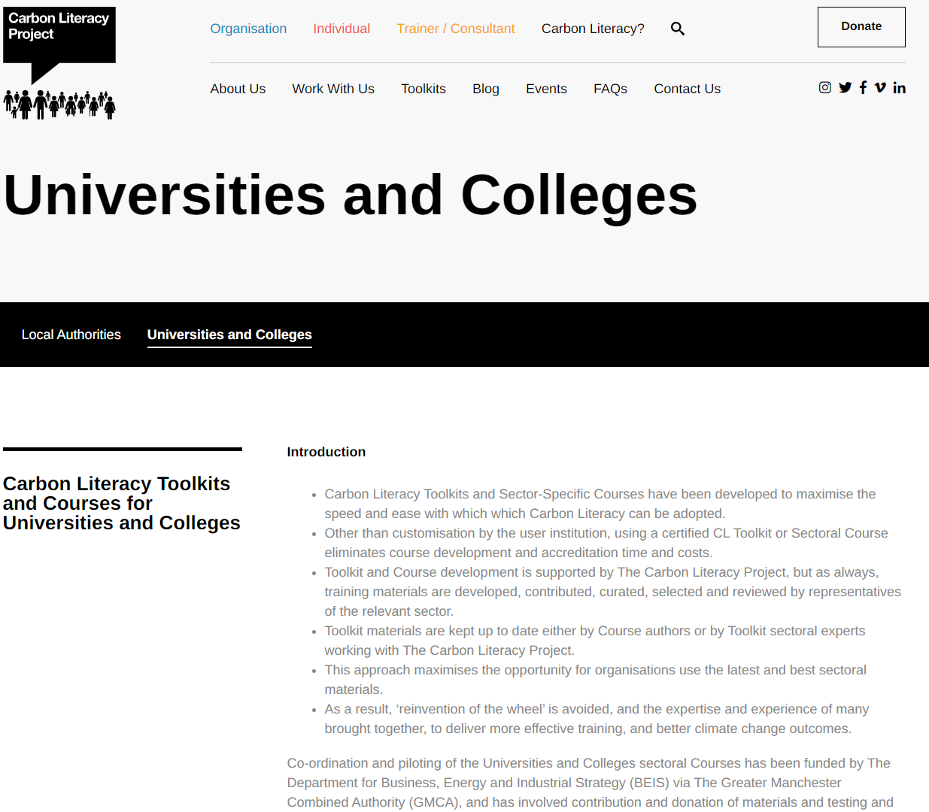
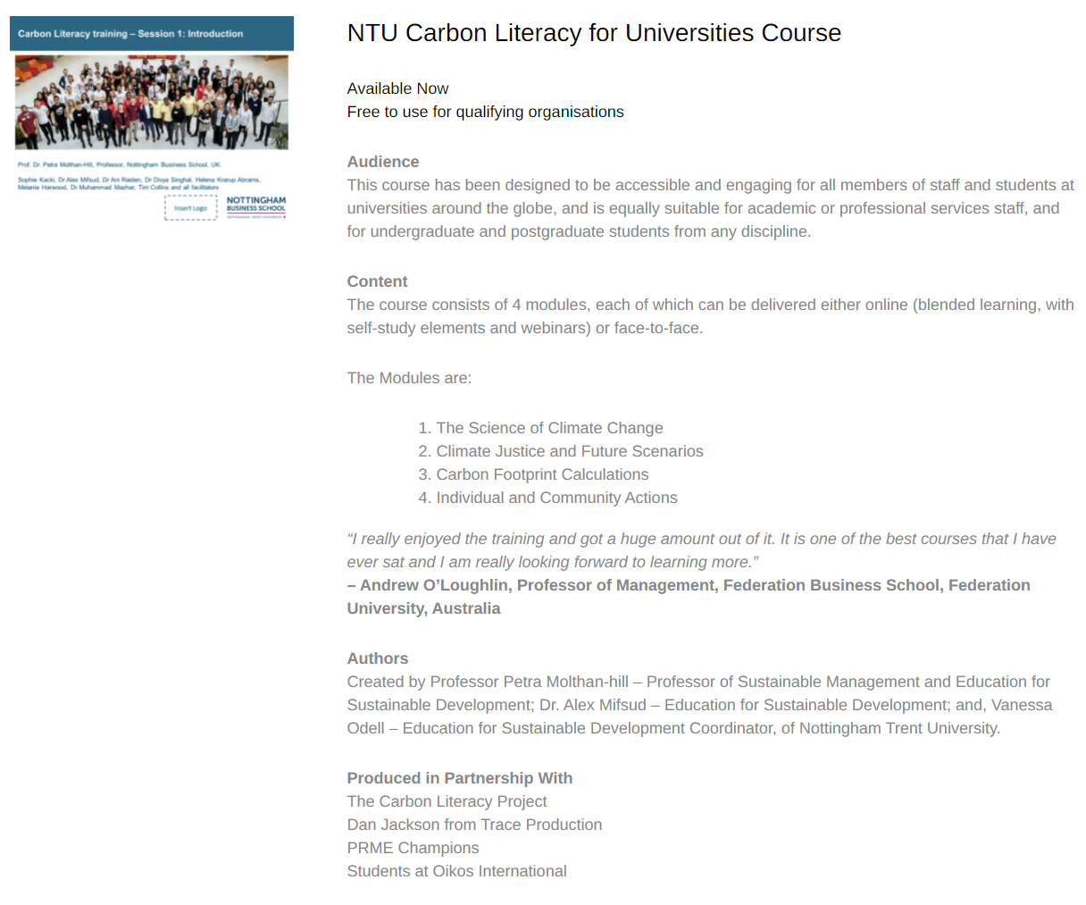
NTU Carbon Literacy Training Course
Please contact education@carbonliteracy.com to request this toolkit.
www.ntu.ac.uk
Notes:
And if you are interested in the wider perspective on how to get everyone in the university carbon literate, NTU has made one of the two open-source tool kits for all staff and students at universities. Lots of information about the resources via https://carbonliteracy.com/toolkits/universities-colleges/. Email education@carbonliteracy.com to request the toolkit.

Slide 12
Read about the Carbon Literacy Training
https://link.springer.com/referenceworkentry/10.1007/978-1-4614-6431-0_154-1

Slide 13
Carbon Literacy for Universities and Colleges
We run Accredited Carbon Literacy Training monthly for anyone from the University and college sector in the UK.
Our Scotland Team also run Carbon Literacy for Scottish institutions at a subsidized rate.
The courses are run by our in-house team of Carbon Literacy trainers.
Each course, attended by multiple institutions, gives delegates insights from others within the sector and a chance to share ideas and best practice.
This course will help you to:
Understand the basics of climate change science and how we know it’s a problem
Explore how climate change is impacting us all now and how it will in the future
Be able to identify ways that you and your organisation can take action to reduce emissions, benefiting from this in the process
For more information and course dates, please visit our website: www.eauc.org.uk/events

Slide 14
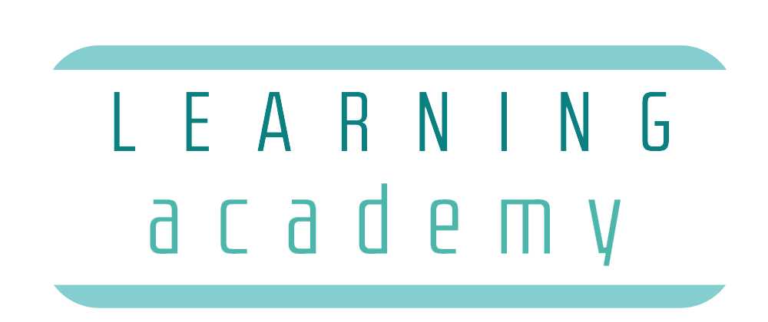
LEARNING ACADEMY : CARBON LITERACY
This training is certified by The Carbon Literacy Project. Upon successful completion of the training, learners will be awarded a Carbon Literacy certificate.
Benefits for your organisation include:
• Our Carbon Literacy course gives both students and staff the direction and motivation to make realistic, manageable changes to reduce their Carbon footprint in the context of their workplace or place of study, thus contributing towards sustainability aims, and potentially reducing direct costs to the university such as energy and travel.
• Ability to engage with a committed group of individuals (course participants) who understand the importance of Climate Action.
• Supporting the aims of other sustainability projects, such as Student Switch Off and Green Impact.
Best for
Student engagement
Behaviour change
Carbon reduction
Staff engagement
Education
Price: Bespoke training per university starts from £2,000+VAT for 20 spaces and includes certification for attendees. For more information please get in touch on hello@sos-uk.org
14

Slide 15
International work-related experience
Take part in a virtual international work-related experience. This opportunity is open to XXX to take part in Carbon Literacy training and work with XXXX As a part of this project you’ll learn about adapting to the culture in XXX in order to do this work and about climate solutions in general and especially for this part of the world. You’ll be fully trained as Carbon Literacy Trainers and receive an external work experience certificate by eduCCate Global https://www.educcateglobal.org/. If you decide to do the assessment form afterwards and pass it, you will also get an external Certificate by the Carbon Literacy Project in Manchester. Time Commitment: Takes place end of November – mid-December (you need to be available every Monday from 15.30-18.00 GMT on 30 November, 7 December, 14 December, 21 December) to take part in the actual virtual delivery to the teachers in XXX and every Thursday from 15.00-17.00 GMT to prepare the session virtually and to reflect on cultural diversity and different approaches (26 November, 3 December, 10 December 17 December). You might need 1-3 hours to prepare yourself in your own time depending on which task you choose as your responsibility. Total: Hours: 5 – 8 hours per week (over 4 weeks) Support: The Green Academy Team at NTU and NBS Professor Petra Molthan-Hill (an experienced Carbon Literacy Trainer) will support you as well as the CEO of eduCCate Global - Melanie Harwood. https://www.educcateglobal.org/ and https://www.ntu.ac.uk/about-us/sustainability/sustainability-in-education/carbon-literacy-training XXX Contact person if you are interested: GreenAcademy@ntu.ac.uk

Slide 16
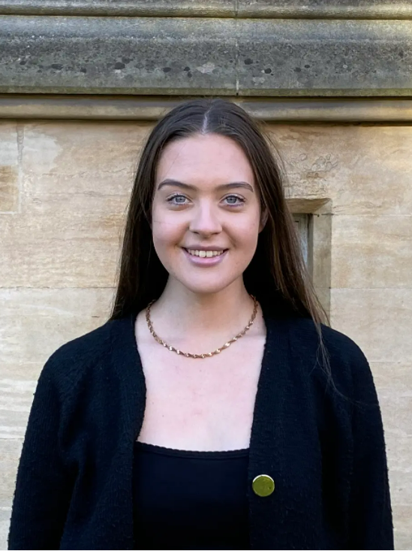
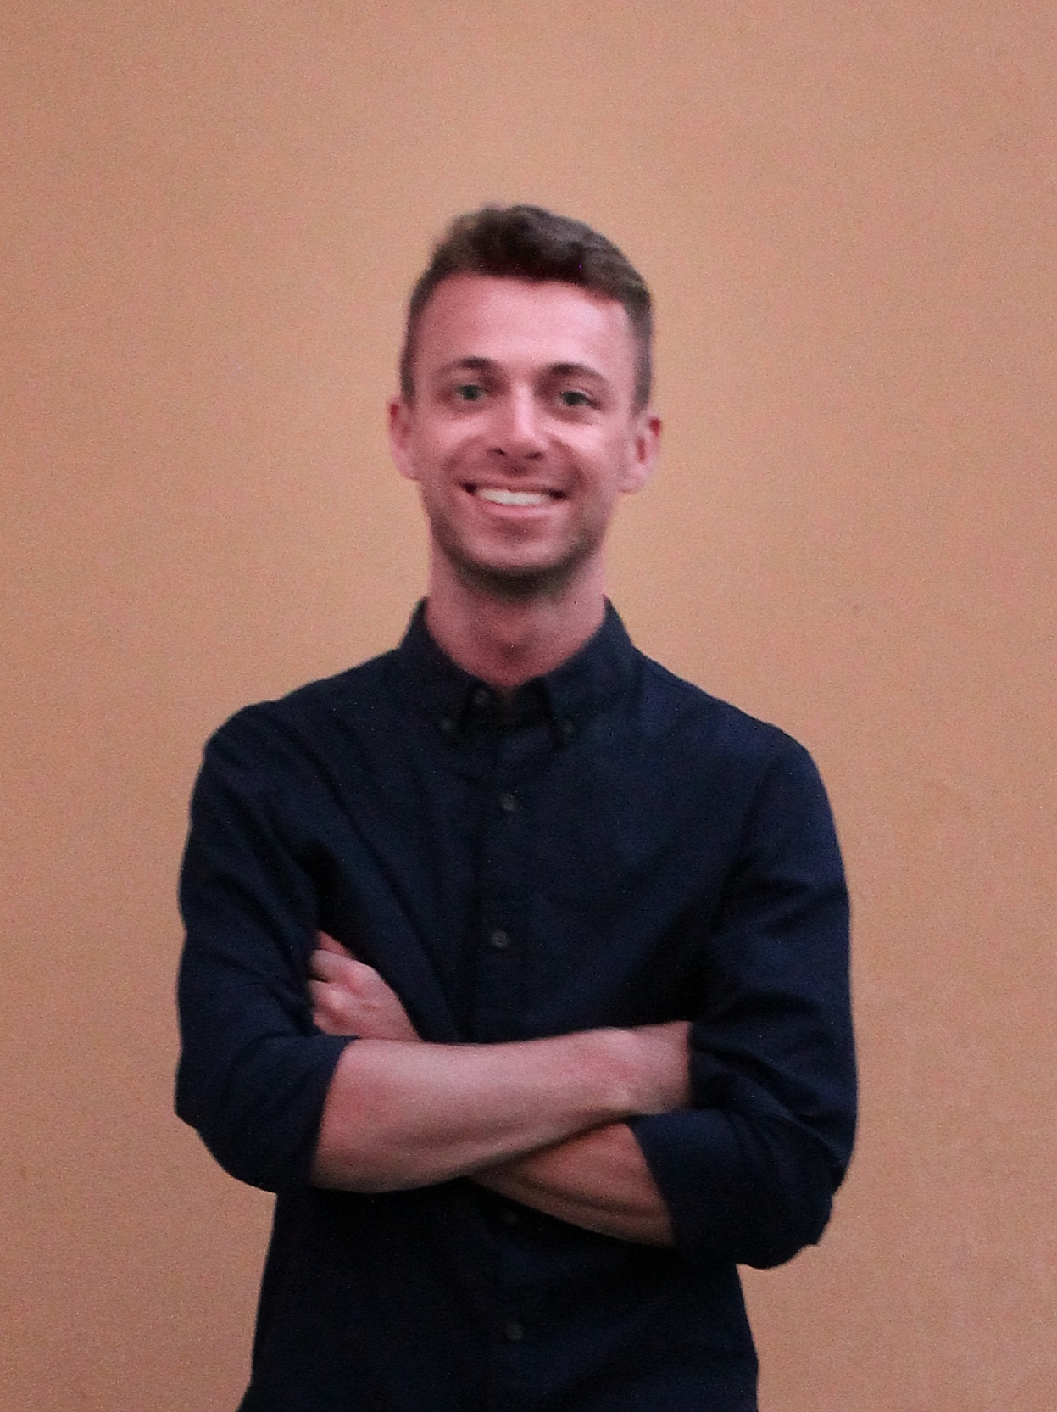
Watch our students talking about …
Sophie Adams
Watch Video Here
Connor Davey
Watch Video Here
Chloe Bottomley
Watch Video Here
Justyna Cuglewska
Watch Video Here

Slide 17
Students changing organisations as part of the core curriculum
Guardian Award 2015
MOLTHAN-HILL, P., ROBINSON, Z.P., HOPE, A., DHARMASASMITA, A. and MCMANUS, E., 2020. Reducing carbon emissions in business through Responsible Management Education: influence at the micro-, meso- and macro-levels. International Journal of Management Education, 18 (1): 100328. ISSN 1472-8117
https://www.theguardian.com/higher-education-network/gallery/2015/mar/19/guardian-university-awards-2015-winners-in-pictures

Slide 18
Sustainability and Inclusive Leadership (SAIL)
A Course for SMEs to ‘build back better’ & tackle the Climate Crisis.
SAIL explores the global climate crisis, the very real impact that this will have on the economic landscape, and how important it is for businesses to be more sustainable as they work towards COVID-19 recovery.
Participants learn:
how businesses are affected by climate change, and vice versa
climate change mitigation tools and high impact solutions: for personal life, work & business
recovery and change strategies, with support to develop an action plan.
In real terms, businesses can expect a range of benefits including saving money, attracting and retaining employees and customers, reducing waste, increasing productivity, and getting a head start on becoming compliant for future regulations – as well as enhancing their mission & values.
Participants can gain a full certificate by the Carbon Literacy Trust. This course has also been accredited by NTU: participants can receive 10 credits towards a Level 4 (degree level) qualification.
To deliver this course in your business or area, email SAIL@ntu.ac.uk for more information.
“I think that a lot of people just don’t have the awareness that’s needed to tackle the problem at scale, so being armed with some facts, ideas for engagement, methods of overcoming objections, and ultimately the confidence to challenge misinformation or misguided opinions is really helpful.”
Participant Ben Williamson, Rebel Recruiters, Nottingham
Nearly 50% of SMEs in our local area do not have a sustainability policy. This represents a significant area of development and opportunity for local businesses.

Slide 19
Pass it on

Slide 20
Want to adapt any of our projects to your university? Please contact Prof Dr Petra Molthan-Hill
petra.molthan-hill@ntu.ac.uk

