Slide 1
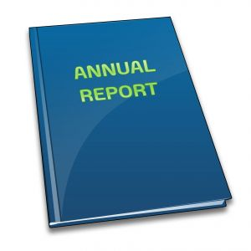


True and fair intellectual property information: a corporate governance issue
Dr Janice Denoncourt
LE PILOTAGE COMPTABLE DE L’INNOVATION
Workshop de la Chaire Innovation & Brevet, 7-8 juillet 2016
Faculté de droit et de science politique, Aix-Marseille Université
3 avenue Robert Schuman, 130100 Aix en Provence, France
©J Denoncourt 2016

Slide 2


About me…Janice Denoncourt
BA, Grad Dip Bus, LLB, LLM, PhD
Senior Lecturer in Law
1996 Australian Barrister & Solicitor
1998 In-house Counsel Australian plc
2001 Senior Associate Minter Ellison, Western Australia
2003 Legal Affairs Manager, large private UK company
2006 Solicitor England & Wales
2008 Law Academic / Researcher

Slide 3




Intellectual Property Research Group
lead IP research within the East Midlands region and focusses on:
IP law and practice
IP law education
IP commercialisation
www.ntu.ac.uk/ipresearch
IP law and practice
IP law education
IP commercialisation
www.ntu.ac.uk/ipresearch

Slide 4

True and Fair Intellectual Property Information: A Corporate Governance Issue
Accounting for intangibles
Historiographic tour of accounting
Corporate financial accounts
IAS 38 intangibles
The missing link: corporate narrative disclosure?
©J Denoncourt 2016

Slide 5
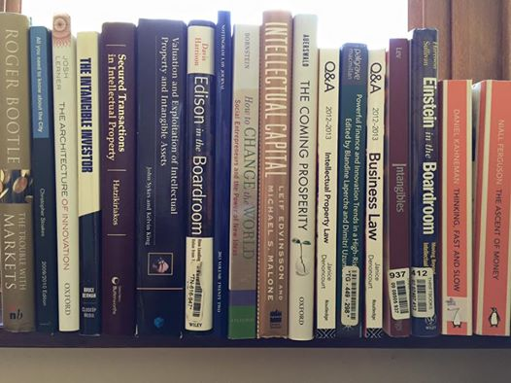
Multidisciplinary
©J Denoncourt 2016

Slide 6



Corporate value of intangible assets
Intangible assets are now estimated to represent
70-80%
of the value of UK companies
Banking on IP?
The role of intellectual property and intangible assets in facilitating business finance
Final report 2013
Final Report from the Expert Group on Intellectual Property Valuation
European Commission, 2013
©J Denoncourt 2016

Slide 7

Intangible assets (goodwill, IC & IP) value uncertainty + legal risks
©J Denoncourt 2016

Slide 8


Imperative need to measure objective value & subjective quality of IP assets
ACCOUNTING DOMINATES
IP ASSET VALUATION
Accounting standards affect valuation and recording of IP assets.
©J Denoncourt 2016

Slide 9

IP assets fall within ‘intangible assets’ and are virtually invisible in traditional financial accounts
Under IAS 38 internally developed IP is an expense and ‘off balance sheet’
©J Denoncourt 2016

Slide 10
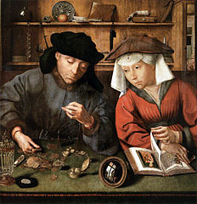
Transforming money
The Money Lender and his Wife (1514)
Quentin Massys (1465-1530) Flemish Northern Renaissance
Musee du Louvre, Paris
The painting depicts the epoch of the commercial revolution in Antwerp, Europe.
©J Denoncourt 2016

Slide 11
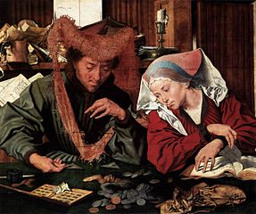
Updated in 1539 to highlight the emerging ‘accounting’ discipline
Shows the counting house of a banker of the period.
Note the abacus the banker has at his right on the table and the accounts book which the wife is holding.
Marinus van Reymerswaele, Museo del Prado, Madrid
©J Denoncourt 2016

Slide 12
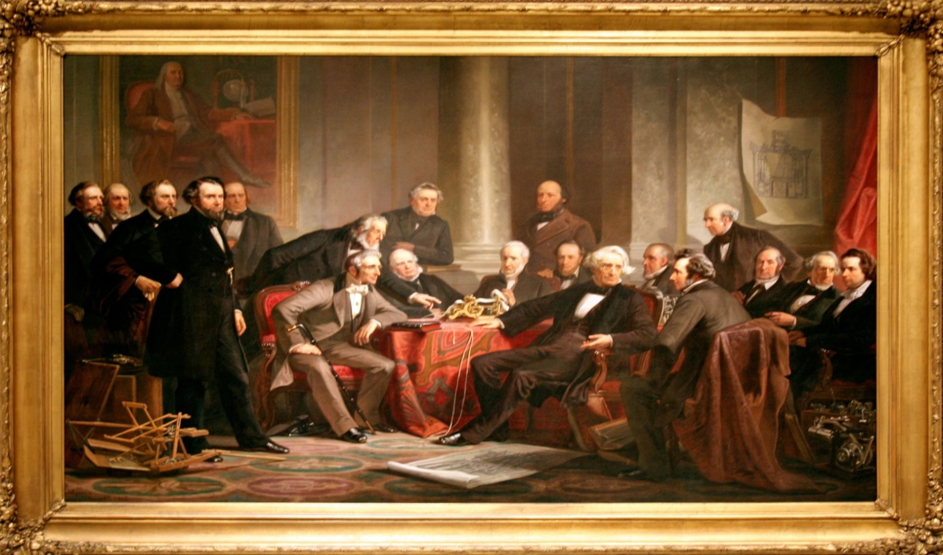
Men of Progress - 19 American inventors
Christian Schussele (1824 -1879) American National Portrait Gallery
Illustrates that the rewards of commercialization
were more accessible to aspiring inventor-capitalists.

Slide 13
Behavioural finance
We blur perception of IP value
obscured in corporate financial statements
with future prediction
Relying on accounting figures alone does not give an accurate picture of corporate IP value.

Slide 14



Leaving IP ‘off balance’ sheet is not a justifiable proposition
Corporate value is now closely linked to the IP.
Directors and investors get a distorted view of corporate strengths and weaknesses, inhibiting deciding and judging strategy.
Shareholders and other stakeholders seek more relevant, accurate and timely information about corporate IP assets – the type of information known to internal management.
At the same time, public disclosure of IP information and strategy invites both accountability and competitive exposure.
©J Denoncourt 2016

Slide 15

Should the LAW take the lead over
accounting practice in order to provide
a ‘true and fair’ view
of IP assets?
©J Denoncourt 2016

Slide 16
Section 396 Companies Act 2006 (UK)
The account MUST provide
a ‘true and fair’ view
= overarching LEGAL standard
©J Denoncourt 2016

Slide 17

True and fair view of corporate performance
Triangulate financial performance
with narrative legal and strategic information.
Triangulation is a powerful technique that
facilitates validation of data through
cross verification from two or more sources.

Slide 18

The Missing Link?
Narrative corporate disclosure of IP assets
Improve public information about corporate IP.
Enhance transparency and shareholder/investor protection.
Create more “certainty”
Improve potential to access debt & equity finance by providing timely, relevant and accurate information about IP assets.

Slide 19

No bespoke regulatory guidance for
IP asset & strategy disclosure
Corporate regulator publishes guidance for corporate disclosure BUT no bespoke guidance for IP assets.
Intellectual capital statements model
Undertake a pilot study
Examine best practice principles
©J Denoncourt 2016

Slide 20

We get the innovations, companies and the world we deserve
©J Denoncourt 2016

Slide 21
Publications
Denoncourt, J. ‘True and Fair Intellectual Property Information: A Corporate Governance Issue’ (2015) Journal of Business Law, Issue 1, pp47-72
Denoncourt, J. Patent-backed Debt Finance: Should Company Law Take the Lead to Provide a ‘True and Fair’ View of SME Patent Assets? (2015 PhD Thesis) available at: http://eprints.nottingham.ac.uk/30743/
Denoncourt, J. Chartered Institute of Patent Attorneys (CIPA) Webinar Series Report, ‘Patent Attorneys IPO due diligence’ (April 2016) CIPA Journal, Vol. 45, No. 4 pp 52-54
Denoncourt, J. Chapter 2 ‘IP Debt Finance and SMEs: Trends and Initiatives from Around the World’ in Toshiyuki Kono (Ed.) Security Interests in Intellectual Property in a Global Context (2016) Springer Verlang
Denoncourt, J. Intellectual Property Assets: Corporate Reporting & Disclosure (2016) Routledge Research in IP Monograph Series (forthcoming)
Denoncourt, J. ‘Financing technological innovation: Analysis of WIPO’s IP Advantage Database’ submitted to the International Journal of Intellectual Property Management, Inderscience
Denoncourt, J. ‘Corporate Disclosure of Intellectual Property Assets: A Comparative System Analysis of the UK, EU and US’ accepted paper at the Society of Legal Scholars (SLS) 2016 Annual Conference, Company Law Section.

Slide 22

THANK YOU

