Slide 1
European Intellectual Property Teachers’ Network
9th Annual Workshop2016
University of Library Studies and Information Technologies Sofia, Bulgaria
The Creative Identity and
Intellectual Property
Janice Denoncourt
orcid.org/0000-0003-2176-8935
4-5 July 2016

Slide 2
The Nottingham Creative Intellectual Property Project

Slide 3
A multidisciplinary public legal education collaboration 2014-2016:
Led by the Nottingham Law School
Legal Advice Centre
IP Research Group
The Hive
School of Art & Design

Slide 5
Nottingham Intellectual Property
Guide for Creatives
Launched on 27 May 2015
Draws from events to provide simple and accessible understanding of IP to help creatives safeguard their ideas and businesses.
Demonstrates how IP applies in the creative industries context through case studies.
Provides advice about how to prepare when entering a collaborative project or meeting a lawyer.

Slide 6
Led to a second project:
UK Intellectual Property Office
StudentshIP Enterprise Awards 2015
NLS awarded £24,980

Slide 7
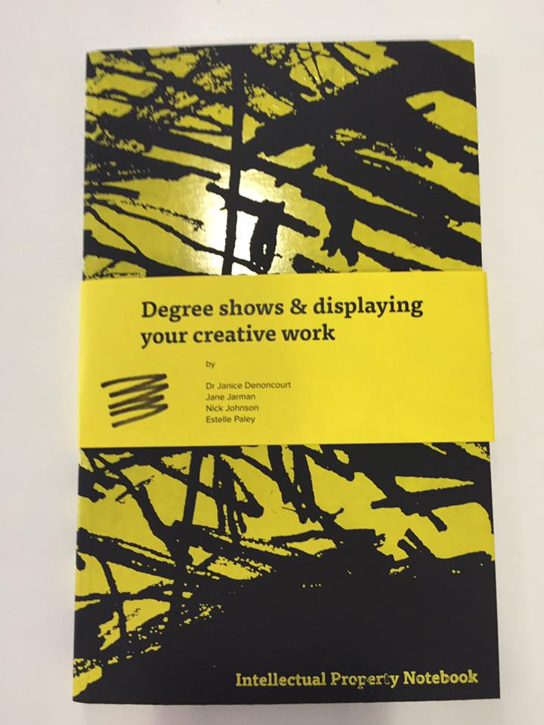
Intellectual Property Notebook:
Degree shows & displaying your creative work
Launched June 2016
:

Slide 8
The Creative Identity and Intellectual Property
Chapter One – Degree Shows and Displaying your Creative Work
Chapter Two – Displaying your Creative Work as a Professional
Chapter Three – Becoming and Entrepreneurial Creative

Slide 9
Denoncourt, J. ‘The Creative Identity and Intellectual Property’ (2016) Nottingham Law Journal Vol. 25, pp39-55, ISSN 0965-0660
Denoncourt, J. ‘Getting Creative’ (23 May 2016) Intellectual Property Magazine: Business Intelligence, Informa UK
http://www.intellectualpropertymagazine.com/design/getting-creative-117271.htm?origin=internalSearch

Slide 10
Nottingham Creative Intellectual Property Project
Thank you!
Janice Denoncourt
Twitter: @JanDenoncourt
Janice.denoncourt@ntu.ac.uk
ResearchGate

