Slide 1
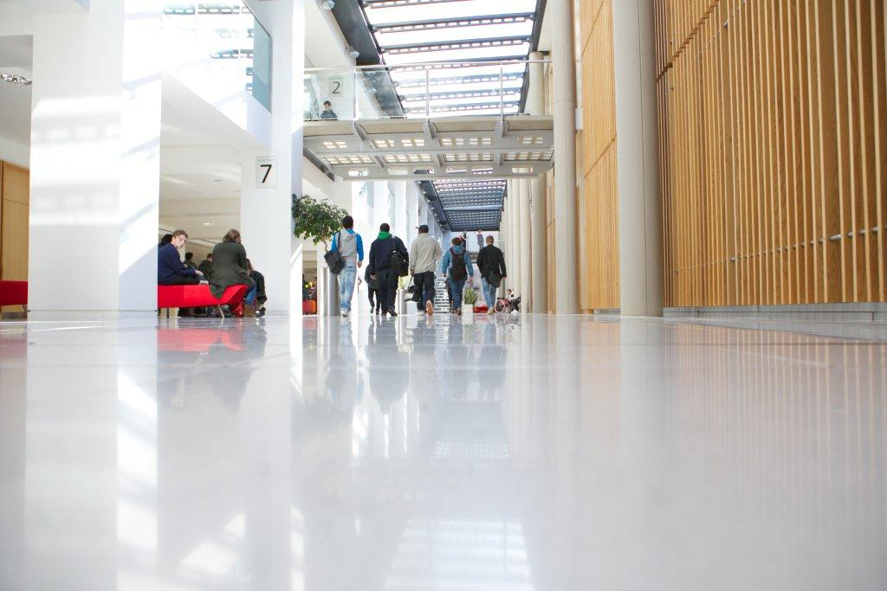
Annual Fire Related Research and Development Conference (Re16)
West Midlands Fire Service HQ, Birmingham
Looking Back, Looking Forward:
Marking 20 years of Fire Related Research, Development and Innovation (RE16)*
The proposed roles of Police and Crime Commissioners in Emergency Services – improving collaboration?
Pete Murphy
Nottingham Business School
15th November 2016

Slide 2
Conservative Party Manifesto
“we will enable fire and police services to work more closely together and develop the role of our elected and accountable Police and Crime Commissioners”
Have we gone from policy based evidence making to Government by Fiat?
(Funnell, W. 2001 Government by Fiat: The retreat from Responsibility. Sydney University of NSW Press)

Slide 3
Rapid policy development! – summary to-date
May 2013. Dissatisfaction with governance and performance of emergency services. PCCs “could clarify accountability arrangements and ensure more direct visibility to the electorate” (Sir Ken Knight 2013).
Home Affairs Select Committee (2014) PCCs had “provided greater clarity of leadership for policing in their area and were increasingly being recognised by the public for the strategic direction they are providing”. Cross party political satisfaction with PCCs
May 2015 Conservative Manifesto.
September 2015 “Enabling closer working between the Emergency Services” consultation - 318 responses.
January 2016 Government response - where it is in the interests of economy, efficiency and effectiveness or public safety, and where a local case is made they will be introduced.
February 2016 Home Office Statement: ‘There is now political consensus’ that PCCs are valuable and that they are here to stay - we will be legislating in .
March and April 2016 informal ministerial briefings – ‘all PCC’s will submit local cases’ for assuming responsibility for FRS.
October/November 2016 Committee stages in House of Lords

Slide 4
Evidence and Literature (politics trumps evidence)
Statistics
Independent Crime Survey
Fire National Statistics
NHS Ambulance Statistics
Recent Official Reports
PAC (2011) Transforming the NHS ambulance Service
Ken Knight Review (2013) Facing the Future
College of Policing (2015) Estimating demand on the Police Service
Home Office (2014) Police and Crime Commissioners: progress to date
Emergency Services Collaborative Working Group (2014) National Overview of Collaboration
Initiatives - projects and pilots
Fire Transformation Fund
Blue light Transformation Challenge Awards
Collaborative programmes
Emergency Services Mobile Communications Programme
Joint Emergency Services Joint Interoperability Programme

Slide 5
Executive Summary of the Consultation
Introducing a new duty on all three emergency services to actively consider collaboration opportunities with one another to improve efficiency and effectiveness;
Enabling PCC to take on the duties and responsibilities of fire and rescue authorities, where a local case is made;
Where a PCC on the responsibilities of a fire and rescue authority, enabling him or her to create a single employer for police and fire staff, facilitating the sharing of back office functions and streamlining management;
In areas where a PCC has not become responsible for fire and rescue services, enabling them to have representation on their local fire and rescue authority; and
Abolishing the London Fire and Emergency Planning Authority and giving the Mayor of London direct responsibility for the fire and rescue service in London, as will be the case in Greater Manchester.

Slide 6
New duty to collaborate
Collaboration between emergency services …is not as widespread or as wide-ranging as it could be in delivering efficiencies and better services…
There are limitations to innovation without a driver for change and there is significant scope for improving the way in which opportunities are identified and implemented
Opportunities to collaborate should be kept under regular consideration … hence a new duty to collaborate …to improve efficiency and effectiveness (economy and public safety!)

Slide 7
Strengthening accountability and governance
PCC take responsibility – where it is in the interests of economy efficiency and effectiveness or public safety
PCC adopts governance responsibility – Business case and local consultation
Transfer of FRS to PCC – all authority agreement; public consultation; request for secondary legislation (same process for single employer)
No agreement – PCC submits business case to Home Secretary/DCLG (later may seek an independent assessment (HMIC CFRA) on which to base findings
The secondary legislation would transfer governance and facilitate ‘ambitious reform’ – based on a cost-benefit analysis within the PCC business case.

Slide 8
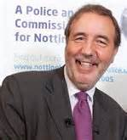
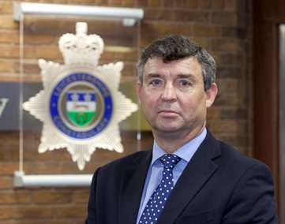
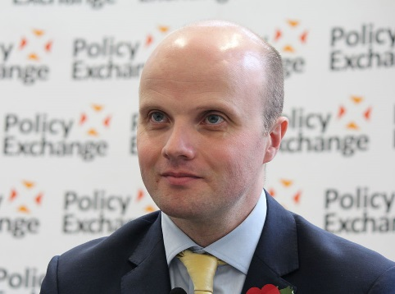
Miscellaneous issues
Boundary Issues – 15 areas are not coterminous (tax) – and future mergers
Improving performance – HMIC v Fire Peer Challenge and Operational Assessment
Scrutiny – expand Police and Crime panels – increased levels of transparency (accountability?)
Complaints – depends if services remain separate or not – deaths, coroners and the IPPC

Slide 9
Some Issues to think about
Differences in organisational cultures , service objectives and operational practices of the services.
The experience of National Offender Management System – the prisons and probation – what happened to probation?
Fire policy repatriation back to the ‘benign neglect’ of the Home Office!
HRM issues (strikes and pensions as well as management and staff issues) have a habit of getting forgotten and derailing grandiose plans – the case of the Irish Fire and Rescue re-organisation.

Slide 10
Governments response to consultation (politics trumps evidence)
Overall they intend to expedite the main proposals,
Ignore most of the practical issues around HR, equalities and complaints issues
Leave some of the unresolved issues to the local business case process….….and others to any PCC pursuing new responsibilities.
Health governance issues - realises you can’t mandate Foundation Health Trusts (or for that matter FRAuthorities) to allow PCC on Board – so PCC to ask the health bodies
Local resilience issues – encourages local resilience forums to look at how any governance changes (PCC, Metro Mayors etc) can enhance local resilience“!

Slide 11
Response to consultation (cont)
Having considered the consultation responses, in February the Government announced it intended to legislate (Policing and Crime Bill 2015-16) to:
introduce a high level duty to collaborate on all three emergency services, to improve efficiency or effectiveness;
enable authorities Police and Crime Commissioners (PCCs) to take on the functions of fire and rescue (FRAs), where a local case is made;
where a PCC takes on the responsibilities of their local FRA, further enabling him or her to create a single employer for police and fire personnel;
in areas where a PCC has not become responsible for fire and rescue services, enabling them to have representation on their local FRA with voting rights, where the local FRA agrees; and
abolish the London Fire and Emergency Planning Authority and give the Mayor of London direct responsibility for the fire and rescue service in London.
These measures will apply to England only.

Slide 12
Political Affiliations (NHS trusts – neutral)
Nottinghamshire | Leicestershire | Northamptonshire
City Council - Labour | City Council – Labour (Elected Mayor) | Northampton (District) - Labour
County Council - Labour | Leicestershire County Council – Conservative | Northamptonshire County Council - Conservative
PCC - Labour | Rutland County Council – Independent | PCC – Conservative (standing down)
Chair Fire Authority - Labour | PCC - Independent Ex military (standing down) | Chair Fire Authority - Conservative
 | Chair Fire Authority - Conservative

Slide 13
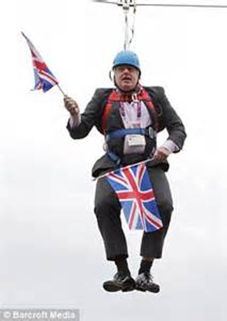
An inconvenient issue - Tom Gash
It is clear that the previous prime minister and chancellor see PCCs as an unappetising second-best solution for police accountability.
The preferred model, long in place in London, is for a directly elected mayor to appoint a visible deputy to oversee the police and crime portfolios (although clearly not Boris).
Greater Manchester has now adopted this model on an interim basis, although it will not be formalised until the first mayoral elections there in May 2017. Other city-regions likely to follow suit.

Slide 14
2016 PCC Election Candidates (party politics takes over)
40 Conservatives
40 Labour
34 UKIP
30 Liberal democrats
24 Independents
7 Greens
4 Paid Cymru (4 Welsh areas)
4 English Democrats
3 Zero Tolerance policing ex chief
27 Existing PCC re-stood
20 out of 27 were re-elected
11 Labour, (10 and 1)
10 Conservative, (7 and 3)
5 Independents (3 and 2)
1 Zero-Tolerance Policing ex chief (0 and 1)
Turnout increased from 12% to 26%

Slide 15
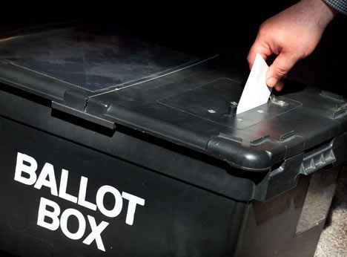
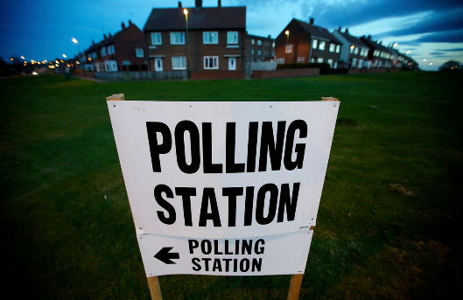
2016 PCC election results - by political party ‘Police and Crime Commissioners: Unloved but re-elected’ (BBC)
Pre-election
16 Conservative
13 Labour
12 Independent
Post-election
20 Conservative
15 Labour
3 Independent
2 Plaid Cymru

Slide 16
Accountability arrangements Pre and Post Police and Crime Commissioners (an inconvenient truth, while politics…)

Slide 17
Home Secretary: Speech to REFORM
Culture
Pay
Leadership/Accountability
Governance
Standards
Information
External assurance

Slide 18
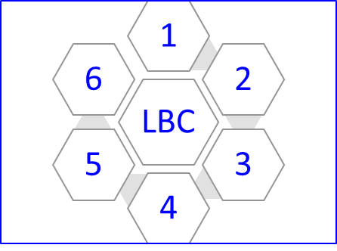
6 components for the Local Business Case
Analysis of local community needs.
Strategic and operational appraisal of current and future deployment of the 3 blue light services
Governance – strategic oversight or full employer (and more powerful scrutiny?)
Demonstrable value for money - Cost/benefit analysis; Financial Return on Investment (RoI) or Social RoI?
Public engagement/consultation
Independent validation and public assurance.

Slide 19
Latest News
While May became PM and Brexit dominated the news the legislation and arrangements have quickly progressed.
HMIC commissioned to scope an Independent Inspection regime
CFOA.FSC/FIA unify research and development
CFOA agreed to produce coherent and comprehensive professional standards
Final House of Lords Committee Stage of the bill – 9th November (Report Stage in House of lords due 23rd November).
Meanwhile combined authorities and elected Mayors?
We are now starting to see some PCCs and Fire Authorities locally taking the initiative

Slide 20
Questions?

