Slide 1
King Abdullah’s Balancing Act: Neo-liberalism Versus ‘The Politics of Tradition’ in Post-Arab Spring Jordan
Dr Imad El-Anis
(imad.el-anis@ntu.ac.uk)
Department of Politics and International Relations
01/03/2017

Slide 2
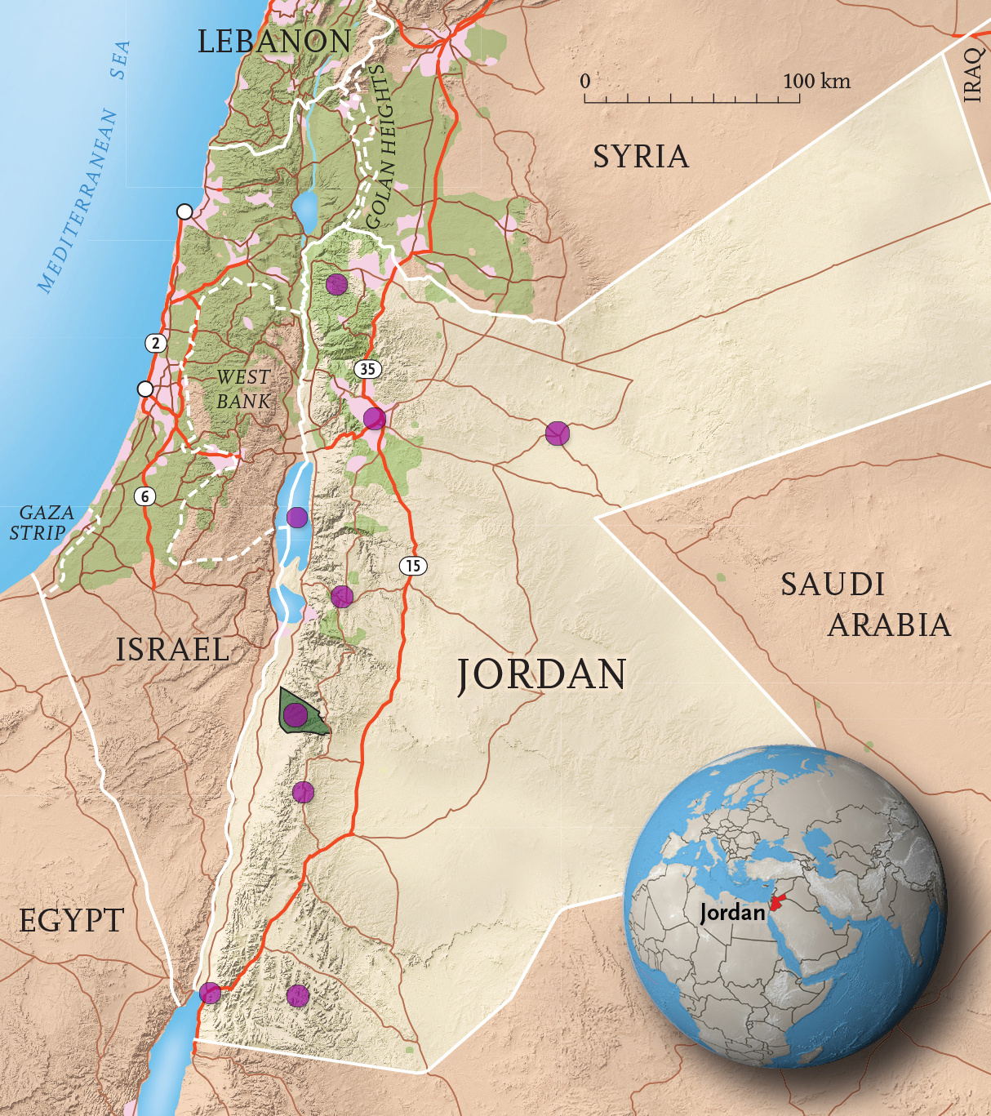
Overview
The Hashemite Kingdom of Jordan المملكة الأردنية الهاشمية
Project Summary
Jordan overview
Macro-data
Socio-cultural
Economic
Political
Politics of tradition
King Abdullah II
Neoliberal policies
Arab Spring experience – undermining the traditional support base

Slide 3
Project Summary
Linked to a larger project:
‘Agency Within Neoliberal ‘Subalternity’: Comparing the Political Economy-Foreign Policy Link in Jordan and Morocco’
Research question: How is foreign policy and economic agency manifested under the structural constraints created by neo-liberal subalternity?
Formally launched at the European International Studies Association Exploratory Symposia (2-5 November 2016, Rapallo, Italy) and part funded by the EISA.
Collaboration with: Anna Khakee, University of Malta; Irene Fernandez-Molina, University of Exeter; Laura Feliu, Universitat Autonoma de Barcelona; Leila Simona Talani, King’s College London; Mohammed Al-Khraisha, University of Jordan.
Plans: Special Issue in MEP; Panel at EISA Sept. 2017; Marie Curie research grant.

Slide 4
Jordan Overview – Socio-cultural data

Slide 5
Small but rapidly growing & young population, with large influxes of refugees – Palestine 1948-49; Palestine 1967; Iraq 1991 & 2003; Syria 2011-

Slide 6
Nationality | Population (millions) | % of Total Population
Jordanians | 6.6 | 69.47
Palestinians without Jordanian citizenship | 0.634 | 6.65
Iraqis | 0.13 | 1.3
Syrians | 1.265 | 13.3
Egyptians | 0.636 | 6.68
Other | 0.25 | 2.6

Slide 7
Largely Sunni Muslim (c. 95%, with Christian minority)
But distinctions between East Bankers and West Bankers.
Major cleavage that in part led to the 1970-71 civil war.
c. 50% of the Jordanian population has Palestinian heritage. This may be higher but the official census does not record this.
Traditionally there has been a divide between who dominates the public, private and political sectors.
Political Elite (EB)
Public Sector (EB)
Private Sector (WB)

Slide 8
Jordan Overview – Economic data

Slide 9
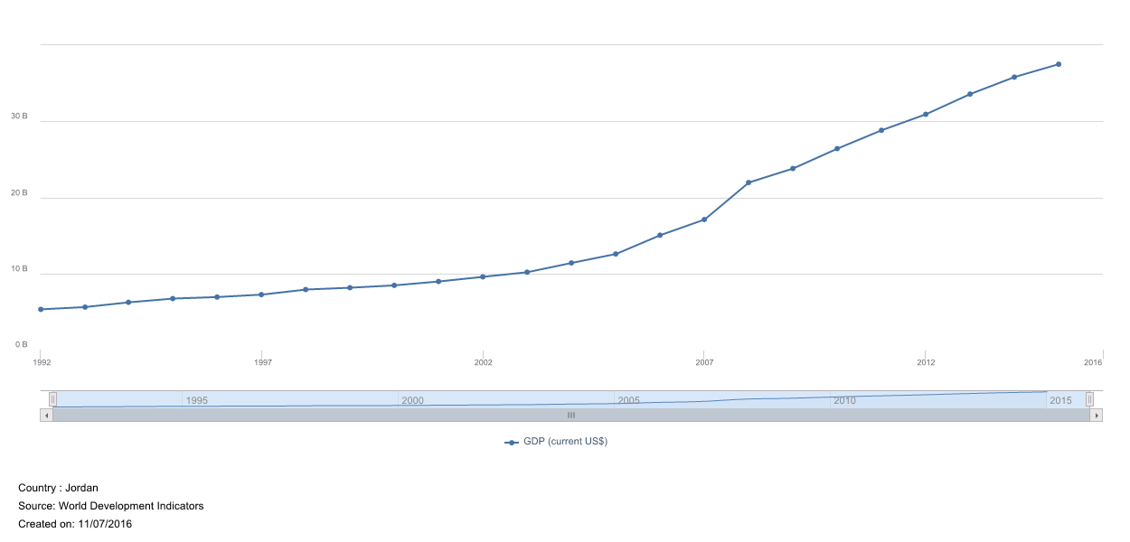
Jordan has a small economy

Slide 10
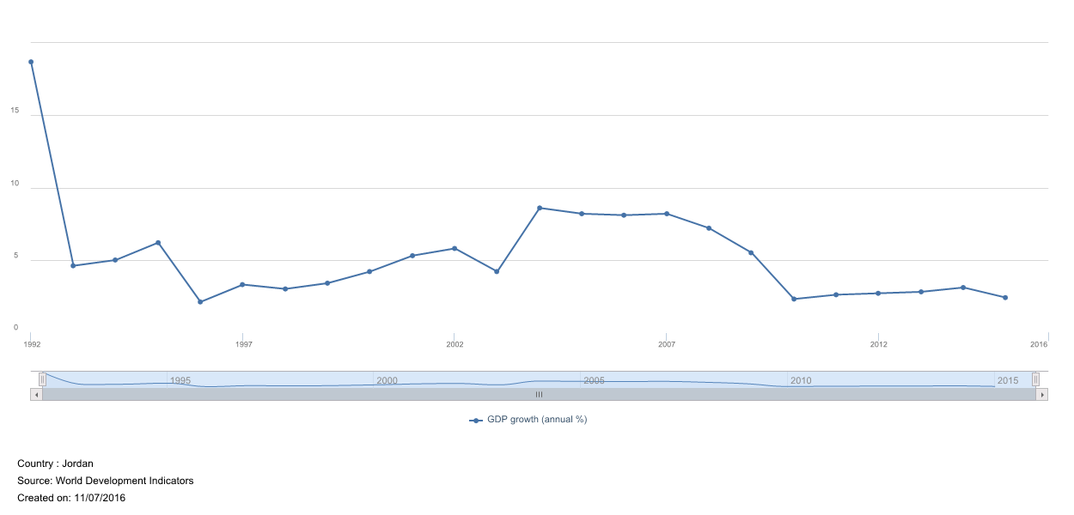
Experiences uneven growth

Slide 11
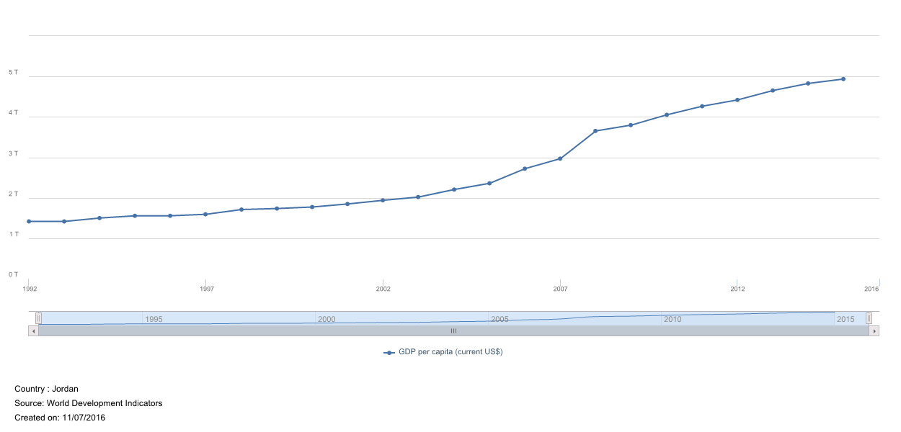
Has a lower middle-income society

Slide 12
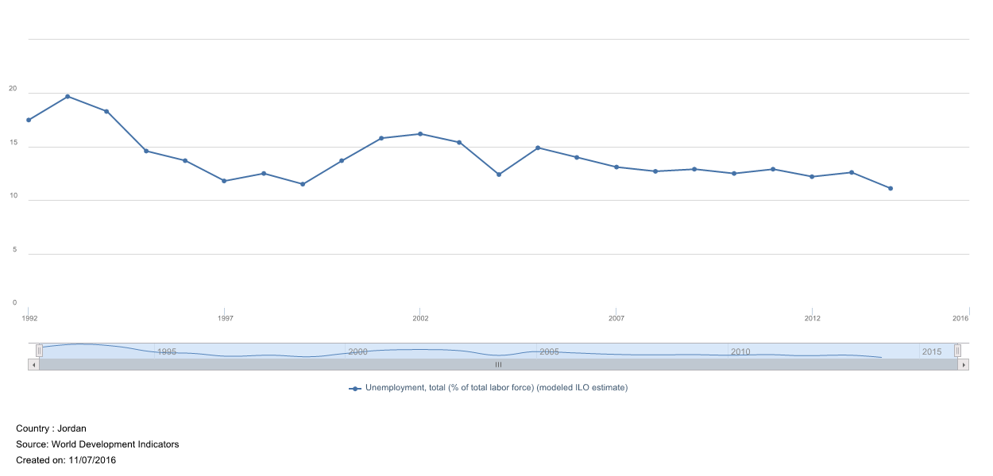
With high unemployment & under-employment rates

Slide 13
Jordan Overview – Political data

Slide 14
System = constitutional monarchy, where the King has a great deal of authority & not many significant restrictions
Managed democratisation
Or democratic facade(?)
Party politics are under-developed with a large number of parties that do not have broad popular bases – localised agendas & support
This in part leads to divisive political discourse at the national level, and narrow, short-term politics at the local level
It has also allowed the monarchy to maintain a power base by playing parties off against each other… but more on that later…

Slide 15
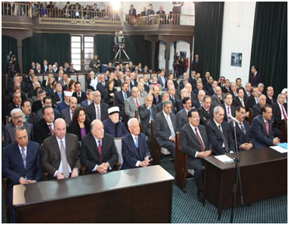
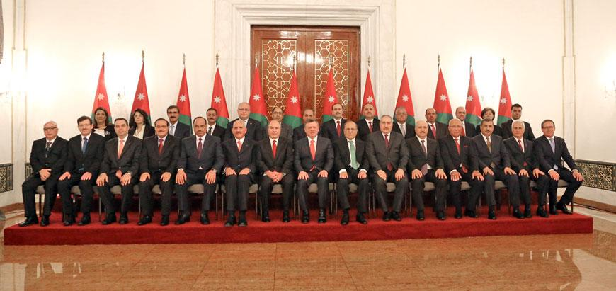
King Abdullah
The Senate
65 appointed members
The House of Representatives
130 directly elected members
The Cabinet

Slide 16
House of Representatives: political groups 2016
Independents (100)
Islamic Action Front (10)
Zamzam (5)
Islamic Centrist Party (5)
National Current (4)
Justice and Reform Party (2)
Arab Socialist Ba'ath (1)
Communist Party (1)
National Union (1)
Al-Awn (1)

Slide 17
Politics of Tradition in Jordan
East Bank support; West Bankers marginalised from top-level decision-making and security roles.
Wasta – derives from the Arabic word for ‘middle’: wasat
State-society contract includes public sector employment – unofficially guaranteed for some sectors of society.
East Banker (esp. tribal) support for the monarchy as counter to West Banker groups; Islamists (IAF) as counter to communists & pan-Arabists.
‘Favouritism & favours’

Slide 18
King Abdullah II

Slide 19
King Abdullah II
Originally was not expected to be King
He had a military career
Military background – trained in the USA and UK (Sandhurst)
Western-educated
Energetic, pragmatic & hands on leadership style
Has drawn heavily on technocrats, economists & consultants from Jordan & elsewhere – likes to make informed decisions
He does not have the same pragmatic approach as his father, the late King Hussein, who relied on charisma, personality & quick decision-making
He has styled himself as…

Slide 20
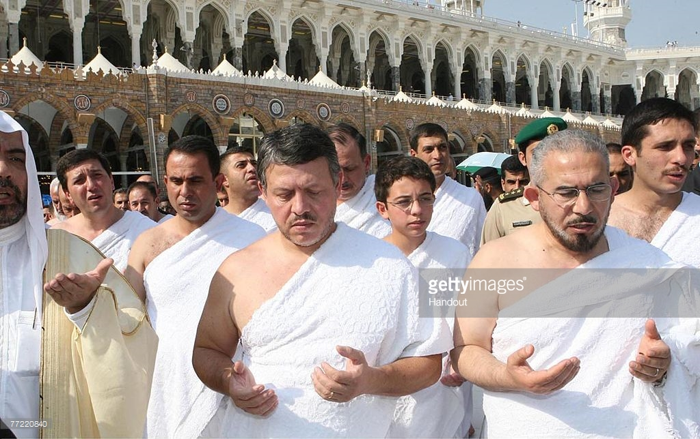
Pious & a true descendent of the Prophet Mohammed (PBUH)

Slide 21
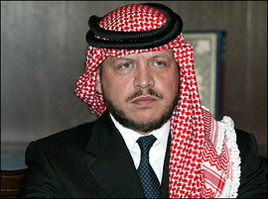
A man of Jordanian tradition & values

Slide 22
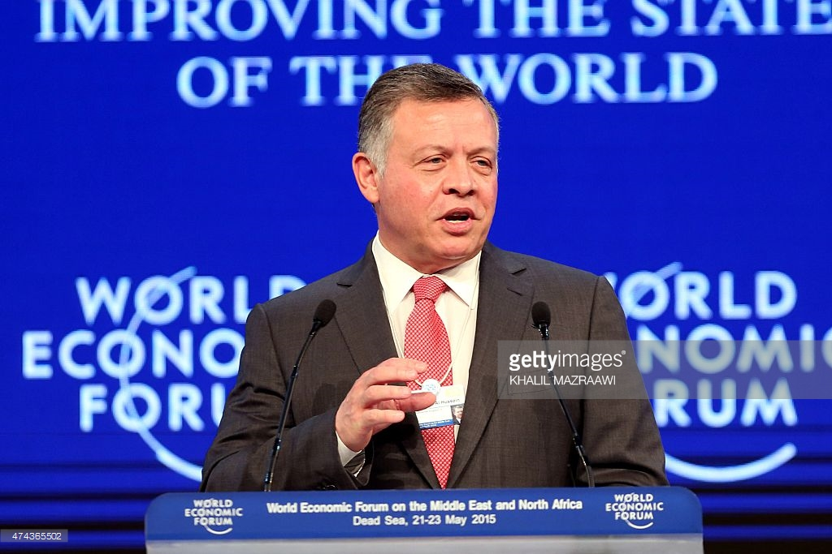
A modern, international & professional statesman
But he is also…

Slide 23
… A tough guy & likes to be ‘hands on’

Slide 24
He also likes Star Trek and was an extra on an episode of Next Generation!!!

Slide 25
Neoliberal Policies in Jordan – the highlights
Policy | Years | Notes
IMF & World Bank Structural Adjustment Programmes | 1989- | Fiscal adjustment; reduced spending: military, energy & food subsidies; increased taxes; debt restructuring; liberalized trade regime
Creation of the Jordan Investment Board | 1995- | One stop shop to promote local & foreign investment in Jordan
Bilateral & multilateral free trade agreements | 1997- | Seven FTAs Covers 55 states
World Trade Organization membership | 2000 | Full member TRIPS+
Executive Privatization Commission | 2000- | Promotes & manages the privatization programme. 18 large privatizations to date 16 on-going Telecoms, transport, water, industry, agriculture, medical
Jordan Anti-Corruption Commission | 2004 | Survey; inform & implement policy; prevent: bribery, embezzlement, abuse of authority, illicit enrichment…
Integrity & Anti-Corruption Committee | 2016 | Ensures adherence to principles of national integrity; fights corruption; develops behavioural norms in the public administration

Slide 26
But why liberalise?
Financial crisis 1989 – IMF as lender of last resort
Economic development & modernity (Abdullah’s views as informed by consultants & specialists… & his own educational & professional background)
Pushed by external actors
appeasement of: USA, EU, WB, IMF
But mostly because Jordanian decision-makers adopted the Washington Consensus in the 1990s & early 2000s
They (including King Abdullah) largely believe in neoliberal remedies for Jordanian problems

Slide 27
Jordan in the Arab Spring/Post-Arab Spring
Arab Spring experience – evidence of some erosion of the traditional support base
Most vocal & organised criticism came from tribal leaders & public sector workers.
Criticism does not mean opposition, but it is unheard of for groups that traditionally have been the backbone of monarchical support to openly express concerns.
This project seeks to explore this process (through Events Data Analysis).

Slide 28
Bibliography
Abu Rumman, Mohamed and Hassan Abu Hanieh, 2013, The “Islamic Solution” in Jordan: Islamists, the State, and the Ventures of Democracy and Security. Amman: Friedrich-Ebert-Stiftung.
Alissa, Sufyan, ‘Rethinking Economic Reform in Jordan: Confronting Socioeconomic Realities’, Carnegie Papers, July 2007, No. 4: 1-31.
Al-Soudi, Abdelmahdi, ‘The Impact of the Arab Spring on the Political Future of the Muslim Brotherhood in the Middle East: Jordan as a Case Study’, Middle East Review of International Affairs, Fall 2015, Vol. 19, No. 3: 41-57.
Antoun, Richard, ‘Fundamentalism, Bureaucratization, and the State’s Co-optation of Religion: A Jordanian Case Study’, International Journal of Middle East Studies, August 2006, Vol. 38, No. 3: 369-393.

Slide 29
Bank, Andre and Anna Sunik, ‘Parliamentary Elections in Jordan, January 2013’, Electoral Studies, 2014, No. 34: 376-379.
Barari, Hassan and Christina A. Satkowksi, ‘The Arab Spring: The Case of Jordan’, Ortadogu Etutleri, January 2012, Vol. 3, No. 2: 41-57.
Barari, Hassan, ‘Reform and the Dynamics of In/stability in Jordan During the Arab Uprisings’, Perceptions: Journal of International Affairs, Winter 2015, Vol. 20, No. 4: 73-95.
Baylouny, Anne Marie, ‘Jordan’s New “Political Development” Strategy, Middle East Report, Fall 2005. http://www.merip.org/mer/mer236/jordans-new-political-development-strategy Accessed 16/08/2016.
Brand, Laurie A., ‘National Narratives and Migration: Discursive Strategies of Inclusion and Exclusion in Jordan and Lebanon’, The International Migration Review, Spring 2010, Vol. 44, No. 1: 78-110.

Slide 30
Brumberg, Daniel, ‘Liberalization Versus Democracy: Understanding Arab Political Reform’, Carnegie Working Papers, May 2003, No. 37: 3-22.
Gutkowski, Stacey, ‘We Are the Very Model of a Moderate Muslim State: The Amman Message and Jordan’s Foreign Policy’, International Relations, 2016, Vol. 30, No. 2: 206-226.
Jamal, Amaney A., ‘Reassessing Support for Islam and Democracy in the Arab World? Evidence from Egypt and Jordan’, World Affairs, Fall 2006, Vol. 169, No. 2: 51-63.
Khakee, Anna, ‘A Long-Lasting Controversy: Western Democracy Promotion in Jordan’, EuroMeSCo Report, May 2009.
Koprulu, Nur, ‘Jordan Since the Uprisings: Between Change and Stability’, Middle East Policy, Summer 2014, Vol. 21, No. 2: 111-126.

Slide 31
Malantowicz, Artur, ‘“Crisis, Chaos, Violence – Is That What We Want?” A Stalled Democratisation in Jordan’, The Copernicus Journal of Political Studies, 2013, Vol. 1, No. 3: 77-96.
Ryan, Curtis, ‘Identity Politics, Reform, and Protest in Jordan’, Studies in Ethnicity and Nationalism, 2011, Vol. 11, No. 3: 564-578.
Ryan, Curtis, ‘Jordanian Foreign Policy and the Arab Spring’, Middle East Policy, Spring 2014, Vol. 21, No. 1: 144-153.
Yom, Sean L. ‘Jordan: The Ruse of Reform’, Journal of Democracy, July 2013, Vol. 24, No. 3: 127-139.

