Slide 1
SHIFTING TECTONIC PLATES Changes to the strategic and operational landscape of the emergency services in the UK
Annual Conference on Fire Related Research and Developments (RE18)
West Midlands Fire Service HQ, Birmingham
13th November 2018
Pete Murphy and Katarzyna Lakoma

Slide 2
CONTENT
Background
Our work to date
The model of three interrelated domains
Analysis
Methodology
Conclusions

Slide 3
BACKGROUND
1

Slide 4
BACKGROUND
Austerity
Government demands
Reducing resources
Changing pattern of risk
Objective
To identify the current disposition of organisations within the emergency services sector and potential opportunities for improvement.

Slide 5
OUR WORK TO DATE
2

Slide 6
OUR WORK TO DATE
Working papers produced for the Fire Sector Federation
Formal responses to consultation processes from the Home Office and HMICFRS
Presentations to the Emergency Services Panel of the International Research Society for Public Management conference in April 2018
Presentations to professional conference organised by Inside Government and the Public Policy Exchange

Slide 7
THE MODEL OF THREE INTER-RELATED DOMAINS
3

Slide 8
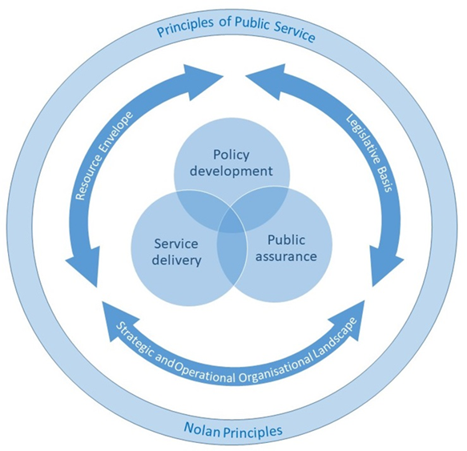
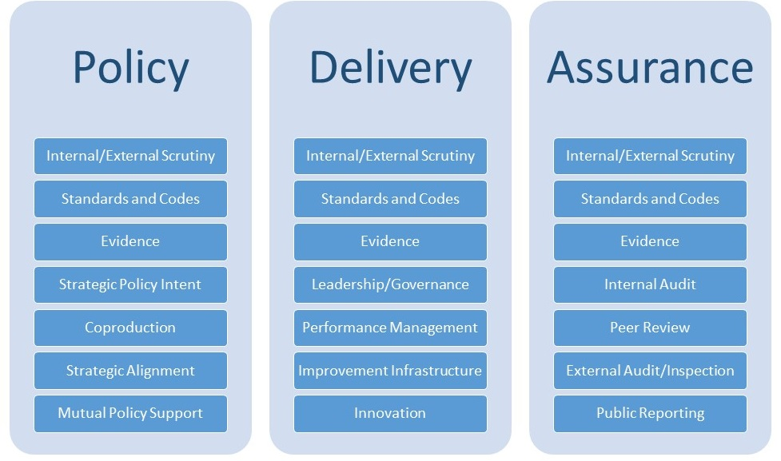
THE MODEL OF THREE INTER-RELATED DOMAINS
Principles of Public Service (Nolan Principles)
Situational or contextual constraints
Policy development, service delivery and public assurance

Slide 9
METHODOLOGY
4

Slide 10
METHODOLOGY
Literature Review
Document analysis
A series of interviews from key stakeholders
National Fire Chiefs Council
External Auditors
National Regulators
HMICFRS
Central Government
Local Government
Improvement Agencies
Fire Standards Board

Slide 11
ANALYSIS
5

Slide 12
THE MODEL
Values – Nolan Principles
Context – English Emergency Services
Evaluation domains – Policy, Delivery, Assurance of Fire and Rescue Services

Slide 13
RESOURCE ENVELOPE
Departmental Programme and Administration Budgets (£ billion)
2015 Spending Review Departmental Expenditure Limits
Departmental capital budgets | 2015-16 | 2016-17 | 2017-18 | 2018-19 | 2019-20 | 2020-21 | Cumulative Real Growth
Home Office | 10.3 | 10.7 | 10.6 | 10.6 | 10.6 | * | -4.8%
Department of Health | 111.6 | 115.6 | 118.7 | 121.3 | 124.1 | 128.2 | +3.3%
DCLG Local Government | 11.5 | 9.6 | 7.4 | 6.1 | 5.4 | * | -6.7%
Scotland | 25.9 | 26.1 | 26.3 | 26.3 | 26.5 | * | -5.0%
Wales | 12.9 | 13.0 | 13.1 | 13.2 | 13.3 | * | -4.5%
Northern Ireland | 9.7 | 9.8 | 9.9 | 9.9 | 9.9 | * | -5.0%

Slide 14
LEGISTLATIVE FRAMEWORK
ENABLING CLOSE WORKING BETWEEN THE EMERGENCY SERVICES (CONSULTATION)
THE EUROPEAN REFERENDUM - BREXIT
THE POLICING AND CRIME ACT 2017

Slide 15
ORGANISATIONAL LANDSCAPE
Pre 2010
New Performance Management
Service Modernisation
2010-2015
Austerity
Sector-led improvement
Post 2015
The Audit Commission
The need for collaboration between emergency services
The abdication of leadership and management of the FRS by the DCLG
National Framework 2012
Responsibility was handed from central government to Fire and Rescue Authorities
Two critical reports into accountability and financial resilience of FRS
Policing and Crime Act 2017 – chapters 1 to 4 related to FRS
Transfer of responsibility for FRS back to the Home Office

Slide 16
POLICY DEVELOPMENT
Policy development
Public assurance
Service delivery
Transfer of responsibility for FRS from DCLG back to the Home Office
New National Framework 2018
Little discussion with third parties (NFCC, LGA)
Poor evidence base
Neither comprehensive nor compelling
Dame Judith Hackitt’s report into the fire regulations – current evidence base is insufficient

Slide 17
SERVICE DELIVERY
Scotland and Northern Ireland – single national services
The loss of momentum towards combing Fire and Rescue Authorities and Services into larger service units
The Policing and Crime Act 2017 and its consequences
England and Wales - transfer of governance of FRS to the Police and Crime Commissioners
Emergency Services collaboration
Policy development
Public assurance
Service delivery

Slide 18
PUBLIC ASSURANCE
Deteriorating public assurance arrangements
Risks to achieving value for money
Diminishing resources from central government
A new external inspectorate – HMICFRS
May be similar to the PEEL assessments
Fire Standards Board (new CFOA) – unknown as yet
A new dedicated fire website www.fireservice.co.uk – will this provide evidence base?
Policy development
Public assurance
Service delivery

Slide 19
CONCLUSIONS
6

Slide 20
CONCLUSIONS
The organisational landscape of Fire and Rescue Services has been rapidly changing.
The service is facing ever more complex challenges (including diminishing resource envelope).
Policy development and public assurance domains – immaturity of many of the organisations.
The service delivery organisations have remained relatively stable (except for PFCCs).
‘FRS is a service that requires further reform to improve accountability, bring independent scrutiny and drive transparency’ (May, 2016).

Slide 21
QUESTIONS?
Contact
Pete peter.murphy@ntu.ac.uk
Katarzyna katarzyna.lakoma@ntu.ac.uk

