Slide 1
RE18: missing pieces? Is absence of evidence the same as evidence of absence?
Pete Murphy, Russ Glennon, Pete Eckersley, Kasia Lakoma
Nottingham Business School, NTU

Slide 2
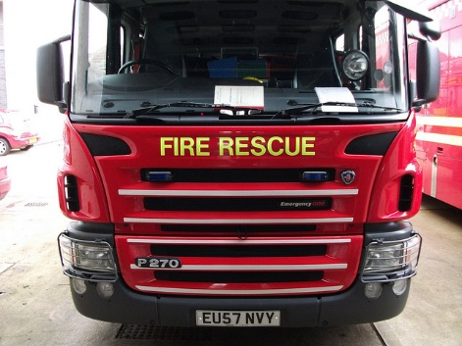
Background:
Public services are more closely accountable to the public (naturally) and to government
Demands are rising, resources are diminishing
The move toward ‘deregulation’ of performance in the public sector
Crime and Policing Act 2017 lacks clarity
Political choices such as blue-light integration are changing the landscape
Difficult to show the value (lives and £) of preventative work
Challenges for accountability, value for money, and improvement
This Photo by Unknown Author is licensed under CC BY-NC-ND

Slide 3
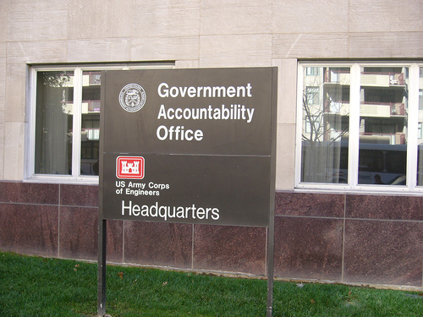
Wait, what is accountability?
Emotionally simple, conceptually muddled
Rooted in accounting and financial control
Many layers of meaning
Horizontal and vertical forms
Multiple and contingent
Strongly influenced by principal/agent theory
Accountability as virtue and as mechanism (Bovens et al., 2014; Dubnick and Frederickson, 2011)
Accountability is ‘the other guy’

Slide 4
Accountability’s Broad conceptual footprint
Performance/ information management
Accounting
Quality systems & frameworks
Transparency
Scrutiny/ overview
Public assurance
Co-production / co-creation
Probity/ ethics
Regulation
Democracy, governance, leadership

Slide 5
A couple of interesting quotes?
“[T]here is no independent inspectorate; no regular audit of performance; and only limited available data on performance over time or between areas.” (Home Office, 2016)
“I intend to bring forward proposals to establish a rigorous and independent inspection regime for fire and rescue services in England.” Rt. Hon. Theresa May MP (as Home Secretary) 24th May 2016

Slide 6
Evidence and data should inform:
Policy development
Service management
Inspection & improvement

Slide 7
Policy development
Broad shifts in policy thinking – deregulation of performance, move away from comparisons, community-focus, public value etc.
Overall resources available
Business cases for change?
What problem?
What opportunity?
PESTLE factors (political, economic, social, technological, legislative, environmental)
Ideological e.g.
Environmental e.g.
Reduction in size of state
Austerity
Police/Fire Integration
Changes to role – prevention, public health
Continued reduction in deaths from fires
Technological developments

Slide 8
Service management
Central policy goals → informing local strategy
Operational performance measures
Regular monitoring
Contextual data – economy, housing, health etc.
Activities of partner organizations
Planned versus reactive
Central
Policy direction
Local environment
Contextual and demographic data
Local service planning
Specific focus on improvement and delivery
Political direction
Local priorities/need

Slide 9
Inspection and improvement
Performance and financial reporting
Inspection (peer/external)
Improvement capacity building
Strategic response to environment
‘Less with more’- economy, efficiency, effectiveness (equity?)
Human capital – e.g. leadership, skills, diversity, training etc.
Accountability
Governance – overall strategy for service
Demographic changes and context
Oversight and scrutiny
Historical Performance
Inspection – how do we know the service is performing?

Slide 10
An absence of Evidence?
Lack of reliable evidence base for the new FRS framework
Real lack of preparation in developing one
Context of overarching reduction or deregulation of performance and evidence gathering
Impossible to validate the business cases or verify savings (lots of comparison here with local government, NHS etc.)
Value for money?
This Photo by Unknown Author is licensed under CC BY-NC-ND

Slide 11
The rush to inspection
New framework feels rushed
Data quality: policy, systems and arrangements
How useful are statements of assurance, IRMP?
Will HMICFRS be fit for purpose?
Early inspections struggling for high-quality data
Local variation in available data
Skills, capacity, and knowledge of inspectorate staff
Consistency of reporting / moderation
Independence?
What’s the (true) aim of inspection? Improvement or punishment?

Slide 12
Problems
National Audit Office report identifies problems with the DCLG Framework for data and service-held data
Report suggested that the ability to assure the public had reduced between 2010-2015
Peer challenge is necessary but insufficient on its own
Resources available to collect, assure, manage or report data
Lessons from Comprehensive Performance Assessment / Comprehensive Area Assessment (CPA/CAA)
The cost of collecting data should not outweigh the value that the data provides

Slide 13
Blue light integration gaps
Policy
Service
Improvement
Establishing a national business case for integration as policy
Drawing up a local case for integration and identifying savings
Evaluation of integration and improvements

Slide 14
Accountability frameworks
Tools for creating accountability frameworks | Tools for demonstrating accountability performance
Plans, strategies, policies Evidence base Needs assessment ‘Contractual’ forms such as local public service agreements | Internal performance reporting of financial conformance and operational performance External performance reporting of financial conformance and operational performance
External standards and benchmarks Quality standards | Audit Self-assessment
Contracts & contractual forms | Contract monitoring
National policy ambitions & goals Governance mechanisms | Intervention External rating, e.g. star ratings, league tables etc.
Inspection (including peer review) for improvement | Inspection (including peer review) for compliance
Prospective | Retrospective
Taken from our book:
Public Service Accountability: Rekindling a Debate (2018)

Slide 15
Evaluating accountability
 | Nature of accountability mechanisms (Focus)
Level of accountability (Locus) |  | Retrospective | Prospective
 | Systemic / Collective | Mode two (institutional comparison) League tables, inspection ratings Performance reporting Self-assessment Inspections | Mode three (facilitating continuous improvement) Governance changes Inspecting for improvement Plans and strategies Needs assessment Contracts
 | Individual | Mode one (service management) Quality auditing Holding to account for individual service failures after they have occurred (complaints) Performance management More operational co-production approaches | Mode four (service design) Service design, co-design, co-production Quality standards and benchmarks Participatory budgeting Individual social care budgets etc.
Taken from our book:
Public Service Accountability: Rekindling a Debate (2018)

Slide 16
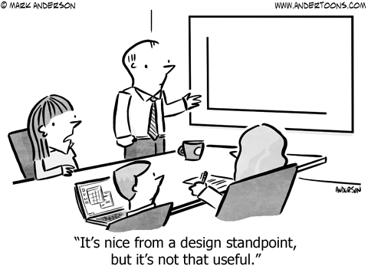
Some Conclusions
Insufficient amount of evidence
Insufficient quality of evidence
Insufficiently transparent analysis of evidence
Inadequate accountability

