Slide 1
The JUC PAC Annual Conference How Place Matters? Leadership, Governance and Public Administration 7th – 8th September 2021
Local authority financial reporting and external audit in England:
The Redmond Review and the future of Local Audit.
Pete Murphy, Peter Eckersley, Katarzyna Lakoma, Bernard Kofi Dom, & Martin Jones.
Nottingham Business School, Nottingham Trent University.

Slide 2
Local Public Audit Systemic problems
“The structure is fragmented and piecemeal. Public sector specialist expertise is now dispersed around different bodies. The structure means also that no one body is looking for systemic problems, and there is no apparent co-ordination between parties to determine and act on emerging risks”.
(Kingman 2018 p. 69 of the independent Review of Financial Reporting Council)

Slide 3
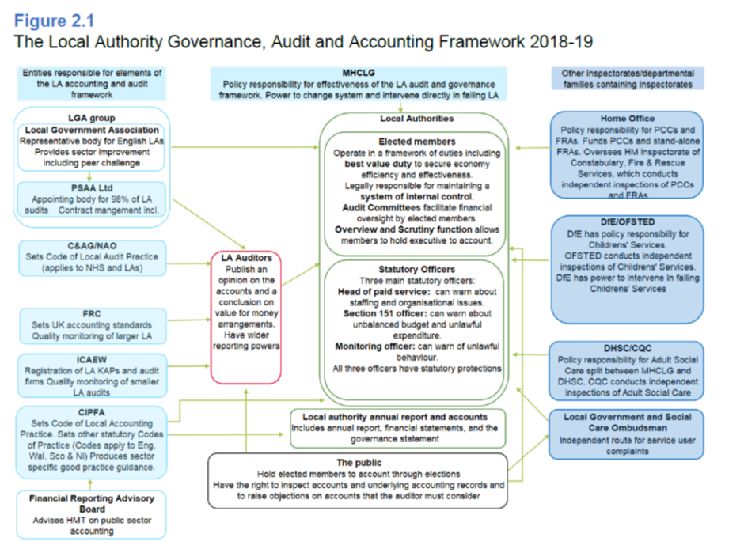
Local Audit Organizational Landscape 2018/19

Slide 4
What was the ‘problem’ It was contested from different perspectives
The government’s perspective – the 2014 Act wasn’t being properly implemented and local audit issues remained unresolved after recent reviews
The sectors and regulators perspective (including CIPFA/ICEAW/NAO) – there is a growing ‘expectations gap’ in what the public assumes is provided and what the system actually provides
The local authorities and the firms lived experience and perspective was of a poorer and slower audit delivered by less knowledgeable and less experienced staff
NTU’s perspective – more holistic, the 2014 Act fundamentally changed local audit from a focus on short, medium and long-term financial management and reinstated the pre-1996 focus on short term financial reporting (resulting in systemic and systematic inadequacies in accountability, accounting, policy, delivery and assurance)

Slide 5
Response to call for views
22 Audit and Audit Stakeholders (such as CIPFA, Welsh Audit)
87 Individual Local Authorities (including all types of authorities)
9 Authority Groups (such Societies of Treasurers
26 Individuals
12 Others (including the media, academics (x2), and specialist interest groups)
100+ interviews with interested parties
High unanimity of responses across all key stakeholders – in summary its is not fit for purpose and it needs replacing

Slide 6
Findings of the Review
Local public audit market fundamentally flawed
Sector Leadership Fragmented
Local Audit not ‘fit for purpose’
‘Going concern’ judgement meaningless in the LG context
No assessment of financial sustainability/resilience/vulnerability
Clearer simpler reporting (Redmond provided a model)
Applies to the NHS, Police, and Fire and Rescue Services
….and small bodies need reform too

Slide 7
The government response to the report (18th Dec 2020 - A good day to bury bad news)
3 Key Problems (problem re-engineering?)
Don’t meet objectives of the 2014 Act
Market Fragility – unattractive market for firms and auditors to operate in
Absence of system leadership since 2014 Act
Recommendations (grouped into 5 themes)
Actions to support immediate market stability (5, 6, 8, 10 and 11)
Consideration of System Leadership ‘options’ (1, 2, 3, 7, 13, 17)
Functioning of local audit and governance of response to findings (4, 9, 12, 18)
Improving transparency of accounts (19, 20, 21, 22)
Audit of smaller bodies (14, 15, 16, 23)

Slide 8
Implementation since publication who is doing what?
Recommendations 1, 2, 3, 7, 13, and 17 (System Leadership) that government is still considering – update in Spring
Recommendations 4, 5, 8, 9, 12, 20 and 21 that the government is committed to working with one or more of LGA, NAO, CIPFA, FRC and ICAEW
Recommendations 19, and 22 that the government is looking to Cipfa to implement
Recommendations 6, 10 and 11 that government has agreed to implement itself

Slide 9
Reasons to be optimistic about the potential for beneficial change
Level of unanimity between key stakeholders
New Code of Audit Practice from NAO
Redmond provided examples and guidance on ‘how to do it’ not just ‘what to do’
Key stakeholders brought into implementation
Implementation has been compartmentalised and is underway
Contestable and non-contested issues separated
Putting the cat among the pigeons
Government is exploring the full range of options for system leadership including close consideration of whether existing bodies could take on this function” as “not currently persuaded that a new arms-length body is required”

Slide 10
Spring Update (May 2021) Market Stability Functions and Governance Transparency Smaller Bodies
Market Stability – 5, 6, & 8, “in progress” 10 & 11 “delivered”
Local Audit Functions and Governance – 4, 9, 12, & 18, all “in progress”
Transparency – 19, 20, 21, & 22, all “in progress”
Smaller Bodies – 14, 16, & 23, all “in progress”

Slide 11
System Leadership
Single body leadership (OLAR) – Yes but
Should be the new “Audit, Reporting and Governance Authority” (AGRA) set to replace the Financial Reporting Council not OLAR.
Procurement/Management of contracts to stay with PSAA
Liaison Committee
Yes, to a committee but chaired by AGRA not MHCLG
Additional Audit Sanctions
Under further consideration
Review 2020 Audit Code of Practice
Accept and look to AGRA to undertake the post implementation review
Assurance of financial sustainability of LAs
Accept additional data in 2020/2021 and monitoring financial pressures from COVID

Slide 12
Conclusions
Local authority financial reporting and external audit in England had become unfit for purpose and the 2013 Local Audit and Accountability Act had exacerbated its inadequacy
Austerity had accelerated the realization and acceptance of the need for significant change
Parallel inadequacies in private sector audit, financial reporting and the operation of the audit market further helped ‘legitimise’ the need for radical change.
All Redmond’s technical and process changes where accepted – but ideological and political presentational factors rather than rational or operational considerations are determining sector leadership decisions

Slide 13
Thank you for listening
Questions?

