Slide 1
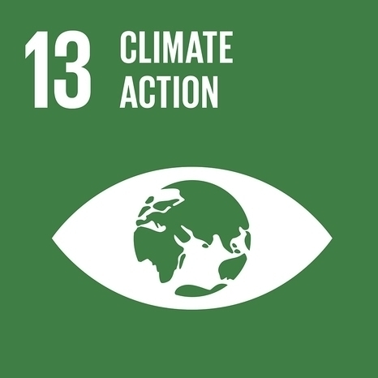
Advancing SDG 13: Integrating Climate Change into Management Education
Dr. Alex Hope
Newcastle Business School, UK
Prof. Dr. Petra Molthan-Hill
Nottingham Business School, UK
Prof. Rajul Singh
Conestoga College, Canada

Slide 2
Presentation overview
The climate emergency
Climate change education
Global climate change education survey
Climate Literacy
Notes:
Or working group would like to present the attached (which will be soon finalised) covering the following topic:
The need for everyone in the business school to understand climate change and climate change mitigation and act upon it.
Climate change education in business schools: strategies Our working group: a) Overview (Petra) b) Our survey, recent publications, and research (Alex) c) Carbon Management and templates (Muhammad) d) Our upcoming events (Rachel)
The first slides might be narrated by different people (to be decided).
For the recording: We could do Thursday 20.05. between 9-12.30 BST. Maybe 11.00-12.30 BST would be best given your time zones? We would appreciate if you could confirm the date and time soon so that we can block it in our diaries.
Or working group would like to present the attached (which will be soon finalised) covering the following topic:
The need for everyone in the business school to understand climate change and climate change mitigation and act upon it.
Climate change education in business schools: strategies for every discipline
Our working group: a) Overview (Petra) b) Our survey, recent publications, and research (Alex) c) Carbon Management and templates (Muhammad) d) Our upcoming events (Rachel)
The first slides might be narrated by different people (to be decided).
For the recording: We could do Thursday 20.05. between 9-12.30 BST. Maybe 11.00-12.30 BST would be best given your time zones? We would appreciate if you could confirm the date and time soon so that we can block it in our diaries.

Slide 3
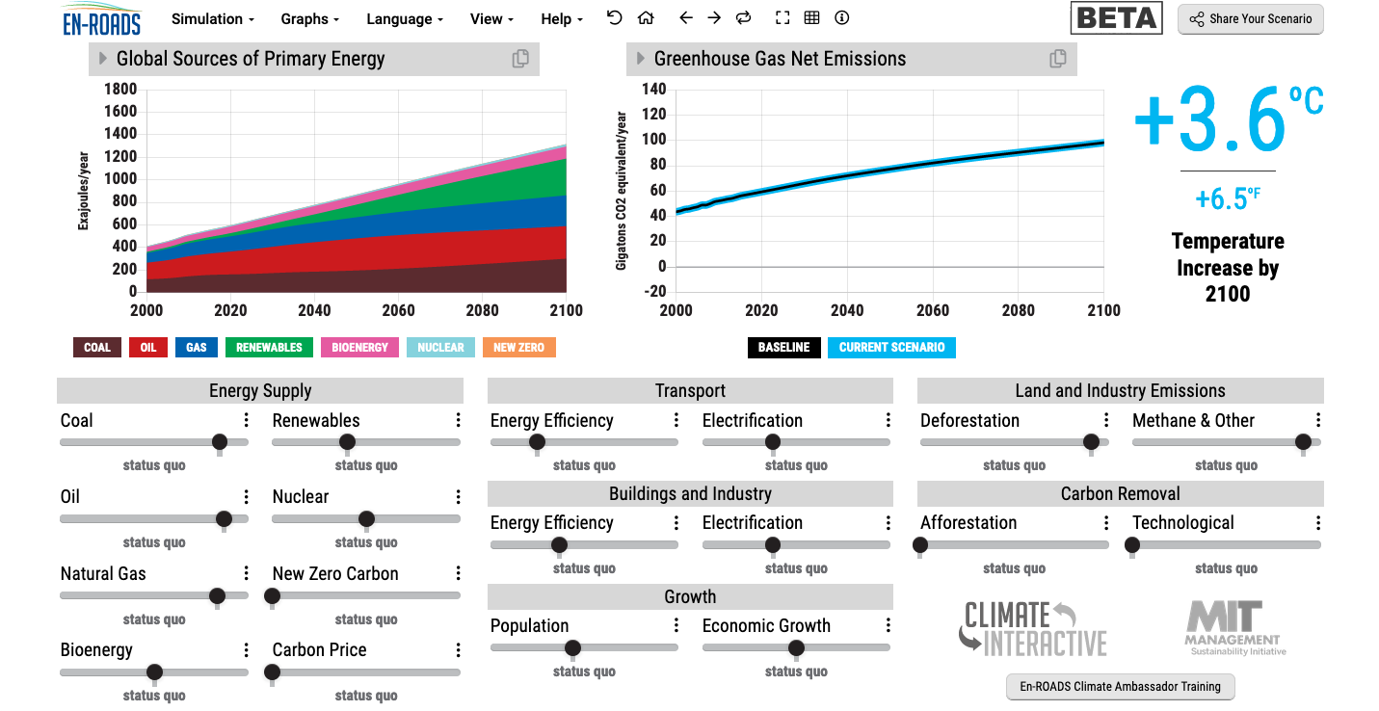
En-ROADS is a cutting-edge simulation model used to test climate solutions and generate climate scenarios for the future.
Notes:
This is our current situation as demonstrated by En-ROADS which was developed by MIT Climate Interactive so that everyone can understand the high impact solutions and which impact they would have.

Slide 4
1. Climate Change Mitigation
1. Climate Change Science Education
Knowledge and understanding of a broad range of scientific concepts and processes related to climate change (e.g. climate, deforestation, habitat loss, water cycle, soil erosion, air pollution), its causes and its consequences, ecologically, socially, economically and politically.
Knowledge and understanding of the dynamics of climate change impact across time and space (e.g. delayed consequences, reducing the quality of life, security and development options of future generations).
Awareness of strategies and technologies to address the negative impacts of climate change (e.g., reducing carbon consumption, encouraging low-carbon development, reducing deforestation through sustainable forest management, improving water and waste management).
Ability to distinguish critically between certainties, uncertainties, projections and risks associated with climate change and to evaluate messages about and public interpretations of climate change science.
This table will be published in: Molthan-Hill, P et al (2021), Climate change education at universities: Relevance and strategies for every discipline. in: Handbook of Climate Change Adaptation and Mitigation (3rd edition), Springer: Cham, Switzerland, forthcoming. Adapted from definitions provided by Mochizuki Y, Bryan A (2015) Climate change education in the context of education for sustainable development: Rationale and principles. Research 9(1): 4-26.
Notes:
We need to distinguish between three areas of climate change education, the first one is the science: Every Graduate need to understand the climate change science enough to make informed decisions and integrate high impact solutions into their life and work. This basic understanding is also necessary for anyone studying business.

Slide 5
1. Climate Change Mitigation
2. Climate Change Mitigation Education
Developing values, knowledge and skills required to make choices and decisions that minimize the use of natural resources, emissions, waste and pollution, while contributing to the development of new solutions to the climate crisis (e.g., rethinking the way we live, buy and consume, how our daily lives are organized, how we socialize, exchange, share, educate and build identities).
Taking individual and/or collective action with the potential to have immediate, direct impact (e.g., reducing energy consumption, using non-polluting and renewable energy sources, environmental conservation, re-forestation and re-greening).
Contributing to policy development with long-term positive impact on societal behavior by examining economic systems, social structures, cultural patterns, lifestyle expectations, consumerism, wealth distribution, aspirations and value systems and their underlying responsibility for excessive greenhouse gas production.
This table will be published in: Molthan-Hill, P et al (2021), Climate change education at universities: Relevance and strategies for every discipline. in: Handbook of Climate Change Adaptation and Mitigation (3rd edition), Springer: Cham, Switzerland, forthcoming. Adapted from definitions provided by Mochizuki Y, Bryan A (2015) Climate change education in the context of education for sustainable development: Rationale and principles. Research 9(1): 4-26.
Notes:
The second one is Climate Change Mitigation Education: Every Graduate needs to know how to best mitigate climate change- what are the best strategies and tools in operations, supply chain management, economics, investment to reduce carbon emissions?

Slide 6
1. Climate Change Mitigation
3. Climate Change Adaptation Education
Building capacity to apply these strategies in future situations, when the delayed impacts of climate change make themselves felt.
Knowledge and understanding of tools and methodologies to respond promptly and effectively in areas that have been negatively impacted by climate change, including Disaster Risk Reduction (DRR) strategies such as community disaster committees, community evacuation and rescue plans, and local first-aid training.
Knowledge and understanding of tools and methodologies to rebuild and restore areas that have been negatively impacted by climate change (e.g., seashores, flood prevention measures).
Implementing measures that reduce the vulnerability of natural and human systems to the impacts of climate change.
Advocating for appropriate channelling of resources at global level to protect negatively affected natural and human systems in a just and equitable way.
This table will be published in: Molthan-Hill, P et al (2021), Climate change education at universities: Relevance and strategies for every discipline. in: Handbook of Climate Change Adaptation and Mitigation (3rd edition), Springer: Cham, Switzerland, forthcoming. Adapted from definitions provided by Mochizuki Y, Bryan A (2015) Climate change education in the context of education for sustainable development: Rationale and principles. Research 9(1): 4-26.
Notes:
In many countries Graduates need to learn how to adapt to climate change now, however in the UK and other high emitting countries the focus should be on mitigation: Is it not better to mitigate against the flooding of London so that major floods will not happen in the near future than to build higher flood defences now?

Slide 7
Climate Change Education Survey
157 complete responses
93 HEIs 22 countries
98% agree climate change is a legitimate topic to be taught in Business Schools
Only 45% do some teaching in this area

Slide 8
Climate Change Education Survey
‘Business through its various activities impact the environment, so future professionals should engage with discussions on climate action’ (Respondent 49) Assistant Professor in Public Health, India
‘Every topic connected with the economy or businesses is a legitimate topic to be studied in business schools. Clearly, there are economic repercussions of climate change’. (Respondent 99) Assistant Professor, Economics UK.
Addressing climate change requires business insight and economic analysis. Students should be taught to think critically about all important issues that have a broad public impact. (Respondent 168) Dean, Finance, USA.
Climate change is a politically motivated myth without unbiased scientific proof (Respondent 143) Head of Department, Strategic Management, USA.

Slide 9
Climate Change Education Survey

Slide 10
CLT - ECOS
Climate change mitigation and focused on solutions
Interactive teaching material
MIT Sloan & Climate Interactive Simulation tool
Certificates for you and your students
www.ntu.ac.uk
Please contact petra.molthan-hill@ntu.ac.uk for more info on this or the more specific training for business schools mentioned earlier.
Notes:
And if you are interested in the wider perspective on how to get everyone in the university carbon literate, NTU has made one of the two open-source tool kits for all staff and students at universities.

Slide 11
Recent publications, and research
Molthan-Hill, P., Blaj-Ward, L., Forh Mbah, M. and Shapiro Ledley. T. (2021) Climate Change Education at Universities: Relevance and Strategies for Every Discipline
Molthan-Hill, P., Hope, A., & Welton, R. (2020). Tackling Climate Change through Management Education. The SAGE Handbook of Responsible Management Learning and Education, 165.
Molthan-Hill, P., Robinson, Z. P., Hope, A., Dharmasasmita, A., & McManus, E. (2020). Reducing carbon emissions in business through Responsible Management Education: Influence at the micro-, meso- and macro-levels. The International Journal of Management Education, 18(1), 100328.
Mbah, M., Ajaps, S., & Molthan-Hill, P. (2021). A Systematic Review of the Deployment of Indigenous Knowledge Systems towards Climate Change Adaptation in Developing World Contexts: Implications for Climate Change Education. Sustainability, 13(9), 4811.
Molthan-Hill, P., Worsfold, N., Nagy, G. J., Leal Filho, W., & Mifsud, M. (2019). Climate change education for universities: A conceptual framework from an international study. Journal of cleaner production.

