Slide 1





JFMPS 2014
Martin Jones and Pete Murphy
Nottingham Business School
Financial Resilience in Local Governments and Municipalities: An Exploration of Anglo-Italian Experiences….
(….and Austria too!)

Slide 2
Contributors
Dr Martin Jones – Nottingham Business School
Pete Murphy – Nottingham Business School
With Colleagues from;
Professor Ileana Steccolini - Associate Professor at Bocconi University, Milan
Dr Enrico Guarini - Assistant Professor at the University of Milano-Bicocca
Carmela Barbera - Assistant Professor at SDA Bocconi School of Management, Milan
Plus…Dr Iris Saliterer - Assistant Professor of Public Management at the Alpen-Adria-University of Klagenfurt, Austria

Slide 3
The Project
CIMA seed corn funding (£5,000)
Timescale - 12 months (to 30th November 2014)
The objectives of the research are as follows:
  exploring the potential of the concept of resilience when applied to the performance management of public administrations, and, more specifically, local authorities
  developing a preliminary conceptualization of financial resilience within local authorities
  exploring inhibitors and enhancers of local authority financial resilience
  developing preliminary practical guidelines for ensuring financial resilience in local authorities.
The project will have at least two outputs: one article for CIMA member magazines and a research report

Slide 4
Why Local Government Financial Resilience?
Are public administrations able to anticipate and cope with unexpected events and crises?
Increasing use of the term “resilience” in practice discourses (Audit Commission 2010; Grant Thornton 2011 & 2013; NAO 2013)
Theoretical aspects:
  Wildavsky (1988) called for an attention to resilience in the field of public administration
  Trade-off between 3 main families of administrative values (Hood, 1991) including:
    Sigma type values – economy and parsimony
    Theta type values – honesty, fairness and mutuality
    Lambda type values – resilience (keep operating in worse case conditions and adapt to crisis)
  NPM has tended to focus on sigma values at the expense of other values?
  Similarly, so have responses during the age of austerity?
But little academic analysis of the discourse of what financial resilience means and how it can be used

Slide 5
Why Local Government Financial Resilience?
Current - Local Authorities are facing significant financial pressures:
Diminishing levels of resources
Increasing demands on resources

Slide 6
Why Local Government Financial Resilience?
Increasing demands on resources:
Demographics (elderly, children, migration)
Impact of recession
Technological change
Demand for quality services
Diminishing levels of resources:
Spending Review outcomes
  Real terms 28% reduction by 2014/15
  Further reductions planned
Changes to tax bases
Reduced direct income from fees and charges

Slide 7
Why Local Government Financial Resilience?
Historically there have been pressures too……
  Recession is not new, its just worse this time around
  Policy demands for improved services
  Wicked issues?
  Demographics have had an ongoing impact too
  Centralist influence over resources……
  …..With some reduction in direct controls (capital, prudential borrowing etc)
  Increasing emphasis on the Use of Resources assessment
  Gershon efficiency savings
  EU Directives eg Landfill
  Financial shocks (Icelandic banks, financial failures eg PFIs)

Slide 8
Defining Resilience
Origins in physics, then ecology then other disciplines including social and organisational fields
Originally focussed on “bouncing back” to original state following a crisis or trauma (sometimes called disruptions)
But there is no single definition
May also include growth and adaptation to new status quo……
….or developing the ability to change or exploit the new environment
Is resilience reactive, proactive or both?
Is resilience a process, a system, a capability or a capacity?
Is financial resilience discrete from organisational resilience?
“Efficiency paradox”? whereby the more efficient organizations may find it more difficult to cut expenditures (Levine, 1979)

Slide 9
Related Concepts and Theories
Vulnerability – pre-crisis, mitigation, degree of exposure
Adaptive Capacity – inherent ability to change and adapt
Financial Stress – a form of crisis
Cut-back Management – a response/strategy of the late 1970s
Austerity – the current context
Strategic Turnaround – of failing organisations
Risk Management – scale, likelihood, impact, mitigation
Slack Resources (redundancies) – for exploratory rather than exploitative strategies
Financial Management – cost efficiency to create reserves (slack)
Financial Condition – financial health and capacity

Slide 10
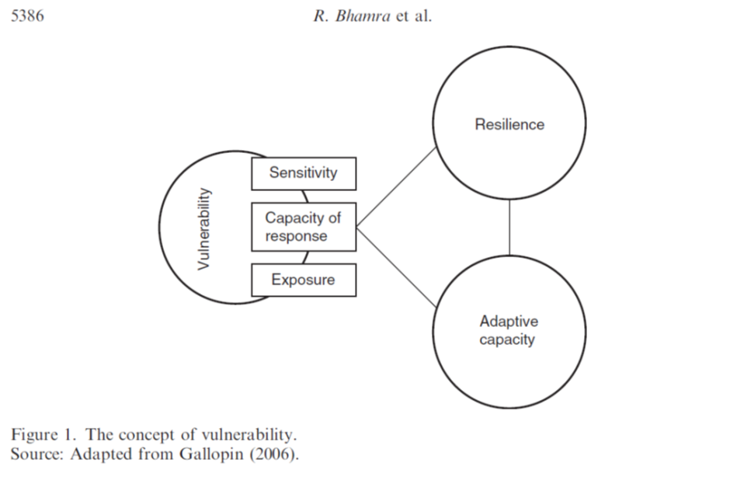
Related Concepts and Theories
Recovery
Preservation
Mechanism for resilience

Slide 11
Stimuli for Research
How have local governmental financial policies been affected by shocks and disturbances?
How do local governments respond and adjust their financial strategies to shocks and disturbances?
Why do some governments seem to be more capable to effectively respond while others face greater difficulties?
What meanings do practitioners attach to resilience?

Slide 12
The Paper
Preliminary ongoing findings of the research project
Initial framing of the landscape for adapting resilience to public sector
High level analysis of English and Italian local governments
Identify interesting behaviours and organisations
Considering Anglo-Italian similarities and differences
Selecting cases for further in-depth study

Slide 13
Methods
Multi-case study analysis
  Longitudinal study (10 years)
  8 cases, four from each country
  A mix of municipal governments but of similar size and functions
Selecting Organisations
  Analysis of government data sets (AIDA PA and Ministero dell’Interno data / RS data)
  Identify key financial measures to track resilience
  10 year surplus/deficit (normalised through averaging) plus volatility (standard deviation)
Interviews (next phase)
  With senior officials, preferably CFOs, but could also include CEOs, elected officials and Assistant CFOs
  Interviews to give rich data regarding strategic financial management and responses to financial crisis
  And provide basis for conceptual development

Slide 14
Challenges
Different accounting rules and basis
Maintaining a long term focus in the current era of austerity
Capturing long term actors
Cultural factors? Between and within countries.

Slide 15
Initial Analysis – Case Study Selection
Choice of measure to select cases
Key factor = Importance to decision makers
Italy = Surplus/Deficit
England = Contributions to Unallocated reserves
Both represent internal autonomy and flexibility……….
……..how the budget is balanced over time (budgetary position)
Therefore we used
Budgetary position (normalised mean percentage of turnover)
Volatility (standard deviation)
Stock measure – balance sheet – measure of capacity?
Flow measure – annual movement – measure of decision making?

Slide 20
Initial Italian Findings: four approaches to resilience
 |  | VOLATILITY
 |  | HIGH | LOW
NORMALIZED SURPLUS | HIGH | FATALIST USE OF SLACK Hares: LODI, BARLETTA Emerging and day-by day financial strategy, with attention to ensure balanced budgets and high surpluses Openness to catch emerging opportunities Postponement of emerging problems to new legislatures | DELIBERATE USE OF SLACK Tortoises: NAPOLI, VARESE Deliberate accumulation of surplus and slack resources to ensure flexibility in spending and the possibility to face shocks Lack of clear managerial or political responsibilities
 | LOW | RANDOM USE OF RESOURCES Grasshoppers: CASERTA, FORLI’ Randomness of slack resource management Short termism Accumulation and cancellation of fictive liabilities and revenues to be recovered | 4 EFFICIENT USE OF RESOURCES Ants: SALERNO, MODENA Strong planning and control culture Conservative approach to spending Continuous monitoring of budget execution and balance Use of resources as they become available

Slide 21
Findings
UK – four apparent approaches
  Relatively low average balances and volatility (most county councils)
  High balances and high volatility (22% of Unitaries)
  Relatively low average balances but high volatility
  Consistent contributions to or from reserves
  Austerity has blown pre 2008 financial problems out of the water
  Context appears to be important – eg level of inherited reserves, owning airports!
  Slack resources are being generated to fund invest to save projects
Italy
  Some association between high surpluses and high volatility
  Similarly low surpluses and low volatility, suggesting different approaches
  Differences between northern and southern municipalities (possibly cultural)
    North and centre - more compact surplus and volatility
    South - wider range of surplus and volatility
England – Italy
  Similarity of spread of stock and flow results…
  …suggesting the selection criteria are on the right track
  But, Italy appears to have a wider range of extremes…
  …suggesting different factors are at play within similar approaches across the two countries

Slide 22
Questions and Contributions
Thank You

Slide 23
References
Audit Commission (2010), Strategic Financial Management in Councils; Delivering Services with a Reduced Income
Grant Thornton (2011), Surviving the storm: how resilient are local authorities?
Grant Thornton (2013), Review of the Council's Arrangements for Securing Financial Resilience (Follow-up),London Borough of Haringey
Hood, Christopher (1991), “A public management for all seasons?”, Public Administration, 69: 3-19
Levine, C H (1978), “Organizational Decline and Cutback Management”, Public Administration Review, 38(4): 316-25.
Wildawsky, A. (1988), The new politics of the budgetary process, Scott, Foresman and Company, Glenwiew, IL.

