Slide 1
Managing escalating demand for public services in a time of austerity A case study of family intervention in a South Wales local authority
Alison Prowle – Centre for Early Childhood Studies, University of Worcester
Peter Murphy and Malcolm Prowle - NBS, Nottingham Trent University

Slide 2
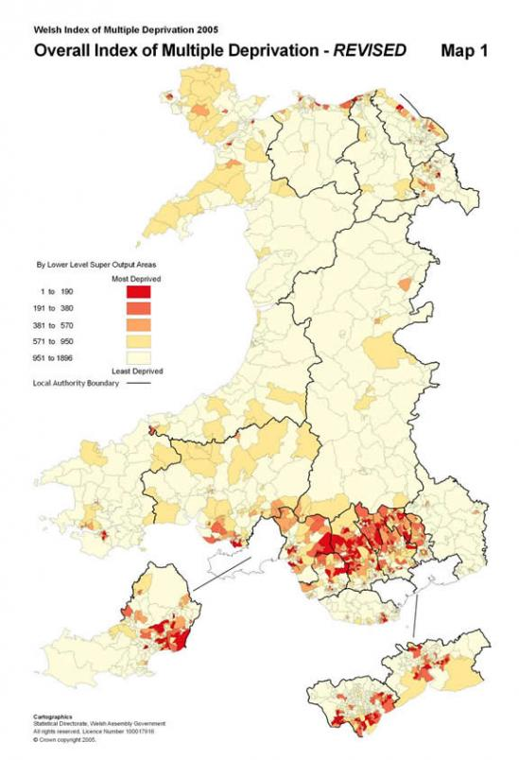
Research setting
Local Authority (Population 70, 064.)
General health poor - 16% ( Wales 12%).
Highest unemployment in Wales
45% people no qualification (Wales 33%).
35% households no car (Wales 26%)
Highest rate of severe child poverty in Wales
Highest level of low birth weight babies in Wales
Highest number of young people who are Not in Education, Employment and Training in Wales

Slide 3
Recent policy has moved from predominantly individual or area based responses to embrace family based interventions across childrens’ services, health and criminal justice.
The context is economic austerity and fiscal constraints
Research subject is Family interventions in ‘troubled families’ (with a debate on definitions)
The approach has been via a Case study
Overriding challenge is clearly increasing demand and diminishing resources
Surveyed analysed and appraised alternative options for family interventions
Highlight some implications of pursuing individual options or interdependent groups of options
Conclusions

Slide 4
Financial and economic austerity
Common International Themes
Significant public budget deficits and levels of private debt prior to start of the wider economic recession
Financing of budget deficits by borrowing - - adds to stock of public national debt
Limited (or nil) economic recovery following global economic recession
Continuation of large public budget deficits financed through borrowing
Implementation of fiscal consolidation policies - usually involved combination of tax increases and reductions in public expenditure
In some cases some form of financial bail-out was implemented either by the IMF or the EU.
UK situation
Public budget deficits from 2002 onwards in a period of economic growth
When the economy entered recession the deficit soared to over 12% of GDP
New government initiated a policy to eliminate the budget deficit over a 4 year period
Involved increases in taxation, cuts in welfare expenditure and reductions in public expenditure programmes average 25% over a four year period
UK economy has shown limited economic growth Lack of strong growth rendered the original plan unachievable - Aim now is to eliminate deficit by 2017/18
Huge challenges may be seen as a watershed in our social and economic history - an era of continued austerity

Slide 5
Troubled families and family interventions
Growing policy emphasis on troubled families
Outcomes for children in these families are very poor
Estimated cost of supporting the families is extremely high
Growing recognition that family based intervention can be effective
New figures on DCLG website suggest that troubled families cost the tax payer an estimated £9 billion per year, equivalent to £75,000 per family

Slide 6
Case study description and research methods
The research examined
The current objectives of family based interventions
Effective models in relation to family based interventions and the hallmarks they display
An assessment of practise in Blaenau Gwent against the hallmarks of effective intervention?
Identification of the barriers to improvement and how can they be overcome in order to improve services?
Methods
Interviews with officials of the Welsh Government
Interviews with strategic managers of the multi-agency partnership
Questionnaire survey of strategic managers, operational managers and front-line key workers
Focus groups with front-line key workers
Participant obsevation

Slide 7
Selected Research Findings
There is confusion about overall aim and purpose of family intervention and little consensus about strategic objectives and how these should be prioritised
The biggest barrier was “how to manage increasing need within a context of diminishing resources ?”
There was a lack of consensus regarding the pitch and reach of current models
There was an assumption that this was a short term issue with neither the nature nor magnitude of the future funding challenge appreciated
There was limited recognition of the role of leadership or the need for organisational change
There was a tension between investing in long term prevention and short term high end interventions
Were able to identify the hallmarks or characteristics of good practise and therefore the basis for future strategy

Slide 8
The Key Challenge
Diminishing Resources
Welsh Government settlement to councils
Reduction in grant funding
Financial constraints in all agencies
Increasing demand
Existing high levels of need
Economic downturn
Welfare Reform
Unemployment
Poverty
Rising numbers of looked after children
Domestic abuse
Need To Bridge The Gap

Slide 9
Options
Prioritisation
Enhanced economy, efficiency and effectiveness
Improved productivity
Early intervention and prevention
Co-production ,co-charging and self regulation
Service innovation

Slide 10
Prioritisation
Prioritisation – traditional response
Strong support from practitioners for better prioritisation approaches
Technical issues should easily be resolved
Balancing need with likelihood of success (readiness to change)
WHO? and HOW?

Slide 11
Improved productivity
Amount of output per unit of input – 2 key areas identified
Get practitioners to do more within existing resources. Examples might include :
having more flexible working and remote/home working
increasing caseloads
improved use of IT reduced sickness absence etc.
Simplifying existing processes for dealing with troubled families through business process re-engineering. The research showed that 53% of key workers identified this as one of the top three barriers to improving productivity.

Slide 12
Enhanced economy, efficiency and effectiveness
Found growing individual and systemic emphasis on Value for Money
Can be achieved in a number of ways, e.g.. implementing effective models, reducing fixed costs, improving commissioning arrangements
Most of hallmarks for effective practice were in evidence but need further work to fully develop and implement effectively
For example there were high levels of staff buy-in to co-location of teams from different services – fixed cost savings
But low levels of appreciation of the importance of applying evidence based models.

Slide 13
Early Intervention and Prevention
Growing recognition that early intervention more effective than crisis intervention
The research highlighted staff frustration that intervention, both in individual cases and conceptually (as a priority within the systemic or collective response) was not sufficiently early
“For too many families the intervention is not timely. Things have got to near crisis point before we get involved, and then everything is harder and more entrenched”

Slide 14
Co-production, co-charging and self regulation
The literature suggested that effective user and community involvement may helps to improve outputs, service quality and client outcomes and reduces the costs for local government (Barker, 2010).
The research found strong support for co-production and self regulation, especially from 3rd Sector
Research demonstrated that user involvement was a key facilitator for success.
But limited support from key workers for co-charging as a means of improving client engagement

Slide 15
Service Innovation
Increasing emphasis on innovation in public services e.g QIPP programme in the NHS (Quality Innovation Productivity and Prevention)
Within the context of family intervention, encouraging innovation could include some of the following actions
Increased empowerment of front line staff to make decisions about service delivery ( strong support from research)
Use of innovation approaches such as brainstorming, action learning sets, RBA approaches, enhanced service user involvement.
Use of social impact bonds to engage private sector approaches, skills and attitudes to support the delivery of improved services.
“Public services are often poor at innovation from within and poor at learning from outside…innovation is an integral part of being strategic recognising that all strategies need to create new knowledge as well as using existing knowledge” (Mulgan 2009 p 170)

Slide 16
Managerial implications of options Issues and Barriers (1)
Option | Issues or Barriers
Prioritisation | Relatively easy to develop and implement prioritisation tool. Political and moral issues in relation to unsupported ?
Improved productivity | Could impact on quality of service delivery. Could have implications for staff morale. Could generate trade union issues.
Enhanced Economy, Efficiency and effectiveness | Hallmarks for effective practice are already in place but need development Political and practical issues to resolve. Low levels of local appreciation of the importance of evidence based models. Staff development needs.

Slide 17
Managerial implications of options Issues or Barriers (2)
Option | Issues or Barriers
Co-production co-charging, and self-regulation | Workforce development implications. Charging policies likely to be unpopular Need to research likely impacts of co-charging on demand and commitment. Efforts at self- regulation even when professionally assisted, do not always yield success
Early prevention | High levels of local buy in to early intervention Requires robust early identification tool. Resourcing preventative work alongside supporting the critical end of need. Limited availability of pump priming resources
Service innovation | Innovation is a lengthy process and it takes time, leadership and dedicated resources . No simple universal formula existing that can be applied to ensure successful innovation. There may be practical, cultural and political factors that inhibit this approach.

Slide 18
Implementation implications of various options Timescales and resources
Option | Implementation timescales | Resource implications
Prioritisation | Short term | Low
Improved productivity | Short-medium term | Medium
Enhanced Economy, Efficiency and effectiveness | Medium term | Medium
Co-production co-charging, and self-regulation | Medium- long term | Medium
Early prevention | Long term | Medium-High
Service innovation | Long term | High

Slide 19
Key requirements for implementing these options
Individual and collective leadership at organisational and systemic levels
Short medium and long term strategies and action plans
Robust Change Management and Organisational Development
Adequate and Dedicated Resources

Slide 20
Conclusions
Family Interventions
The numbers and needs of troubled families are rising (and predicted to rise further) causing an increasing demand for family interventions when resources are diminishing.
Managing this tension will be a key priority for the future
A number of possible options, have been identified as means for reducing tensions
However, these options have a different range of implications and there is a clear need for a strategy to best deal with the tensions involved.
Local responses will be situational but the challenges and interdependencies require a collective or multi-agency response as well as individual organisational responses.
General
There are other public services which have similar features of increasing demand and declining resources, in a time of austerity
It is appropriate to consider the applicability of the options identified to other public services.
Further research would be needed to establish the degree of relevance of these approaches to the different services
They should provide a framework for developing a workable strategy for dealing with the challenges ahead.
The research demonstrated a clear need for service and systemic innovation in the long term which is probably endemic across the public services.

Slide 21
Questions/Comments
Mrs Alison Prowle
Centre for Early Childhood Studies
Institute for Education
University of Worcester
E-mail: a.prowle@worc.ac.uk
Mr Peter Murphy and
Professor Malcolm J Prowle
Nottingham Business School
E-mail: peter.murphy@ntu.ac.uk
E-mail: malcolm.prowle@ntu.ac.uk or

