Slide 1
A Fair “Hearing”: Voice Identification, Parades and PACE
Jeremy Robson, Principal Lecturer and Barrister

Slide 2
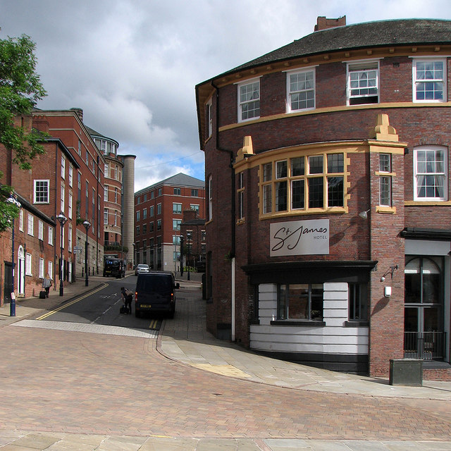

Slide 3
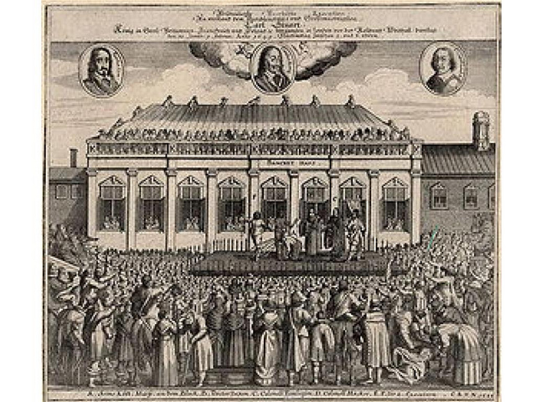

Slide 4
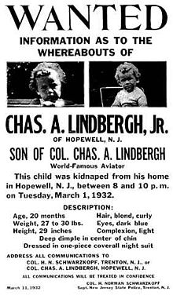

Slide 5
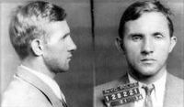

Slide 6
‘There is no story to be dissected, just a simple assertion to be accepted or rejected. If the witness thinks he has a good memory for faces, when in fact he has a poor one, there is no way of detecting the failing.’
Devlin Report 1976

Slide 7
2011 Code D Police and Criminal Evidence Act Para 2.1
test the witness’ ability to identify the suspect as the person they saw on a previous occasion.
provide safeguards against mistaken identification

Slide 8
1985 Code D Police and Criminal Evidence Act
If a witness wishes to hear any parade member speak…the identification officer shall first ask whether he can identify anyone on the basis of appearance only. When the request is to hear members of the parade, the witness shall be reminded that the participants in the parade have been selected on the basis of physical appearance only. Members of the parade may then be asked to comply with the witness’s request to hear them speak

Slide 9
R v Deenik [1992] Crim LR 578
“The submission that the provisions of code D relative to visual identification are material to a decision as to whether it would be unfair to admit evidence of identification by voice is of little, if any, assistance. There is an obvious but important difference between voice and appearance. A suspect can alter his voice but not his appearance: he can change the tone; he can change the pitch; he can change the rate at which he speaks; he can adopt or suppress an accent. Alert the suspect to the object of the exercise and its value is immediately destroyed. So it would not have been practicable to give the applicant the opportunity to refuse to let Miss Stacey hear his voice or to suggest the conditions under which she should listen to it.” McCullough J

Slide 10
R v Hersey [1998] Crim. L.R. 281
“[i]t is often overlooked that identification parades may be as valuable to an accused as they are to the prosecution.” Swinton Thomas LJ

Slide 11
R v Gummerson [1999] Crim. L.R. 680
“Code D has no application here. It relates only to visual identification. We do not think that the draftsman of the Code had voice identification in mind.” Clarke LJ

Slide 12
“It is, therefore, incumbent on English law to formulate appropriate safeguards and procedures to ensure that an efficient and reliable system is established for pre-trial and trial uses of voice identification evidence.” Ormerod 2001

Slide 13
Home Office circular 057 / 2003 ADVICE ON THE USE OF VOICE IDENTIFICATION PARADES
‘This work to develop reliable procedures for voice identification, which may ultimately go forward for inclusion in Code D of the PACE Codes of Practice is on-going in consultation with relevant stakeholders.’

Slide 14
Flynn and St John [2008] EWCA Crim 970
The ability of a lay listener correctly to identify voices is subject to a number of variables. There is at present little research about the effect of variability but the following factors are relevant:
(i) the quality of the recording of the disputed voice or voices;
(ii) the gap in time between the listener hearing the known voice and his attempt to recognise the disputed voice;
(iii) the ability of the individual lay listener to identify voices in general. Research shows that the ability of an individual to identify voices varies from person to person.
(iv) the nature and duration of the speech which is sought to be identified is important. Obviously, some voices are more distinctive than others and the longer the sample of speech the better the prospect of identification.
(v) the greater the familiarity of the listener with the known voice the better his or her chance of accurately identifying a disputed voice.

Slide 15
R v Forbes [2001] 1 AC
“Whenever a suspect disputes an identification, an identification parade shall be held if the suspect consents unless paragraphs 2.4 or 2.7 or 2.10 apply. A parade may also be held if the officer in charge of the investigation considers that it would be useful, and the suspect consents.”

Slide 16
R v Forbes [2001] 1 AC
“(1) Code D is intended to be an intensely practical document, giving police officers clear instructions on the approach that they should follow in specified circumstances. It is not old-fashioned literalism but sound interpretation to read the Code as meaning what it says.
(2) Paragraph 2.3 was revised in 1995 to provide that an identification parade shall be held (if the suspect consents, and unless the exceptions apply) whenever a suspect disputes an identification. This imposes a mandatory obligation on the police. There is no warrant for reading additional conditions into this simple text.”

Slide 17
2011 Code D Police and Criminal Evidence Act Para 2.1
“While this Code concentrates on visual identification procedures, it does not preclude the police making use of aural identification procedures such as a “voice identification parade”, where they judge that appropriate.”

Slide 18
Freedom of Information request
The number of criminal offences investigated by the force.
The number of video identification procedures conducted in accordance with Code of Practice ‘D’ of the Police and Criminal Evidence Act 1984.
The number of voice identification parades conducted in accordance with ‘the McFarlane guidelines’ (contained within Home Office circular 057/2003).
The number of cases involving a voice identification procedure (as described in 3)) where;
A failure by the witness to identify the suspected person on the parade has resulted in no further action being taken against that suspected person.
A positive identification by the witness of the suspected person on the parade has formed part of the prosecution case against an accused.

Slide 19
Results

Slide 20
Matter of policy not to
Gwent (don’t have the equipment).
Bedfordshire.
Humberside.
West Midlands.
City of London.
Gloucestershire.
South Yorkshire.

Slide 21
What are the implications for PACE?
May be difficulties of application BUT
Matter for ‘judgment’ on case by case basis.

Slide 22
Factors which may prevent parade
‘No comment’ interview.
Not sufficient length of recording/quality.
Distinctiveness or otherwise of voice.
Representation of voice in local community.
These difficulties are covered by ‘unless it is not practicable or it would serve no useful purpose in proving or disproving whether the suspect was involved in committing the offence.’

Slide 23
Impact upon trial – Cases where evidence turns wholly on voice
Careful judicial consideration at outset
Where close familiarity and prolonged exposure may proceed but carefully and with close scrutiny.

Slide 24
Impact upon trial – Other evidence
Example R v George [2014] EWCA Crim 2507
Close scrutiny beforehand. Consider s78 to exclude?

Slide 25
Impact of conducting not conducting parade
Was a parade conducted?
Y
N
Was D identified?
Was consideration given to parade?
Y
N
Y
N
Were there objective reasons for not holding parade?
Evidence of parade may be admitted with warning to jury about significance.
Should weigh very heavily against admission
N
Treat as breach of PACE. Consider exclusion – give strong warning to jury
Y
Evidence may be admitted but jury should be given warning

Slide 26
An attempt to argue this?
R v Suleman [2014] EWCA Crim 2507

Slide 27
An Irish Perspective
[2015] IECCA 9
‘Be that as it may, the Court agrees with counsel for the appellant that the total absence of safeguards meant that minimum standards of fairness were not met in the circumstances of this particular case, and accordingly the conviction cannot be upheld… Undoubtedly, the adoption in a particular case of a voice identification procedure which attempts to address potential biases and infirmities by means of safeguards, is likely to improve the cogency of such evidence. Therefore such measures are strongly to be encouraged on that account alone. Perhaps even more importantly they are also to be strongly encouraged in the interests of procedural fairness.’

Slide 28
Further reading
http://irep.ntu.ac.uk/id/eprint/29636/

