Slide 1
The Quality of Work Among Older Workers
Chris Lawton, NTU christopher.lawton@ntu.ac.uk
Daniel Wheatley, University of Birmingham d.wheatley@bham.ac.uk

Slide 2
Introduction
This paper explores patterns of work among older adults and reflects, in particular, on the quality of work encountered by older workers (defined as aged 50 and over)
In recent years public and societal discourse has increasingly focused on extending the working lives of older adults (Felstead, 2010, 1294)
Driven by trends in population demographics and the changing age structure of the workforce, as well as the impact of recession and recovery (austerity)
Gaps in understanding surrounding the drivers of extended working lives (EWL) (voluntary vs involuntary), and the quality of work encountered by older workers
Our analysis of the UK combines data from the Annual Population Survey, Annual Survey of Hours and Earnings, Labour Force Survey, and in-depth analysis of Understanding Society using Two-Step Cluster analysis and multinomial logistic regression
Generates findings with relevance to current debates and policy agendas, and suggestions for further research
Notes:
In past research definitions of ‘older adults ‘ or ‘older workers’ vary considerably, from those aged over 40 to those aged over 75 (Bourne, 1982; Warr, 2000). However, increasingly it is accepted that older workers most appropriately refers to individuals aged 50 and over (Kooij et al, 2008, 365).
It is also acknowledged that chronological age provides an imperfect measure of ageing, as it ignores the variations present in physical and psychological well-being and other demographic and occupational factors (Kooij et al, 2008, 365).
Nevertheless, the policy context remains focused around chronological age in the absence of an alternative method of categorizing individuals with respect to ageing.

Slide 3
Legislative, Policy and Structural Factors
Policy discourse promoting EWL, e.g. European Commission promotion of ‘active old age’ (2003); OECD’s Live Longer, Work Longer, UK’s Opportunity Age launched in 2005; etc.
Contrasts ‘lump of labour’ concept prevalent in 1970s
Changes to state pensions – planned increases in state pension age to 66 (2020), 67 (2028) and eventually 68 (2044-46) through Pensions Act
Abolition of statutory retirement age through The Employment Equality (Repeal of Retirement Age Provisions) Regulations 2011 (No. 1069)
Changes to welfare through Employment and Support Allowance (ESA) and Work Programme

Slide 4
Recent UK Policy Discourse
The Altman Review - ‘A New Vision for Older Workers: Retain, Retrain, Recruit’ (March 2015)
‘Fuller Working Lives’ strategy (DWP, February 2017)
Government’s Response (including 2017 Spring Budget) and Women & Equalities Select Committee Inquiry (launched in March 2017, call for evidence suspended due to purdah prior to the General Election)
Strong common assumption: longer working lives, including working past State Pension Age, are generally desirable and to be facilitated by addressing barriers that are principally on the demand-side e.g. age discrimination by employers
Government strategy does recognise challenges faced by carers (and that this is often highly gendered) and states aim for cross-Government ‘Carers’ Strategy’

Slide 5
Method
Descriptive statistics of UK secondary data sources including the Labour Force Survey/Annual Population Survey (LFS/APS), Mid-Year Population Estimates (MYE) and Sub-National Population Projections (SNPP) and Annual Survey of Hours and Earnings (ASHE)
Two-Step Cluster Analysis of Wave 4 of the Understanding Society Survey
Note: question on employment quality only included in every other Wave - Wave 6 data not published when research conducted
Extended through Multinomial Logistic Regression using cluster membership variable as dependent variable

Slide 6
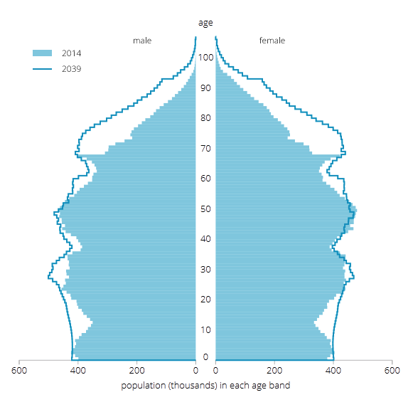
The UK Population is Getting Older…
… and is forecast to continue to do so
Life expectancy is increasing
There were two significant ‘spikes’ in birth rates, immediately after WWII and in the 1960s
The UK population aged 50 and over has increased from 18.3 million in 1995 to 23.6 million in 2015
The ONS project that the number of people aged over State Pension Age will increase by 33% by 2039, compared to 15% for the population as a whole
Source: ONS Crown Copyright, 2015. ‘National Population Projections: 2014-based, Statistical Bulletin’, online resource [accessed on 7th November, 2016].

Slide 7
Demographic Factors are not the only Drivers…
The number of older people is increasing AND the proportion participating in the labour market is growing
In 1996, the employment rate of 50-64 year olds was 58% (compared to a total UK working-age population average of 70%)
In 2016, this had increased to 71% (compared to a UK average of 75%)
The number of 50-64 year olds in employment has grown by 22% over the decade, to 8.6 million people, compared to an increase of 9% for the entire workforce aged 16+
The number of people aged 65+ in work has increased by 95% over the decade to 1.2 million
The majority (52%) of people over 65 state that their ‘main’ reason for working past retirement age is voluntary – they are “not ready” to stop working
However, 15% of those over 65 who were working in 2015 gave essential financial reasons (such as paying bills) as their ‘main’ reason for working

Slide 8
The Increasing Participation of Older Workers Employment Rates, Aged 50-64 and All Working Age (16-64)
Source: ONS Crown Copyright, 2016. ‘Table A05 NSA: Employment, unemployment and economic activity by age group (not seasonally adjusted)’, online resource [accessed on 27th October, 2016].

Slide 9
Decisions to Leave or Remain in Paid Work: Economic Necessity, Health and the Quality of Work
Economic necessity: likely to increase due to changes to public policy
Health: key drivers affecting physical and/or mental ability to continue in paid work
Quality of work: important factor influencing choice to remain in paid work, but also the experience of paid work in later life
The quality of work refers to degree to which work exhibits characteristics which provide benefits or otherwise to the worker, including to physical and psychological well-being (Green, 2006)
Careers of older workers have been argued as becoming polarised into those with low and those with high career capital (Tempest and Coupland, 2016)
Older workers with high career capital are likely to remain in secure employment in their career occupation and/or industry, making use of phased or partial retirement arrangements
But, those with low career capital may find themselves employed, involuntarily, in temporary or ‘flexible’, low pay, low quality jobs

Slide 10
Employment Options for Older Workers
Employment Option | Definition
Phased retirement | Non-standard work arrangement in which an employee remains in their existing employment while reducing their work contribution, often gradually, in terms of both working hours and effort (Hutchens, 2010).
Partial retirement | Usually used to describe a reduction in work effort outside of the career job (Gustman and Steinmeier, 1984a).
Gradual retirement | General term used in reference to reduced work effort during the final years of work (Hutchens, 2010).
Bridge employment | ‘Bridge job’ (paid work) that is taken by an older worker, usually after career employment has ended in order to span the gap between a career job and retirement (Beehr, 2014, 1102; Hedge et al, 2006, 126).

Slide 11
Structure of Work: Part-time and Full-time
A higher proportion of workers over 50 work part-time
But this has remained very stable since 2004: the proportion of older workers working part-time has not increased significantly since the 2008 Recession
The exception is for the self-employed (the ‘rise of the odd jobbers’, TUC & ONS, 2015)
The proportion of younger workers (16-24) working part-time has increased very significantly
This is due to long-term trends, particularly the increase in participation in Further and Higher Education, but also – with further increases since 2008 – due to the impacts of the Recession and recovery for young people (e.g. increasingly ‘precarious’ work)

Slide 12
Trends in Median Earnings
2015: Peak wage (at 39) £3.30 higher than for 64 year-olds
2009: Peak wage (at 34) £4.06 higher than for 64 year-olds
Source: ONS Crown Copyright, 2016. ‘Statistical Bulletin: Annual Survey of Hours and Earnings, 2015 - Table 17: Real median hourly earnings (excluding overtime) by age’, online resource [accessed on 7th November, 2016].

Slide 13
Understanding Society: Two-Step Cluster Analysis & Multinomial Regression
 | Cluster 1 | Cluster 2 | Cluster 3 | Cluster 4 | Cluster 5
Characteristics | concentration in their 50s even gender split high skill levels all employees | oldest cluster (av. 60) self-employed two-thirds men high levels of voluntary work | three-fifths women part-timers lowest skill levels | three-fifths women greatest household contribution (housework, care) | youngest cluster (av. early 50s) three-fifths women over 10% self-employed divorced/split
Quality of Work Indicators | high-quality, high commitment jobs: long hours managers/ profs high incomes & financial security high autonomy high job sat | managers/ profs or skilled trades highest degrees of autonomy least likely to want to stop working high incomes high job sat | low skilled jobs, reflecting bridge employment lower incomes low autonomy few negative feelings toward job high job sat | associate prof, admin, caring & leisure occs lower autonomy high prefs for training high sat with job/life, but low sat with leisure | caring & leisure, sales & customer service occs longest hours low incomes low job sat preferences for new job / stop working low job sat
Notes:
Cluster 1 – EWL through choice
Cluster 2 – self-employed older workers
Cluster 3 – bridge employment
Cluster 4 – older workers with household constraints
Cluster 5 – financial necessity in low quality, low pay jobs

Slide 14
Discussion and Conclusions
The number of older people (aged 50+) has increased significantly in most advanced societies. In the UK, it is forecast to grow at more than double the average rate between 2014 and 2039
Participation in work is increasing due to structural, cultural and legal/policy drivers
‘Main’ reason for work past 65 overwhelmingly voluntary, rather than financial expedient
Older workers no more likely to be working part-time since 2008 than in 2004 and have been less affected by falling real earnings than workers in their 20s and 30s
But our analysis suggests a portion of older workers work into older age due to economic necessity, and that many of these older workers are those employed in low quality jobs
It is important for policy makers to recognise the heterogeneity of experiences as well as career capital in enabling older workers to maintain quality work
Policy makers should also recognise trade-offs, including reduced time for volunteering, and for grand-parenting and other non-marketized care which may impact on participation of younger age groups
The publication of Wave 6 of Understanding Society will enable analysis of panel data across waves, providing further insight

