Slide 1
Politics, public opinion and evidence in changes to the governance of fire and rescue services
Dr Peter Eckersley
Katarzyna Lakoma
Nottingham Trent University
Annual Conference on Fire Related Research and Developments (RE18)
West Midlands Fire Service HQ, Birmingham
13th November 2018

Slide 2
Overview of presentation
Introduction
Public consultations on the introduction of PFCCs in seven force areas
Arguments for and against PFCCs
Whose story is more convincing? What does this tell us about the use of evidence and the purpose of local public services?
Conclusions: what’s the evidence base for PFCCs?

Slide 3
The genesis of PFCCs
Statutory duty to collaborate
Six PCCs taking over responsibility for Fire and Rescue – the ‘governance’ model
Each PCC set out a business case to evaluate different models: status quo; ‘representation’; ‘governance’; and ‘single employer’ and consulted locally
Where the PCC wishes to change governance arrangements, the Act requires an assessment of why (i) it is in the interests of economy, efficiency and effectiveness, or (ii) it is in the interests of public safety for this to happen.
Essex and Northants relatively uncontroversial
Local opposition in West Mercia, North Yorkshire, Cambridgeshire and Staffordshire, but all approved; Hertfordshire abandoned
Other areas have recently proposed a change in governance, e.g. Norfolk
Notes:
Not all business cases set out status quo option (North Yorks and Essex, after preliminary consultations suggested public appetite for change)
‘Representation’ model means PCC sits on FRA and has voting rights
‘Governance’ means PCC takes on the functions of FRA but two separate organisations with separate budgets
‘Single employer’ means PCC takes on responsibilities of FRA and organisations are merged
Some also considered ‘ease of delivery/implementation’ as a factor when deciding which model to adopt
Essex and Northants uncontroversial because of history of poor performance: one firefighter “We may as well go with you because things cannot get any worse!”

Slide 4
Public consultations
All seven areas conducted extensive consultations, including paper-based and online surveys and local events, promoted through social media, flyers, local press, TV, radio, etc.
These consultations involved firefighters, police officers, other public servants, residents, councillors, MPs, etc
The consultations were structured in different ways, but responses varied by force/FRA area and also by roles (e.g. staff affected, residents, local politicians, etc)
Notes:
Northants – 1109 responses (2017 population 733,000 = 0.15%)
Cambs – 2426 responses (population 849,000 = 0.29%)
Staffs – 2361 responses (population 1.12m = 0.21%)
West Mercia – 1279 responses (population 1.26m = 0.1%)
North Yorks – 2587 responses (population 813,000 = 0.32%) – following initial consultation with 1050 residents
Essex – 1708 responses (population 1.8m = 0.09%)
Hertfordshire – 304 responses, 272 from general public (population 1.18m = 0.03%, 0.02%)

Slide 5
Consultation responses I
Force area | Agree |  |  |  |  | Disagree
 | Residents | Elected reps | FRS staff | Police staff | Councils | Residents | Elected reps | FRS staff | Police staff | Councils
Northants | 57% | 63% | 92% | 62% |  | 35% | 30% | 4% | 5%
West Mercia | 64% | 33% | 37% |  | 0 | 36% | 67% | 67% |  | 8
Cambs | 53% | 3 | n/a | n/a | 0 | 39% | 1 | n/a | n/a | 2
Herts | 52% | 11 | n/a | n/a | 1 | 34% | 0 | n/a | n/a | 3
Consultations to seek approval for PCC decision to opt for Governance model: i.e. no other options presented
Notes:
Cambs question: “the Police and Crime Commissioner becomes the Police, Fire and Crime Commissioner (PFCC) and has overall responsibility for the governance of both Cambridgeshire Fire and Rescue Service and Cambridgeshire Constabulary”
Northants question: “How much do you agree or disagree with the proposal for the Northamptonshire Police and Crime Commissioner to take on the governance of Northamptonshire Fire & Rescue Service?”
West Mercia Consultation Questionnaire focused only on the proposal put forward by the PCC and the benefits that the PCC considered would result from this proposal (stated as fact). The public consultation did not seek respondents’ views on which of the three models considered in the Initial Business Case (Representation, Governance or Single Employer model) they preferred.
Herts consultation very limited – only 304 responses (272 from general public)

Slide 6
Consultation responses II
Essex
 | 1 – no benefit | 2 | 3 | 4 | 5 – significant benefit
Representation | 42 | 18 | 15 | 11 | 14
Governance | 34 | 8 | 10 | 18 | 30
Single employer | 45 | 13 | 15 | 12 | 15
 | Staffordshire |  |  |  |  |  | North Yorkshire
 | Elected reps | FRS staff | Police staff | Residents | Public/VCS | Overall | Online | Residents | FRS staff | Police staff | Overall
No change | 44 | 60 | 41 | 49 | 34 | 50 | n/a | n/a | n/a | n/a | n/a
Representation | 14 | 19 | 5 | 10 | 13 | 11 | 40 | 22 | 27 | 48 | 29
Governance | 26 | 12 | 26 | 23 | 30 | 22 | 48 | 61 | 59 | 27 | 55
Single employer | 16 | 9 | 28 | 17 | 23 | 17 | 12 | 17 | 14 | 25 | 15
Notes:
Essex felt change was necessary after Lucas review, though public evidently did not…
Essex question:
Considering the benefits and the ease of delivery presented in the three options, please rate each of them. Rate each option on a scale of 1-5:
1 – Being, I do not see any benefits being delivered through this option.
5 – Being, I see significant benefits being delivered through this option.
Clear opposition in Staffs, but this made no difference
North Yorks preceded by a preliminary consultation that found residents were in favour of greater collaboration between FRS and Police. This then excluded No Change from subsequent consultation – example of an initial leading question resulting in a skewed survey afterwards

Slide 7
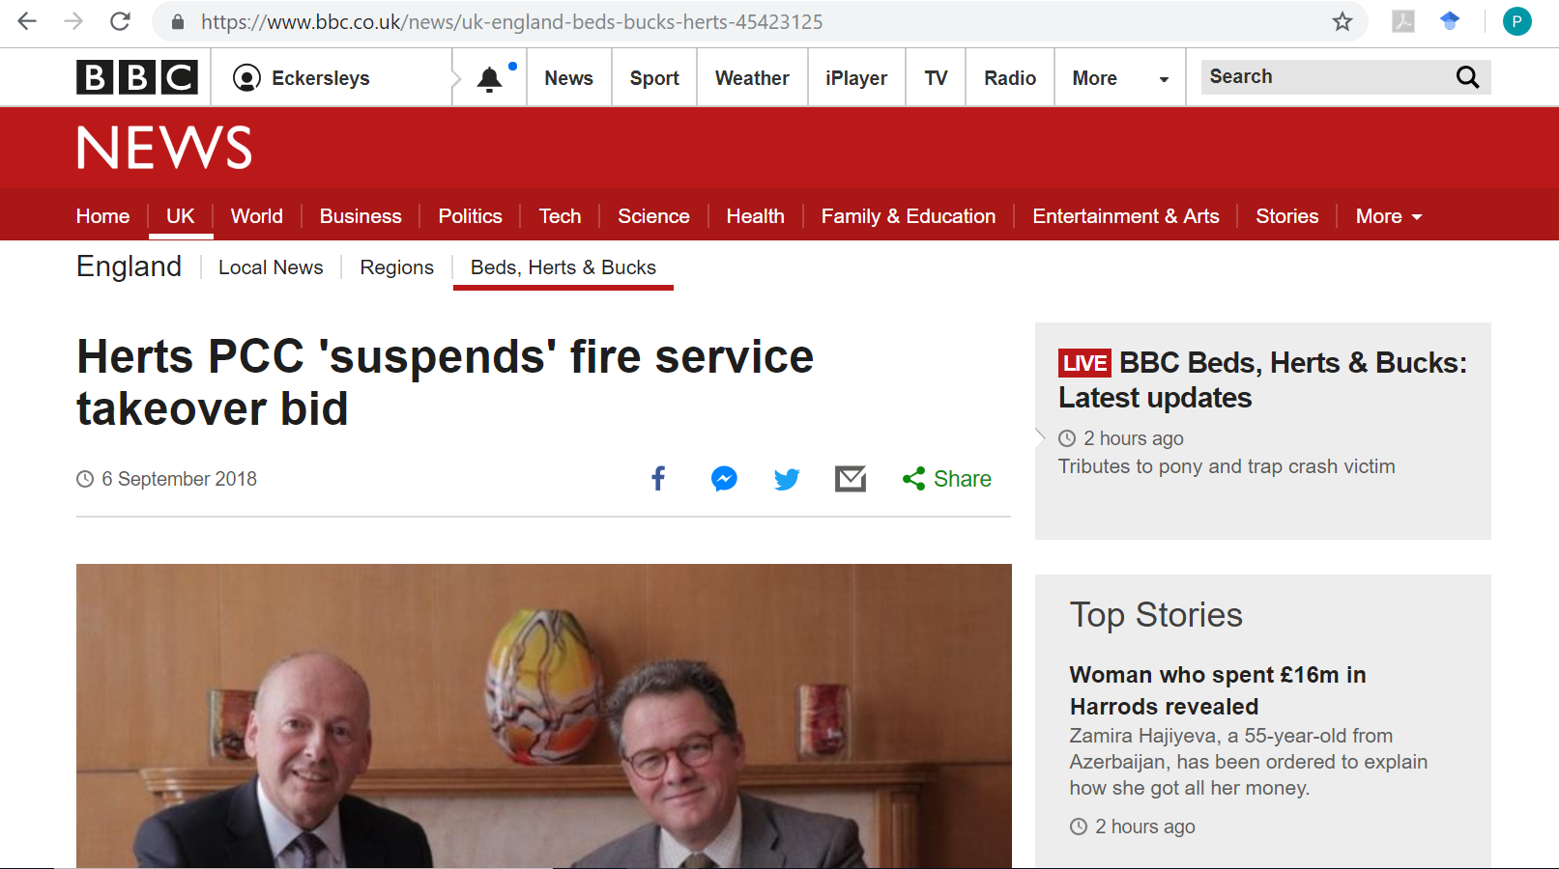
The outlier
Notes:
Hertfordshire as the only example where public opposition as expressed through an open survey actually influenced the result?

Slide 8
CIPFA analyses of business cases
Limited to assessing the impact of the selected governance model on VfM (the 3Es) and public safety
Results largely inconclusive, and don’t appear to be influential
Very hard to verify many of the promised financial savings or judge the impact on public safety
Where opinions are expressed, they are sceptical: “it is our view that the scale and timing of the savings included in the LBC… are ambitious and not supported by any detailed plans.” (West Mercia)
None damning enough to warrant a re-think
Notes:
CIPFA analysis required where there was local opposition to a change.

Slide 9
So if there is limited public support for change, and business cases are unconvincing, why do reform proposals get the go-ahead?
Notes:
What does this tell us about policymaking and evidence?

Slide 10
What is the narrative/story around potential change?
 | In favour |  |  | Opposed
 | "Financial" narrative | "Performance" narrative | "Accountability" narrative | "Cuts" narrative | "Ain't broke" narrative | "Power grab" narrative
Setting (policy problem) | Insufficient resources | Lack of coordination | Lack of scrutiny and accountability | Insufficient resources | Problem 'invented' by PCC | PCC wants more power
Villains (cause the problem) | Not specified | Current structural arrangements | Current governance arrangements | Central govt | PCC | PCC
Victims (harmed by the problem) | The public | The public | The public | The public | The public | The public
Heroes (potential fixers of the problem) | PCC | PCC | PCC | Front-line public servants | None: there is no problem to fix | Opponents of change to governance
Plot (process of developing the solution) | Governance model will save money | Governance model will improve joint working | Elected PFCC will make services more accountable | Better funded public services | Two services distinct but collaboration can be good | Think about who should be in charge of public services
Moral (solution to the problem) | PFCC | PFCC | PFCC | Trust your public servants | More important issues facing fire and police | Many heads are better than one
Notes:
Relationship between these narratives

Slide 11
Financial narrative
“It’s about time one person was in charge of both services and got a grip on the money being wasted” (Essex)
“The primary reason for supporting the PCC’s proposal expressed by respondents to the Consultation Questionnaire was ‘Financial considerations (67.2%).” (West Mercia)
“If the admin and call centres can be more efficient thus leaving more resources for the front line I see this as a benefit. The same goes for the buildings - if one hub will work for all and the need for half-empty buildings goes again we can put more money into the front line.” (Northants)
Our police and fire services need to find efficiencies at the moment. Working together more would help them find those efficiencies in support functions, rather than on the front line” (Cambs)
“Sounds like a good idea as both the Police and Fire brigade seem to be under pressure from the government trying to reduce their budgets, so maybe they will be stronger combined.” (Herts)
Notes:
Intuitive perception that ‘it is a good idea’ or ‘common sense’

Slide 12
Performance narrative
“It is logical for all the emergency services to be integrated for both speed of delivery and monetary reasons.” (Cambs)
“This provides an opportunity for more joined up work at a strategic level.” (Cambs)
“More opportunities for early intervention and prevention work. Greater value coming from quicker and easier sharing of information.” (Northants)

Slide 13
Accountability narrative
“Evidence suggests that single, streamlined governance can accelerate reform and improve public visibility, accountability, transparency and effective scrutiny.” (Cambs)
“I think the transparency of a combined commissioner will be a lot more beneficial to Fire and Rescue as opposed to how we often get lost amongst other priorities within the County Council.” (Northants)
“I would suggest that democracy and accountability is improved by having a directly elected Fire Commissioner rather than appointed local councillors acting as an FRA.” (PCC, West Mercia)

Slide 14
‘Cuts’ narrative
“I am deeply concerned about the proposals for ‘estate rationalisation’. This clearly indicates the closure of local police stations and locating the services in Fire Stations.” (Staffs)
“This is clearly a money saving exercise.” (Essex)
“This is just an exercise to save money not improve our protection.” (Cambs)
“The government will use it as an excuse to reduce the budget even more as services are being shared thus making both emergency services unable to cope with the demand and growth of the county.” (Northants)
“Both need more money. No need to work together” (West Mercia)
Notes:
Scepticism about the impact of proposed cost-cutting on public services, and whether the efficiencies would actually be delivered anyway

Slide 15
‘Ain’t broke’ narrative
“There is no reason why EP and ECFRS can't share knowledge and best practice without the PCC needing to take on both roles.” (Essex)
“Services provided by the Fire Brigade have been operating effectively. Therefore why risk this?” (Cambs)
“I would like to see these two essential services remain as they are and interacting as they already do so well… I see no advantage in change for change’s sake.” (Herts)
“The Commissioner’s Local Business Case does not make a compelling argument as to why it is necessary to adopt the Governance Model to address the stated shortcomings in the pace and scope of collaboration between the Police and the Fire and Rescue Service.” (North Yorks)
“The two work together at the moment and if something is not broken why change.” (Northants)
Notes:
Scepticism about whether the efficiencies would actually be delivered anyway, and the implementation costs of change. E.g. Herts CC line by line fisking of business case – detailed response then from PCC

Slide 16
‘Power grab’ narrative
“It is clear that the proposal to move responsibility for the Fire and Rescue Service is being made for purely political reasons and to support the narcissistic ambitions of an individual politician, who has created a false impression of the current situation” (Staffs)
“We live in a democratic society. This proposal gives one person far too much power over such important services.” (Cambs)
“There is no need for this. It politicises the Fire Service. Empire building by the Police Commissioner” (Herts)
“Anxious when control is transferred to one person, rather than an elected authority as it weakens democracy. Would like to see the Police Authority return.” (North Yorks)
“Mr Campion seems to be way off the mark and power crazy” (West Mercia)
Notes:
Implications for democratic control, plus also scepticism around how surveys were conducted and business cases developed

Slide 17
Do these stories matter? Or do these reforms just illustrate the exercise of political power?
Notes:
Responses overwhelmingly from Conservative councils and MPs. Very few Labour MPs or councils responded. MPs’ responses somewhat skewed – many expressed in joint letters or copied and pasted text, making little reference to the arguments or the business case
Only top tier and district councils included here. Some councils did not respond, or gave a neutral view. Parish councils tended to oppose.

Slide 18
Conclusions
Essex and Northamptonshire had specific local reasons for governance reform, and little local opposition
Other force areas were much more controversial, business cases were unconvincing and there was often significant local opposition
Yet only Hertfordshire was abandoned - and at the PCC’s instigation – all others were approved by the Home Office
Suggests that P(F)CCs may be more powerful than many first anticipated
Thus far, only Conservative PCCs have requested a change of governance. What does this tell us about the politics of PFCCs? Would a Labour PCC find it so easy?
Do the public realise (or care about) this? What are the democratic implications, given the low turnout figures?

