Slide 1
The Future of Blue Light Services Collaboration: Developing a Shared Vision for Effective Emergency Services De Vere Grand Connaught Rooms, London Assessing the Legislative Framework: Reflecting on the Policing and Crime Act 2017 and exploring the future role of Police Crime Commissioners in governing Fire and Rescue Services
Professor Pete Murphy
Nottingham Business School, Nottingham Trent University
17th January 2019

Slide 2
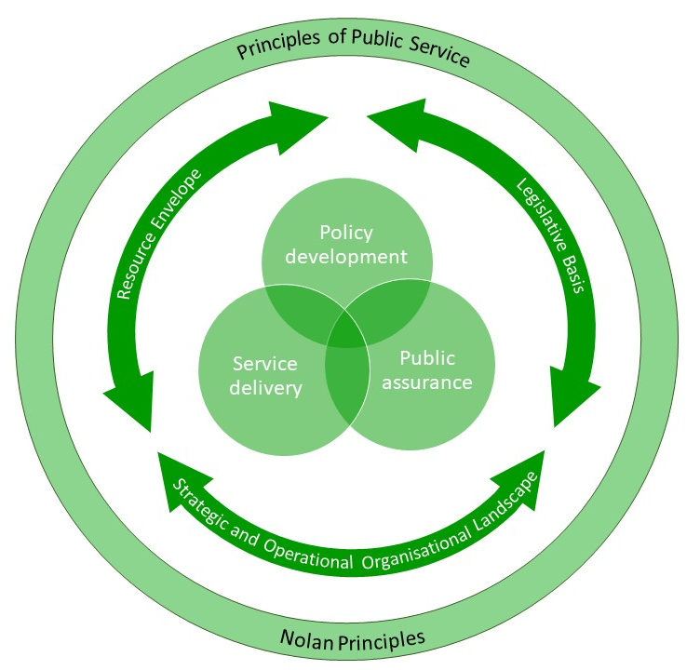
National Frameworks The context, the parameters, the agencies and the relationships operating within the three domains of policy development, service delivery and public assurance in public services

Slide 3
The Policing and Crime Act 2017 and wider legislative framework for Fire & Rescue Services
The Crime and Disorder Act 1998
The Local Government Act 1999
The Fire and Rescue Services Act 2004
The 2004 Civil Contingencies Act
Regulatory reform (fire safety) order 2005
Safeguarding Vulnerable Groups Act 2006
Equalities Act 2010
Building Regulations Act 2010
Public Services (Social Value) Act 2012
Local Audit and Accountability Act 2014
Health and Safety Acts 1974, 2005, 2015

Slide 4
How robust has the PFCC local case process been?
Essex and Northamptonshire - specific local reasons for governance reform, and little local opposition
Business Case – Independent CIPFA analysis - results inconclusive and uninfluential – they couldn’t verify the promised financial savings or judge impact on public safety
Public Consultation was fairly extensive but support was limited
Democratic accountability and collaboration – improved accountability still contested, collaborative improvements asserted rather than evidenced
Scrutiny - FRS experience on police and crime panels – have there been any credible independent FRS expertise added to any panel?

Slide 5
Government’s ambitions for PFCCs
Improved Governance, Accountability, Transparency, Scrutiny
Improved leadership and collaboration across blue light services
Improved national and local resilience
If PCC wishes to change governance arrangements, Act requires an assessment
is in the interests of economy, efficiency and effectiveness, or
is it in the interests of public safety

Slide 6
What has the APCCs and/or individual PCCs achieved?
Focus to-date has been on their individual areas or as spokesperson for particular aspects of the PCC role.
Have they challenged the other system parameters or contributed to Grenfell, Hackitt, 2018 National Framework or HMICFRS?
Have the contributed to improving elements of:
Policy development
Service Delivery
Public Assurance and Regulation
Have they been a conspicuous voice or provided leadership for a sector badly needing support and leadership?

Slide 7
Emerging ‘big’ lessons: the first HMICFRS inspection reports A pragmatic and cautious approach to the first inspections nevertheless reveals services in dire need of support and investment.
Under performance and unwarranted variations in effectiveness, efficiency and how well the services uses its people – ubiquitous across response, prevention and protective services
Inadequate data information and intelligence and outdated and inadequate technology
Long-term under investment in Prevention and Protection Services – understaffed and under-resourced
Acknowledged Fire and Rescue is a risk based not a demand-led service – and needs to be resourced that way.

Slide 8
Improved Collaboration?
To-date - back office, premises, control rooms
Joint databases, systems, processes, protocols?
Major emergencies (Grenfell, Manchester) Whether local resilience has been effective - regional co-ordination and resilience has been widely criticised
New Inspections – with the exception of collaborative work with the police on arson and fire setting in community safety partnerships; the vast majority of examples of good or innovative collaborative working come from initiatives with health, housing or local government, as well as work across borders and with other fire and rescue services.

Slide 9
Changes to legislative framework Assessing the future role of PFCCs
Post-austerity financial provisions – Spending Review and updated SDPs imminent
Emerging demands for a new Housing Act
Grenfell/Hackitt will generate statutory changes
Primary and/or secondary legislation
Too early for HMICFRS to be strategically re-positioning
Have PFCC or APCC even established a strategic position in the FRS landscape?

Slide 10
Questions?
Contact
Pete Murphy
Nottingham Business School,
Nottingham Trent University
Mob: 07775 877949
Peter.murphy@ntu.ac.uk

