Slide 1
The impact of segregation on self-harm behaviours in prison(with consideration of dual harm)
Dr Karen Slade C.Psychol (forensic)
Associate Professor

Slide 2
Aims
To explore how restrictive (punishment) regimes may relate to self-harm in prison
Therefore, this study will aim to:
Explore the relationship between harm to self and other in-prison incidents which may lead to punishment.
Explore whether restrictive (punishment) regimes may impact on self-harm rates and choice of methods.

Slide 3
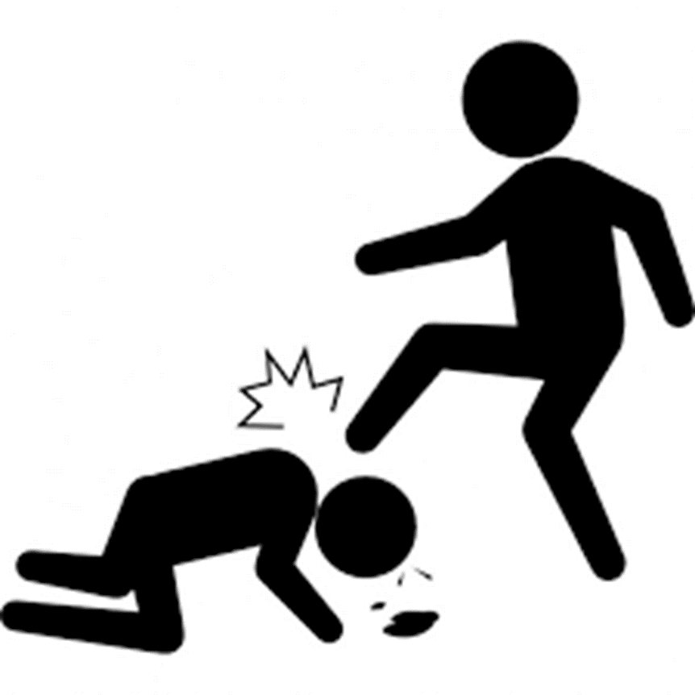
The link between violence and self-harm
Community Violence
Exposure to violence increases risk of SH and suicide ideation (Vermeiren, et al. 2002)
Systematic review ‘Evidence suggests that aggression and SH frequently co-occur’ with most patients who engaged in self-harm engaged in aggression (74%), whereas most patients who engaged in aggression did not engage in self-harm (20%) (O’Donnell, House and Waterman, 2015).
BUT conducting repeated violence is a stronger risk of suicidal behaviour (Jordan & Samuelson, 2015)
Prison Violence
Those who engage in institutional physical violence has been demonstrated to be linked with suicide and self-harm behaviour (lifetime link: Mann et al., 1999)
USA study (Young et al, 2006) suggested that prisoners in healthcare units who self-harmed were 8 times more likely to assault a staff member.
USA: Lanes (2011) demonstrated that male prisoners who self-harm were more likely to be violent and be in segregation.
UK: Slade (2017; men) and Kottler et al. (2018;women). Very recently confirmed that 40% who self-harmed were also violent with higher incidences of ligature and firesetting.

Slide 4
What we know and what we don’t
We know that violence and self-harm are very clearly linked behaviours. Shown in all populations in which it has been researched.
But
We have no idea of the characteristics of this group except in the highly exceptional situation when the harm is fatal (homicide-suicide).
We have no idea of the range of behaviours
We have no idea of the level of risk posed by these (and other) behaviours
We have no idea why they are linked.
We have no idea whether it matters.

Slide 5
Service issue: Underlying Assumptions and Response
Individualised Supportive Care
Zero Tolerance
Punishment
Segregation or Care Suite?

Slide 6
Definitions
Assault: Assaults in prison custody cover a wide range of physically violent incidents including fights between prisoners.
Self-harm: Any act where a prisoner deliberately harms themselves irrespective of the method, intent or severity of any injury.
Dual Harm: Physical harm to both self and others
Reportable Incident: Any incident, as outlined in HM Prison Service Order 1400, which requires staff to report it onto the PNOMIS electronic computer system. These include: damage to property, fire, drugs, mobile phone possession, miscellaneous, incidents at height, tool possession and barricade (NB: assault and self-harm have been removed from this definition)

Slide 7
Method
Location: Medium Security (Cat B) Adult Male (18+) remand and early stage prison in England.
Data: Routinely gathered detailed incident, location and demographic data from HM Prison Service electronic database system
Each participant had demographic, current offence, incident dates and incident types recorded.
Each participant had segregation and Basic regime dates recorded PLUS whether they had ever self-harmed under these regimes.
Details on every method of self-harm behaviour in prison was also gathered.

Slide 8
Sample
Group | N (%)
Sole Self-Harm (harm to self only) | 70 (7.3) | SH 175 (18.2%)
Dual Harm (harm to self and others) | 105 (10.9)
 |  | Assault 328 (34%)
Sole Assault (harm to others only) | 223 (23.1)
No Harm (incidents but no SH or assaults) | 86 (8.9) | Neither 567 (58.7%)
No Incidents | 481 (49.8)
Total | 965

Slide 9
Rate of wider incidents (per person year)

Slide 10
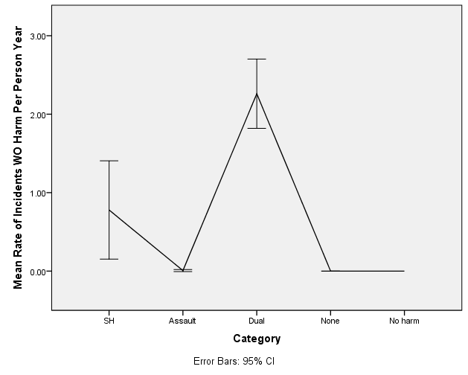
Total Incidents (per person year)
All incidents (not including self-harm or assault) per person year.
Kruskal-Wallis test revealed dual harm had significantly higher rate than all other groups (p <.001 for all comparisons).

Slide 11
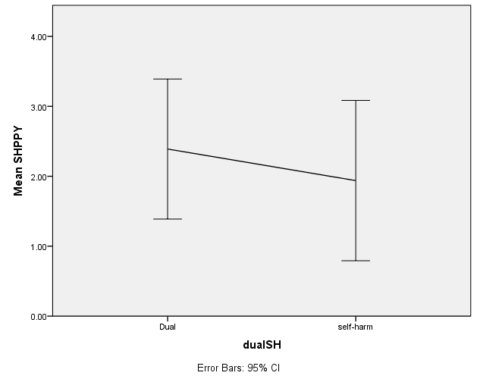
#Self-harm
Kruskal-Wallis test confirmed that there was no significant difference in the number of self-harm incidents between the dual and sole self-harm group, p =.361

Slide 12
Conclusion
Dual Harm prisoners are involved in far greater levels of rule breaking than all other groups ; also with SH above violent and non-harm groups.
Dual harm and secondly, self-harm groups are therefore most likely to be punished and encounter one of the restrictive regimes.

Slide 13
Self-harm under punishment
Segregation and ‘Basic’ regime

Slide 14
Restrictive (punishment) regimes in the UK context
Segregation
Segregation involves a prisoner being removed from their wing and being put on the segregation unit. There, prisoners will be isolated from the rest of the prison, with a much reduced regime and often only half an hour or so out of their cells each day.
NB some additional self-harm risk management exist (MH check, ‘defensible decision’ for those considered self-harm risk)
Basic level
Prisoners are placed on basic level because they have failed to meet local criteria for admission to standard and enhanced levels. (PSI 30/2013)
“Basic level is deliberately designed to be a miserable way of life. Prisoners are forced to wear prison-issue clothing, are denied most personal possessions and are usually not permitted to rent a small portable TV set. In addition, in many prisons inmates on Basic aren't permitted much time out of their cells (for association with other prisoners) and, unless they have a job or are participating in an education course, can find themselves 'banged up behind their doors' (locked in their cells) for up to 23-hours a day”. http://prisonuk.blogspot.co.uk/2014/07/the-iep-system-one-of-biggest-changes.html
NB No additional self-harm risk management

Slide 15
Questions
How prevalent is self-harm under restrictive regimes?
2. Are dual harm prisoners more likely to self-harm under restrictive regimes than sole self-harm?
3. Does the experience of restricted regimes have an impact on the risk of lethal SH methods?
Note: Only persons who had ever self-harmed in prison were included in the following analyses (N = 175).

Slide 16
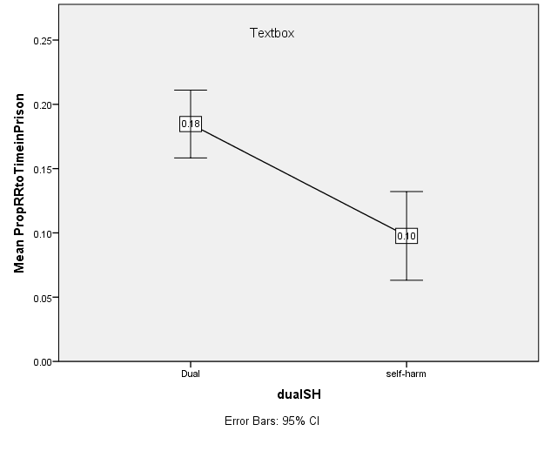
Prevalence of RR experience amongst those who self-harm in prison
 | Ever experienced RR N (%) | 1+ SH under RR N (%)
Segregation | 98 (56%) | 29 (28.4)
Basic Regime | 145 (83%) | 44 (31)
Either | 151 (86%) | 60 (41.1) 25 (17%) have 2+ incidents
Conclusions:
86% of those who SH will experience some form of RR during their prison time
Around 40% of those who SH will do so (at least once) whilst experiencing RR.
The proportion of dual harm prison time spent on RR is almost 2x that for solely SH.

Slide 17
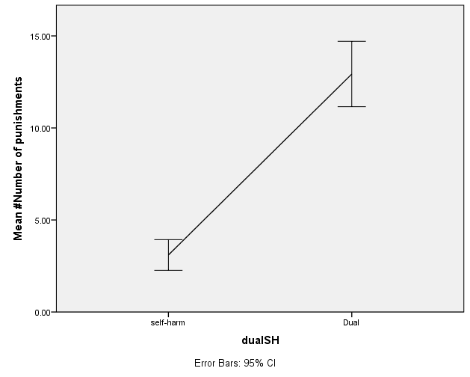
Proportion of SH occurring under restrictive regimes (RR)
Including only those who had experienced a form of restrictive regime
The proportion of ‘#incidents of SH under RR’ to ‘#experiences of RR’ is .34 (therefore, averaging 1 incident for every 3-4 punishments), for both sole SH and dual harm prisoners.
However, (*see graph) dual harm prisoners will (on average) experience these forms of RR 4 times more often, F = 37. 809, p < .001

Slide 18
Self-harm method

Slide 19
Experience of RR and self-harm method
 |  | Only those who have experienced RR, N = 151
Type of self-harm | All self-harm N = 175 N (%) | SH under RR N = 60 | Never SH under RR N = 86 | p | OR
Ligature | 68 (30.3) | 29 (48.3) | 18 (19.8) | <.001 | 3.79 (1.84 – 7.82)
Self-strangulation | 35 (20) | 23 (38.3) | 11 (12.1) | <.001 | 4.5 (2 - 10.24)
Cuts | 127 (72.6) | 48 (80) | 63 (69.2) | .145 | 1.78 (. 82 – 3.85)
Overdose | 39 (22.3) | 19 (31.7) | 14 (15.3) | .02 | 2.5 (1.16 – 5.6)
Headbanging | 10 (5.7) | 3 (5) | 3 (3.3) | .603 | .648 (.126-3.32)
Punched wall or self | 13 (7.4) | 8 (13.3) | 5 (5.5) | .103 | 2.64 (.822 – 8.52)
Swallowed item | 14 (8) | 12 (20) | 2 (2.2) | .002 | 11.12 (2.39–51.76)
The risk of using a more lethal method if RR = SH is x 2-4 times more than for those who RR ≠ SH

Slide 20
Time under RR and relationship with Method Logistic regression
Ever used | Yes M (SD) | No M (SD) | Proportion of time in prison under RR | p | OR
Ligature | 288 (302) | 179 (205) | 22% vs 13% | .<.001 | 167 (10.1 – 2656.7)
Self-strangulation | 309 (316) | 184 (212) | 23% vs 13% | .001 | 165.9 (9.23 – 2980)
Overdose | 235 (179) | 207 (259) | 16% vs 15% | .567 | 2.271 (.137 – 37.61)
Swallowing Item | 337 (278) | 200 (238) | 13% vs 12% | .803 | 1.662 (.03 – 90.6)

Slide 21
Questions and some answers
How prevalent is self-harm under restrictive regime?
Around 40% of those who SH will do so (at least once) whilst experiencing RR.
2. Are dual harm prisoners more likely to self-harm under restrictive regimes?
Not proportionally but they will experience 4 times more RR and proportionally, twice as much of their time.
3.Does the experience of restricted regimes have an impact on the risk of lethal SH methods?
Yes, ligature and self-strangulation are far more prevalent in this group; but not cutting, punching or other methods.
The risk of using ligature and self-strangulation notably increases with the proportion of time in prison spent under a RR.

Slide 22
Conclusion
Risk of harm is not limited to one behaviour for a significant proportion. There is no difference in the rate of self-harm between dual and sole self-harm groups, but with far higher rates of other incidents suggestive of a greater variability of behaviours and greater overall risk of harm > This also leads to far greater experience of restrictive regimes.
Similar proportion of SH occurs for dual and sole self-harm prisoners; but those who do SH under these regimes also have experience of more lethal methods, suggesting they may be more at risk of self-inflicted death or serious harm.
As the proportion of prison time spent under an RR increases, the likely move to using lethal methods increases. Relatedly, the proportion of time on RR for dual harm prisoners is far greater than any other prisoner group. Therefore, dual harm are at greater risk of using lethal methods during their prison stay, potentially as a by-product of greater RR.
In conclusion, we should be aware of those who:
Have ever self-harmed under an RR
Have spent a larger proportion of their prison time under an RR (> 1 day/week on average)
Dual harm in prison
Have experience of ligature or self-strangulation in prison

Slide 23
Service issue: Underlying Assumptions and Response
Individualised Supportive Care
Zero Tolerance
Punishment
Segregation or Care Suite?

Slide 24
Previous dual harm paper:
Slade, K. (2017) Dual Harm: An exploration of the presence and characteristics for dual violence and self-harm behaviour in prison. Journal of Criminal Psychology (online).
Please contact me if you’d like the slides, papers or interested in research avenues: karen.slade@ntu.ac.uk

