Slide 1
Dual Harm
Dr Karen Slade C.Psychol
Associate Professor in applied forensic psychology
Nottingham Trent University

Slide 2
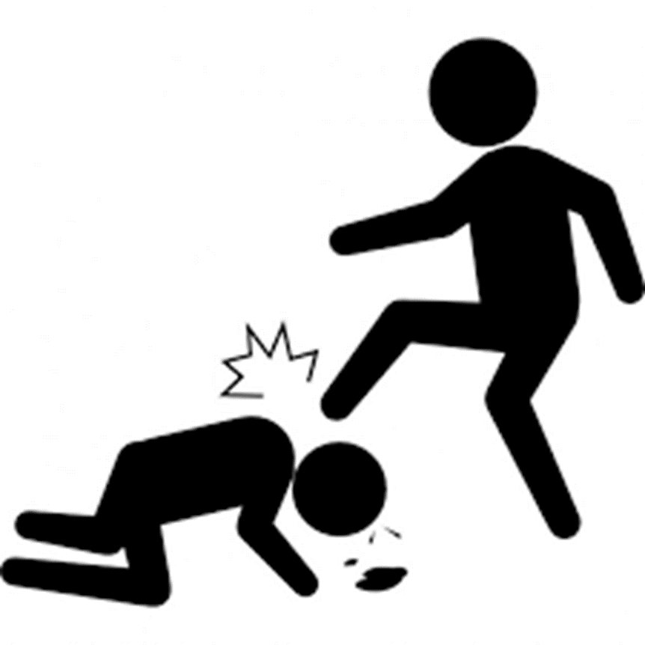
The link between violence and self-harm or suicidal behaviour
Community Violence
Exposure to violence increases risk of SH and suicide ideation (Vermeiren, et al. 2002)
Systematic review ‘Evidence suggests that aggression and SH frequently co-occur’ with most patients who engaged in self-harm engaged in aggression (74%), whereas most patients who engaged in aggression did not engage in self-harm (20%) (O’Donnell, House and Waterman, 2015).
‘Violent offences have consistently been the most serious offence associated with the deceased person’s detention (53%)’ (Australian Government, 2015)
BUT conducting repeated violence is a stronger risk of suicidal behaviour (Jordan & Samuelson, 2015)
Prison Violence
Relationship between violence and SH in prisoners has, so far, largely been correlating SH with violent convictions (Static) with few institutional studies.
Those who engage in institutional physical violence has been demonstrated to be linked with suicide and self-harm behaviour (e.g. lifetime link: Mann et al., 1999)
USA study (Young et al, 2006) suggested that prisoners in healthcare units who self-harmed were 8 times more likely to assault a staff member.
USA: Lanes (2011) demonstrated that male prisoners who self-harm were more likely to be violent and be in segregation.
UK: Women Kottler et al. (2018) Very recently confirmed that 40% of women who self-harmed were also violent with higher incidence of ligature and firesetting.

Slide 3
What we know and what we don’t
We know that violence and self-harm are very clearly linked behaviours. Shown in all populations in which it has been researched.
But
We don’t know the characteristics of this group except in the highly exceptional situation when the harm is fatal (homicide-suicide).
We don’t know the range of other behaviours
We don’t know the level of risk posed by these (and other) behaviours
We don’t know why they are linked.
We don’t know whether it matters.

Slide 4
Aims
To explore possible risk factors for dual harm prisoners.
Therefore, this study will aim to compare sole self-harm, sole assault and dual harm prisoners:
To explore demographic variables and offence types
To explore incident rates, incident types and (where applicable) rates of restrictive punishment regimes.
To explore any differences in methods or lethality of self-harm.

Slide 5
Exploring Sole and Dual Harm
Location
Medium Security (Cat B) Remand and early stage prison in England
Groups
(based on in-prison incidents)
Sole Assault (physical assault)
Sole Self-harm (physical harm to self)
Dual Harm: Both assault and self-harm
No incidents
No harm (incidents but not physical harm)

Slide 6
Method
Data: Routinely gathered detailed incident, location and demographic data from electronic database system
Each participant had demographic, current offence, incident dates and incident types, dates of segregation and placement on basic regime recorded.
Further details on method and severity of self-harm behaviour was also gathered.

Slide 7
Definitions
Assault: Assaults in prison custody cover a wide range of physically violent incidents including fights between prisoners.
Self-harm: Any act where a prisoner deliberately harms themselves irrespective of the method, intent or severity of any injury.
Reportable Incident: Any incident, as outlined in HM Prison Service Order 1400, which requires staff to report it onto the PNOMIS electronic computer system. These include: assault, self-harm, damage to property, fire, drugs, mobile phone possession, death of a prisoner, miscellaneous, incidents at height, tool possession and barricade.

Slide 8
Sample
 | N(%)
Sole Self-Harm | 70 (7.3)
Dual Harm | 105 (10.9)
Sole Assault | 223 (23.1)
No Harm | 86 (8.9)
No Incidents | 481 (49.8)
Total | 965

Slide 9
Index offence
Logistic Regression undertaken considering whether we could distinguish dual from either sole self-harm or sole assault groups on the basis of their current offence type.
The following offence types were coded:
Violent
Sexual
Acquisitive
Drugs
Arson
All analyses were all non-significant (p>. 05), meaning offence type does not distinguish the harm groups.

Slide 10
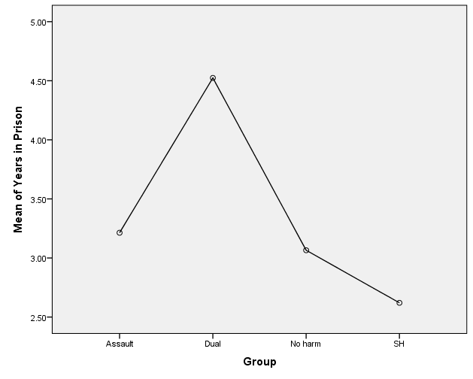
Years in Prison
ANOVA
Significant difference in time in prison
p <.001 Dual vs all other groups.

Slide 11
Rate of wider incidents (per person year)

Slide 12
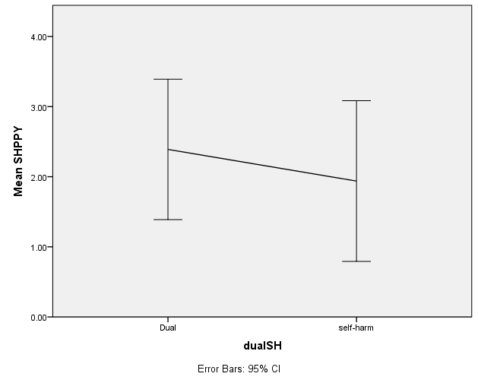
#Self-harm
Kruskal-Wallis test confirmed that there was no significant difference in the number of self-harm incidents between the dual and sole self-harm group, p =.361

Slide 13
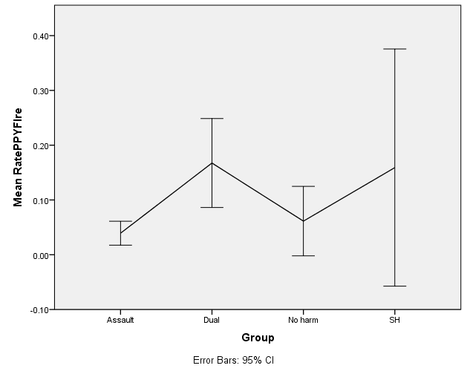
#fire
Kruskal Wallis confirmed that dual harm have far greater rate of fire incidents than any other group, p <.0001 for all comparisons.
Relative Risk of dual harm prisoners ever setting a fire in prison was calculated:
Dual vs SH: 4.8; Dual vs Asst: 3.6
Dual harm prisoners 3-4 times more likely to set a fire at some point.

Slide 14
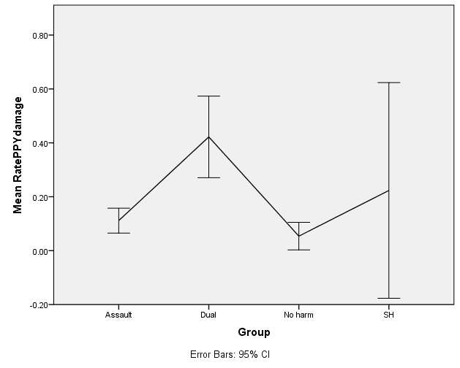
#property damage
Kruskal-Wallis tests revealed that Dual harm also have greater rate of damage and disorder incidents than all other groups, p <.001 for all comparisons.

Slide 15
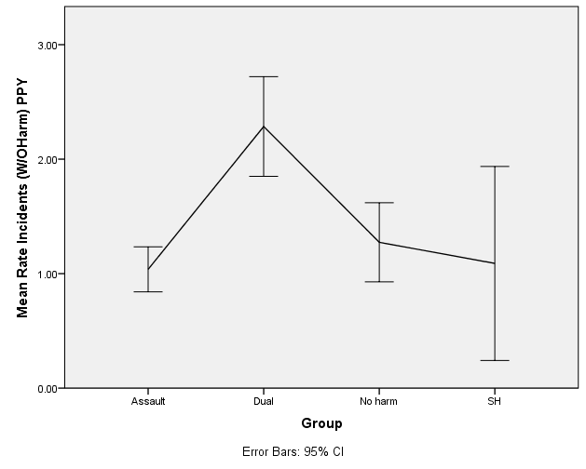
Total Incidents (per person year)
All incidents (not including self-harm or assault) per person year.
Kruskal-Wallis test revealed dual harm had significantly higher rate than all other groups (p <.001 for all comparisons).

Slide 16
Punishment regimes

Slide 17
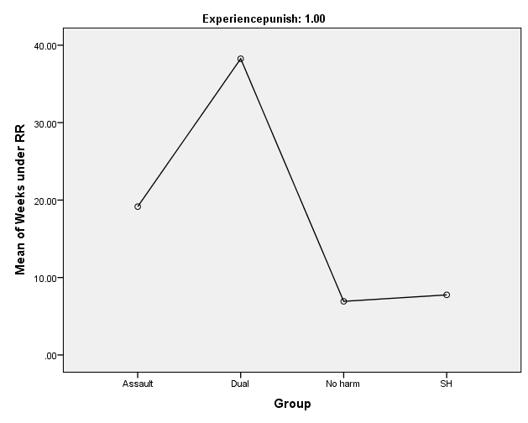
Punishment experience
 | Basic regime experience N (%) | Segregation experience N (%)
Assault Only | 186 (83) | 110 (49)
Dual | 103 (98) | 84 (80)
Incident but no harm | 67 (78) | 31 (37)
Self-harm | 45 (64) | 19 (27)
Total | 401 (83) | 244 (50)
p (Dual vs the rest) | <.001 | <.001

Slide 18
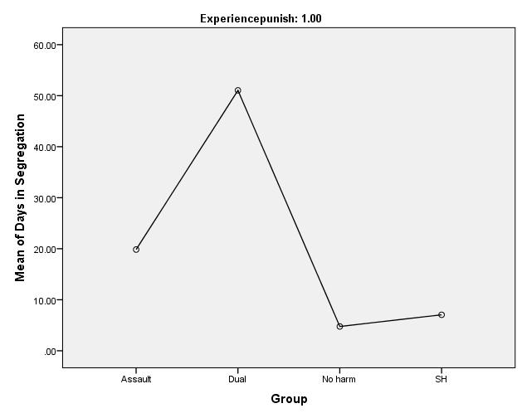
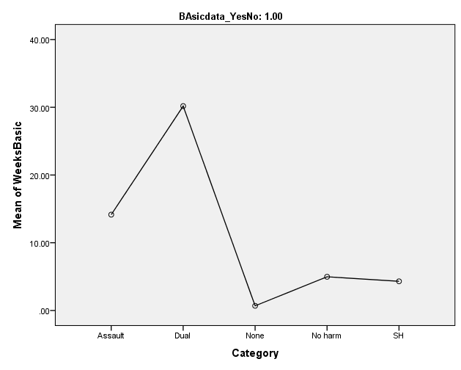
Restrictive regimes
Segregation
 | N | WEEKS Mean | SD
Assault | 164 | 14.15 | 14.17
Dual | 79 | 30.17 | 23.98
No harm | 69 | 4.98 | 6.42
SH | 58 | 4.31 | 6.91
Total | 441 | 12.12 | 16.93
Basic Regime
Group | DAYS M (SD)
Assault Only | 19.84 (48.45)
Dual | 51.04 (71.5)
No harm | 4.76 (13.8)
SH only | 7.05 (27.45)

Slide 19
Dual Harm
Self-harm method

Slide 20
Method of self-harm
Type of self-harm | All self-harm N = 175 N (%) | Self-harm only (N = 70) N (%) | Dual (N =105) N (%) | p | OR (95% CI)
Ligature/Self-strangulation | 68 (38.9) | 20 (28.6) | 48 (45.7) | .024 | 2.1 (1.1 – .014)
Cuts | 127 (72.6) | 50 (71.4) | 77 (73.3) | .782 | 1.1 (.56 – 2.16)
Overdose | 39 (22.3) | 10 (14.3) | 29 (27.6) | .041 | 2.29 (1.03 – 5.07)
Headbanging | 10 (5.7) | 5 (7.1) | 5 (4.8) | .509 | .65 (.18 – 2.33)
Punched wall or self | 13 (7.4) | 2 (2.9) | 11 (10.5) | .079 | 3.98 (.85 – 18.53)
Swallowed item | 14 (8) | 3 (4.3) | 11 (10.5) | .152 | 2.61 (.70 – 9.73)
Other (insertion, burns, kicking, set fire, NPS) | 11 (6.3) | 3 (4.2) | 8 (7.6)
Odds Ratio indicates the risk of ligature or overdose is x2 those in the Sole SH group

Slide 21
Number of SH Methods (max of 7)
Methods | Dual % | Self-harm %
1 | 55 | 79
2 | 24 | 14
3 | 11 | 4
4 | 8 | 1
5 | 2 | 1
6 | 1 | 0
Mann Whitney U-test confirmed that Dual Harm (Mdn = 1.66) used a greater range of methods of SH than Sole self-harm (Mdn = 1.24)
(U = 2,769, P = .001)

Slide 22
Summary of Dual Harm
Amongst the full offender population: Dual Harm ≈ 11%.
Amongst an in-prison self-harm population: 40-60% also have an assault in prison.
Far greater rate of other incidents (particularly fire, damage) but not of self-harm.
No differences in index offence but far longer experience of both prison and of restrictive regimes .
Wider range of self-harm methods used and greater use of ligature and overdose
Amongst an in-prison self-harm population: 40-60% also have an assault in prison.

Slide 23
Discussion
Dual harm risks are not limited to one behaviour, but a potential range of harmful behaviours.
There is no difference in the annual rate of self-harm, but higher rates of fire setting and property damage (in addition to violence). The pattern looks more like the self-harm group. However, the greater variability of behaviours creates an overall picture of far higher rates of incidents and greater overall risk of harm.
Due to high levels of incident they will experience significant levels of punishment and restrictive regime (without seemingly much effect). This is more like the assault group.
Dual harm offenders seem to have a pattern of behavioural variability which changes over time and across spheres, including SH methods. Managing one risk at a time may be unlikely to result in lasting impact on overall risk of harm. Coupled with greater use of more lethal methods i.e. ligature and overdose, they may be more at risk of self-inflicted death or serious harm.
They will be resource intensive and with changing behaviour patterns, single case management is recommended across services.

Slide 24
Previous paper:
Slade, K. (2017) Dual Harm: An exploration of the presence and characteristics for dual violence and self-harm behaviour in prison. Journal of Criminal Psychology (online).
Please contact me if you’d like the slides, papers or interested in research avenues: karen.slade@ntu.ac.uk

