Slide 1
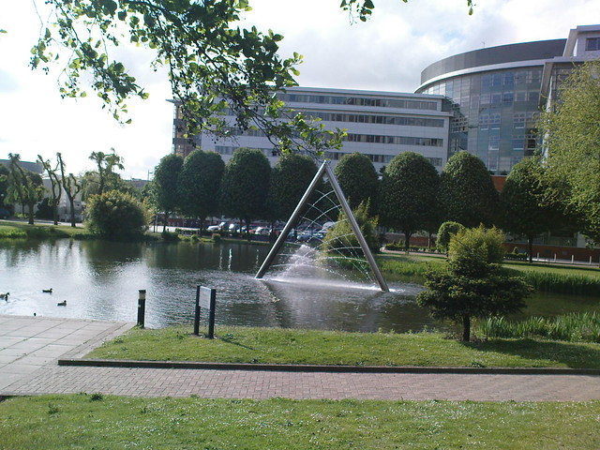
BAM Conference 2019 Professional Development Workshop
Critical Understanding of Interoperability and Governance Issues in The Blue-Light Emergency Services: Need For A Joined-Up Approach
Paresh Wankhade, Swetketu Patnaik, Peter Murphy, David Weir, Silvia Nelson.
This Photo by Unknown Author is licensed under CC BY

Slide 2
Critical understanding of Governance and Interoperability
2010 onwards, the performance management arrangements in England were not delivering joined up policy development; service delivery was sub-optimal and public assurance was deteriorating.
The last governments’ response was to adopt the reforms to the police from 2011-2016 and replicate them in the Fire and Rescue Service
Key aspects included changes to governance (PCCs and PFCCs), better data and information, and even a common Inspectorate

Slide 3
HMIC HMICFRS
Scope, design, governance and modus operndii for first inspections all based on police arrangements (PEEL annual appraisals)
HMIC traditionally much closer to the Home Office and Government than other external performance management inspectorates
2/3rd of the first round of inspections (30 out of 45) completed. No evaluation of governance, strategy or IRMPs.
HMICFRS External academic advisory group extended to admit academics interested in FRS or all emergency services

Slide 4
HMICFRS external academic advisory group – May Does any member of the group know of any academic work on a generic model for performance management regimes in either police or fire?
As a matter of fact…….

Slide 5
National Frameworks The context, the parameters, the agencies and the relationships operating within the three domains of policy development, service delivery and public assurance in public services
Central Government (Spending Reviews and PSAs)
Local Authorities (Best Value, CPA, CAA, SLI)
Schools and Education (Ofsted inspections CPA Safeguarding)
Health and Social Care (Standards 4 Better Health; World Class Commissioning, NHS operating mandate)
National Parks (National Assessments and Peer Reviews)
Regional Development Agencies
Criminal Justice HMIC; HMIP; HMIP; HMI Courts; CPS and HMICFRS
Universities REF 2021

Slide 6
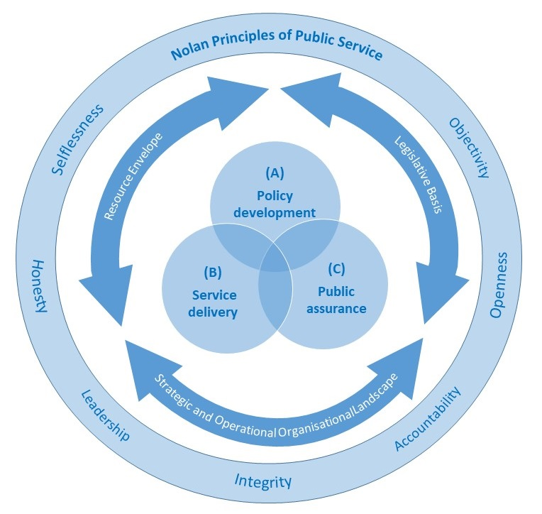
A model for national frameworks and performance regimes
Principles of Public Service
7 ‘Nolan’ Principles
Situational or contextual constraints
Legislative framework
Resource Envelope
Organisational Landscape
Core areas or domains
Policy development,
Service delivery
Public assurance

Slide 7
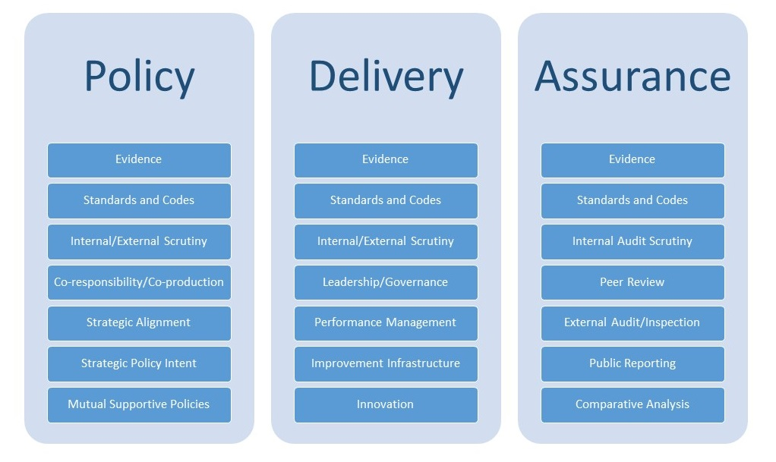
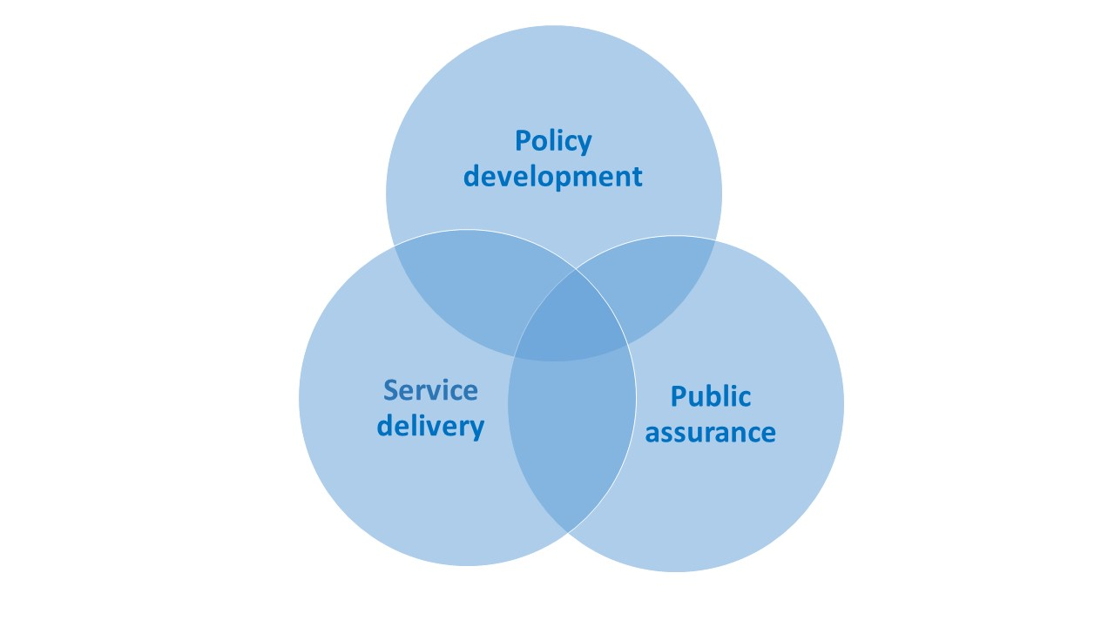
Details of the core areas

Slide 8
The purposes of the model
Identify the underlying principles and assumptions of working in and operationalising the delivery of public services in the public interest
Helps to identify the situational or contextual constraints which may be short term parameters to action (although they may be variable in the medium to long term)
Illustrates the relationships between different parts of a performance regime and helps understand any dependencies and reciprocities
Facilitates the evaluation, analyses and comparison of individual performance regimes or national frameworks

Slide 9
Any performance regime or national framework that seeks to be comprehensive has to cover policy, service delivery and public assurance and be cognisant of their interrelationships and interdependencies
Why?
Key partners and collaborative stakeholders, particularly those in multi-agency and joint and collectively responsible operating environments (such as local authorities and the NHS in their respective sectors; or the Police, Fire and Ambulance Services), need this information and assurance if they are to continually improve their respective services and meet their individual and collective responsibilities to the public.

Slide 10
Any Questions?
Contacts
Pete Murphy
peter.murphy@ntu.ac.uk

