Slide 1
GREECE TNE Webinar
8 July 2020

Slide 2
Our speakers
Eduardo Ramos, Head Transnational Education, UUKi
Dr Vangelis Tsiligiris, Principal Lecturer, Nottingham Business School, Nottingham Trent University
Katerina Fegarou, Education Marketing Manager, Greece
Notes:
(career days, open virtual events on topical themes/Covid-19 related or international studies). This is very important for the profile raising of Colleges and of their UK programmes and partnering institutions.

Slide 3
What we will talk about today
Greece UK TNE at a glance
Current levels of provision, types of partnerships, subject areas
Recognition
Quality Assurance
Insight from institutions (state & private) and students
Insights from recent partnership pursuits
Internationalisation of Greek HEIs
HE sector response to Covid-19
The Future of UK TNE in Greece: a consolidated overview
Staying Connected & Working Together
Notes:
(career days, open virtual events on topical themes/Covid-19 related or international studies). This is very important for the profile raising of Colleges and of their UK programmes and partnering institutions.

Slide 4
Greece at a glance
With 16,555 TNE students, Greece is the top host country for UK TNE learners in the EU
Amongst the top ten markets globally, ranked 3rd in the number of UK programmes and 8th in terms of enrolments
With 9,920 students, Greece is also among the top 20 sending markets to the UK globally
one of the largest UK alumni communities in the world vs population with an estimated number of more than 300k UK alumni.
Notes:
(career days, open virtual events on topical themes/Covid-19 related or international studies). This is very important for the profile raising of Colleges and of their UK programmes and partnering institutions.

Slide 5
Current landscape of provision
UK TNE provision is long standing and well established
> 70% of provision is delivered through franchise and validation at licenced private colleges
There are 35 colleges in Greece able to engage in TNE activities at the tertiary education level
75% of TNE provision is at undergraduate level
Most popular subjects: business and administrative studies, biological sciences, computer sciences, creative arts
70 UK institutions have some TNE presence; 5 of those, account for 60 per cent of the total UK TNE market in Greece
Notes:
(career days, open virtual events on topical themes/Covid-19 related or international studies). This is very important for the profile raising of Colleges and of their UK programmes and partnering institutions.

Slide 6
Student Nos & Level of study

Slide 7
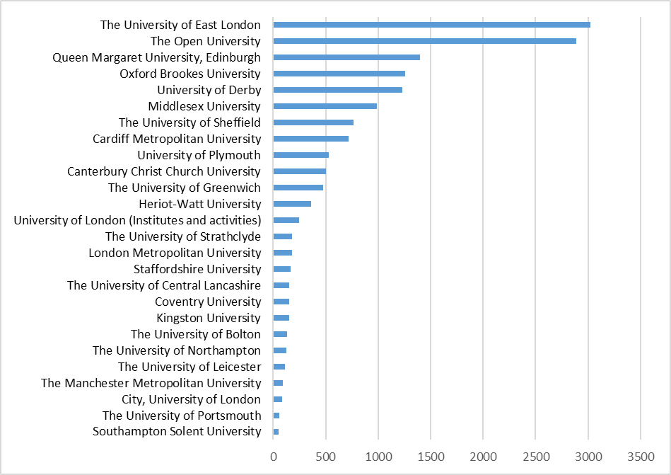
UK institutions with >50 students

Slide 8
Top 10 college providers
1 | Metropolitan College
2 | Deree College
3 | City College
4 | Mediterranean College
5 | New York
6 | Aegean Omiros College
7 | City Unity College
8 | AKTO College
9 | BCA College
10 | Hellenic American College

Slide 9
UK TNE leading the Greek market

Slide 10
Professional Recognition
Professional equivalence: (article 3, PD/38/2010) applies to EU member states & third countries for “typical” higher education degrees, meeting the following criteria: a) minimum 3 years duration for UGs programmes, b) less than 3 years duration for PGs and c)minimum 3 years for PhDs
The recognition of professional equivalence of typical higher education degrees of an EU member state or third country grants the right to the degree holder to exercise economic activity as salaried employee or self-employed with the same terms & conditions which apply to holders of comparable domestic degrees; exemptions: professions which require high academic standards (Professors of Greek HEIs, researchers and specialized scientific staff)
Notes:
profession is said to be regulated when access and exercise is subject to the possession of a specific professional qualification.

Slide 11
Professional Recognition
Recognition of Professional Rights is assessed either on the basis of the general recognition system of qualifications (chapter I, title I, PD 38/2010) or the recognition of professional experience (chapter II, title III, PD 38/2010).
RPR applies to regulated professions: doctors, dentists, pharmacists, nurses, architects, etc. A complete list of regulated professions in Greece is available at https://ec.europa.eu/growth/tools-databases/regprof/index.cfm
Responsible authorities for the recognition of professional rights are the professional associations provided that they are constituted as legal entities of public law (nomika prosopa dimosiou dikaiou)
Notes:
profession is said to be regulated when access and exercise is subject to the possession of a specific professional qualification.

Slide 12
Professional Recognition Body
ATEEN (Ιndependent Department responsible for the implementation of European Legislation, Ministry of Education) is the responsible authority to receive the applications and to issue decisions for professional equivalence or professional rights of degrees from EU member states or third countries.
Practical Training or Written Testing for professional rights
ATEEN or the relevant professional body is authorized to request the applicant to complete practical training (max 3 years) or a written test to asses level of competence if a) the education received by the applicant is substantially different to comparable education in Greece, b) the regulated profession in Greece consists of one or more regulated professional activities which do not exist in the country of origin /origin of the degree
Notes:
profession is said to be regulated when access and exercise is subject to the possession of a specific professional qualification.

Slide 13
Professional Recognition
Written testing for professional equivalence: ATEEN is authorized to request written exams if substantial differences are identified between the programme of studies of the applicant and the comparable degree of a Greek HEI.
For PR & PE, decisions are issued within 4 months since the submission of applications. If practical training (PR) or written testing (PR & PE) is necessary, ATEEN issues decision within a 4month period including providing the details of the practical training or testing. Following the completion of the training or testing, the final decision is issued within 30 days.
Notes:
profession is said to be regulated when access and exercise is subject to the possession of a specific professional qualification.
Τhe applicant has the right to submit once an admistrative appeal to ATEEN requesting the cancellation or modification of ATEEN’s decision .ΑΤΕΕΝ notifies the applicant of its decision within three months at the latest.

Slide 14
Quality Assurance
TNE in Greece is not subject to an external quality audit by the Hellenic Quality Assurance Agency
UK TNE providers are subject to quality assurance audits by QAA
Greek Colleges have been in favour of external quality audits and have taken initiatives to cover the existing gap in Greek policy. For example, the British Accreditation Council accredit all members of the Hellenic College Association
Local providers would welcome being part of a national quality assurance system which would strengthen the profile of the programmes delivered and pave the way for the academic recognition of UK TNE degrees.
Notes:
profession is said to be regulated when access and exercise is subject to the possession of a specific professional qualification.

Slide 15
Insights: Greek HEIs
Evidence indicates very positive prospects for the development of TNE collaborations with Greek HEIs on double or dual and joint degree arrangements
The key drivers for TNE collaborations for Greek HEIs are:
Raising their international profile and attracting international students
Developing their internationalisation capacity
There is a need to increase awareness among senior management at Greek HEIs around internationalisation of higher education.
Notes:
profession is said to be regulated when access and exercise is subject to the possession of a specific professional qualification.

Slide 16
Insights: Colleges
90% of Greek colleges from those participating in this research reported a desire to expand their existing or develop new collaboration.
Local partners indicate that the subjects with the most positive demand prospects for the future in Greece are those related to computer science, business studies, biological science (including psychology), and subjects allied to medicine.
Notes:
profession is said to be regulated when access and exercise is subject to the possession of a specific professional qualification.

Slide 17
Insights: Students
UK TNE students in Greece
are generally satisfied with their existing student experience.
would like to see improvements that relate to the programme design (electives, working experience opportunities), model of delivery (contact hours; interaction with UK HEI academic staff; practical case studies), and more consistency in the quality of academic staff
perceive the USA and the UK as the top countries for the value and quality of their higher education.
Overall, students appreciate the benefits of TNE as mode of higher education provision but also the quality of the UK HE system.
Notes:
profession is said to be regulated when access and exercise is subject to the possession of a specific professional qualification.

Slide 18
Insights from current partnership pursuits
Three local, private Colleges are seeking to expand their current UK offer; another is keen to establish links with the UK
Open to explore different delivery models & partnerships – franchise, validation, articulation 2+2
Interested to offer Literature, History & Heritage, STEM and Music
Good infrastructures in place; for example, excellent lab facilities (including music labs)
Level of fees is a concern
Recognition of professional qualifications
Why this sudden increase of interest from the private sector?
Notes:
profession is said to be regulated when access and exercise is subject to the possession of a specific professional qualification.

Slide 19
Internationalisation of Greek Universities
Legislation was recently introduced
to reinforce the administrative autonomy of universities
Enhance and promote HEIs’ internationalisation through foreign language programs, summer courses, more distance learning programs, as well as academic collaborations with foreign universities or international programs with institutions abroad.
The capacity of state HEIs to internationalise will also be measured and determine funding allocations therefore, universities will have strong incentives to accelerate their internationalisation.
Notes:
profession is said to be regulated when access and exercise is subject to the possession of a specific professional qualification.

Slide 20
HE sector response to Covid-19
All kinds of educational activities requiring physical activity are prohibited till the end of academic year 2019-20. Exceptions: lab based courses and exams for which physical presence is considered essential
Programmes are delivered on line; on line-provision was quickly and smoothly implemented during the lockdown.
No public announcement has been made yet re start of the new academic year
Notes:
(career days, open virtual events on topical themes/Covid-19 related or international studies). This is very important for the profile raising of Colleges and of their UK programmes and partnering institutions.

Slide 21
TNE Greece: future prospects- a consolidated overview
The UK drives TNE provision in Greece and the market is growing steadily (7.1% in 2018-19 vs previous year)
For the first time, there is a clear national education mandate vigorously supporting Greek Universities to internationalise and giving them autonomy and incentives to do so independently
Greek Universities are keen to increase their international collaborations (evidence-based)
Colleges are looking to expand their collaborations with UK institutions (evidence-based)
Termination of home fees and loans – an opportunity for more TNE in Greece?
Covid-19: new dynamics and opportunities for more distance learning and partnership models?
Barriers to overcome: uncertainties of recognition of professional rights post-Brexit
Notes:
profession is said to be regulated when access and exercise is subject to the possession of a specific professional qualification.
Τhe applicant has the right to submit once an admistrative appeal to ATEEN requesting the cancellation or modification of ATEEN’s decision .ΑΤΕΕΝ notifies the applicant of its decision within three months at the latest.

Slide 22
Staying Connected & Working Together
Our support for HE partnerships is increasingly focused on Transnational Education partnerships which build local capacity and support local and UK policy priorities and create opportunities for UK sector engagement
We maintain strong relationships with Ministry of Education & Greek Universities
We work closely with British Embassy, UK partners, local providers (bilateral framework of co-operation in education, quality assurance, professional recognition)
Webinars – Insights- Bespoke Services: to support your internationalisation strategies & TNE priorities in Greece
Notes:
profession is said to be regulated when access and exercise is subject to the possession of a specific professional qualification.
Τhe applicant has the right to submit once an admistrative appeal to ATEEN requesting the cancellation or modification of ATEEN’s decision .ΑΤΕΕΝ notifies the applicant of its decision within three months at the latest.

Slide 23
Contact Us
Maria Tsakali, Head Education, maria.tsakali@britishouncil.gr
Katerina Fegarou, Education Marketing Manager, Katerina.Fegarou@britishcouncil.gr
Almut Caspary, Higher Education & Research Co-Ordinator, EU region, Almut.Caspary@britishcouncil.gr
thank you for your attention!
Thank you for your attention!
Notes:
profession is said to be regulated when access and exercise is subject to the possession of a specific professional qualification.
Τhe applicant has the right to submit once an admistrative appeal to ATEEN requesting the cancellation or modification of ATEEN’s decision .ΑΤΕΕΝ notifies the applicant of its decision within three months at the latest.

