Slide 1
Its not like it is on TV
Dr Karen Slade CPsychol
Associate Professor of applied forensic psychology
HCPC registered forensic psychologist

Slide 2
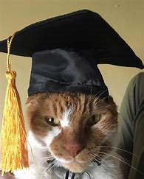
Becoming a psychologist: Where it all began
I was not excited by school and did not excel
My family is from the Caribbean
Romford is not plush
A few important lessons:
People who are ‘different’ can feel they don’t ‘fit’ – but you can bring what you have, there’s no template.
Don’t be afraid to do what’s right for YOU, it can be hard, takes persistence and not sticking with the crowd.
I went reluctantly to university and my disillusionment led to me applying for a placement year….the rest is history.
Not sure what you want yet?
Notes:
Romford, East London.

Slide 3
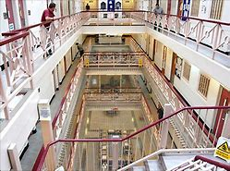
getting more experience than you bargained for!
My first day of placement – HMP Whitemoor, Sept 1994.
Day 1: Escape : conditioning
Month II: Major riot
Month IV: Hostage incident
Psychology worked hard behind the scenes to avoid incidents
Evidence-based negotiation and prevention advice
Supporting anti-conditioning strategy and training
Assessments and Interventions with prisoners
Data analysis to identify risk
Perpetrator summaries

Slide 4
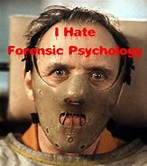
Back to uni: what the experience taught me
I found something I really wanted to do and impressed by the balance needed by Forensic Psychologists.
Their clients largely don’t want their help, but really need it with quite the story to tell.
Deal confidently with conflict and threat (on your own) and then sit down next day and talk.
Deal with high pressure environments where you must respond
Can benefit others by advising on what helps to keep everyone safe
Within boundaries, chat and even laugh with people with serious offences (because you are not judgemental but approachable, genuine and human)
Show compassion for people in prison and their difficulties
Notes:
Your degree can get you through the door but it’s a long journey of professional and personal development.

Slide 5
‘But its so hard to get experience!’
You are very unlikely to get voluntary experience by writing to a prison or emailing the Governor.
But there are masses of opportunity for experience (some paid, some voluntary) to only to see if you like it.
Examples:
Prison Independent Monitoring Board http://www.imb.org.uk/join-now/current-vacancies/
Shannon Trust (toe by toe) https://www.shannontrust.org.uk/volunteer/

Slide 6
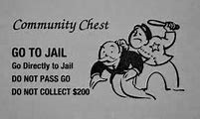
Experience is not all about psychology
Did I go straight back to prison? Far from it
Working on ‘the boats’
Running pubs
Civil Service Fast Track Scheme
Learning quality skills in other environments are really valuable
Notes:
Putline some of my other roles;
Working on the boats – drunk customers from American tourists to very drunk people trying to kill someone on a boat at sea.
ACCESS database and mail merge – a skill I learnt 20 years before was critical in a later role.
– Highly controversial department, learnt how to respond to the public, to Ministers, PM question briefings in a calm and factual way. Beef-on-the-bone.

Slide 7
Training routes
GBR status with British Psychological Society
(3 + years)
Accredited BSc Psychology
Accredited MSc/PGDip Psychology
Academic Stage 1
(1-2 years)
Accredited MSc in Forensic Psychology
Taught elements of a Doctorate
(in forensic psychology: usually self-funded)
Supervised Practice (Stage 2)– provision of large portfolios proving competence
(2-5 years)
BPS Qualification in FP
Doctorate/PGDip with placements in FP (NOT a PhD)

Slide 8
Stage 1: The whys and the whats
Stage 1 was BPS accredited MSc in forensic psychology part-time alongside working with men in prison.
Eye-opener – the ‘why’, the ‘what works’ and the ‘what next’.
My advice? Do it when there’s a bit of a fire burning in the subject and the people.

Slide 9
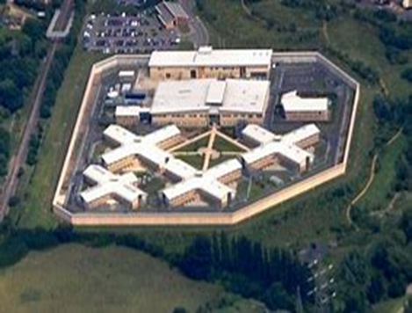
Stage II training@ HMP Wellingborough
Risk assessments for the parole board for lifers
Group and individual offending behaviour interventions
Research and consultancy work on reducing self-harm
Training staff in talking to the men.
Staff support after bad incidents
Reflective practice
Groupwork: Burglary 101

Slide 10
Intervention work
Many psychologists start their career in delivering group-based offending behaviour interventions
You can get a job as a:
group facilitator,
psychology assistant
healthcare assistant
delivering interventions in prisons, probation or secure hospital settings.

Slide 11
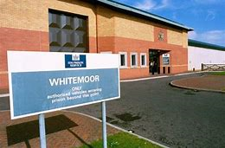
Back to hmp Whitemoor
I return to HMP Whitemoor and after a time become the Head of Psychology and Interventions
We did more ‘deep dive’ into high intensity offending behaviour and substance use interventions
Highly varied and complex individuals so I am trained in a wide range of therapeutic approaches (e.g. CBT, REBT, MI, CFT, psychodynamic)

Slide 12
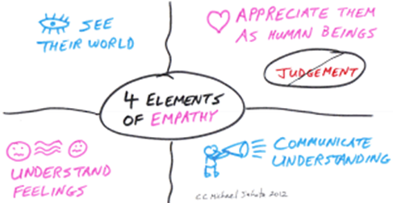
Seeing the good
Forensic Psychology asks you to do a really difficult thing: Not to judge.
The courts made the judgements, not you.
Justice is not about being judgmental, but about encouraging fairness for all.
If you can believe that even people who have done very bad things can change and people you really don’t like, have a right to be helped, then things can change.
Examples:
‘Mr Angry’ and ‘PCL-R man’

Slide 13
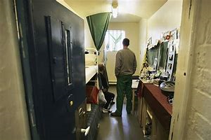
Finding your passion
Your career can and will shift and change
Try out opportunities and see where your passion lies
For me? The prison environment is not like the community, it is unique, fascinating and highly damaging.
Suicide and self-harm behaviour
What are you passionate about?

Slide 14
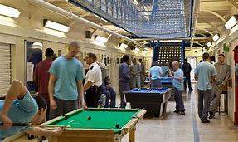
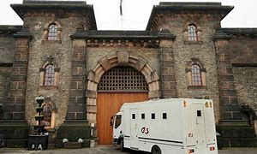
HMP Brixton
Evidence-based practice in action or ‘Putting my money where my mouth is’ with innovative psychologically-based suicide prevention
Led the prison and health service in suicide and self-harm prevention
Covered 100s of staff and professionals and 800 men in prison.
Reduced the suicide rate from 8 deaths in previous 4 years to zero in the next 4 years.
There are many ways to make a difference.

Slide 15
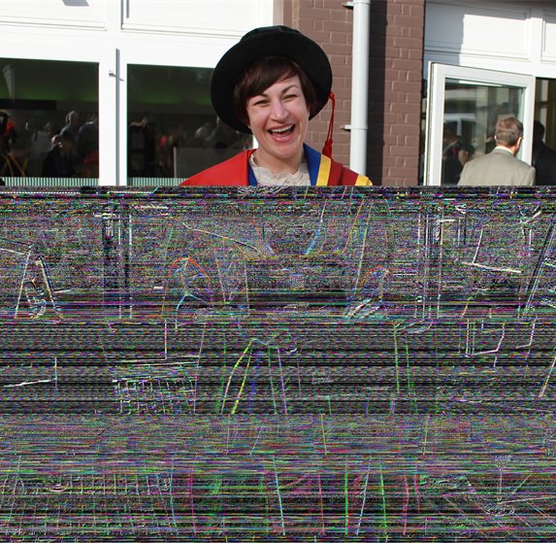
Stepping out
Whilst at Brixton, I undertook a research doctorate based on my passion.
Finding the love of research to answer vital practice questions.
Health problems made travelling and on-call hours difficult so I looked around….
Moved out to NTU in 2011 and developed a balance of teaching, research and am using it to inform practice.

Slide 16
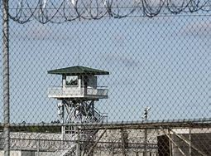
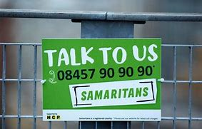
forensic psychologists do many things
You can specialise in an area of forensic psychology and make a difference across the world.
As an expert in suicide and self-harm in forensic populations, I work with a wide range of services, at front-line and senior levels, including:
Mental health services
Police
Government Ministries
Probation Services
Correctional Services around the world.
Network Rail
Samaritans

Slide 17
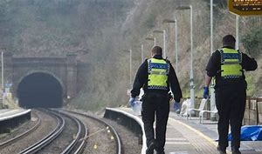
Police
Forensic Psychologists rarely profile serial killers or work directly for the Police but if interested look @ Investigative Psychology
However, Forensic Psychologists can apply their knowledge and experience to many challenges relevant to Policing.
Development of the Police Welfare Assessment (PoWA)
There are many ways to make a difference.
Notes:
And no private jets.

Slide 18
Forensic psychology research is vital
Forensic Psychologists are also researchers – you will do research at BSc, MSc and often two pieces for publication or doctoral thesis, during your supervised practice stage II.
Finding new knowledge changes practice
Dual Harm is changing the way we think about those who harm and services are changing for the better.
There really are many ways to make a difference.

Slide 19
Think big

Slide 20
Thinking you Want to help?
You can ‘help’ in many ways as a forensic psychologist
You can help people move towards a life without offending and harm
Help the public by understanding a person’s risk and providing recommendations for reducing it.
Help an individual by working with someone to develop their understanding, skills and changing their behaviour
Help through changing the environment to reduce harm and increase the chance of rehabilitation
Help by developing psychologically-based knowledge in others who can then apply it
Help by developing new knowledge through research or practice which change the way we think and practice.
Help services by developing new ways of working which affect others in a positive way.

Slide 21
Forensic Psychology

Slide 22
Thank you for listening

