Slide 1
The Public Sector Post Covid19
26th June, 2020
Hosted by the William J. Clinton Institute
at Queen’s Management School

Slide 2
Find us on Twitter
British Academy of Management - @bam_ac_uk
Irish Academy of Management - @iamirl
Dr Russ Glennon - @russglennon
Prof Robert MacIntosh - @rob_macintosh
Dr Joanne Murphy - @changeresearch
Prof Alma - @nuigalway
Prof Peter Murphy - @peterpmurphy
Richard Jefferies - @rhjefferies
Prof Robert Galavan - @robertgalavan

Slide 3
Welcome
Chair Irish Academy of Management – Dr Felicity Kelliher
CEO – British Academy of Management – Ms Madelaine Barrows

Slide 4
Dr Russ Glennon
Manchester Metropolitan University
Chair of Today’s event
@russglennon

Slide 5
Professor Robert MacIntosh
Heriot-Watt University
@rob_macintosh

Slide 6
A Liminal Funding Landscape
UK business schools receive 33% less funding from the UK Government than 10 years ago ... yet funding to other fields grew in real-terms by 9% over the same period
ESRC awards over the current REF Cycle …
2014-15 … 3,320 FTE staff in UK Business Schools … 1 award
2018-19 … Business Management = 3.5% of total funding
EU’s share of research funding for Business & Management has more than doubled (now at 27%, ) over the same period

Slide 7
Scottish Government: Advisory Group on Economic Recovery … pulse survey (22 June 2020)
Most respondents planning for increased remote working when lockdown is eventually lifted.
> 60% of respondents plan to revisit space requirements … this was truer for bigger businesses and notably truer for public and charitable organisations than it was for private business.
> 40% respondents saw the need for significant reskilling in the medium term; again, most prevalent in larger organisations
Predictions of more cashless transactions … a view more prevalent in smaller businesses

Slide 8
A Liminal Economic Landscape
Public focus (and funding) is on testing, treatment and vaccination
Business research needed to complement this … specifically the logistics of distribution as and when a vaccine becomes available
but
the challenge for our researchers is to play a leading role in building a more sustainable, resilient, inclusive economy … and cultivating public, private and third sector partnerships

Slide 9
Social Poetics
It’s almost like Dorothy in the Wizard of Oz; they click their heels and they want to go back to Kansas. You can’t go back. Humpty Dumpty’s off the wall – I’m sorry.
Ann Cunliffe (2002) Social Poetics as Management Inquiry, Journal of Management Inquiry

Slide 10
Dr Joanne Murphy
Queen’s University, Belfast
@changeresearch

Slide 11
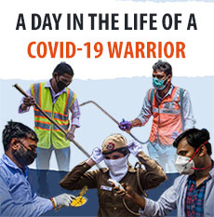
The ‘War’ on Covid19
Extreme Contexts / Leadership / Groups and Teams
Risky, Emergency, Disruptive, Surprising
Rapidly compressed decision making intensifies the impact of volatility
Highly dynamic, interconnected and interdependent environments create enormous complexity
Lead to conflicts over authority, clashes over domains or jurisdictions, and a lack of action
Lessons during / lessons after

Slide 12
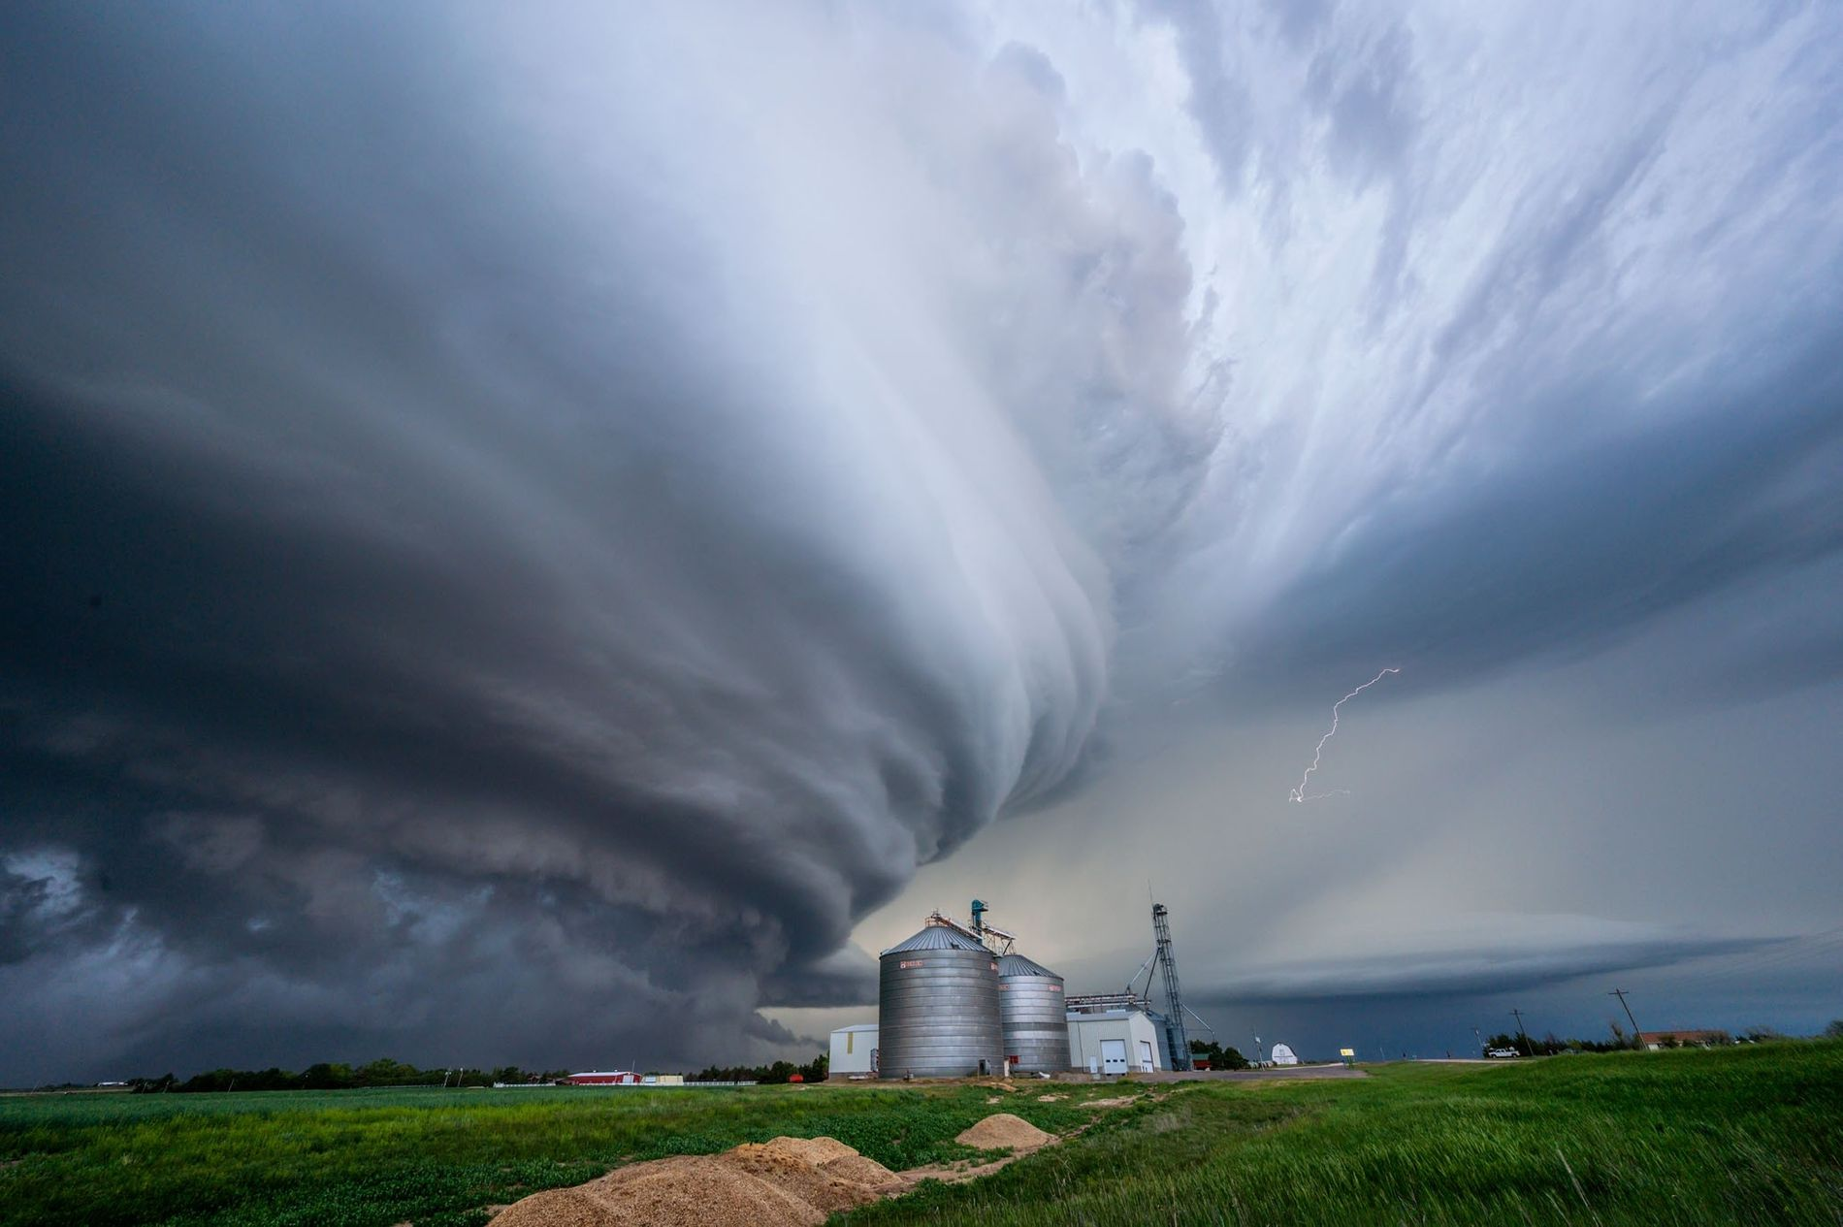
Leadership ‘Configurations’
We tend to be very ‘actor-centric’ (Buchanan & Hällgren, 2018)
Individual and Collective leadership
Importance of teams and individual capability (Fraher, 2011)
Helpful to think about networks of individuals (Gronn,2009)
Building trust, discouraging risky behaviour, identifying future vulnerabilities, making rapid decisions, taking courageous action and learning from crisis to effect change (James & Wooten, 2005)

Slide 13
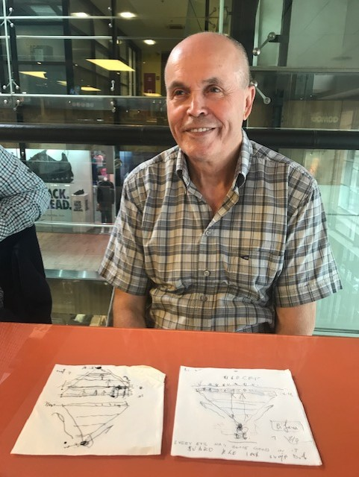
Evidence from the Field
“In such a situation you are not that important…You are at the bottom of the pyramid not the top. You are carrying them on your shoulders”
“Organisation is everything”
“you have no time. You have to make decisions. To make decisions without time you have to be brave” (Ismet Kumalic)
“Because we had a duty of hope” (DFAT)
Murphy, J. Management and War: How Organisations Navigate Conflict and Build Peace, Palgrave Macmillan - out August 2020

Slide 14
Helpful Practices
Courage - distribute authority, acknowledge mistakes, take responsibility
An awareness of organisational resilience – Foresight, insight, Oversight, Hindsight *
Being able to cope with complexity - focus on ‘more than one thing, at one time’.
Look for your boundary spanners
Preserve a ‘duty of hope’
*Denyer, D. (2017). Organizational Resilience: A summary of academic evidence, business insights and new thinking. BSI and Cranfield School of Management

Slide 15
Professor Alma McCarthy
National University of Ireland Galway
@nuigalway

Slide 16
Public Sector HR Management:
Responding to the Crisis and Beyond
Valuing our public service and front line workers
Many public servants have had to quickly adapt and re-adjust the way in which services are delivered to ensure continuity – some inconsistencies in response
Political and public health leadership has been key
What opportunities might the crisis bring for change?

Slide 17
National Remote Working Survey in Ireland
end April/first week May 2020 Public Sector Respondents
3,860 public sector respondents
63% never worked remotely before COVID-19
45% report easy/somewhat easy work remotely; 40% difficult/somewhat difficult
Top 3 challenges:
Collaboration and communication with co-workers is harder
Not being able to switch off from work
My physical workspace (1/3 do not have dedicated workspace)

Slide 18
Top 3 advantages:
No traffic and no commute
Reduced costs of going to work and commuting
Greater flexibility as to how I mange my working day
Confidence in organisation’s leadership team to make the right decisions to manage through this crisis?
79% confident/very confident; 21% not so confident/not at all
Compared to normal, productivity while working remotely is:
About the same | 34.5%
Higher | 29.2%
Lower | 26.2%
It is impossible to say given crisis | 10.1%

Slide 19
Future?
80% want to continue to work remotely post-COVID:
Several times a week = 41%; Several times a month = 28%; Daily = 10%
Challenges to continue RW?
My organisation will not support it (26.5%)
There are no challenges for me to continue working remotely (16.7%)
Inadequate equipment and/or resources
Nature of work does not allow / Manager will not support (11.7 each)
Sustaining resilience and building a more effective and responsive public service: key learnings; what to retain from the crisis; take opportunity for radical change?
Public service capacity development and people-centric leadership

Slide 20
Professor Peter Murphy
Nottingham Trent University
@peterpmurphy

Slide 21
A post Covid-19 scenario
The rise of ‘populism’ both in existing and in new parties/groups
From evidence based to evidence free policy making
Economic, social and environmental de-regulation
Further reductions in public expenditure to achieve a smaller state
Endemic short-termism
Reaction and response prioritised over prevention and protection
Behaviour change

Slide 22
Another post-Covid-19 scenario
Co-produced and integrated policy and delivery (collaborations)
Collective local and national responses to wicked issues and contexts
Agreed mutual priorities and multi-organisational programmes
Facilitated by new systems, processes, organisations, and networks.
Development focussed on the UN’s Sustainable Development Goals
Strengthening of individual, organisational and community resilience
Subsidiarity and appropriate local solutions.

Slide 23
Will either set of characteristics reassert themselves
Which characteristics were best deployed in response to Covid-19
Which characteristic are best deployed against climate change
Robert stated earlier
“the challenge for our researchers is to play a leading role in building a more sustainable, resilient, inclusive economy … and cultivating public, private and third sector partnerships”

Slide 24
Professor Robert Galavan
National University of Ireland Maynooth
@robertgalavan

Slide 25
Dr Felicity Kelliher
Waterford Institute of Technology, Ireland
Q&A
@iamirl

Slide 26
Dr Russ Glennon
Manchester Metropolitan University
@russglennon

