Slide 1
High impact climate solutions: We can do it! –The NTU toolkit for HEIs
Dr Petra Molthan-Hill, Professor of Sustainable Management and Education for Sustainable Development and Co-Chair UN PRME Working Group on Climate Change & the Environment, NBS, NTU
Helen Puntha, Lead of NTU Green Academy
Dr Alex Mifsud, Carbon Literacy Trainer

Slide 2
Agenda
NTU’s Carbon Literacy Training for staff and students at universities: A Systems Approach
NTU’s Green Academy and embedding carbon literacy, climate change education and climate solutions in a university
NTU’s toolkit and NBS’s toolkit disseminated worldwide through UN PRME and other networks

Slide 3
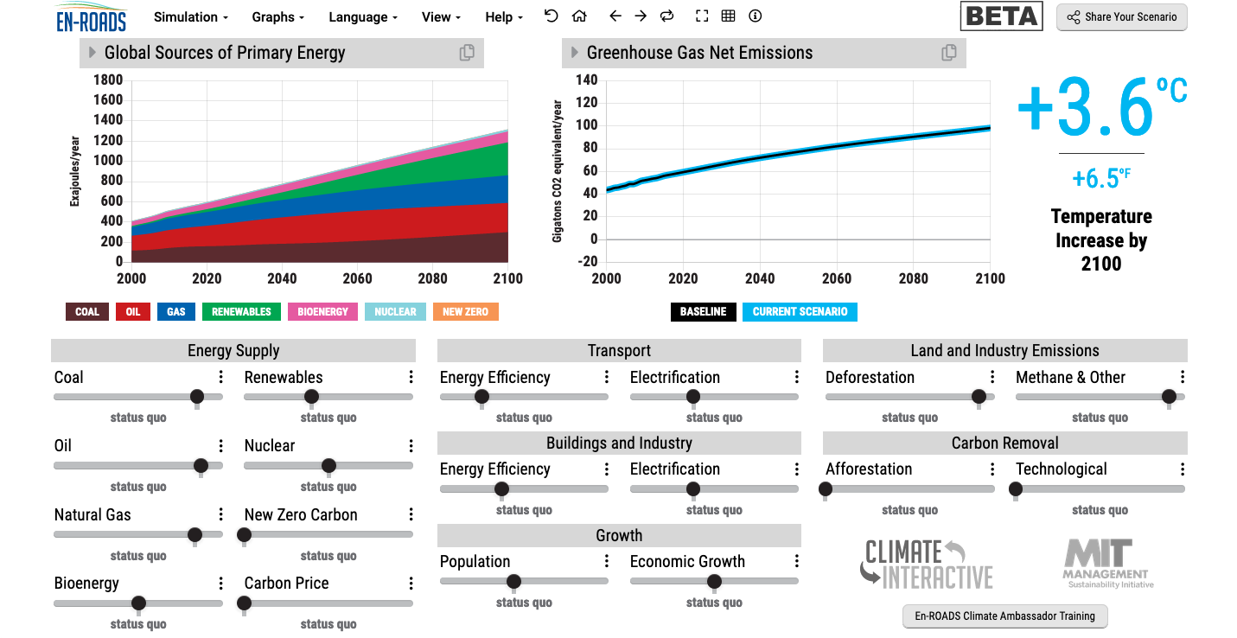
En-ROADS is a cutting-edge simulation model used to test climate solutions and generate climate scenarios for the future.
Notes:
This is our current situation as demonstrated by En-ROADS which was developed by MIT Climate Interactive so that everyone can understand the high impact solutions and which impact they would have.

Slide 4
Solutions: A lot to know…
https://profilebooks.com/how-bad-are-bananas.html
https://www.drawdown.org/
Notes:
Knowing these climate change mitigation tools and strategies will allow them to judge, whether Bill Gates is suggesting good solutions in his new book or whether Mark Carney got it right.

Slide 5
Inspired by Carbon Literacy Training in:
Chapple, W., Molthan-Hill, P., Welton, R., Hewitt, M.
Lights Off, Spot On: Carbon Literacy Training Crossing Boundaries in the Television Industry.
J Bus Ethics 162, 813–834 (2020).
https://doi.org/10.1007/s10551-019-04363-w

Slide 6
Carbon Literacy Training for Business Schools
What if every recruit into corporations from the world’s business schools was qualified as Carbon Literate?
This training was developed by Nottingham Business School (Nottingham Trent University) in collaboration with the UN PRME Champions, Oikos International and the Carbon Literacy Project.
The aim of this project is to get academics, students and others Carbon Literate within a short time frame and to get as many people as possible actively involved in embedding climate solutions in their own life and work. In order to do so we have chosen a train-the-trainer approach, so we will offer regional events inviting all the universities and business schools in the vicinity to train academics and students there so that they can become trainers in their own institution and/or get involved in training others in other regions of the world.
Notes:
In our Carbon Literacy Training for Business Schools we have a strong focus on these high impact solutions so that everyone in a business school, whether in teaching, research or operations would know the best actions to take.

Slide 7
2. Climate Change Mitigation Education
Developing values, knowledge and skills required to make choices and decisions that minimize the use of natural resources, emissions, waste and pollution; while contributing to the development of new solutions to the climate crisis (e.g., rethinking the way we live, buy and consume, how our daily lives are organized, how we socialize, exchange, share, educate and build identities).
Taking individual and/or collective action with the potential to have immediate, direct impact (e.g., reducing energy consumption, using non-polluting and renewable energy sources, environmental conservation, re-forestation and re-greening).
Contributing to policy development with long-term positive impact on societal behaviour by examining economic systems, social structures, cultural patterns, lifestyle expectations, consumerism, wealth distribution, aspirations and value systems and their underlying responsibility for excessive greenhouse gas production.
Part of a table published in: MOLTHAN-HILL, P., BLAJ-WARD, L., MBAH, M.F. and LEDLEY, T.S., 2021. Climate change education at universities: relevance and strategies for every discipline. In: M. LACKNER, B. SAJJADI and W.-Y. CHEN, eds., Handbook of climate change mitigation and adaptation. New York: Springer, pp. 1-64. ISBN 9781461464310
Notes:
The second one is Climate Change Mitigation Education: Every Graduate needs to know how to best mitigate climate change- what are the best strategies and tools in operations, supply chain management, economics, investment to reduce carbon emissions?

Slide 8
NTU Carbon Literacy Training Course
Climate change mitigation focused on solutions
Interactive teaching material
MIT Sloan & Climate Interactive Simulation tool
Certificates for you and your students
Please contact petra.molthan-hill@ntu.ac.uk for more info on this or the more specific training for business schools mentioned earlier.
www.ntu.ac.uk
Notes:
And if you are interested in the wider perspective on how to get everyone in the university carbon literate, NTU has made one of the two open-source tool kits for all staff and students at universities.

Slide 9
Use the NTU toolkit if you want…
A Systems Approach
All SDGs
A focus on high impact climate solutions
We include the best solutions from different sources such as Project Drawdown and constantly update our material.
We provide world class tools so that you can easily understand the quite complicated systems of climate change causes and solutions.
We highlight the strong links to all Sustainable Development Goals (SDGs) and multiple benefits in addition to high impact climate solutions.
www.ntu.ac.uk

Slide 10
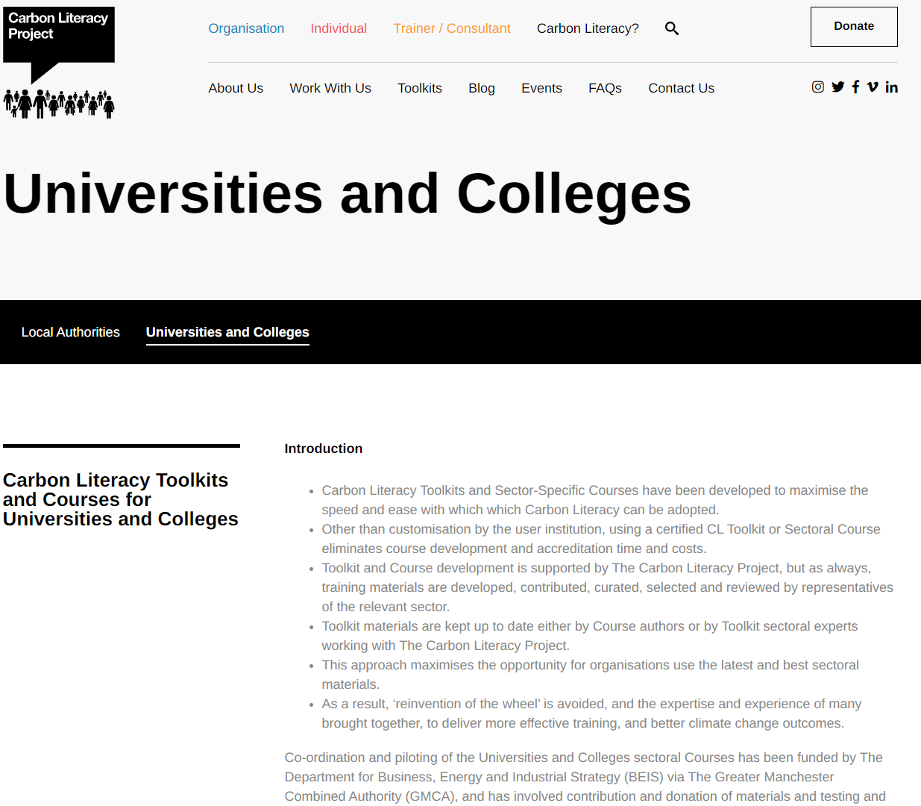
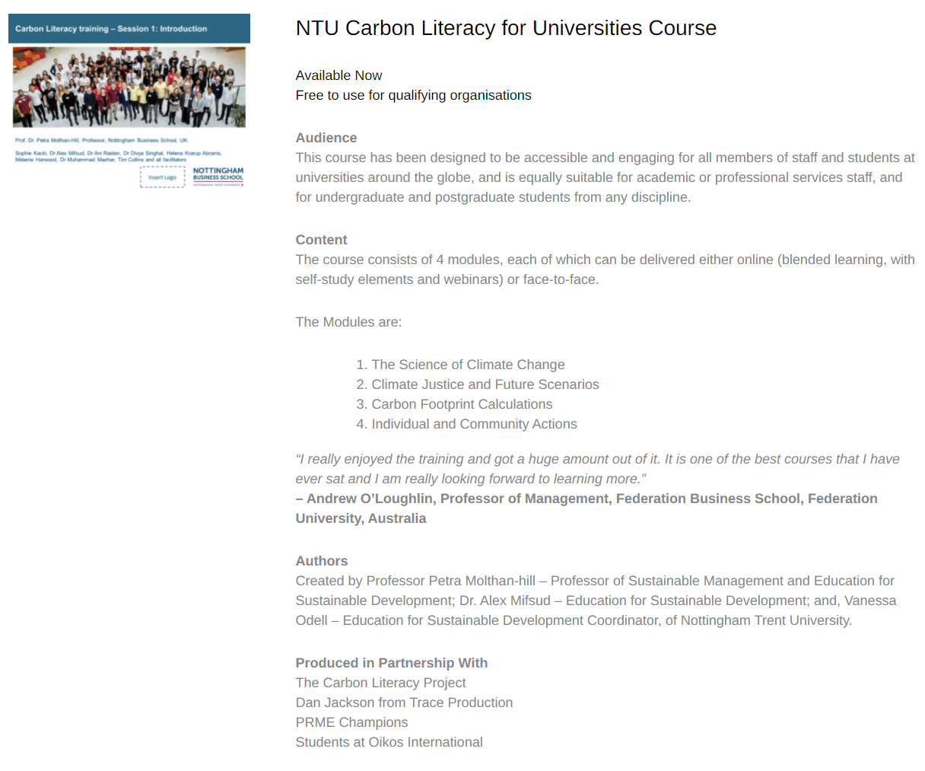
NTU Carbon Literacy Training Course
Please contact education@carbonliteracy.com to request this toolkit.
www.ntu.ac.uk
Notes:
And if you are interested in the wider perspective on how to get everyone in the university carbon literate, NTU has made one of the two open-source tool kits for all staff and students at universities. Lots of information about the resources via https://carbonliteracy.com/toolkits/universities-colleges/. Email education@carbonliteracy.com to request the toolkit.

Slide 11
Read about the Carbon Literacy Training
https://link.springer.com/referenceworkentry/10.1007/978-1-4614-6431-0_154-1

Slide 12
Carbon Literacy for Universities and Colleges
We run Accredited Carbon Literacy Training monthly for anyone from the University and college sector in the UK.
Our Scotland Team also run Carbon Literacy for Scottish institutions at a subsidized rate.
The courses are run by our in-house team of Carbon Literacy trainers.
Each course, attended by multiple institutions, gives delegates insights from others within the sector and a chance to share ideas and best practice.
This course will help you to:
Understand the basics of climate change science and how we know it’s a problem
Explore how climate change is impacting us all now and how it will in the future
Be able to identify ways that you and your organisation can take action to reduce emissions, benefiting from this in the process
For more information and course dates, please visit our website: www.eauc.org.uk/events

Slide 13
International work-related experience
Take part in a virtual international work-related experience. This opportunity is open to XXX to take part in Carbon Literacy training and work with XXXX As a part of this project you’ll learn about adapting to the culture in XXX in order to do this work and about climate solutions in general and especially for this part of the world. You’ll be fully trained as Carbon Literacy Trainers and receive an external work experience certificate by eduCCate Global https://www.educcateglobal.org/. If you decide to do the assessment form afterwards and pass it, you will also get an external Certificate by the Carbon Literacy Project in Manchester. Time Commitment: Takes place end of November – mid-December (you need to be available every Monday from 15.30-18.00 GMT on 30 November, 7 December, 14 December, 21 December) to take part in the actual virtual delivery to the teachers in XXX and every Thursday from 15.00-17.00 GMT to prepare the session virtually and to reflect on cultural diversity and different approaches (26 November, 3 December, 10 December 17 December). You might need 1-3 hours to prepare yourself in your own time depending on which task you choose as your responsibility. Total: Hours: 5 – 8 hours per week (over 4 weeks) Support: The Green Academy Team at NTU and NBS Professor Petra Molthan-Hill (an experienced Carbon Literacy Trainer) will support you as well as the CEO of eduCCate Global - Melanie Harwood. https://www.educcateglobal.org/ and https://www.ntu.ac.uk/about-us/sustainability/sustainability-in-education/carbon-literacy-training XXX Contact person if you are interested: GreenAcademy@ntu.ac.uk

Slide 14
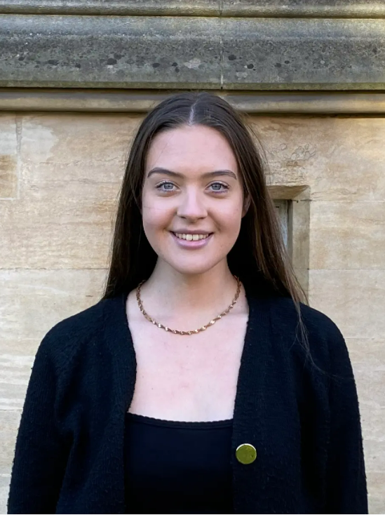
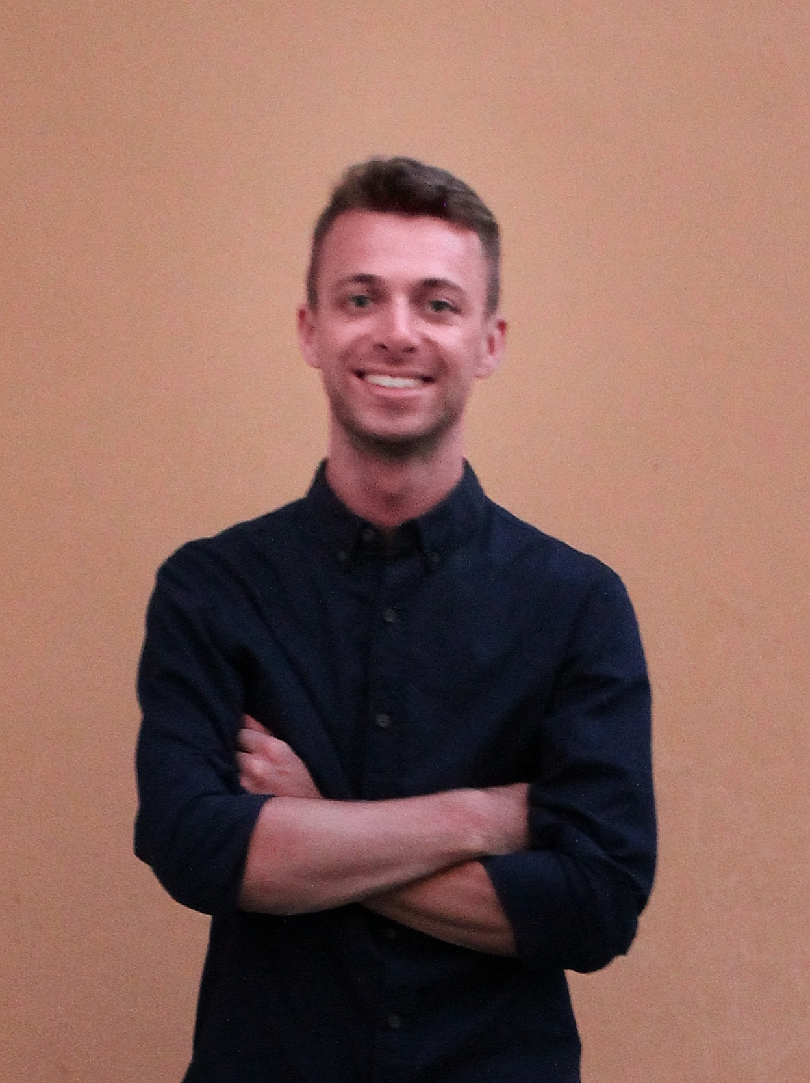
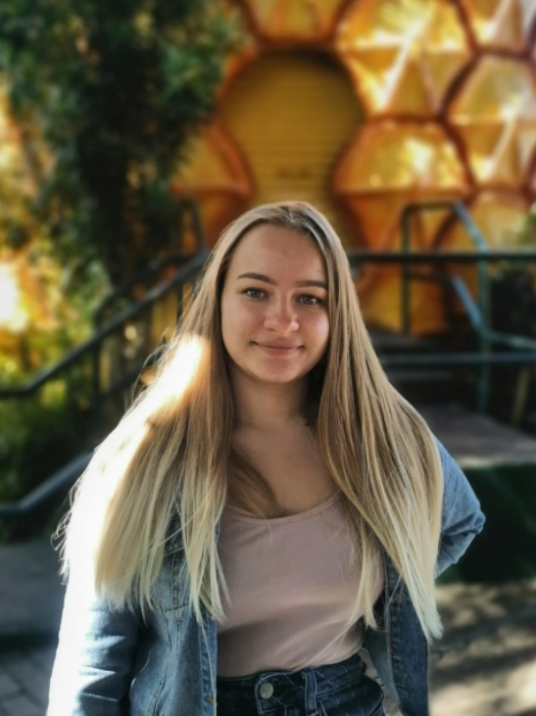
Watch our students talking about …
Sophie Adams
Watch Video Here
Connor Davey
Watch Video Here
Chloe Bottomley
Watch Video Here
Justyna Cuglewska
Watch Video Here

Slide 15
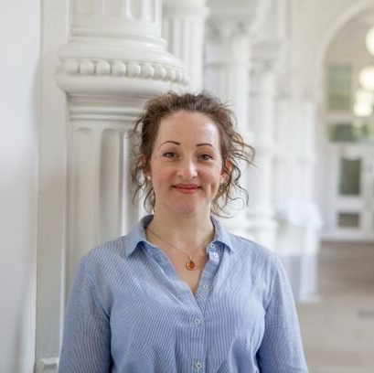
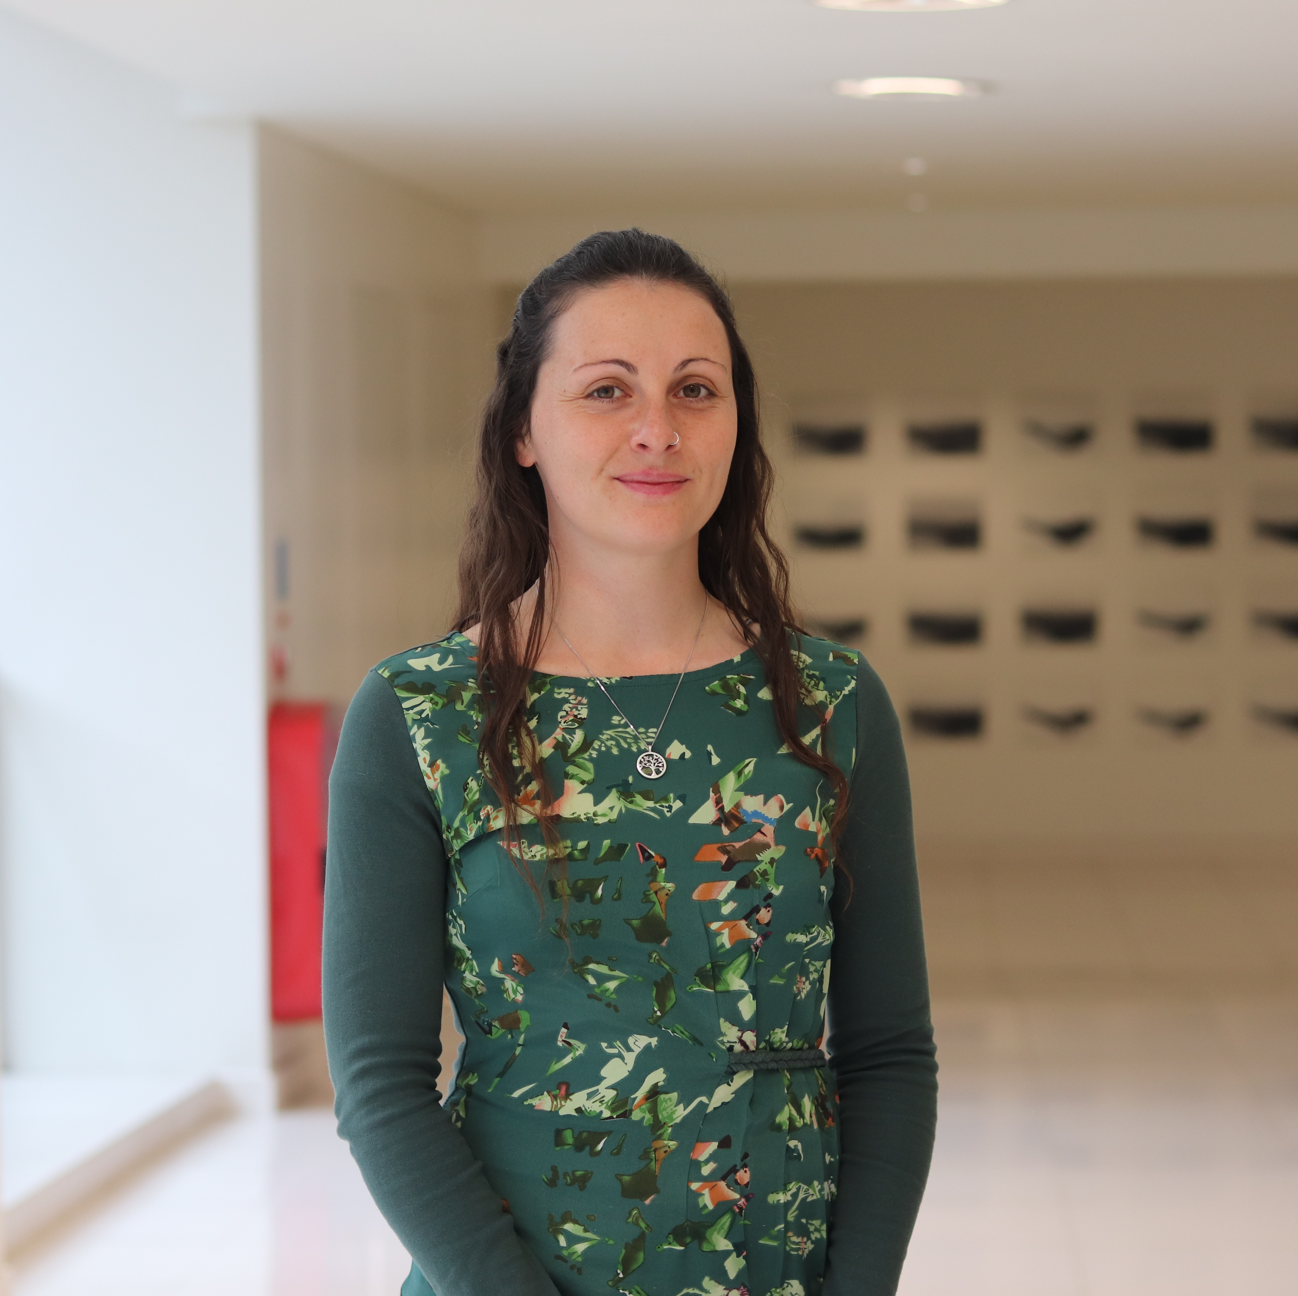
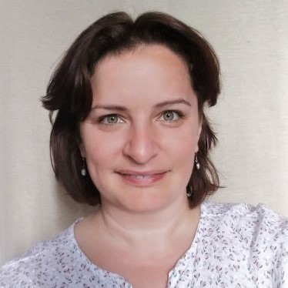
NTU Green Academy
Mission
Pioneer a shared understanding of Sustainability Education including climate education and the UN SDGs
Stimulate pedagogical innovation and practice-sharing in area of Sustainability Education
Support faculties to develop their Sustainability Education offer in line with NTU University, reimagined
Co-facilitate a ‘Think Global, Act Local’ approach
Create clear pathways for colleagues to develop their ESD practice and scholarship
Examples of work
Support offer for NTU course approvals, re-validations and subject benchmark renewals in line with QAA ESD Guidance
Staff development module on integrating the SDGs into courses (mandatory for most colleagues with teaching responsibilities)
Collaborations with faculty e.g. game-based learning, employer challenges, staff and student workshops
Online Sustainability in Practice (SiP) certificate for all students and staff
https://www.ntu.ac.uk/about-us/sustainability/sustainability-in-education

Slide 16
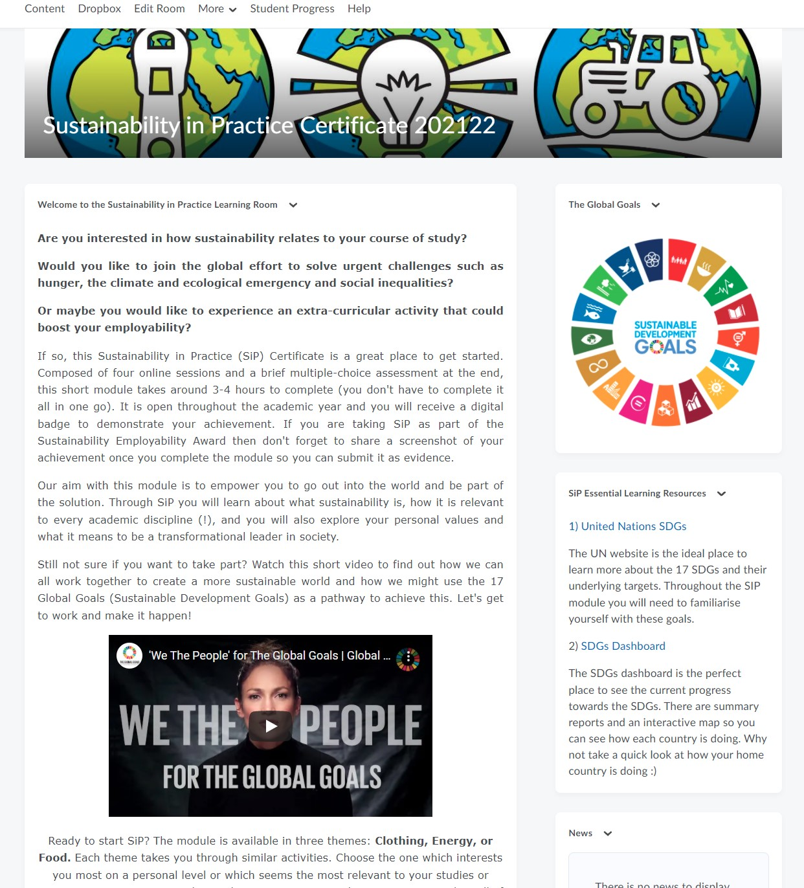
Sustainability in Practice (SiP) module
Short online module available to all our students and staff through our VLE since 2013
Provides a foundational knowledge of sustainability and the climate and ecological emergency
Three themes: Clothing, Energy or Food
4 online sessions (2-4 hours in total)
Upon completion: certificate and (Undergraduate students only) HEAR entry and Bronze Sustainability Employability Award.

Slide 17
SiP Structure
 | Topic | Aim | Activities and reflection
Session one | Student experience of sustainability | Engage students on a personal level | Sustainability skills inventory, exploring personal values, thematic issues (clothing, energy, food), and the climate & ecological emergency. Flipgrid video activity (optional)
Session two | Sustainability and the academic disciplines | Facilitate disciplinary understanding of sustainability | Planetary boundaries, discipline specific resources, place-based learning activity to explore SDG progress in home nation / hometown.
Session three | Connections between disciplines; systems thinking and identifying challenges | Facilitate interdisciplinary and holistic understanding of sustainability | Product life cycles, Long-term thinking, indigenous wisdoms, exploring mindsets, multiple choice quiz on SDGs and SiP theme.
Session four | Global and local solutions, individual agency | Identify disciplinary/ interdisciplinary solutions to sustainability challenges and explore own agency. | Linear and circular systems, doughnut economics, interconnectedness, leadership styles, local and global sustainability solutions, Flipgrid video activity (optional), sustainability skills inventory.
End Assessment: Multiple-Choice Assessment Optional extras: Accompanying workbook to explore personal values, mindsets and leadership styles; ‘Sustainable Solutions’ video competition (Session 4).

Slide 18
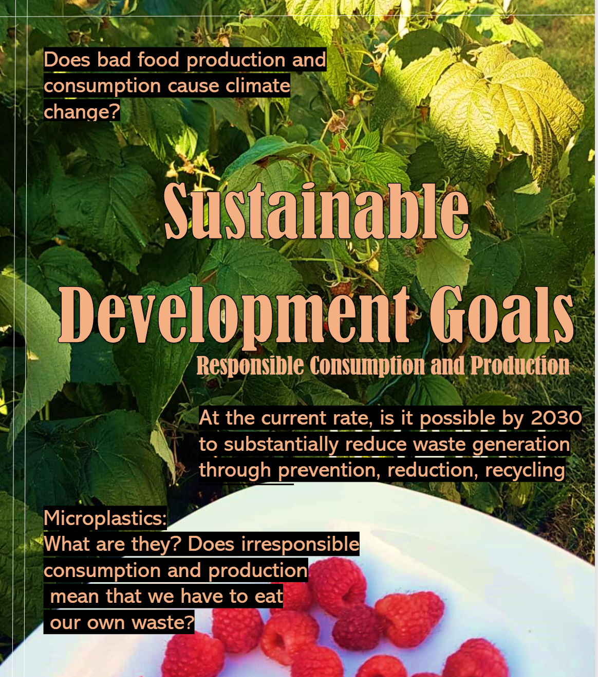
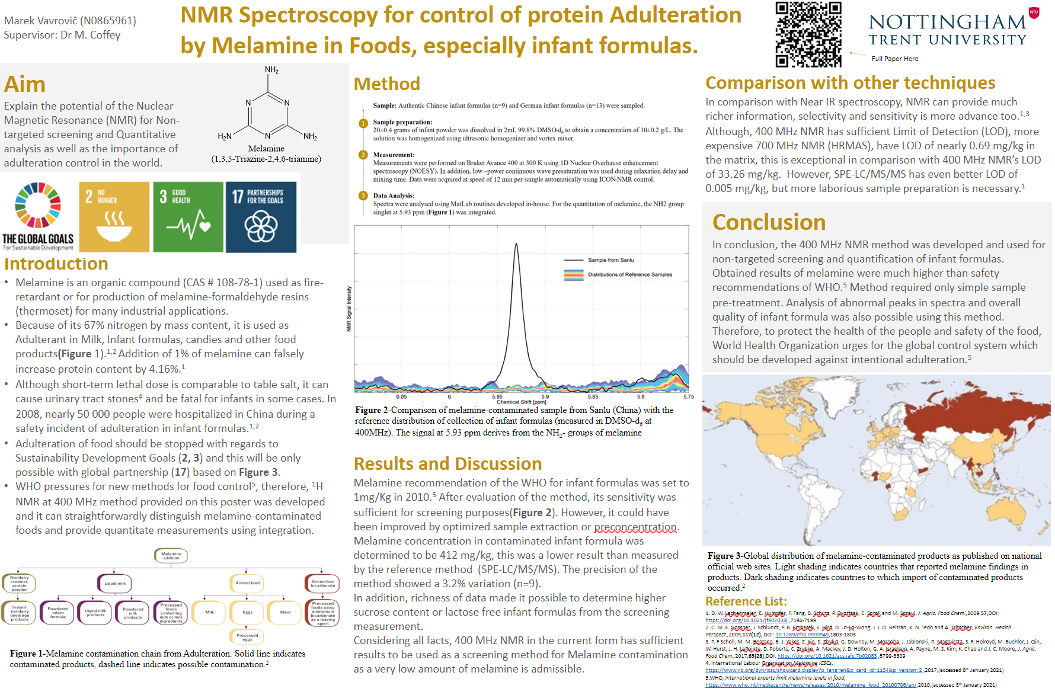
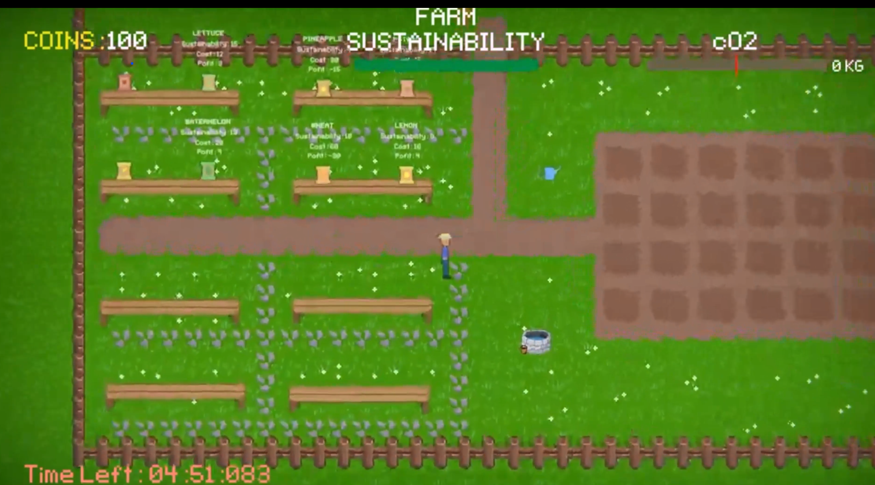
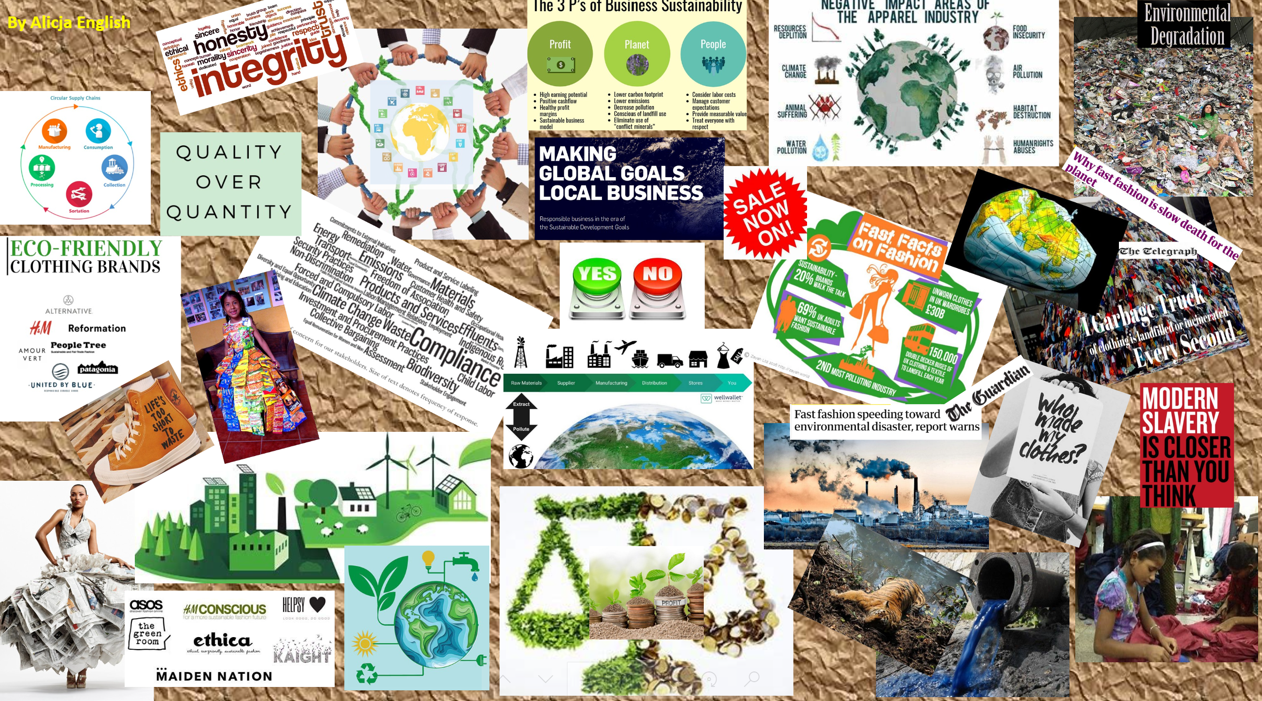
SiP Student Outputs
Artefact
Research Poster
Video
Flipbook
Moodboard
36-hour Game Jam

Slide 19
Students changing organisations as part of the core curriculum
Guardian Award 2015
MOLTHAN-HILL, P., ROBINSON, Z.P., HOPE, A., DHARMASASMITA, A. and MCMANUS, E., 2020. Reducing carbon emissions in business through Responsible Management Education: influence at the micro-, meso- and macro-levels. International Journal of Management Education, 18 (1): 100328. ISSN 1472-8117
https://www.theguardian.com/higher-education-network/gallery/2015/mar/19/guardian-university-awards-2015-winners-in-pictures

Slide 20
Sustainability in Enterprise
The Sustainability in Enterprise (SiE) programme provides fully funded support and grants to reduce the carbon emissions of eligible Nottingham small and medium-sized enterprises (SMEs). SiE will help businesses improve their environmental performance across four key areas: People, Products, Processes and Premises.
This project is part-funded by the European Regional Development Fund (ERDF).

Slide 21
Sustainability and Inclusive Leadership (SAIL)
A Course for SMEs to ‘build back better’ & tackle the Climate Crisis.
SAIL explores the global climate crisis, the very real impact that this will have on the economic landscape, and how important it is for businesses to be more sustainable as they work towards COVID-19 recovery.
Participants learn:
how businesses are affected by climate change, and vice versa
climate change mitigation tools and high impact solutions: for personal life, work & business
recovery and change strategies, with support to develop an action plan.
In real terms, businesses can expect a range of benefits including saving money, attracting and retaining employees and customers, reducing waste, increasing productivity, and getting a head start on becoming compliant for future regulations – as well as enhancing their mission & values.
Participants can gain a full certificate by the Carbon Literacy Trust. This course has also been accredited by NTU: participants can receive 10 credits towards a Level 4 (degree level) qualification.
To deliver this course in your business or area, email SAIL@ntu.ac.uk for more information.
“I think that a lot of people just don’t have the awareness that’s needed to tackle the problem at scale, so being armed with some facts, ideas for engagement, methods of overcoming objections, and ultimately the confidence to challenge misinformation or misguided opinions is really helpful.”
Participant Ben Williamson, Rebel Recruiters, Nottingham
Nearly 50% of SMEs in our local area do not have a sustainability policy. This represents a significant area of development and opportunity for local businesses.

Slide 22
NTU’s Operation: Pledge
NTU has pledged to achieve Net Zero Carbon emissions across all three carbon scopes by 2040 in order to create a Zero Carbon culture across the NTU community
https://www.ntu.ac.uk/about-us/sustainability/sustainability-in-action/carbon

Slide 23
Carbon Literacy - International
Collaboration between Nottingham Business School and United Nations Principles in Responsible Management Education (UN PRME) Working Group on Climate Change and Environment.
With 850 Business Schools, UN PRME are best positioned to support NTU’s international work in Europe, US, Asia, Australia and South Africa.
UN PRME Working Group on Climate for our Business Schools toolkit.
Experience in adapting CLT toolkits to other universities and countries.
EU adapted toolkit.

Slide 24
Key Figures
# of people who have become certified through the PRME global training
# of countries engaged in the CLC map training
# of people who have attended at least part of the PRME global training
total # of learners from CLC mapped training
9
2044
142
508
# of pins on the CLC map
23
average # & range of participants in each pinned training
# of trainers engaged in PRME global training
# of facilitators engaged in PRME global training
88
(10 – 565)
35
~15

Slide 26
Some quote from UN PRME/NBS training in November/December 2020 from Australian participants
"I really enjoyed the training and got a huge amount out of it. It is one of the best courses that I have ever sat and I am really looking forward to learning more.” – Prof. Andrew O'Loughlin, Professor of Management, Federation Business School, Federation University, Australia
“I particularly like the number of practical tools and resources that Petra and team introduced us to, these will really help us start the CL process at our Business School.” – Dr. Micaela Spiers SFHEA; Course Director, Bachelor of Commerce; Lecturer, Work Integrated Learning (WIL); Deakin Business School, Faculty of Business and Law, Australia
“I have loved stepping out of my comfort zone to undertake the CLT. I had little spare time but my commitment to CLT has really paid off and I go into 2021 feeling empowered.” – Prof. Kerrie Bridson, Associate Dean Quality, Standards and Accreditation; Associate Professor (Marketing), Faculty of Business and Law, Deakin Business School, Australia

Slide 27
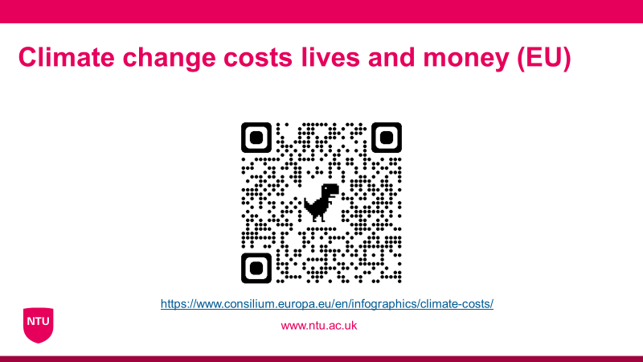
EU Adapted Toolkit

Slide 28
Although I’m not a total newbie to sustainability and climate change: The Carbon Literacy Training was a real eye-opener to me. Dr. Alex Mifsud did a tremendous job in making the consequences for global warming tangible when it comes to the way we live, how companies do business, and how politics is done. Getting a clearer picture of which measures have a strong and positive effect on the reduction of Green House Gases is key to understand what we as individuals can do. It is also super important to understand what society as a whole can do to keep global warming to below the well-known Paris-goal of 1.5℃ compared to pre-industrial levels.
Prof. Dr. Oliver Plum, Professor of Strategy & Innovation at CBS International Business School

Slide 29
UN PRME working group on climate change
https://www.unprmeclimate.org/
Three main objectives:
1. Policy/Strategies: This section provides business schools and universities with policy templates on how climate change and other environmental issues can be integrated into operational policies/strategies but also into learning and teaching policies/strategies.​
2. Teaching: Sharing of good ideas, best practice and innovative training methods on how to integrate climate change and other sustainability issues into management education and training within universities and beyond. A special focus is on how to encourage students to work towards sustainable solutions.
3. Cooperation: Explores the dialogue between business schools and private/public sector organizations especially through Global Compact in order to work together on solutions to climate change and other environmental challenges. The vision is that companies put up ‘wicked ‘ problems and the best brains across the world will contribute to solving them.

Slide 30
Pass it on

Slide 31
Any further questions? Please contact:
Dr Petra Molthan-Hill petra.molthan-hill@ntu.ac.uk
Helen Puntha greenacademy@ntu.ac.uk or helen.puntha@ntu.ac.uk
Dr. Alex Mifsud sustainabiltybyalex@gmail.com

