Slide 1






Governmental Financial Resilience
– A European Perspective
EGPA Conference September 2021
Sanja Korac - University of Speyer, GER
Iris Saliterer - University of Freiburg, GER
Carmela Barbera - University of Bergamo, IT
Bernard Kofi Dom - Nottingham Trent University | University of Essex, UK
Céline Du Boys - Aix-Marseille University, FR
Ileana Steccolini - University of Essex, UK
Notes:
.

Slide 2
AGENDA
Background
The Framework and Dimensions of Governmental Financial Resilience
Patterns and Consequences of Governmental Financial Resilience
Reflections
Notes:
I will begin the presentation with a short glance on why the concept of financial resilience may be worth your while and will report on the research on governmental financial resilience that we have conducted so far, before I go more into detail on the framework and the dimensions of governmental financial resilience. Some results from our latest empirical study will complement the more general description of the respective dimensions.
Iris will then take over to discuss the patterns and organizational consequences of governmental financial resilience before providing some reflections on what we have learned so far.

Slide 3
1. Background
The Covid-19 Pandemic has been a major shock for most European local governments (LGs) and as such offers a unique possibility to progress in the understanding of LGs resilience, i.e., governments’ capacity to anticipate and cope with shocks and difficulties (Barbera et al., 2015, 2017 2018; Steccolini et al., 2018)
Conducting a survey of top executives from cities over 15 000 inhabitants, in four major European countries (i.e. France, Germany, Italy and UK), we aim to
  analyze resilience dimensions against the background of the pandemic and across countries,
  and increase our understanding on how pre-existing resilience capacities and the sensemaking of top managers (i.e. strategic impact of crisis) influenced the ability to deal with the consequences (i.e. sense of control) and the level of conflict caused by the crisis as well as the impact of the latter on the LG performance.
  shedding light on different performance-enabling capacities.
Notes:
The Covid-19 Pandemic has been a major shock for most European local governments (LGs) and as such offers a unique experiment in comparative government. It put considerable pressure on them and involved an unprecedented mobilisation of actors and resources. All over Europe, LGs responded to the crisis by maintaining, developing and adapting public services, by transforming their internal and external organisation, changing their work habit, by developing new networks… First feedbacks suggest some successes… and some failures.
To progress in the understanding of LGs response to the crisis, we mobilized the concept of financial resilience, i.e., governments’ capacity to anticipate and cope with shocks and difficulties affecting their finances (Barbera et al., 2015, 2017 2018; Steccolini et al., 2018). We conducted a survey of top executives from cities over 15 000 inhabitants, in four major European countries, differently impacted by the crisis (i.e. France, Germany, Italy and UK), to investigate their vulnerability sources, anticipative and coping capacities before the crisis, and their reactions to the crisis.
We aim at understanding how pre-existing resilience capacities and vulnerability perception influenced the sensemaking of top managers (THREAT OR OPPORTUNITY), their response to the crisis (CHANGE?), and their perceived ability to deal with the crisis’ impact on service delivery and performance (SENSE OF CONTROL). The survey reveals significant differences with regard to the levels of capacities and vulnerabilities, leading to country-specific financial resilience profiles for local governments. Through analysing the combination of internal and external resilience dimensions against the background of the pandemic and across countries, the survey sheds light on different performance-enabling capacities.

Slide 4
1. Research on Governmental Financial Resilience
Need for alternative conceptual lenses and frameworks to explore and understand
  how governments face unexpected events and crises
  whether and why responses are different across countries and organizations
  what lessons can be learned to be ready to face future shocks
Resilience as the capacity to deal with shocks/uncertainty
  capacity to react to crises/absorb shocks (bouncing back)
  capacity to cope with the unexpected and adapt to new and complex situations (bouncing forward)
how governments „keep operating even in adverse, ‚worst case‘ conditions and adapt rapidly in a crisis“ (Hood 1991, 14)
Notes:
This highlighted the need for alternative conceptual lenses and frameworks that could integrate a financial management as well as an organizational view in order to explore and understand how governments „keep operating even in adverse, ‚worst case‘ conditions and adapt rapidly in a crisis“ (Hood 1991, 14); which means investigating
how governments face unexpected events and crises
whether and why responses are different across countries and organizations
what lessons can be learned to be ready to face future shocks
In this endeavor, our research team has applied the general concept of resilience as the conceptual lens for our research.
In short, we can say that resilience is the capacity to deal with shocks or uncertainty. There are two different approaches to resilience:
The first is understanding resilience as the capacity to react to crisis efficiently or to absorb shocks. The main aim here is on bouncing back to „normal“ or to a situation as of before the crisis.
The second understanding of resilience follows an evolutionary approach where organizations thrive through crisis and bounce forward by anticipation and quick adaptation to new challenges.

Slide 5
1. Research on Governmental Financial Resilience
The management of shocks, crises, unexpected events - increasingly becoming ‘routine’ for governmental entities
During crises governments are prompted to reset priorities, cut back expenditures, restructure service delivery
Important opportunity for adopting a long-term, strategic view (Bozeman 2010)
  emphasizing the role of internal capacities and looking at the interplay of different dimensions
Notes:
Governments are no strangers to dealing with unforeseen events negatively affecting their finances. As disruptive events become more common, the management of shocks, crises, and unexpected events increasingly turn into ‘routine’ for governmental entities.
During crises and austerity, governments are prompted to reset priorities, cut back expenditures, and restructure service delivery strategies in order to deliver services in a stable, uninterrupted manner, meeting their citizens’ demands.
Even though academic interest in decline and cutback management seemed to have peaked in the 1970s and 1980s, governmental responses to the global financial crisis have led to a resurgence of „old-fashioned“ cutback and austerity measures and also the respective rhetoric at the national levels.
While this has led to an impressive accumulation of contextual knowledge on fiscal and organizational response strategies, there have also been warning calls that the focus on decline and cutback management may cause scholars to miss an important opportunity (Bozeman 2010) for adopting a longitudinal and strategic view on the whole life cycle of public organizations, one that emphasizes the role of internal capacities and looks at the interplay of different dimensions beyond fiscal responses.

Slide 6
Relationhsips
H1: Good Polit-Admin Relationships increase (decrease) Controlabillity (Conflicts)
H2: Vuln Assessment* increase (decrease) Controlabillity (Conflicts)
H3: Level of strategic impact decreases (increases) Controlabillity (Conflicts)
H4: High level of internal collaboration increase (decrease) Controlabillity (Conflicts)
H5: Level of employee adaptablity increase (decrease) Controlabillity (Conflicts)
H6: Level of controllability increase Performance
H7: Level conflicts decrease Performance
Indirekte Effekte (?)
*Name differently
Notes:
Hypothesis lb: High levels of information use among top managers will be positively related to their interpretation of strategic issues as controllable.

Slide 7
Model (only H shown)
H3 (a-c)
Pol-Admin Relations
H2 (a-c)
H4 (a-c)
H1a (+)
H1b (-)
Vulnerability Assessment*
Controllability of situation caused by C-19
H6 (+)
Strategic Impact C-19
Organisational
Performance
H6 (-)
Controls
Abs_Diff Strategies
Level of Conflict
caused by C-19
Employee Adaptability
Current Ratio
Invest Ratio
H5a (+)
H5b (-)
Debt Ratio
Internal Collaboration

Slide 8
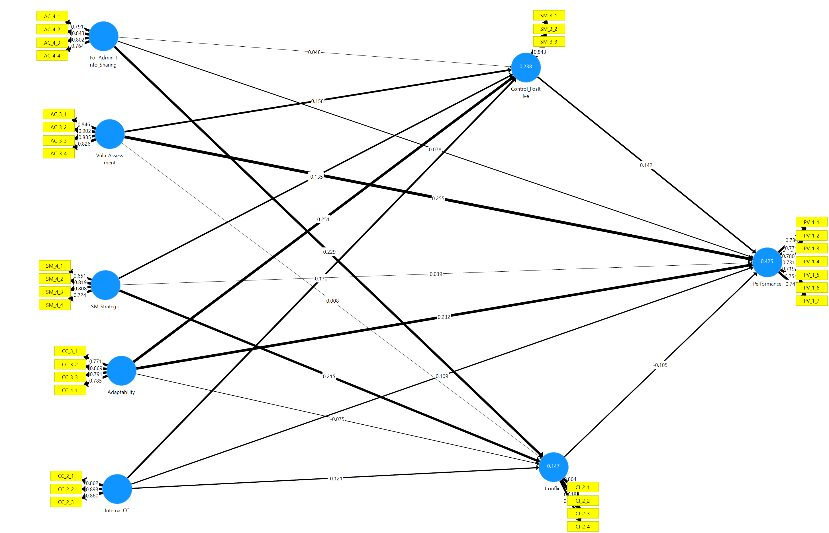
Notes:
What is the relative strength of the direct and indirect paths between the sensemaking activities of scanning
and interpretation, and organizational performance?

Slide 10
AC related Constructs
AC_4_1 | Information is shared freely between political decision makers and administrative staff
AC_4_2 | Political decision makers are aware of the local government's/organization's vulnerabilities
AC_4_3 | Political decision makers encourage administrative staff to bring forward information that may be considered 'bad news’
AC_4_4 | Elected officials rely on the expertise of administrative staff
Pol-Admin
Relations
AC_3_1 | We regularly… - analyse and assess the risks associated with our vulnerabilities
AC_3_2 | We regularly… - analyse and assess both the probability and impact of potential disruptions
AC_3_3 | We regularly… - attempt to drive awareness for potential disruptons to our employees
AC_3_4 | We regularly… - engage in contingency planning to prepare for potential disruptions
Vulnerability
Assessment

Slide 11
CC related Constructs
CC_2_1 | Employees collaborate with each other to diagnose and solve problems
CC_2_2 | Employees interact and exchange ideas also across departments
CC_2_3 | Cross-departmental collaboration is part of business-as-usual
Internal
Collaboration
CC_3_1 | Employees are able to assimilate and apply new knowledge in their practical work
CC_3_2 | Employees do a good job in keeping up with new ways of doing things
CC_3_3 | Employees are able to adapt quickly to changing circumstances
CC_4_1 | Employees regularly update their knowledge on new practices and tools
Employee
Adaptability

Slide 12
C-19 related Constructs
SM_4_1 | an issue that affects the local government as a whole
SM_4_2 | an issue which reshapes the local government's identity and values
SM_4_3 | an issue that impacts the local government's strategic priorities and goals
SM_4_4 | an issue that leads to substantial changes in the way the local government operates
Strategic
Impact
CI_2_1 | caused inter-departmental conflicts within the local government/organization
CI_2_2 | caused disputes with citizens/service recipients
CI_2_3 | caused disputes between political actors and administration actors in my local government
CI_2_4 | is an issue that changes the influence of certain groups within the local government
Conflict
SM_3_1 | Most employees... - feel that we have the capabilities needed to deal with the consequences of the crisis
SM_3_2 | Most employees... - feel that we are in control of the situation
SM_3_3 | Most employees... - think that we have a good understanding of the crisis and its consequences for our local government
Controllability
Notes:
Sensemaking. Interpreting. Impact.
Sensemaking. Interpreting. Controllability. Two of the most salient strategic issue labels are "opportunity" and "threat" (Dutton & Duncan, 1987; Mintzberg, Raisinghani, & Theoret, 1976; Nutt, 1984; Perrow, 1970). Jackson and Dutton (1988) showed that three dimensions differentiate those strategically relevant interpretation labels: (1) whether decision makers evaluate an issue in positive or negative terms, (2) whether they see it as representing potential gain or loss for their organization, and (3) whether they see it as controllable or uncontrollable. Thomas
Sensemaking. Interpreting. Conflict.

Slide 13
Performance
PV_1_1 | Quality of service delivery
PV_1_2 | Efficiency in service delivery
PV_1_3 | Goal effectiveness/attainment
PV_1_4 | Responsiveness of services
PV_1_5 | Success in developing new/innovative ways of service delivery
PV_1_6 | Reputation of work excellence
PV_1_7 | Competence of staff
Performance
Notes:
As noted earlier, a body of work now exists exploring internal linkages among the sensemaking processes of scanning, interpretation, and action. Thomas and McDaniel (1990) argued that a "critical mass" of such research now exists and that one of the key remaining research issues is the extension of those relationships to account for organizational performance. Specifically, researchers need to examine how differences in the performance of similar organizations are related to differences in their ability to carry out the three sensemaking tasks. It is apparent that without a performance referent, neither researchers nor executives have a good way of evaluating the effectiveness
of their scanning and interpretation processes or the associated actions. Additionally, examining the performance implications of the sensemaking process can provide a basis for understanding how the informationprocessing structures of firms might be designed to facilitate this vital set of activities.

Slide 14
Basis
Basis
Financial Vulnerability
Organisational
Performance
H5 (a-c)
Controls
Abs_Diff Strategies
Current Ratio
Invest Ratio
Debt Ratio
Model A Retrenchment
Model B Inactive
Model C Repositioning

Slide 15
-.185**/ -.208**/ -.193***
-.239***/-.074/ -.210***
-0.125/ -0.068 /-0.160**
MCS Use
Belief
MCS Use Boundary
H3: .282*/.148/.263**
-307***/.-162**/-.196***
H4: .176/.176*/.014
Performance (adj. R²) = 0.286
= 0.282
= 0.264
Financial Strength
H5: .015/-.216**/-.122
MCS Use
Diagnostic
H1:-.174/.026/.182**
H2: .255**/.167/.045
MCS Use
Interactive
Bold: Retrenchment, Italic: Inactive, Normal: Repositioning, Underlined: Significant Indirect Effect
Signficance: *< 0.1; ** < 0.05; *** < .01

