Slide 1
Does prefecture characteristics affect bank profitability in Japan?
Dr. SHINYA MINEGISHI
Dr. Thao Nguyen
10-2022

Slide 2
Outline of the presentation
Objectives
Regional Banks in Japan
Literature review
Methodology
Results
Conclusions

Slide 3
1. Objectives
We examine the role of prefecture characteristics on Japanese commercial banks from 2011 to 2018 (Data limitation).
The recent Japanese economy has suffered from the severe recession since the bubble-burst in 1989 (actually it calls as “lost 3 decades”)
Independent variables: Regional GDP growth, Unemployment rate, Housing price index
Control variables including bank specific factors

Slide 4
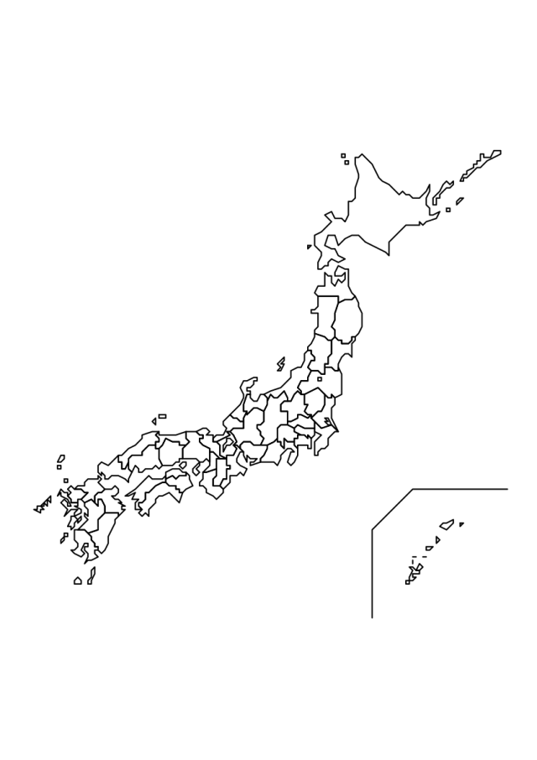
2. Regional banks in japan
(10/2022)
Regional Banks (62)➔1-2 banks /pref.
2nd Regional Banks (37)➔0-2 banks /pref.
*************************
They have different central organization and historic background.
But both are based on “the development of Regional area”.
➔ being influenced from the regional economy?
47 prefectures
Regional banks and economies are facing the severe super-low interest rate and the imbalance of population (aging).

Slide 5
3. Literature review
Harada (2018) describes the profitability, efficiency, and soundness of Shinkin banks (Credit Association) in Japan, from 1989-2008 data.
Horie and Arioka (2018) investigate the profitability of regional banks in Japan connecting with loan interest, commission revenue, and ordinary expenses.
Hirata and Ojima (2019) examine the impact of increased competition in Japanese regional banking industry to the stability of financial system, utilizing a dataset of 56 regional banks in Japan over the period from 1996 to 2017.
Yasuda (2019) assesses the relationship of diversification of profit-making sources to bank performance such as ROA and ROE, using a dataset of commercial banks in Japan in 1981-2018.
Kawamoto et al (2020) investigate the movement of bank loans in the super-low interest condition using 1999-2016 dataset of regional banks and Shinkin banks.
The existing literature provides some limited examination of the effects of prefecture characteristics on Japanese bank proﬁtability. The problem in the existing papers is that they do not involve the factor of local economy, even if they target the regional banks.
None of them has captured the impact of the prefecture characteristics on bank performance

Slide 6
4. Methodology

Slide 7
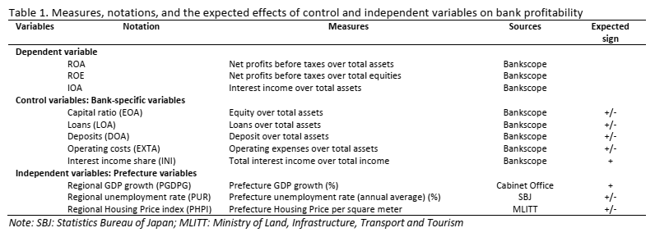

Slide 8
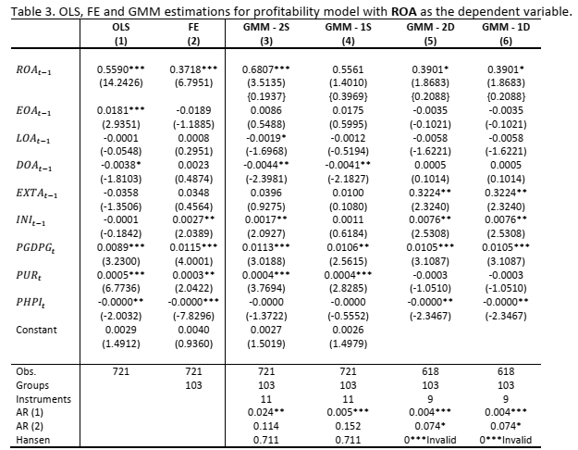
5. Results

Slide 9
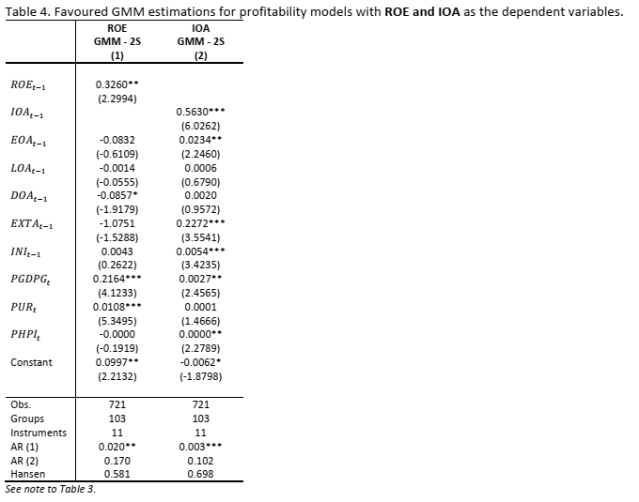

Slide 10
6. Conclusions
Data, data, and data
The following bank-specific variable is positively and significantly correlated with profitability (ROA and IOA): interest income (INI).
The bank-specific factors that are negatively and significantly related to profitability (ROA) are loans (LOA) and deposits (DOA).
Regarding the prefecture factors, the GDP growth rate (PGDPG) is positively and significantly associated with all bank profitability measures. Unemployment rate (PUR) also correlated with ROA and ROE.

Slide 11
6. Conclusions
The Bank of Japan (BOJ) should have policies to tackle factors that adversely affect bank profitability (ROA) such as loans (LOA) and deposits (DOA).
The recent restructuring plan allows the BOJ to intervene in weak and old credit institutions, leading to the quick and thorough handling of these credit institutions.
The BOJ also focuses on interest income (INI) of commercial banks to improve bank profitability (ROA and IOA).
Furthermore, when the regional economies expand more rapidly GDP growth increases which enhances bank profitability whereas unemployment rate also increases ROA and ROE

Slide 12
6. Conclusions
Failing birth rate
Earth wake: affected only a few prefectures
Interest income replaces IOA
Aging following prefectures
Add national variables

Slide 13
Thank you for your attention!

