Slide 1
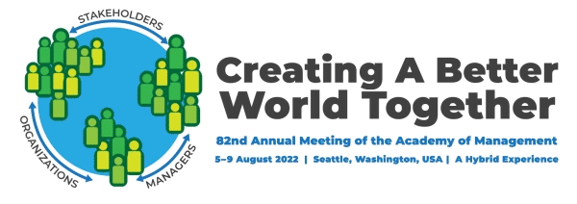
Assessing climate solutions to create a better world together
AOM 2022
Seattle, WA, USA
Notes:
Welcome everyone to this session. We are glad you can join us today and we appreciate anyone who is up early or late to be part of this session.
Start chat with Names & Reason early

Slide 2
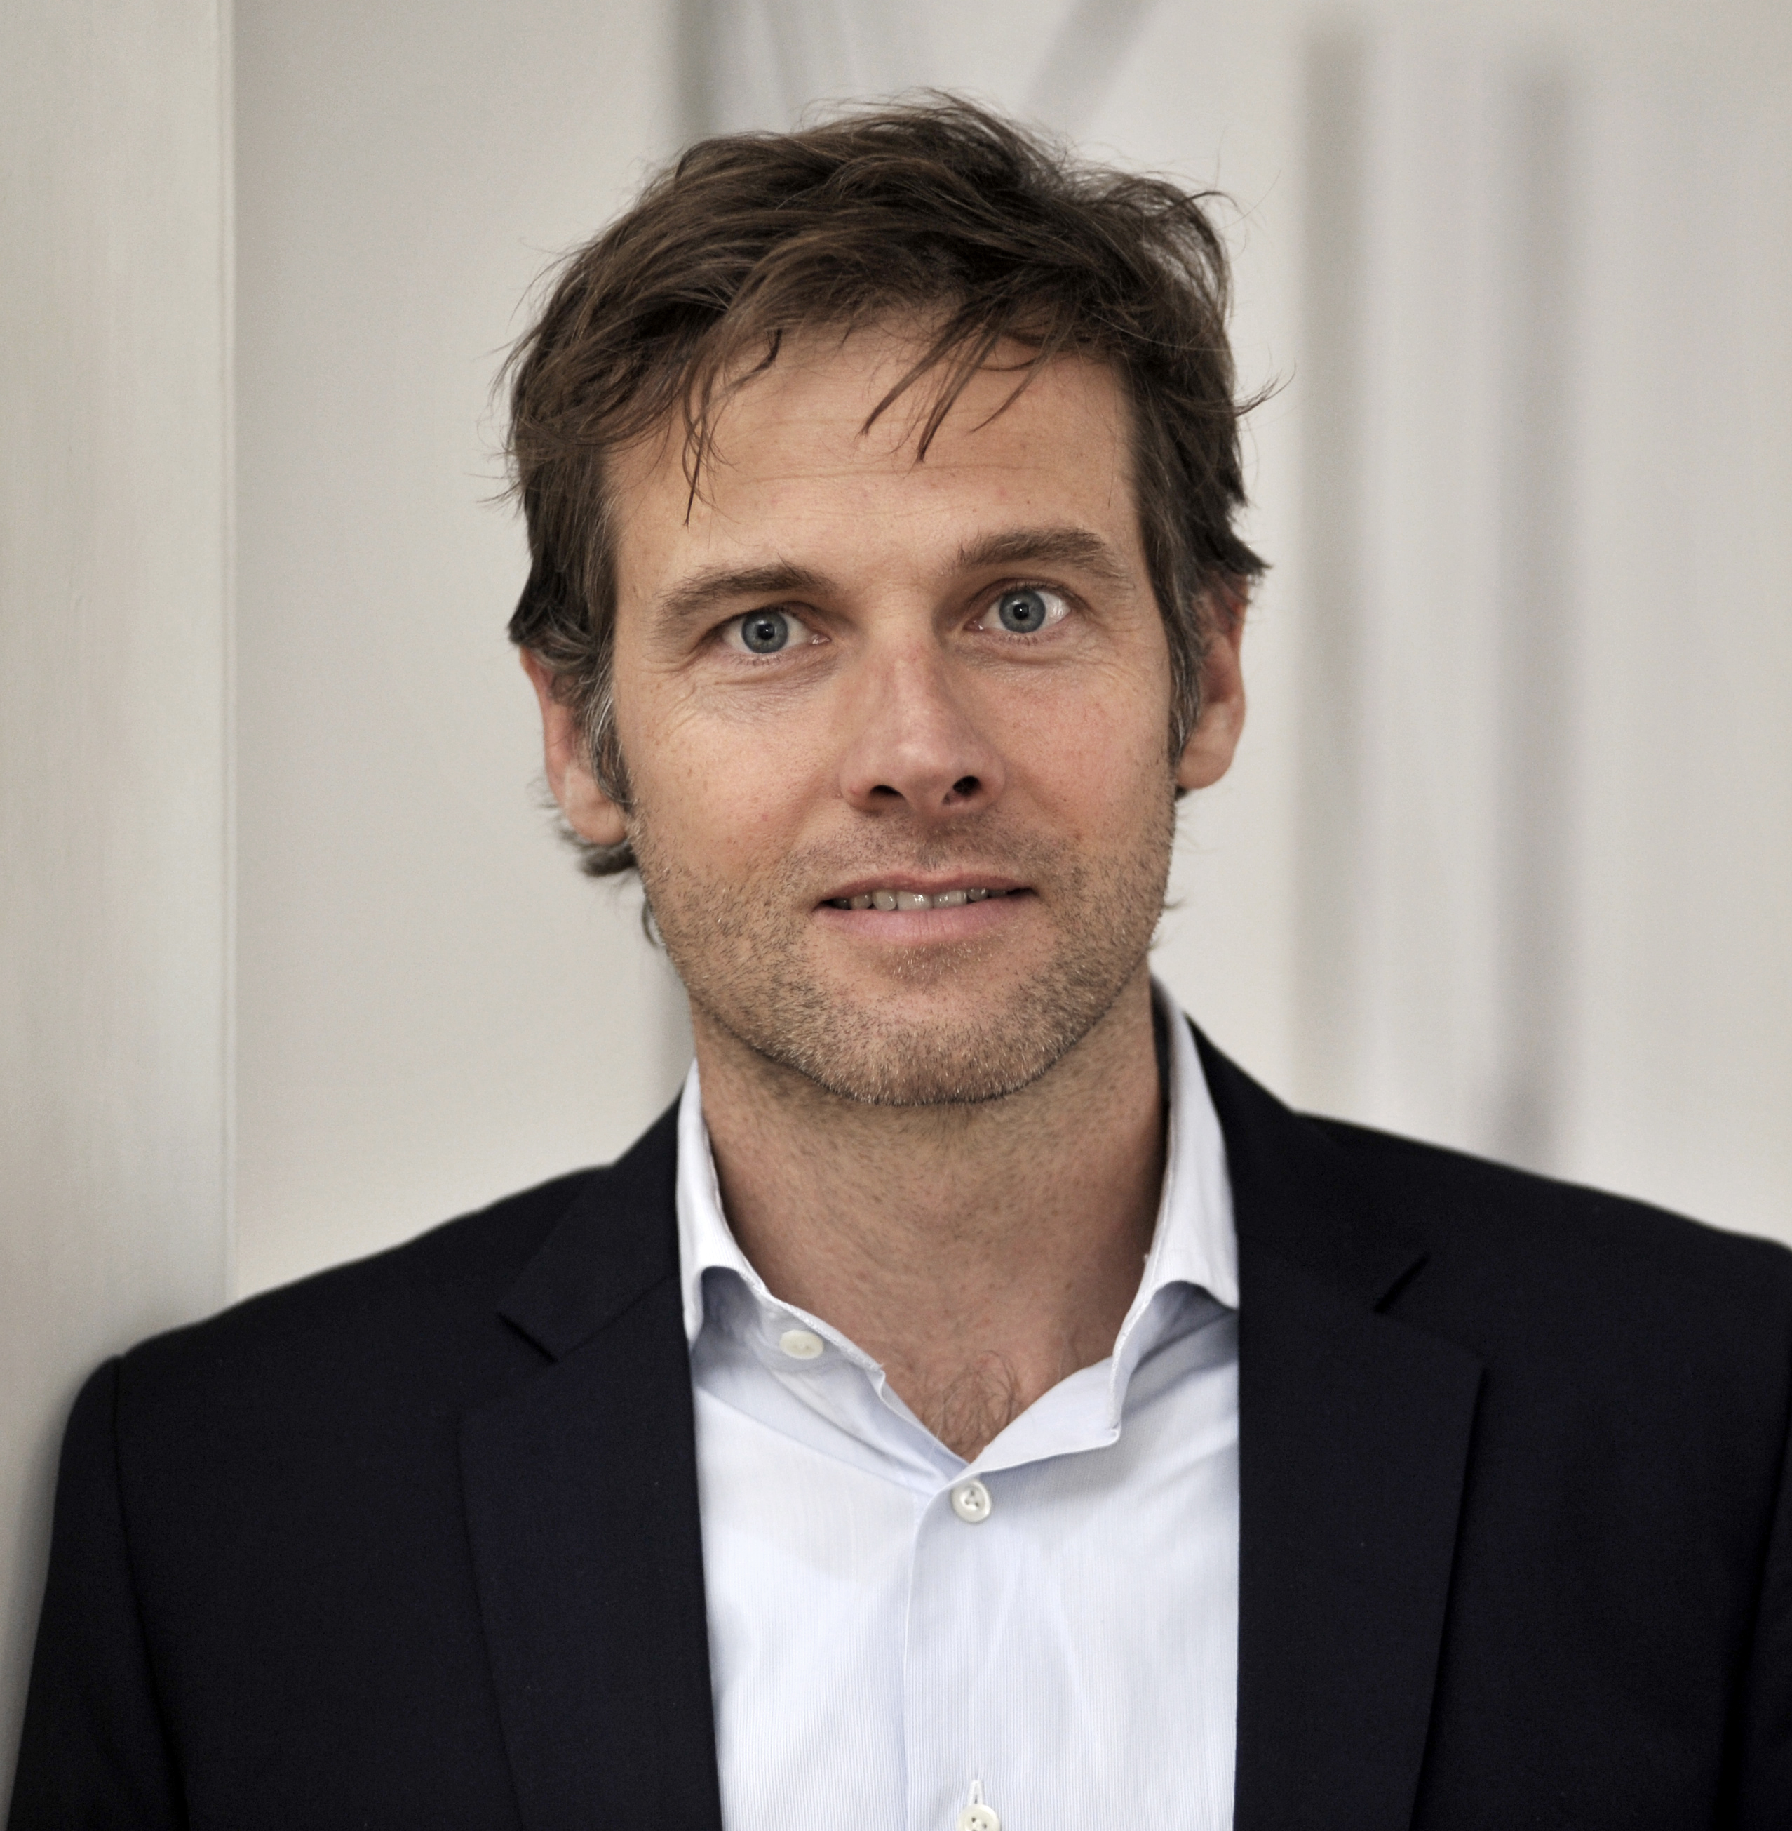
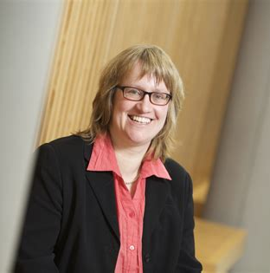
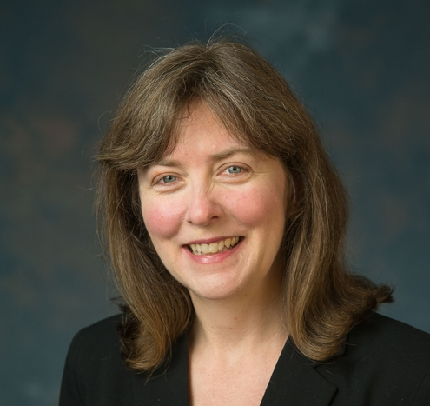
Ready to integrate climate Change education (CCE) into your courses?
Agenda
Introductions
Short case studies
Breakout Working Groups
​
Breakout Discussions: Integrating Climate Solutions Assessment Into…
Room 1: Semester Course/Module w/ En-ROADS
Room 2: Systemic Curriculum Changes
Room 3: When Getting Started w/ CCE
Come to the AOM-TLC Session Assessing Climate Solutions to Create a Better World Together (session 655)
7 August, 8:30-9:15 PST, Check your local time zones

Slide 3
Facilitators & Introductions
Florian Kapmeier
Jennifer Leigh
Petra Molthan-Hill
​​
ESB Business School, Reutlingen University
florian.kapmeier@ reutlingen-university.de
Nazareth College School of Business & Leadership jleigh4@naz.edu
Nottingham Business School
petra.molthan-hill@ ntu.ac.uk
Notes:
Jen Starts & Petra & Florian continue
Time: 2 minutes!!!
We are an international group deeply interested in climate change education. We will all introduce ourselves briefly.
As we do this please introduce yourselves in the chat-Name and why you joined.
I’m Jennifer Leigh, a professor at a regional college in upstate NY and current editor of the JME
Florian…
Petra…

Slide 4
Session Introduction
The purpose of this session is to offer AOM members from any management or business discipline frameworks and tools that will assist them in integrating climate solutions into
sessions of a semester course or module,
course or module, and
curriculum & program.
Notes:
Jen:
Recent research has shown that 98% of educators in business schools agree that climate change should be taught in business schools; however, only 45% do some Many cite lack of expertise as their main barrier

Slide 5
agenda
Introductions (2)
Name, Place, & Your Why for Attending in the chat
Key Terms (6) & Case studies (17)
Key Terms
Integrating Climate Solutions Assessment into a Semester Course or Module with En-ROADS
Systemic Curricular Changes
Breakout groups (15)
Room 1: Sessions of a Semester Course or Module Integrating of En-ROADS CCE assessment (Florian)
Room 2: Systemic Curricular CCE Assessment (Petra)
Room 3: Getting Started with CCE Assessment (Jen)
WRAP-UP & NEXT YEAR’S AOM (5)
Notes:
Jen
Invite people to note their take aways in the google doc already during the session:
Link to google doc: https://docs.google.com/presentation/d/1Dt0OGw7TzcsRB_wcgY7lRSq88crto1W9aDNJvtieSZ0/edit?usp=sharing

Slide 6
Assessment Terms & CCE
Level of assessment: Co-curricular/Curricular
Curricular Levels
Lesson (Pass / Fail) -> RM 1 (Florian & En-ROADS)
Course/Module -> Rm 3 (Jen & Getting STARTED)
Program/ Course -> Rm 2 (Petra & Systemic CURR.)
Business school (please ask Petra after Session)
University (please ask Petra after Session)
Notes:
Jen (3 minutes)
When discussing assessment, we can think of two large areas: curricular (graded) and co-curricular (non-graded/student-faculty-or staff led)
For curricular assessment, there are many levels to consider for CCE
Smallest level “lesson” (1 or more class meetings)
Course (US) or Module (UK) the larger unit of learning led by the faculty member (typically a number of weeks-15 US Semester course)
Program/Course: This is the degree level in the US. So, I lead the program assessment for all undergraduate students in the business and leadership program. Assessment entails evaluating how their coursework contributes to our program outcomes. Likewise, substitute course for UK.
Business Schools have assessments, often driven by accreditors like AACSB, EQUIS, IACBE
Universities in the UK and US have institution-wide assessment processes
This whirlwind review is to remind us of the various places there are opportunities to integrate CCE starting within our own realm of control.
Now Petra will share some important cimate change education terms.

Slide 7
1. Climate Change Science Education
Knowledge and understanding of a broad range of scientific concepts and processes related to climate change (e.g. climate, deforestation, habitat loss, water cycle, soil erosion, air pollution), its causes and its consequences, ecologically, socially, economically and politically.
Knowledge and understanding of the dynamics of climate change impact across time and space (e.g. delayed consequences, reducing the quality of life, security and development options of future generations).
Awareness of strategies and technologies to address the negative impacts of climate change (e.g., reducing carbon consumption, encouraging low-carbon development, reducing deforestation through sustainable forest management, improving water and waste management).
Ability to distinguish critically between certainties, uncertainties, projections and risks associated with climate change, and evaluate messages about and public interpretations of climate change science.
Table published in: Molthan-Hill, P et al (2021), Climate change education at universities: Relevance and strategies for every discipline. in: Handbook of Climate Change Adaptation and Mitigation (3rd edition), Springer: Cham, Switzerland. Adapted from definitions provided by Mochizuki Y, Bryan A (2015) Climate change education in the context of education for sustainable development: Rationale and principles. Research 9(1): 4-26.
Notes:
Petra: 3 minutes for the 4 slides
We need to distinguish between three areas of climate change education, the first one is the science: Every Graduate need to understand climate change science enough to make informed decisions and integrate high impact solutions into their life and work. This basic understanding is also necessary for anyone studying business. This can be done in one hour.

Slide 8
2. Climate Change Mitigation Education
Developing values, knowledge and skills required to make choices and decisions that minimize the use of natural resources, emissions, waste and pollution; while contributing to the development of new solutions to the climate crisis (e.g., rethinking the way we live, buy and consume, how our daily lives are organized, how we socialize, exchange, share, educate and build identities).
Taking individual and/or collective action with the potential to have immediate, direct impact (e.g., reducing energy consumption, using non-polluting and renewable energy sources, environmental conservation, re-forestation and re-greening).
Contributing to policy development with long-term positive impact on societal behaviour by examining economic systems, social structures, cultural patterns, lifestyle expectations, consumerism, wealth distribution, aspirations and value systems and their underlying responsibility for excessive greenhouse gas production.
Table published in: Molthan-Hill, P et al (2021), Climate change education at universities: Relevance and strategies for every discipline. in: Handbook of Climate Change Adaptation and Mitigation (3rd edition), Springer: Cham, Switzerland. Adapted from definitions provided by Mochizuki Y, Bryan A (2015) Climate change education in the context of education for sustainable development: Rationale and principles. Research 9(1): 4-26.
Notes:
Petra: 3 minutes for the 4 slides
The second one is Climate Change Mitigation Education: Every Graduate needs to know how to best mitigate climate change- what are the best strategies and tools in operations, supply chain management, economics, investment to reduce carbon emissions?

Slide 9
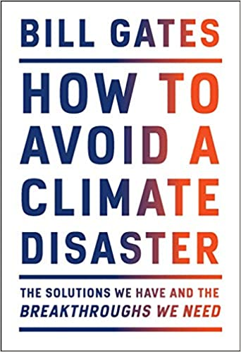
Good?
Notes:
Petra: 3 minutes for the 4 slides
Knowing these climate change mitigation tools and strategies will allow them to judge, whether Bill Gates is suggesting good solutions in his new book or whether Mark Carney got it right?!

Slide 10
3. Climate Change Adaptation Education
Building capacity to apply these strategies in future situations, when the delayed impacts of climate change make themselves felt.
Knowledge and understanding of tools and methodologies to respond promptly and effectively in areas that have been negatively impacted by climate change, including Disaster Risk Reduction (DRR) strategies such as community disaster committees, community evacuation and rescue plans, and local first-aid training.
Knowledge and understanding of tools and methodologies to rebuild and restore areas that have been negatively impacted by climate change (e.g., seashores, flood prevention measures).
Implementing measures that reduce the vulnerability of natural and human systems to the impacts of climate change.
Advocating for appropriate channelling of resources at global level to protect negatively affected natural and human systems in a just and equitable way.
This table will be published in: Molthan-Hill, P et al (2021), Climate change education at universities: Relevance and strategies for every discipline. in: Handbook of Climate Change Adaptation and Mitigation (3rd edition), Springer: Cham, Switzerland, forthcoming. Adapted from definitions provided by Mochizuki Y, Bryan A (2015) Climate change education in the context of education for sustainable development: Rationale and principles. Research 9(1): 4-26.
Notes:
Petra: 3 minutes for the 4 slides
In many countries Graduates need to learn how to adapt to climate change now, however in the UK and other high emitting countries the focus should be on mitigation: Is it not better to mitigate against the flooding of London so that major floods will not happen in the near future than to build higher flood defences now? However, business schools might want to teach both so that graduates know how their future employers could do both, mitigate the worst but also prepare and adapt as best as possible.

Slide 11
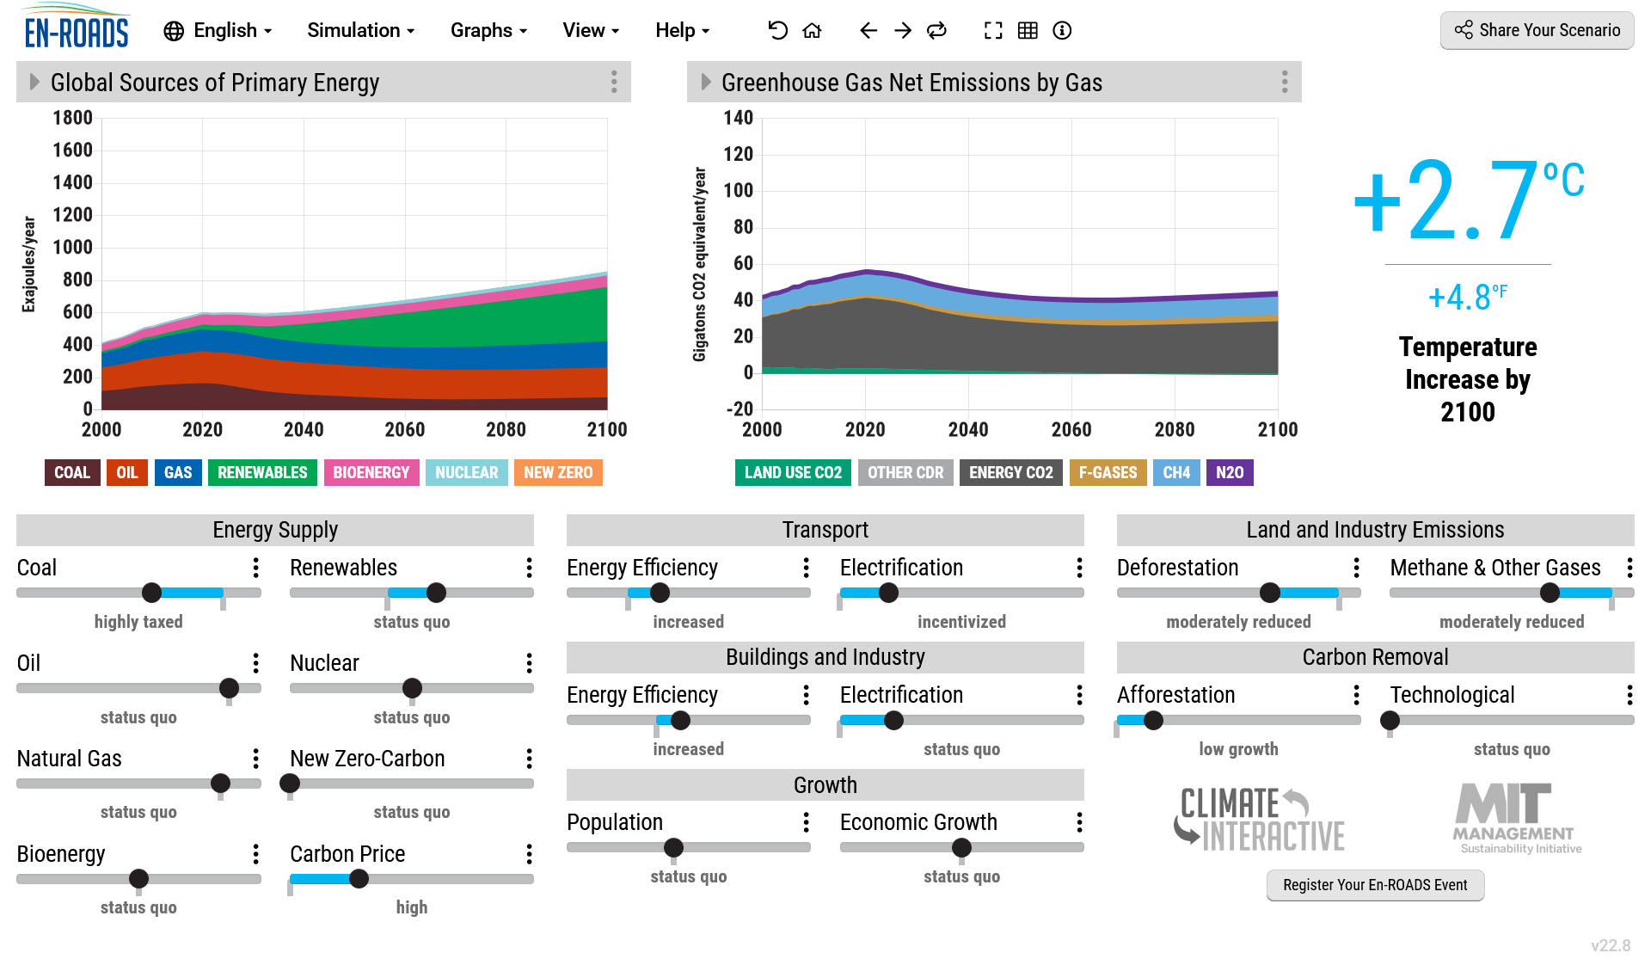
Case Study 1: integrating climate solutions Assessment into a Semester Course or Module with Climate-Energy Simulator En-ROADS
En-ROADS Workshop @ COP 25 in Madrid. Source: Bindu Bhandari
Learning objective
Increase…
awareness of urgency of climate change
understanding of high-leverage actions to mitigate climate crisis
www.en-roads.org
Notes:
Florian:
Time: 5-7 minutes
BACKGROUND
En-ROADS is a freely-available online simulator that provides policymakers, educators, businesses, the media, and the public with the ability to test and explore cross-sector climate solutions.
Flexible assessment
Introductory session to any study program
In any course of any study program as a 3h session (single or 2x1.5h), over multiple weeks, etc.
Students might write paper / theses on topics using En-ROADS, that can be assessed
www.en-roads.org

Slide 12
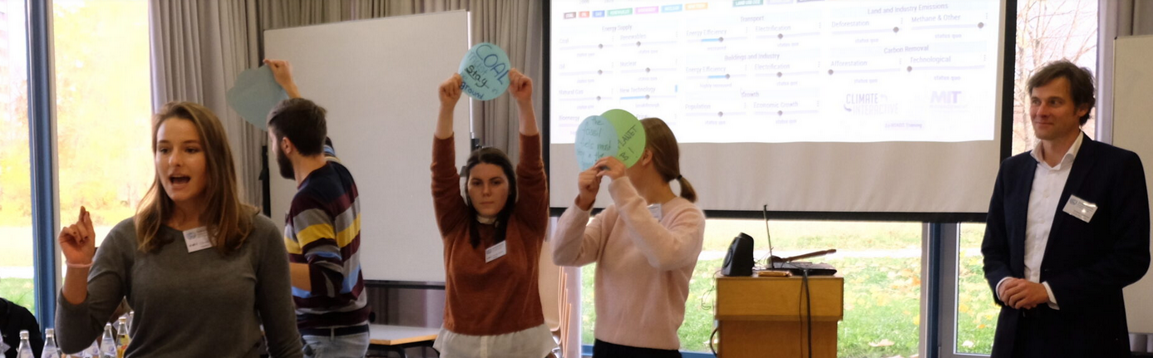
Case Study 1: integrating climate solutions Assessment into a Semester Course or Module with Climate-Energy Simulator En-ROADS
CAS @ ESB Business School. Source: Florian Kapmeier
Learning objective
Learning activities
Assessment tools
reflection
Increase…
awareness of urgency of climate change
understanding of high-leverage actions to mitigate climate crisis
En-ROADS Climate Workshop
Role-playing game “Climate Action Simulation”
En-ROADS Student Assignment
Pass/fail
Procedure: dialogue about insights into an En-ROADS scenario in line with the Paris Agreement (considering learning objectives)
Highly engaging exercises
Flexible engagements
81% of participants of the roleplaying game have a higher motivation to act (Rooney-Varga et al., 2018, 2020)
Notes:
Florian:
Time: 5-7 minutes
BACKGROUND
En-ROADS is a freely-available online simulator that provides policymakers, educators, businesses, the media, and the public with the ability to test and explore cross-sector climate solutions.
Flexible assessment
Introductory session to any study program
In any course of any study program as a 3h session (single or 2x1.5h), over multiple weeks, etc.
Students might write paper / theses on topics using En-ROADS, that can be assessed

Slide 13
Case Study 2: Students changing organisations as part of the core curriculum in their final year
MOLTHAN-HILL, P., ROBINSON, Z.P., HOPE, A., DHARMASASMITA, A. and MCMANUS, E., 2020. Reducing carbon emissions in business through Responsible Management Education: influence at the micro-, meso- and macro-levels. International Journal of Management Education, 18 (1): 100328.
MOLTHAN-HILL, P., WINFIELD, F., BADDLEY, J. and HILL, S., 2017. Work based learning: students solving sustainability challenges through strategic business partnerships. In: P. FLYNN, M. GUDIĆ and T. TAN, eds., Redefining success: integrating the UN global compact into management education. PRME . Abingdon: Routledge.
Guardian Award 2015
https://www.theguardian.com/higher-education-network/gallery/2015/mar/19/guardian-university-awards-2015-winners-in-pictures
Notes:
The first project I want to introduce is on offer since 2011 and won the Guardian Award in 2015, still ongoing. I have added two publications which go into quite a bit of detail in case you would like to replicate it at your business school.

Slide 14
Case Study 2: Students changing organisations as part of the core curriculum in their final year (Undergraduates)
Learning objective
Learning activities
Assessment tools
reflection
To undertake a group based low carbon consultancy project with a real business to facilitate understanding of sustainability and carbon management issues in businesses
To present information in a consultancy report adhering to standard academic and/or professional conventions
Carbon management in business
Carbon foot printing methodology
Management Consultancy
Project Management
Poster Design and Report Writing
Poster Presentation:
10-minute presentation of consultancy project
Consultancy Report:
Low carbon business consultancy report. Supported by individual report.
High praise from students since 2011 and still ongoing
Graduates reported that they were hired because of this additional knowledge to a ‘normal’ degree
Notes:
Consultancy Report:
Low carbon business consultancy report and reflection and analysis of development of sustainability and carbon management knowledge and skills in relation to field or discipline of study and future career.
Supported by individual report.

Slide 15
Sustainability in Enterprise (SiE)
The SIE programme provides fully funded support and grants to reduce the carbon emissions of eligible Nottingham small and medium-sized enterprises (SMEs).
SIE will help businesses improve their environmental performance across four key areas: people, products, processes and premises.
This project is part-funded by the European regional development fund (ERDF).
Now transdisciplinary on offer
Notes:
In 2021, the project was developed into a bigger project where also students from other faculties such as architecture and product design offer consultancy to organisations.

Slide 16
Systemic Changes
Capstone Module in year 1: Sustainable Fashion in first year module with input from all disciplines (core)
Modules in year 2 specific to degree (core)
Personalization: Students can choose extra-curricular activities such as the Employability Sustainability Award
Capstone Module in year 3: Each discipline has their own tailored version e.g. BSc Management (Greenhouse Gas Management Consultancy) or BSc Marketing (Consultancy Project with Nottingham City Council)

Slide 17
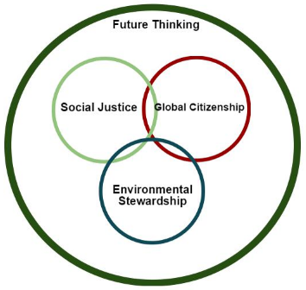
Embedding the SDGs into the curriculum at NTU

Slide 18
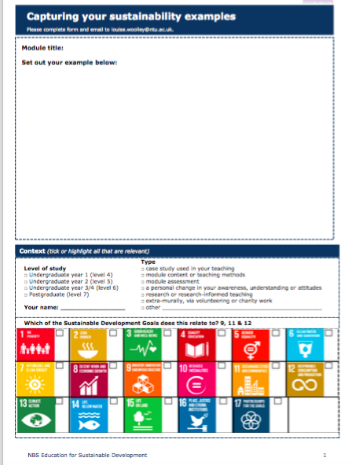
What is already happening?
Capturing pockets of good practice

Slide 19
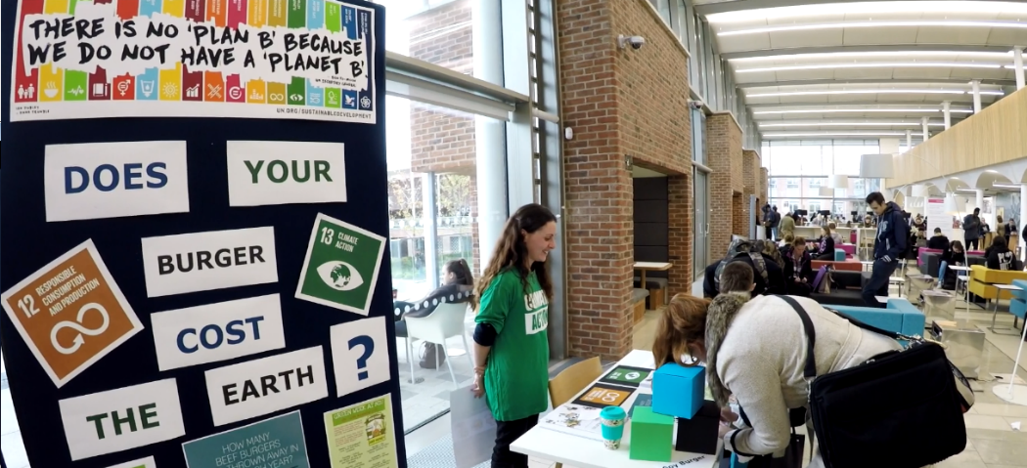
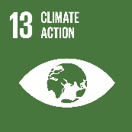
Extra-curricula Visual Displays Example of our First Interactive Visual Display
Impact of Food
12.2 Achieve the sustainable management and efficient use of natural resources
12.3 Halve per capita global food waste at the retail and consumer levels
12.8 Ensure that people everywhere have the relevant information for sustainable development and lifestyles in harmony with nature
13.3 Improve education, awareness-raising and capacity on climate change management

Slide 20
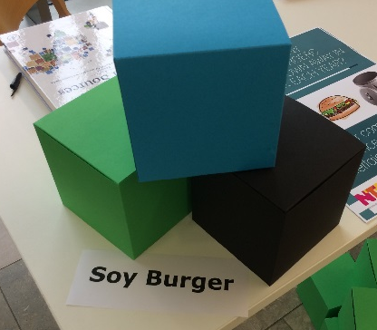
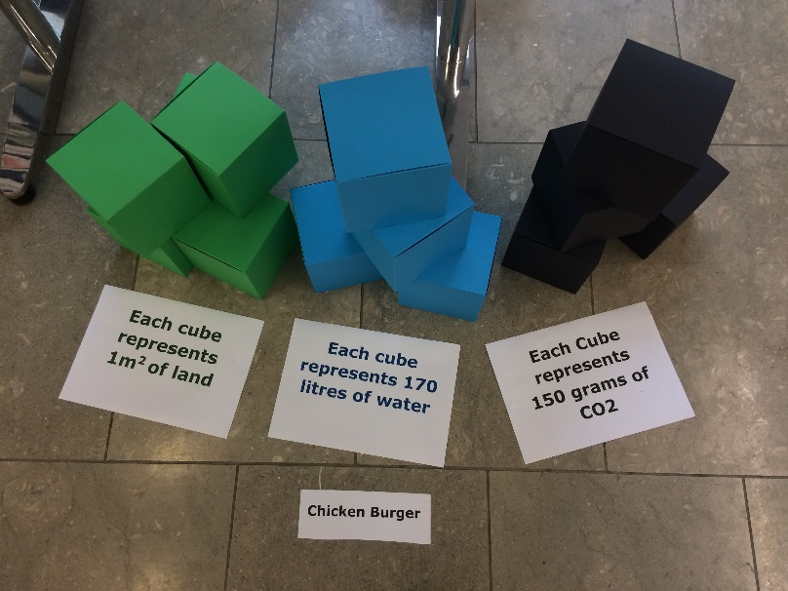
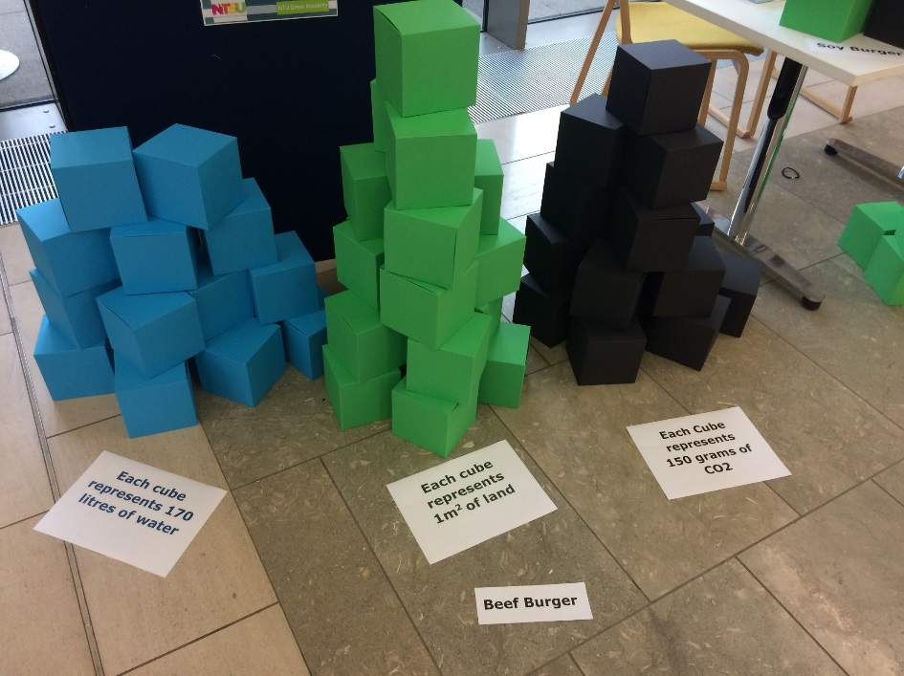
150g Soy Burger
168 litres of water
0.9 m² of land 0.14kg of CO₂
150g Beef Burger
2,410 litres of water
23.4 m² of land 2.25kg of CO₂
150g Chicken Burger
650 litres of water
4.8 m² of land
0.65kg of CO₂

Slide 21
Sign up for our next traininG
On behalf of the UN PRME Working Group on Climate Change & Environment and QS World Merit charity, we would like to invite you to join our upcoming Climate Literacy & Action Training CLT-ECOS.
The training will take place on the following Fridays: 16, 23, 30 September, 7 and 14 October, 15:00-17:00 GMT+1
A certificate is awarded upon full participation across five weeks and completion of the individual project, issued by The Carbon Literacy Project.
Please register here: https://bit.ly/3nJfx8M

Slide 22
Breakout rooms
Integrating Climate Solutions Assessment Into…
Room 1: A Semester Course or Module with En-ROADS (Florian)
Room 2: Systemic Curriculum Changes (Petra)
Room 3: Course/Module (getting started w/ CCE assessment (Jen)
Time: 20 Minutes or when you get the broadcast notice in Zoom
Notes:
Jen
Breakout Rooms: each of us
Time: 20 minutes
Note: Somebody should be responsible for noting in the wrap up: What is a key insight from each breakout room?
Or: Everybody invited to write down key words in google doc: https://docs.google.com/presentation/d/1Dt0OGw7TzcsRB_wcgY7lRSq88crto1W9aDNJvtieSZ0/edit?usp=sharing

Slide 23
Wrap-Up & Resource Sharing
What is a key insight from each breakout room?
​
What resources would you like to share (AOM Sessions, announcements, etc.)?
(Put in Zoom CHAT or google doc)
What would you like to see next AOM related to Climate change education?
Notes:
Florian
Link to google doc: https://docs.google.com/presentation/d/1Dt0OGw7TzcsRB_wcgY7lRSq88crto1W9aDNJvtieSZ0/edit?usp=sharing
Do we want to create Google doc. During the session to share after?
Prepare another handout on resources

Slide 24
Thank you
Stay in touch!​

Slide 25
Breakout Slides

Slide 26
Getting Started Breakout Room
Where are you on your Climate change Education integration journey?
Just curious?
Student learning objective formulation?
Learning activities identified?
Needing assessment approaches?
Notes:
I’d like to get a pulse of the room and why you select this one.
Where are you at in your Climate Change Education/Climate Literacy Integration Journey?
If we can all share in the chat-or share when I call on your for time’s sake
Thanks-I’m glad you are here and we can begin this discussion with your experience and interest.

Slide 27
Getting Started Breakout Room
Questions
LEVELS
Lesson
Course/Module
Program/Course
School
University
What is the learning objective you hope to achieve?
What level are you targeting?
What are learning activities?
How might we assess it?
If you are stuck answering these questions, why might that be?
Notes:
I thought we could take some time to do some thinking and planning.
Let’s take 5 minutes to reflect on these questions—Keep in mind this might not be a linear process to begin. Some of us can start at setting the SLO, others think in terms of learning activities, just do a little thinking and we can discuss and brainstorm together.
Write whatever you can-even if messy or incomplete.
Reflection time

Slide 28
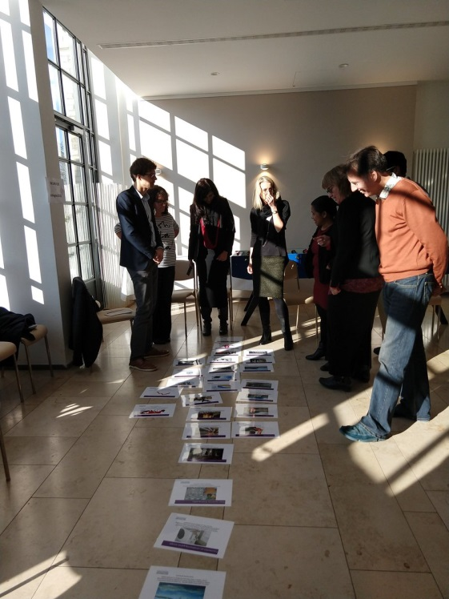
Getting Started Breakout Room
ex: learning activities
Carbon Literacy Training (CLT) Exercise: Positive & Troubled Futures
Course/Module: Business Ethics
Course learning objective: Differentiate the major ethical theories, including those from classical philosophical traditions and contemporary behavioral social sciences, and extrapolate how these relate to real-life at the individual, group/team, organizational, stakeholder, societal, and ecological levels.
Assessment: formative through dialog; contributed to daily class participation
LEVELS
Lesson
Notes:
Here’s where I began and have been the last two years in my classes
I took the CLT and loved the Positive & Troubled futures exercise. You can see in the photo the process where students develop a narrative of how we do (or don’t get to the goal of keeping global warming below 2C through various carbon reduction (or production) activities.
I began with the activity and the built out the other dimensions
How does this relate to my existing course SLOs in ethics?
How can I assess their learning?
Now I’m expanding into my Senior Seminar Course to integrate more of the CLT and develop a CLT specific SLO.
Other example emerging:
Learning Activity: Carbon Literacy Training & self-direct carbon reduction project.
SLO: Students will be able to identify high-impact climate solutions for their future workplaces.
Assessment: Direct assessment of essay reviewing recommended solutions based on the content of the training.

Slide 29
SLO Development
Domain
LEVEL
Quality
Cognitive, behavioral, affective
Course-Module-Program Basic-Mastery
Aligned, Realistic, Measurable
​
Notes:
https://docs.google.com/document/d/1cnDqCQJZ3JIacWBwbMNVA9EYF_aOBWa3PxP5JfABwnY/edit
Talking about SLOs if audience is interested
To develop SLOs we have to assess the domain, level, and quality
Do I want a cognitive (knowledge-focused) SLO? Certain behaviors (carbon reduction) or changes in values (concern for the environment)?
Where is this SLO located (course, program, school)?
What level of achievement do I hope for basic or mastery? What does this look like for UG, PG, executives?
Is this a quality SLO? Can I actually do it with resources? Can I measure what I want students to learn?

Slide 30
Start where you are
SITUATE by using existing program SLOs to begin
BEGIN with 1 SLO
REVIEW other institutions or the field’s professional organization(s) for examples
FOCUS on the central aspects of the discipline/field & those that are most meaningful and important.
STRONG VERBS that describe what information, skills, and cognitive/developmental changes students should be able to demonstrate because of the learning opportunities in the program.
SELECT only learning outcomes the program can reasonably & directly address
AVOID JARGON so students & others can understand the outcomes.
REMEMBER THE END all outcomes must be assessed, so create outcomes that are measurable
COLLABORATE in development for collective acceptance of the SLO
SHARE widely with faculty once approved
Notes:
Here’s some guidance for those seeking support in developing SLOs
Your instructional designers, education colleagues, and experienced faculty can help with this.

Slide 31
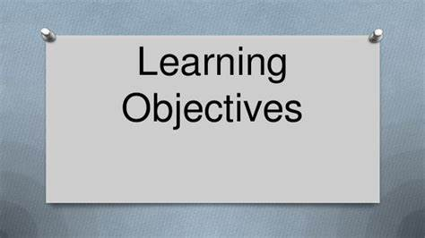
Quality SLOs
What are the characteristics of a set of “good” SLOs?
Consistent with the program mission & goals
Comprehensive (collectively cover the main program goals)
Focused on student learning (not teaching or another program aspect)
Realistic (can potentially be achieved by a significant portion of students & in line with what is being taught)
Actionable (can be used for program improvement)
Clearly stated simple statement
Measurable by more than one assessment method
Notes:
More on quality SLOs
These also need to be aligned with departmental, institutional, and accreditation standards.

Slide 32
Breakout Room Petra
Please introduce yourself and either
share a question you might have after our presentation
an example of your own practice with regards to climate change education
or an idea of how you want to integrate this in the future!

Slide 33
What is already happening?
Capturing pockets of good practice

Slide 34
Program/Course: nAME CLO:
Course/
Module 1:
Course/
Module 2:
Course/
Module 3:
LO 1:
LO2:
LO3:
Learning Activity:
Assessment:
Learning Activity:
Assessment:
Learning Activity:
Assessment:

Slide 35
summary
Thanks for joining us!

