Slide 1
Climate solutions for a net zero future
Prof Dr Petra Molthan-Hill
Professor of Sustainable Management and Education for Sustainable Development and Co-Chair UN PRME Working Group on Climate Change & the Environment
Nottingham Business School, Nottingham Trent University, UK

Slide 2
Halve CO₂ emissions by around 2030
In order to limit global warming to 1.5°C, the IPCC stresses that the world needs to halve CO₂ emissions by around 2030 and reach Net Zero CO₂ emissions by mid-century.
In addition, the IPCC emphasises the need for deep reductions in non-CO₂ emissions across the economy to achieve this limit.
CDP (2020) Foundations for science-based net-zero target setting in the corporate sector: https://sciencebasedtargets.org/resources/files/foundations-for-net-zero-full-paper.pdf p5

Slide 3
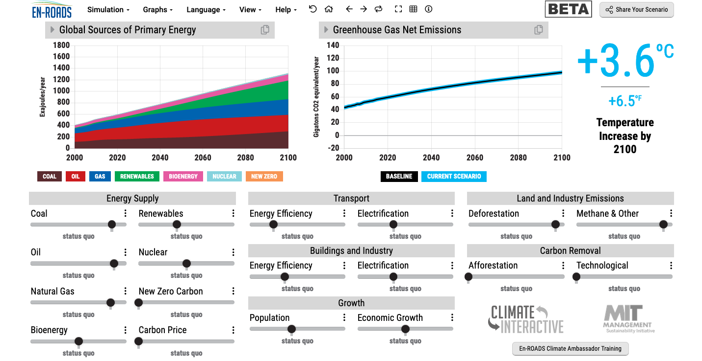
En-ROADS is a cutting-edge simulation model used to test climate solutions and generate climate scenarios for the future.
Our key challenge: How to get to 1.5°C?
Notes:
This is our current situation as demonstrated by En-ROADS which was developed by MIT Climate Interactive so that everyone can understand the high impact solutions and which impact they would have.

Slide 4
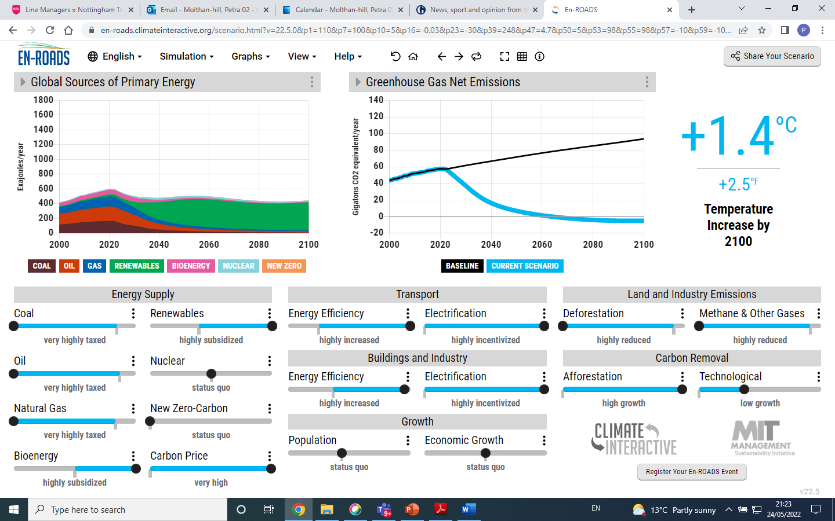

Slide 5
Solutions from En-ROADS
Big changes will be achieved by:
Increasing energy efficiency and electrification in transport, buildings and industry.
Reducing Methane e.g. by reducing food waste.
Increasing natural carbon capture as much as possible, including stopping deforestation and increasing afforestation.
Agreeing on a carbon price.
Notes:
After going through this slide, end with: We will now have some examples for the first three and how everyone on every level can do their bit..

Slide 6
Climate Change Mitigation Education into the core curriculum of every discipline
Developing values, knowledge and skills required to make choices and decisions that minimize the use of natural resources, emissions, waste and pollution; while contributing to the development of new solutions to the climate crisis (e.g., rethinking the way we live, buy and consume, how our daily lives are organized, how we socialize, exchange, share, educate and build identities).
Taking individual and/or collective action with the potential to have immediate, direct impact (e.g., reducing energy consumption, using non-polluting and renewable energy sources, environmental conservation, re-forestation and re-greening).
Contributing to policy development with long-term positive impact on societal behaviour by examining economic systems, social structures, cultural patterns, lifestyle expectations, consumerism, wealth distribution, aspirations and value systems and their underlying responsibility for excessive greenhouse gas production.
Table published in: Molthan-Hill, P et al (2021), Climate change education at universities: Relevance and strategies for every discipline. in: Handbook of Climate Change Adaptation and Mitigation (3rd edition), Springer: Cham, Switzerland. Adapted from definitions provided by Mochizuki Y, Bryan A (2015) Climate change education in the context of education for sustainable development: Rationale and principles. Research 9(1): 4-26.
Notes:
The second one is Climate Change Mitigation Education: Every Graduate needs to know how to best mitigate climate change- what are the best strategies and tools in operations, supply chain management, economics, investment to reduce carbon emissions?

Slide 7
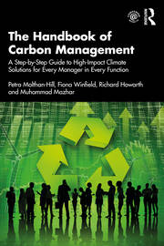
Integrated into every discipline/function
The Handbook of Carbon Management: A step-by-step guide to high-impact climate solutions for every manager in every function (Routledge)
Procurement and Supply: pushing the boundaries to remove carbon emissions
Marketing for a better climate
Pension funds, accounts and other investments
GHG emissions accounting
Climate communication and reporting to internal and external stakeholders
https://www.routledge.com/The-Handbook-of-Carbon-Management-A-Step-by-Step-Guide-to-High-Impact-Climate/Molthan-Hill-Winfield-Howarth-Mazhar/p/book/9781032227603

Slide 8
In your own time….
Free online course:
https://www.futurelearn.com/courses/climate-literacy-and-action-for-all

Slide 9
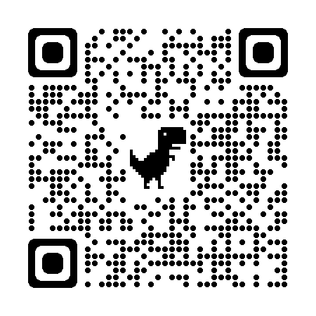
Get expertise through a master’s module
Climate Solutions for a Net Zero Future
Discover climate solutions you can implement in your industry, workplace, or household to help achieve a net zero future.
Master’s level, 100 hours, 10 credits, starting in May!
More info here:
https://www.futurelearn.com/courses/climate-solutions-for-a-net-zero-future
Notes:
NBS to offer three microcredentials (each worth 10 cp) that can be used towards a PG certificate (with 30 cp from elsewhere)

Slide 10
Inspired by Carbon Literacy Training in:
Chapple, W., Molthan-Hill, P., Welton, R., Hewitt, M.
Lights Off, Spot On: Carbon Literacy Training Crossing Boundaries in the Television Industry.
J Bus Ethics 162, 813–834 (2020).
https://doi.org/10.1007/s10551-019-04363-w

Slide 11
Carbon Literacy Training for Business Schools
What if every recruit in every organisation from the world’s business schools were qualified as Carbon Literate?
Developed by Nottingham Business School (Nottingham Trent University) in collaboration with the UN PRME Champions, Oikos International and the Carbon Literacy Project.
The aim is to ensure that academics, students and others are Carbon Literate within a short time frame, to ensure that as many people as possible are actively involved in embedding climate solutions in their own life and work.
To do this, we have chosen a train-the-trainer approach, where we offer regional events inviting all the universities and business schools in the vicinity to train academics and students there, so they can become trainers in their own institutions and/or get involved in training in other parts of the world.
Notes:
In our Carbon Literacy Training for Business Schools we have a strong focus on these high impact solutions so that everyone in a business school, whether in teaching, research or operations would know the best actions to take.

Slide 12
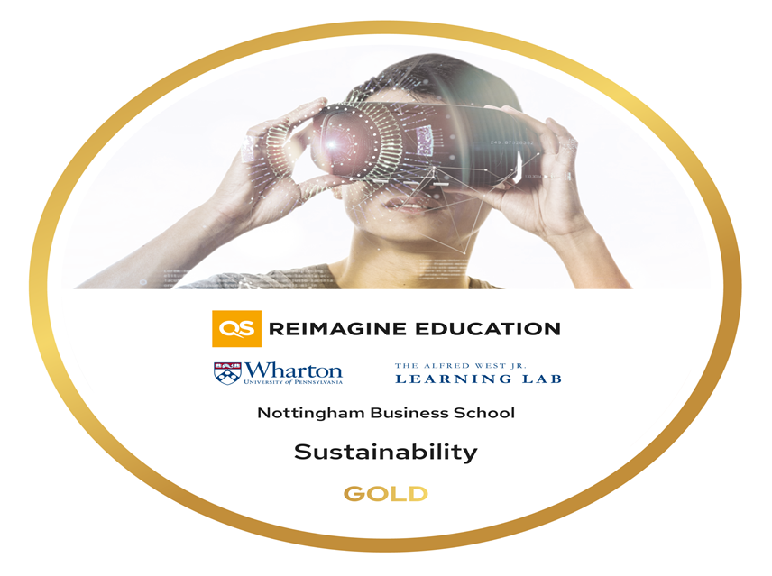
Get the certificate and be part of a community….
Take our free Climate Literacy & Action Training in June and July (on fixed days, virtual, interactive):
On behalf of the UN PRME Working Group on Climate Change & Environment and QS World Merit charity, we would like to invite you to join our upcoming Climate Literacy & Action Training CLT-ECOS.
Please register here: Meeting Registration - Zoom

Slide 13
What is your idea to achieve Net Zero (Research/Project/Action)?
Go to www.menti.com
Use the code: 8246 0496
https://www.mentimeter.com/app/presentation/alpaav432odzzryym9m9qw3ii7hk8rtb/p34ob724pirc

Slide 14
Pass it on

Slide 15
Want to find out more? Please contact Prof Dr Petra Molthan-Hill
petra.molthan-hill@ntu.ac.uk

