Slide 1
Net Zero and Decarbonisation: Understanding and Communicating the Basics
Prof Dr Petra Molthan-Hill
Professor of Sustainable Management and Education for Sustainable Development and Co-Chair UN PRME Working Group on Climate Change & the Environment,
Nottingham Business School, Nottingham Trent University, UK

Slide 2
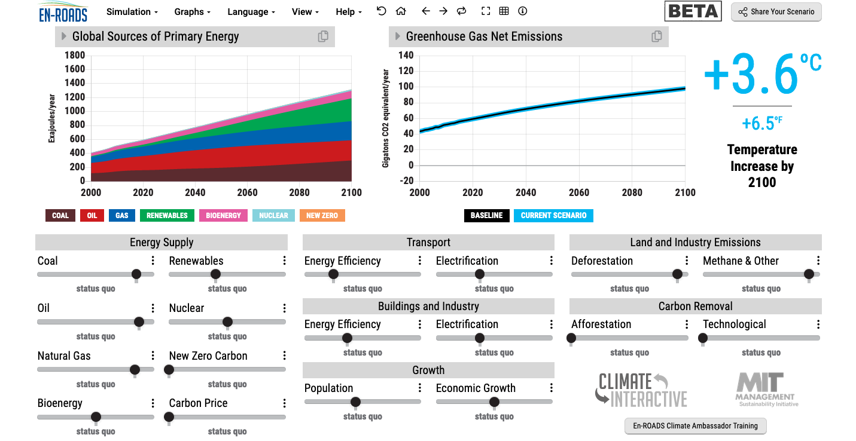
En-ROADS is a cutting-edge simulation model used to test climate solutions and generate climate scenarios for the future.
Our key challenge: How to get to 1.5°C?
Notes:
This is our current situation as demonstrated by En-ROADS which was developed by MIT Climate Interactive so that everyone can understand the high impact solutions and which impact they would have.

Slide 3
Halve CO₂ emissions by around 2030
In order to limit global warming to 1.5°C, the IPCC stresses that the world needs to halve CO₂ emissions by around 2030 and reach Net Zero CO₂ emissions by mid-century.
In addition, the IPCC emphasises the need for deep reductions in non-CO₂ emissions across the economy to achieve this limit.
CDP (2020) Foundations for science-based net-zero target setting in the corporate sector: https://sciencebasedtargets.org/resources/files/foundations-for-net-zero-full-paper.pdf p5

Slide 4
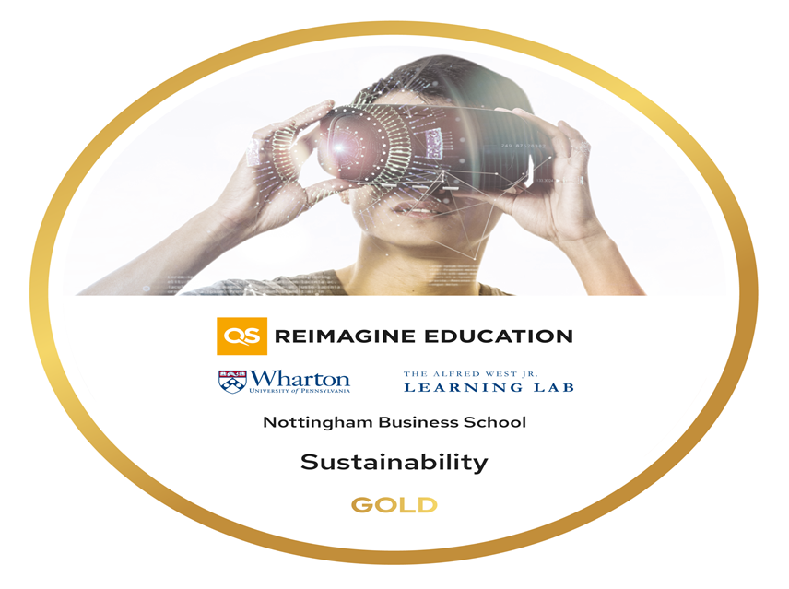
To get you started….
Take our free Climate Literacy & Action Training in February and March:
On behalf of the UN PRME Working Group on Climate Change & Environment and QS World Merit charity, we would like to invite you to join our upcoming Climate Literacy & Action Training CLT-ECOS.
The training will take place on the following Thursdays: 23 February, 2, 9, 16 and 23 March,11:00-13:00 GMT
Please register here: https://www.unprmeclimate.org/events-1

Slide 5
Inspired by Carbon Literacy Training in:
Chapple, W., Molthan-Hill, P., Welton, R., Hewitt, M.
Lights Off, Spot On: Carbon Literacy Training Crossing Boundaries in the Television Industry.
J Bus Ethics 162, 813–834 (2020).
https://doi.org/10.1007/s10551-019-04363-w

Slide 6
Carbon Literacy Training for Business Schools
What if every recruit into corporations from the world’s business schools was qualified as Carbon Literate?
This training was developed by Nottingham Business School (Nottingham Trent University) in collaboration with the UN PRME Champions, Oikos International and the Carbon Literacy Project.
The aim of this project is to get academics, students and others Carbon Literate within a short time frame and to get as many people as possible actively involved in embedding climate solutions in their own life and work. In order to do so we have chosen a train-the-trainer approach, so we will offer regional events inviting all the universities and business schools in the vicinity to train academics and students there so that they can become trainers in their own institution and/or get involved in training others in other regions of the world.
Notes:
In our Carbon Literacy Training for Business Schools we have a strong focus on these high impact solutions so that everyone in a business school, whether in teaching, research or operations would know the best actions to take.

Slide 7
Get expertise: Take CLT-ECOS
Climate change mitigation focused on solutions
Interactive teaching material
MIT Sloan & Climate Interactive Simulation tool
Certificates for you and your students
Please contact petra.molthan-hill@ntu.ac.uk for more info on this or the more specific training for business schools mentioned earlier.
www.ntu.ac.uk
Notes:
And if you are interested in the wider perspective on how to get everyone in the university carbon literate, NTU has made one of the two open-source tool kits for all staff and students at universities.

Slide 8
Read about the Carbon Literacy Training and other topics
https://link.springer.com/referenceworkentry/10.1007/978-1-4614-6431-0_154-1

Slide 9
In your own time….
Online course:
https://www.futurelearn.com/courses/climate-literacy-and-action-for-all

Slide 10
Climate Change Mitigation Education into the core curriculum of every discipline
Developing values, knowledge and skills required to make choices and decisions that minimize the use of natural resources, emissions, waste and pollution; while contributing to the development of new solutions to the climate crisis (e.g., rethinking the way we live, buy and consume, how our daily lives are organized, how we socialize, exchange, share, educate and build identities).
Taking individual and/or collective action with the potential to have immediate, direct impact (e.g., reducing energy consumption, using non-polluting and renewable energy sources, environmental conservation, re-forestation and re-greening).
Contributing to policy development with long-term positive impact on societal behaviour by examining economic systems, social structures, cultural patterns, lifestyle expectations, consumerism, wealth distribution, aspirations and value systems and their underlying responsibility for excessive greenhouse gas production.
Table published in: Molthan-Hill, P et al (2021), Climate change education at universities: Relevance and strategies for every discipline. in: Handbook of Climate Change Adaptation and Mitigation (3rd edition), Springer: Cham, Switzerland. Adapted from definitions provided by Mochizuki Y, Bryan A (2015) Climate change education in the context of education for sustainable development: Rationale and principles. Research 9(1): 4-26.
Notes:
The second one is Climate Change Mitigation Education: Every Graduate needs to know how to best mitigate climate change- what are the best strategies and tools in operations, supply chain management, economics, investment to reduce carbon emissions?

Slide 11
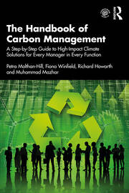
Integrated into every discipline/function
The Handbook of Carbon Management: A step-by-step guide to high-impact climate solutions for every manager in every function (Routledge)
Procurement and Supply: pushing the boundaries to remove carbon emissions
Marketing for a better climate
Pension funds, accounts and other investments
GHG emissions accounting
Climate communication and reporting to internal and external stakeholders
https://www.routledge.com/The-Handbook-of-Carbon-Management-A-Step-by-Step-Guide-to-High-Impact-Climate/Molthan-Hill-Winfield-Howarth-Mazhar/p/book/9781032227603

Slide 12
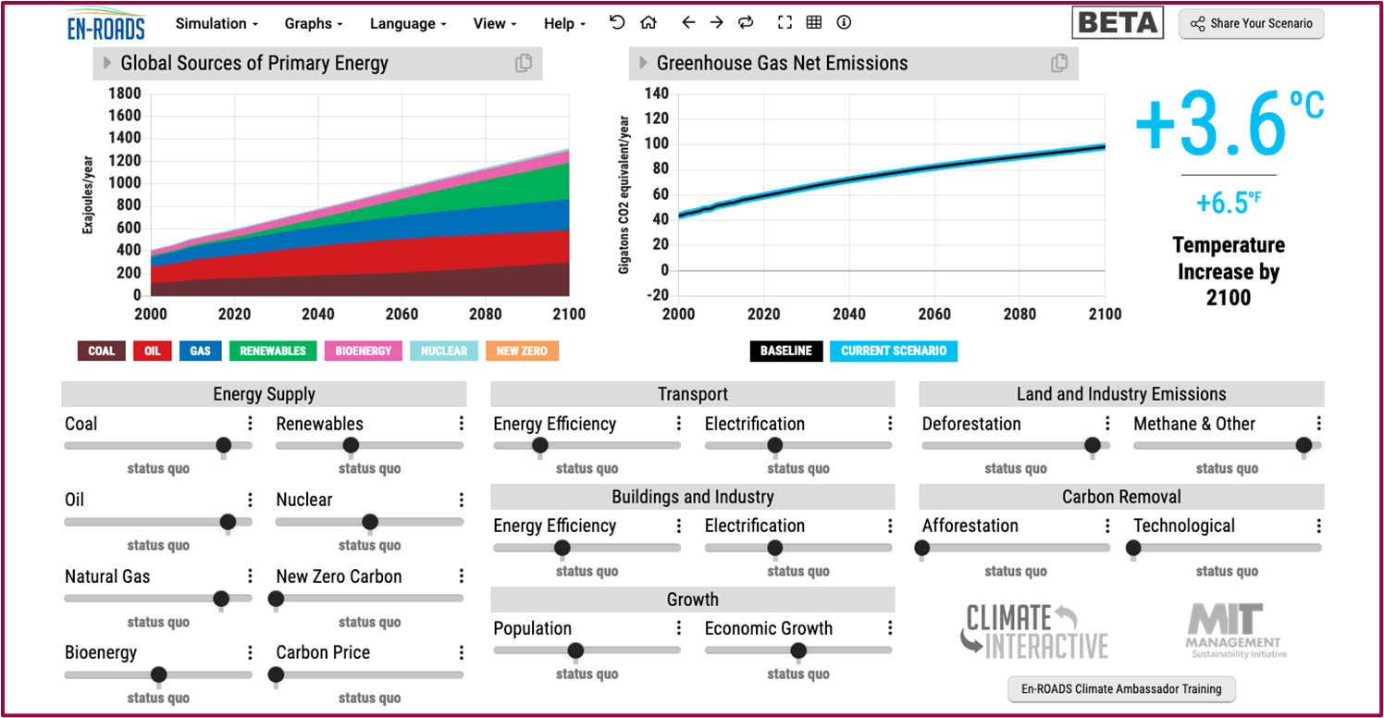
Our key challenge: How to get to 1.5°C?
En-ROADS is a cutting-edge simulation model used to test climate solutions and generate climate scenarios for the future.
Notes:
This is our current situation as demonstrated by En-ROADS which was developed by MIT Climate Interactive so that everyone can understand the high impact solutions and which impact they would have. Run with this group as interactive activity…

Slide 13
Which solution would you choose?
Go to www.menti.com
Use the code: 5220 8025
https://www.mentimeter.com/app/presentation/alou6n8ocw6gegakfavdxo1d2763exor/o5afxttk1k1d
Notes:
Change to En-Roads and let people choose their answer…

Slide 14
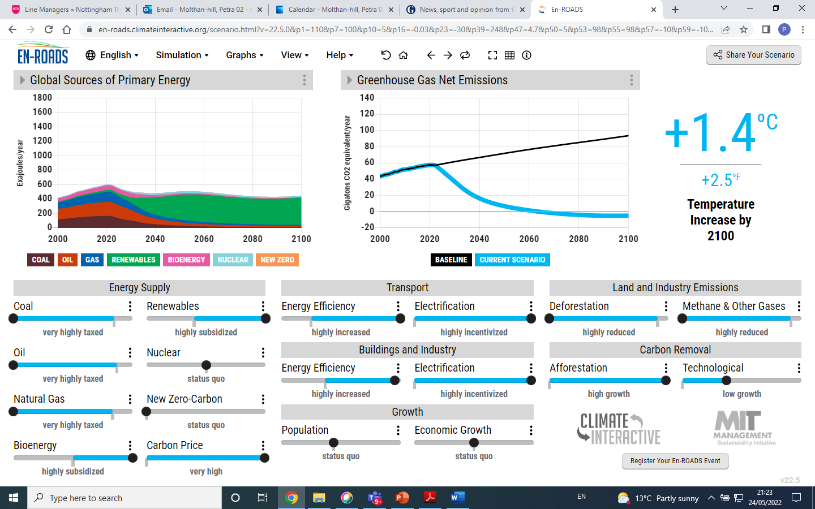

Slide 15
Coming back to En-ROADS
Big changes will be achieved by:
Increasing energy efficiency and electrification in transport, buildings and industry.
Reducing Methane e.g. by reducing food waste.
Increasing natural carbon capture as much as possible, including stopping deforestation and increasing afforestation.
Agreeing on a carbon price.
Notes:
After going through this slide, end with: We will now have some examples for the first three and how everyone on every level can do their bit..

Slide 16
What is your idea to achieve Net Zero (Research/Project/Action)?
Go to www.menti.com
Use the code: 8246 0496
https://www.mentimeter.com/app/presentation/alpaav432odzzryym9m9qw3ii7hk8rtb/p34ob724pirc

Slide 17
Pass it on

Slide 18
Want to find out more? Please contact Prof Dr Petra Molthan-Hill
petra.molthan-hill@ntu.ac.uk

