Slide 1
Climate solutions for a Net Zero Future The RACE to a good future
Prof Dr Petra Molthan-Hill
Co-Chair UN PRME Working Group on Climate Change & the Environment
Professor of Sustainable Management and Education for Sustainable Development
Nottingham Business School, Nottingham Trent University, UK

Slide 2
Introduction
Dr Petra Molthan-Hill is Co-Chair of the United Nations Principles for Responsible Management Education (PRME) Working Group on Climate Change and Environment and Professor of Sustainable Management and Education for Sustainable Development (ESD) at Nottingham Business School, Nottingham Trent University, UK.
She is an international multi-award-winning expert for Climate Change Mitigation Tools, Greenhouse Gas Management and ESD and leads the ‘Climate Literacy Training for Educators, Communities, Organisations and Students’ (CLT-ECOS) distributed worldwide.
She has worked with organisations from SMEs to bigger organizations like the NHS on how to reduce GHG emissions and is lead author of the 'Handbook of Carbon Management. A Step-by-Step Guide to High-Impact Climate Solutions for Every Manager in Every Function ' https://www.routledge.com/The-Handbook-of-Carbon-Management-A-Step-by-Step-Guide-to-High-Impact-Climate/Molthan-Hill-Winfield-Howarth-Mazhar/p/book/9781032227603

Slide 3
Halve CO₂ emissions by around 2030
In order to limit global warming to 1.5°C, the IPCC stresses that the world needs to halve CO₂ emissions by around 2030 and reach Net Zero CO₂ emissions by mid-century.
In addition, the IPCC emphasises the need for deep reductions in non-CO₂ emissions across the economy to achieve this limit.
CDP (2020) Foundations for science-based net-zero target setting in the corporate sector: https://sciencebasedtargets.org/resources/files/foundations-for-net-zero-full-paper.pdf p5

Slide 4
Net Zero
A state of balance between anthropogenic emissions and anthropogenic removals. In most cases, it is important to specify either net-zero CO2 emissions or net-zero GHG emissions, which also includes non-CO2 GHGs. Net-zero GHG emissions must be achieved at the global level to stabilize temperature increase, and targets set using the Net-Zero Standard must cover all UNFCCC/Kyoto GHG emissions.
https://sciencebasedtargets.org/blog/net-zero-jargon-buster-a-guide-to-common-terms

Slide 5
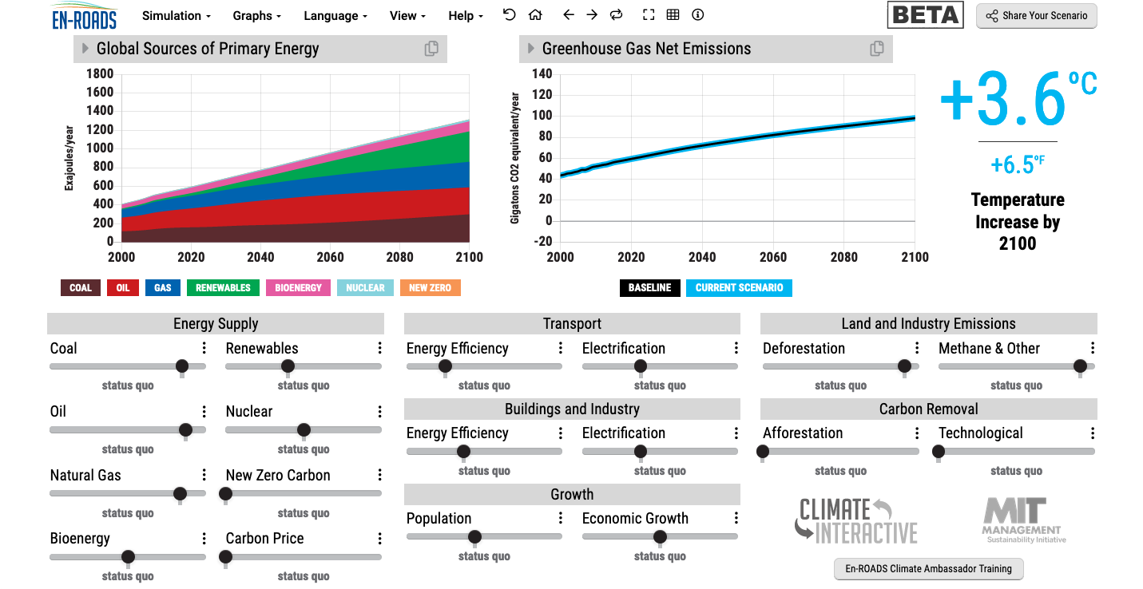
En-ROADS is a cutting-edge simulation model used to test climate solutions and generate climate scenarios for the future.
Our key challenge: How to get to 1.5°C?
Notes:
This is our current situation as demonstrated by En-ROADS which was developed by MIT Climate Interactive so that everyone can understand the high impact solutions and which impact they would have.

Slide 6
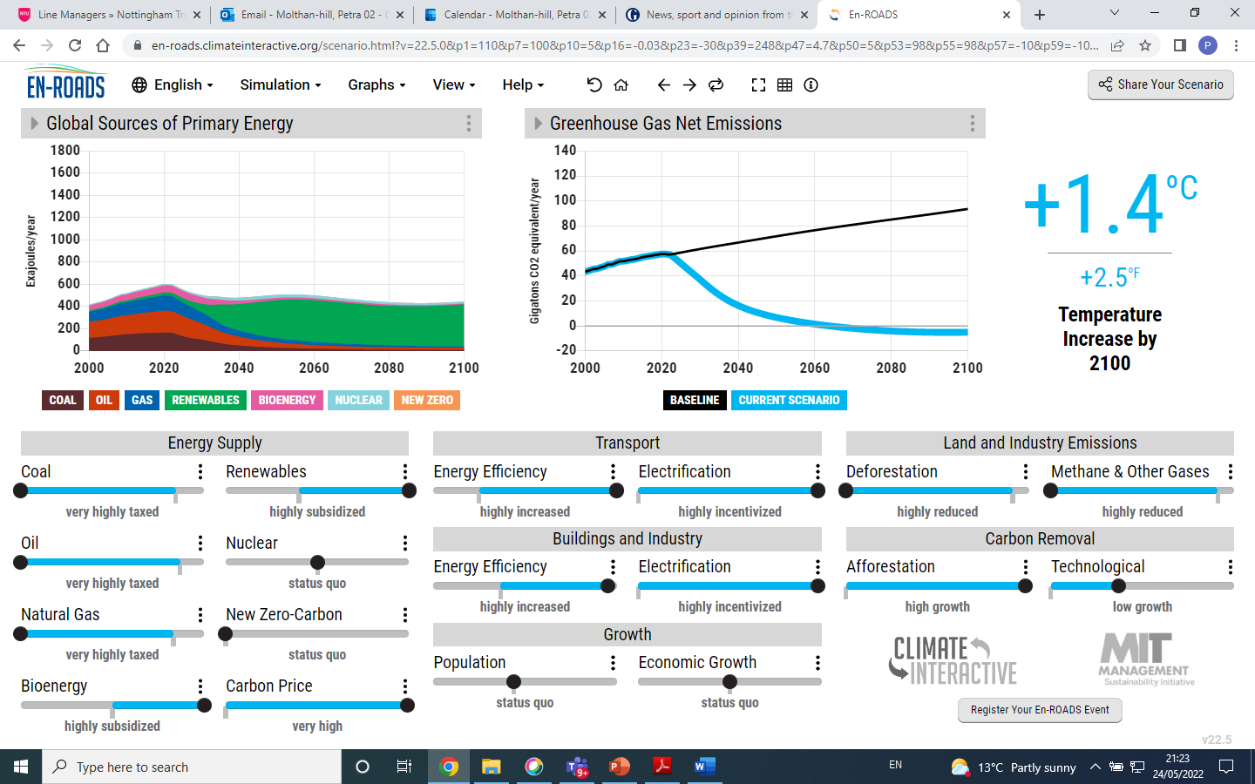

Slide 7
Solutions from En-ROADS
Big changes will be achieved by:
Increasing energy efficiency and electrification in transport, buildings and industry.
Reducing Methane e.g. by reducing food waste.
Increasing natural carbon capture as much as possible, including stopping deforestation and increasing afforestation.
Agreeing on a carbon price.

Slide 8
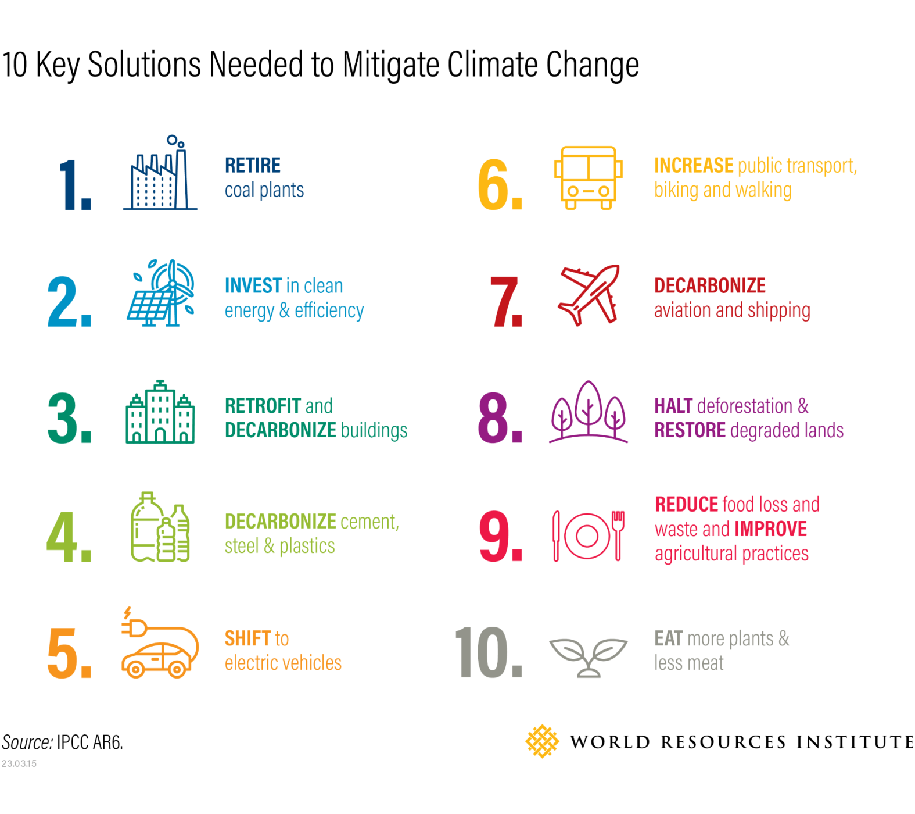

Slide 9
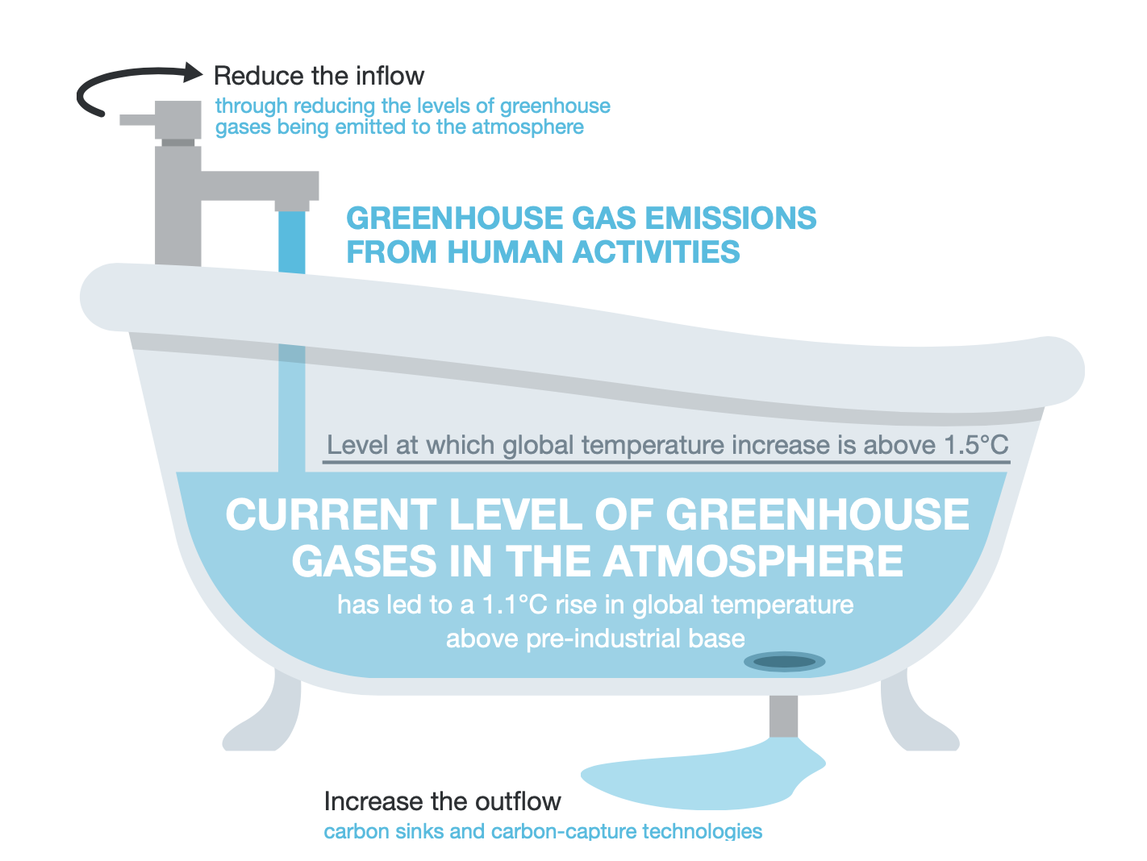
Net Zero
Net Zero on Campus Interactive, 2022

Slide 10
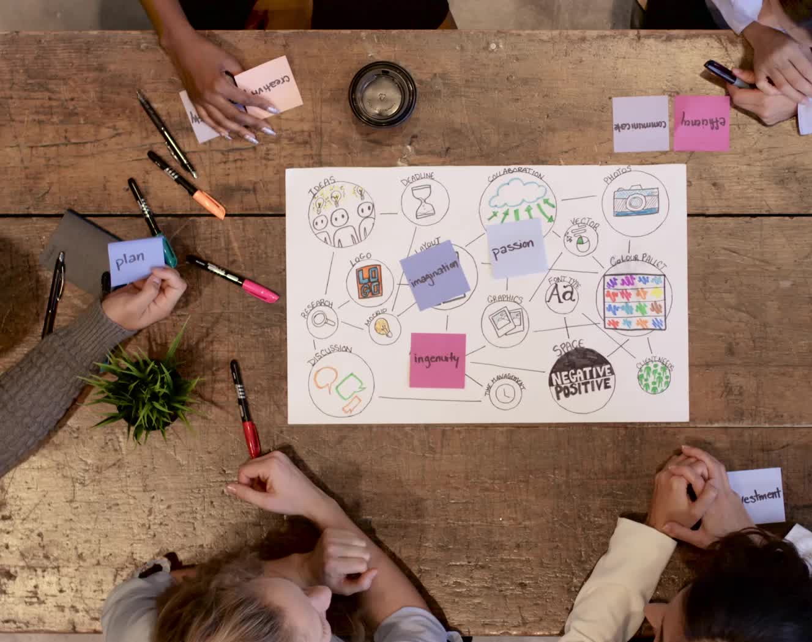
Project Drawdown
An excellent resource to familiarize yourself with the solutions and pathways to get us to Net Zero https://www.drawdown.org/
Their aim is to showcase the solutions that will help use to literally draw down the global temperature. In their own words, they describe themselves as conducting an: “ongoing review and analysis of practices and technologies that are able to reduce greenhouse gas concentrations in Earth’s atmosphere”
Project Drawdown focuses on solutions that are:
currently available, growing in scale, financially viable
able to have a net positive impact
Each solution reduces greenhouse gases by avoiding emissions and/or by sequestering carbon dioxide already in the atmosphere.
https://drawdown.org/solutions

Slide 11
Scope 1-3
How much control you have…..

Slide 12
Scope 1 What you own….
Scope 1 — This one covers the Green House Gas (GHG) emissions that a company makes directly — for example while running its boilers and vehicles. (https://www2.deloitte.com/uk/en/focus/climate-change/zero-in-on-scope-1-2-and-3-emissions.html )
Write down anything you own: buildings, vans and ?
Solution Examples:
Redesign your building e.g. using heating from one area to heat another one
New Build: https://www.theguardian.com/environment/2022/mar/26/amory-lovins-energy-efficiency-interview-cheapest-safest-cleanest-crisis
Quick Wins: Use foil for your windows even in listed buildings

Slide 13
Scope 2 How do you buy your electricity/gas?
Scope 2 — These are the emissions an organisation makes indirectly – like when the electricity or energy it buys for heating and cooling buildings, is being produced on its behalf. (https://www2.deloitte.com/uk/en/focus/climate-change/zero-in-on-scope-1-2-and-3-emissions.html )
Write down anything you buy from a provider e.g. energy?
Solution Examples:
Switch to a renewable electricity provider
Quick Wins: Anything that reduces your energy consumption e.g. nothing on stand-bye or install light sensors which allows lights to switch on and off depending on movement in the building.

Slide 14
Scope 3 Not fully in your control such as suppliers etc.
Scope 3 — In this category go all the emissions associated, not with the company itself, but that the organisation is indirectly responsible for, up and down its value chain. For example, from buying products from its suppliers, and from its products when customers use them. Emissions-wise, Scope 3 is nearly always the big one. (https://www2.deloitte.com/uk/en/focus/climate-change/zero-in-on-scope-1-2-and-3-emissions.html )
Use the picture on the next slide to write down your suppliers, customers, anyone you could influence but is outside your direct control?
Solution Examples:
Engage your suppliers to reduce emissions together
Influence your tenants or customers e.g. washing at 30 C

Slide 15
https://ghgprotocol.org/sites/default/files/standards/Corporate-Value-Chain-Accounting-Reporing-Standard_041613_2.pdf p 10

Slide 16
Scope 3 Massive Opportunities
Travel: Public Transport
Food and food waste: What is on offer? Courses how to cook with ‘food waste’
Regenerative Agriculture with tenants
Shops: Work with suppliers
Engagement activities

Slide 17
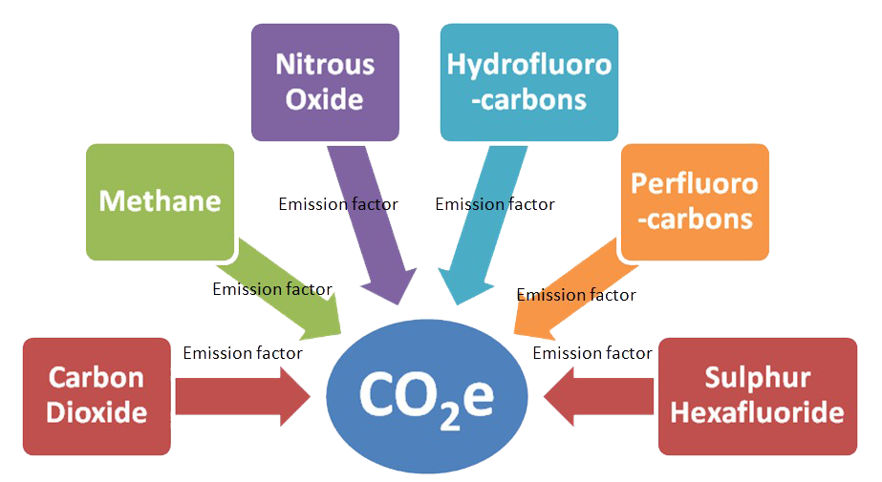
Carbon Dioxide Equivalent

Slide 18
Inspired by Carbon Literacy Training in:
Chapple, W., Molthan-Hill, P., Welton, R., Hewitt, M.
Lights Off, Spot On: Carbon Literacy Training Crossing Boundaries in the Television Industry.
J Bus Ethics 162, 813–834 (2020).
https://doi.org/10.1007/s10551-019-04363-w

Slide 19
Carbon Literacy Training for Business Schools
What if every recruit into corporations from the world’s business schools was qualified as Carbon Literate?
This training was developed by Nottingham Business School (Nottingham Trent University) in collaboration with the UN PRME Champions, Oikos International and the Carbon Literacy Project.
The aim of this project is to get academics, students and others Carbon Literate within a short time frame and to get as many people as possible actively involved in embedding climate solutions in their own life and work. In order to do so we have chosen a train-the-trainer approach, so we will offer regional events inviting all the universities and business schools in the vicinity to train academics and students there so that they can become trainers in their own institution and/or get involved in training others in other regions of the world.
Notes:
In our Carbon Literacy Training for Business Schools we have a strong focus on these high impact solutions so that everyone in a business school, whether in teaching, research or operations would know the best actions to take.

Slide 20
Interview with Iain MacLeod producer Coronation Street
Sorry cannot share link in slide show but will show on day!

Slide 21
BAFTA Albert’s approach
Carbon Calculator
Carbon Literacy Training
Certification
https://wearealbert.org/
https://calc.wearealbert.org/login
https://wearealbert.org/events/training/
https://wearealbert.org/production-handbook/production-tools/
https://wearealbert.org/editorial/case-studies/
https://wearealbert.org/news-articles/

Slide 22
Training possibilities - Get expertise: Take CLT-ECOS
Climate change mitigation focused on solutions
Interactive teaching material
MIT Sloan & Climate Interactive Simulation tool
Certificates for you and your students
Please contact petra.molthan-hill@ntu.ac.uk for more info on this or the more specific training for your organisation
www.ntu.ac.uk
Notes:
And if you are interested in the wider perspective on how to get everyone in the university carbon literate, NTU has made one of the two open-source tool kits for all staff and students at universities.

Slide 23
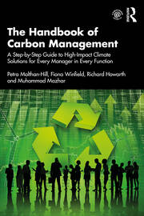
Training possibilities - Get expertise: Buy this book
The Handbook of Carbon Management: A step-by-step guide to high-impact climate solutions for every manager in every function (Routledge)
Procurement and Supply: pushing the boundaries to remove carbon emissions
Marketing for a better climate
Pension funds, accounts and other investments
GHG emissions accounting
Climate communication and reporting to internal and external stakeholders
https://www.routledge.com/The-Handbook-of-Carbon-Management-A-Step-by-Step-Guide-to-High-Impact-Climate/Molthan-Hill-Winfield-Howarth-Mazhar/p/book/9781032227603

Slide 24
In your/their own time….
Free online course:
https://www.futurelearn.com/courses/climate-literacy-and-action-for-all

Slide 25
CoachingOurselves is…
a company co-founded in 2008 by Professor Henry Mintzberg and Phil LeNir.
a library of ~100 peer learning discussion guides available on important organizational and management themes.
small groups of employees getting together, live or virtually, for 90-minutes of self-directed or facilitated learning and insight sharing.
a collaboration with 60+ management and business school thinkers across the globe who author our peer learning discussion guides based on their own research, seminars, and workshops.
www.coachingourselves.com

Slide 26
CoachingOurselves Topic: Climate Actions for Every Employee
Awareness of sustainable development issues with environmental and social impacts is now integral for quality organizational leadership.
Use the CoachingOurselves peer learning discussion guide “Climate Actions for Every Employee” in your peer learning programs to help your leaders, managers, and individual contributors understand how their small individual actions have multiple benefits for their workplace, home, and communities. Catch the message of possibility and get all employees involved in actively supporting your organization’s sustainability goals.
Theme areas: transportation, energy, food, coffee, and natural carbon capture options.
Contact Warren@coachingourselves.com for more details.

Slide 27
https://charteredcertifications.com/learning/courses/ccml
Please send this Referral Code to anyone who might be interested, so they will enjoy a special 10% discount when registering to this program with this Coupon Code:
Referral Code / Coupon Code is: C9034FAC
Certified Carbon Management Leader (CCML)
Petra Molthan-Hill and Stephen Snider

Slide 28
Get expertise through a master’s module
Climate Solutions for a Net Zero Future
Discover climate solutions you can implement in your industry, workplace, or household to help achieve a net zero future.
Master’s level, 100 hours, 10 credits, starting in May!
More info here:
https://www.futurelearn.com/courses/climate-solutions-for-a-net-zero-future
Notes:
NBS to offer three microcredentials (each worth 10 cp) that can be used towards a PG certificate (with 30 cp from elsewhere)

Slide 29
Coming soon……
https://charteredcertifications.com/
Certified Carbon Management Leader (CCML)
Petra Molthan-Hill and Stephen Snider

Slide 30
Pass it on

Slide 31
Want to find out more? Please contact Prof Dr Petra Molthan-Hill
petra.molthan-hill@ntu.ac.uk

