Slide 1
How the UK government responds to financial, service, and corporate failings in local authorities: Intervention and Monitoring.
Peter Murphy and Martin Jones.
Nottingham Business School
Nottingham Trent University

Slide 2
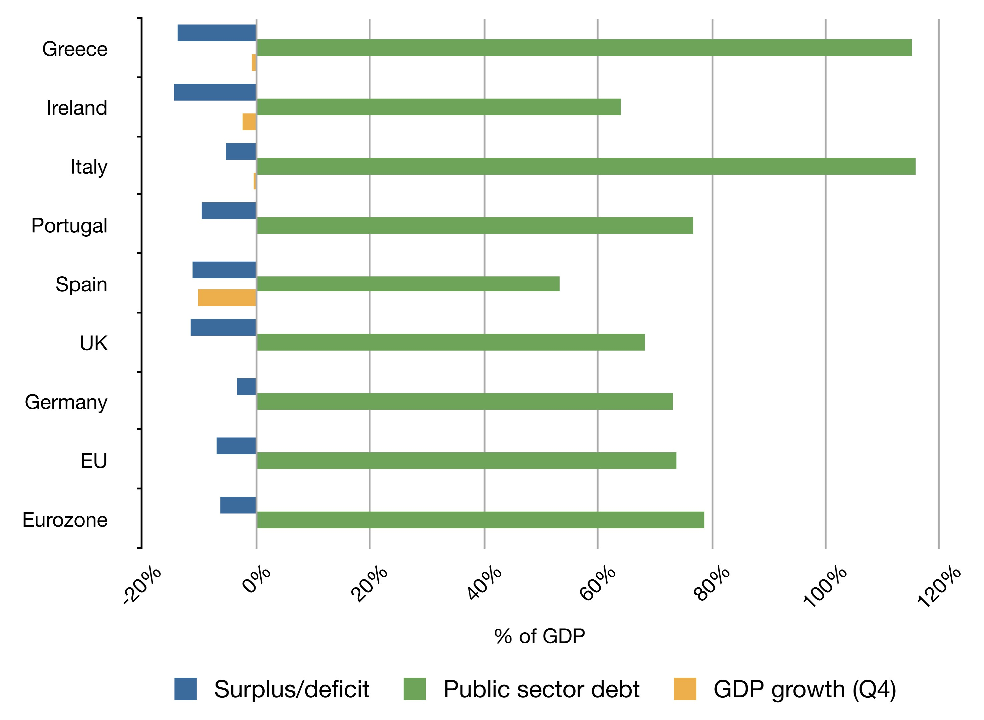
Putting local government financial failure in context – national bankruptcies
Legal Context: Local Public Entities in Distress (Coordes, Marique & Vaccari, INSOL 2022)
Portugal, Ireland, Greece and Spain in 2009 (Troika interventions)
EY Porto Rica Case Study 2017-2022 Puerto Rico Financial Turnaround
By Rannpháirtí anaithnid - Own work, CC BY-SA 3.0, https://commons.wikimedia.org/w/index.php?curid=10200348Portugal, Ireland Greece Spain (PIGS) intervention

Slide 3
UK Historical Antecedents
Financial Irregularities
Internal and External Audit, (Independent Auditors and District Audit established in 1868), Audit Commission in 1983. Public Interest Reports (PIRs), Corporate Failures and near misses e.g.,
Rate capping rebellion in 1985
LB Hammersmith and Fulham 1988 (Ultra-Vires speculating on stock market)
Islandic Banks in 2008(108 Local Authorities lost £1billion)
Service Scandals and Corporate Failures
External Service Inspections (HMI Schools 1839, HMI Constabulary 1856,)
Performance Audit (Audit Commission 1983) and
Improvement and Development Agency Peer Reviews (1998).

Slide 4
UK Legislative basis
The Local Government Act 1999 introduced
The duty to achieve ‘Best Value’
A new requirement to facilitate the continuous improvement of all services and activities.
External Best Value Inspections
Interventions (following service and corporate failings) were piloted in 2002, a number were challenged under Judicial Review, but all challenges failed.
Local Government Act 2003 (Part 8 sections 99 and 100) clarified both performance categories and the exercise of powers in relation to performance.
All subsequent interventions have been based on a failure to achieve or be achieving Best Value.
In July 2023 the government issued a consultation on “Best Value, Standards and Intervention” – really an ex-post facto tidying up exercise.

Slide 5
4 previous distinguishable regimes/periods
Pre-1997 - External Audit, Public Interest Reports and External service inspections of some LA services (Schools, Police and Social Services – partial coverage with weak intervention powers.
1997-2010. Best Value, Comprehensive Performance Assessments co-ordinated by Audit Commission. Corporate inspection covered all services and activities 3 pilots, and the first CPA results led to 13 new cases of intervention (in addition to 3 pilots). Monitoring and Intervention introduced under new powers.
2010-2018. Audit Commission abolished, sector led improvement meant inspections were limited, despite strong intervention powers they were triggered by service scandals (Doncaster 2010, Rochdale 2011, Birmingham 2014, Rotherham 2014, Tower Hamlets, Kensington & Chelsea 2017).
2018-2023. Limited inspections, strong intervention powers but used almost entirely for financial issues. Now only a partial and weak evidence base for service or non-financial intervention and most have resulted from Section 144 notices. DLUHC Select Committee reported a “systemic” financial problem

Slide 6
Intervention approach under New Labour (1997-2010).
The nature and philosophy behind the government’s response – strategic turnaround and recovery “we will not reward failure, but we will support progress and success”.
It dealt with both corporate and service performance as well as governance (political), managerial and community leadership inadequacies (administrators) – with all-party support and party-political involvement.
Included formal intervention and more informal monitoring with an excellent and improving evidence base (147 National reports and 7000+ inspections) and developed an effective ‘early warning’ system.
Criteria for coming out of intervention – clear bespoke benchmarks for individual cases and robust positive trajectory of improvement, validated though performance indicators and inspection reports.

Slide 8
Coalition Government Policy Change 2010-2015
The UK government and England reverted to New Public Management and ‘Shrinking the State’ policies
The Coalition government in England abolished the Audit Commission, abandoned external assessments and inspections, (replaced with sector-led improvement), and significantly reduced the evidence base available.
Local Audit and Accountability Act 2014 – outsourced Local Public Audit, changed the audit regime, reduced the scope of audit and reporting requirements. (Short-term purely financial reports).
The devolved administrations in Scotland and Wales continued developing their response based upon the principles of Public Value and New Public Governance, but couldn’t change UK austerity policies

Slide 9
This created long term structural issues 2010-2024
Long-term reductions in central government support funding and caps on LAs raising council tax
Increasing demand for social care, housing and welfare services (Dom 2023) because of austerity-localism, demographic changes, and increasing inequalities.
Reductions in strength, quality and quantity of scrutiny. Local Audit not fit for purpose and only 9% of Local Public Audits formally signed off on time by Sept 2023 (40 years it was 100%).
CIPFA Financial Resilience Index, and EY Section 151 Confidence Barometer, (“72% of LAs are reducing funding in areas that are long term priorities, to meet short term budget pressures”. EY 2023). Essex Financial Resilience Toolkit.

Slide 10
By 2018 Section 114 notices re-emerged (LG Finance Act 1988)
2019 Sir Tony Redmond appointed to produce an “Independent Review into the Oversight of Local Audit and the Transparency of Local Authority Financial Reporting”
In his evidence to the 2019 Spending Review inquiry, Sir Amyas Morse of NAO said
“a combination of reduced funding and higher demand has meant that a growing number of authorities have not managed within their service budgets and have relied on reserves to balance their books. These trends are not sustainable over the medium term”
Institute for Fiscal Studies (Ogden & Phillips 2020) updated and assessed the 2021/22 Local Government Finance Statement (LGFS) plans for both core funding and top-ups for ongoing COVID-19 related costs.
The scale of the problem is significant, it will continue to increase and the number of councils under financial stress will almost inevitably rise - a “systemic problem” (DLUHC Select Committee Chair (2024).

Slide 11
What are Section 114 Notices
In the UK local authorities cannot go bankrupt. A section 114 notice indicates that, in the opinion of the Statutory Section 151 officer the council’s forecast income is insufficient to meet its forecast expenditure in the next financial year.
The current and forecast allocations for service delivery and other activity must continue to meet the statutory requirements needed to achieve Best Value
Not all S114s have led to monitoring or intervention and between 2020 and 2024 government provided some temporary additional funding to all LAs in the UK for Covid-related impacts as the number of reports about possible 114s increased.

Slide 12
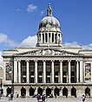
Nottingham City Council From Monitoring to Intervention (LB Croydon 2020)
2020 Section 114 – Robin Hood Energy – Bankrupt/£38m loss led to an independent ‘Improvement and Assurance Board’, who established a Recovery and Improvement Plan in 2021.
In Dec 2021, the council acknowledged unlawful accounting practices associated with its ring-fenced Housing Revenue Account going back six years and totalling £15.86m. (DLUHC threatened commissioners and issued new statutory directions)
29 Nov 2023, the S151 officer issued S114 notice but this time it was long-term structural factors – “Children and Adults Social Care costs, rising homelessness presentations, and inflation” amongst a rising tide of costs.
Statutory intervention: New commissioners “there has been a distinct lack of urgency in tackling the necessary change”. Need to increase the pace of change in governance, finance, transformation, corporate planning, companies and workforce culture and performance outcomes.

Slide 13
The background and the ‘trigger’
Long-term structural factors
Long-term real fall in LAs Spending power (31%) due to reductions in central government grants
Demand for services increasing as a result of demographic changes, inequality and austerity particularly Adult and Childrens’ Social Care.
More recently - rises in inflation
Trigger
“On 5 September 2023, BCC issued a ‘section 114 notice’… as the council anticipated a gap of £87 million between income and expenditure for the (current) 2023/24 financial year. In addition to this gap, the council estimated that it would have to pay £650 million to £760 million in backdated equal pay claims, following a court judgment in 2012.

Slide 14
15th Sept DLUHC external commissioners appointed
6 Commissioners Lead Max Caller plus 2 political advisers to support BCC leaders as they take difficult decisions”
Leader of the Council Cllr Cotton and CEO Deborah Cadman (both relatively new to their positions) vowed to work constructively and collaboratively with the commissioners Cadman stood down in March.
Response required from BCC
Sales of Assets
Raising the level of Council Tax (21% over the next 2 years agreed )
Reductions in services and/or the quality of statutory services.
Withdrawal of discretionary services (and potentially statutory services)
Possible dismissal of Political Leaders and Senior Officials
and as the last resort borrowing from Central Government.

Slide 15
Comparison: 1997-2010 and 2018-2024
 | Prior to 2010 | After 2018
Evidence | Extensive and detailed – services, corporate performance and community leadership | Robust but narrowly focussed and based on S114s.
Scope | Broad –includes corporate and wicked problems & service delivery | Narrow essentially financial objectives
Objectives | Sustainable organisational recovery | Short-term balancing of the revenue budget
Emphasis | Collaboration | Coercion
Focus | Organisational development | Reducing services/transferring assets
Success? | Yes | Questionable (Northamptonshire)

Slide 16
Barriers to success…..
The governments future spending plans 2024-2029 announced in the ‘Autumn Statement’ 2023
The rising level of Local Authority Debt

Slide 17
Birmingham and Nottingham’s Section 114s attracted international publicity - but this didn’t! Note the timing - 2024 election year – the problem was kicked into the long grass?
Exceptional financial support for local authorities (Capitalisations)
2020-21 | 9 | £78.2m | Bexley, Croydon, Eastbourne, Lambeth (100m in 2017/18), Luton, Nottingham, Peterborough, Redcar & Cleveland, Wirral
2021-22 | 4 | £63.3m | Copeland, Croydon, Eastbourne, (Bexley, Luton, Nottingham and Peterborough “withdrew requests”)
2022-23 | 4 | £356.5m | Copeland, Croydon, Kensington & Chelsea, Slough (2018-23) (Bournemouth “withdrew request”)
2023-24 | 19 | £3.05bn | Birmingham (2020-24) Bradford (2022-24) Cheshire (East 2022-24) Croydon, Cumberland, Eastbourne (2022-24), Havering, Medway, Middlesborough, N Northants, Nottingham, Plymouth, Slough, Somerset, Southampton, Stoke-on-Trent, Thurrock, W Northants, Woking.

Slide 18
Moody’s Top 20 English councils’ debt for their size (2023). *Nb Spelthorne and Warrington (and LB Tower Hamlets) are subject to on-going Best Value Inspections.
Authority | Borrowing | Ratio to income | Authority | Borrowing | Ratio
Spelthorne* | £1.1bn | 87.9 | Brentwood | £226m | 9.7
Woking | £2.0bn | 62 | Mole Valley | £103m | 9.6
Eastleigh | £550m | 41.1 | East Hants | £120m | 9.5
Runnymede | £643m | 23.4 | Thurrock | £1.5bn | 7.5
Worthing | £204 | 14 | Adur | £165m | 7.1
Surry Heath | £170m | 14 | Epsom & Ewell | £64m | 6.8
Rushmoor | £120m | 11 | Broxbourne | £58m | 6.3
Cherwell | £188m | 10 | Guildford | £295 | 6.0
Uttlesford | £302m | 10 | Chorley | £78m | 5.9
Warrington* | £1.8bn | 10 | Warwick | £268m | 5.9

Slide 19
What happened to Improvement, Support and Infrastructure?
Audit Commission run down and abolished 2010-2015
Improvement and Development Agency closed 2010
Government Regional Offices closed April 2011.
Local Audit regime privatised and weakened by Local Audit and Accountability Act 2014
Distributional model of LG funding support frozen in 2013
Financial support 2010-2024 reduced by 30%-40% in real terms by successive Spending Reviews.
Dec 2022 announcement that funding review and reset of business rates retention will not take place for at least two years.

Slide 20
Some interesting aspects
Austerity has applied to all LAs in the UK but there have been no section 114 notices in Scotland, Wales or Northern Ireland (yet!)
The first step in any improvement journey is to cease ‘denial’ of the problem/causes and work with the commissioners(?)
In Birmingham there is unlikely to be a local government re-organisation (as in Northamptonshire or Cumbria).
July 2023, the Office for Local Government (Oflog), a new local government information and performance body for England was announced inter alia. to improve performance statistics.
As a result of recent cases sector-led improvement was likely to be toughened (by Conservatives) but now replaced?

Slide 21
Questions? Contact: peter.murphy@ntu.ac.uk

