Slide 1

Professionalism in the English Fire and Rescue Services
Pete Murphy, and Katarzyna Lakoma
Nottingham Business School
Nottingham Trent University

Slide 2
Structure of presentation
Introduction, background and purpose of the paper
Theory: the ‘traits’ approach to professionalism and professional bodies
Methods
Recent history and antecedents of professionalism in FRS
Empirical findings on professionalism
Discussion of the recommendations of the previous Conservative Government
The recommendations of the former Home Affairs Select committee
Conclusions and recommendations

Slide 3

Literature: professionalism and the ‘traits’ approach
an extensive theoretical knowledge base,
a legitimate expertise in a specialized field,
an altruistic commitment to service,
an unusual degree of autonomy in work,
a code of ethics and conduct overseen by a body of representatives from within the field itself, and
a personal identity that stems from the professional’s occupation.

Slide 4
Research questions and methods
RQ1: How professionalism of FRS has been conceptualised by the UK government since 2010?
RQ2: How did FRS in England understand professional accountability in the fire sector?
Primary data collection (March 2020 to June 2021) | Fire and Rescue Services’ understandings of professional accountability: 6 out of 44 services in England Methods: - 35 semi-structured interviews with senior management (CFOs, deputy CFOs, Assistant CFOs, Directors of Assurance, Directors of Finance, Directors of Prevention and Protection) - 3 interviews and 5 focus groups with firefighters (3-5 participants),
Secondary data collection (2010 -2024) | UK legislation, consultations, guidance and ministerial speeches. Official and formal national reports (e.g. HMICFRS reports)
Data analysis | Thematic coding.

Slide 5
Recent history: Professionalism since 2010
Centralised top-down performance management arrangements under CPA/CAA had been replaced by much weaker accountability and transparency arrangements under ‘austerity-localism’ and ‘sector-led’ performance management policies.
These arrangements in practice reduced legal and bureaucratic accountability of local public services and shifted the spotlight onto local political accountability and professional accountability.

Slide 6

Responsibility transferred to
Home Office in 2016
Between 2010-2016 the quality and the consistency of the application of standards deteriorated and in 2017 it was agreed by both government and the sector that the service needed an Independent Standards Board
Professional standards criticised in the Grenfell Tower and the Manchester Arena Terrorist Attack inquiry reports (Kerslake 2018, Moore-Blick 2019).
Increasing interest in greater professionalism in the Police and Ambulance Services (particularly Ambulance Services).
Increasing interest and new professionalisation initiatives internationally particularly in Australia, New Zealand, USA, and Canada

Slide 7
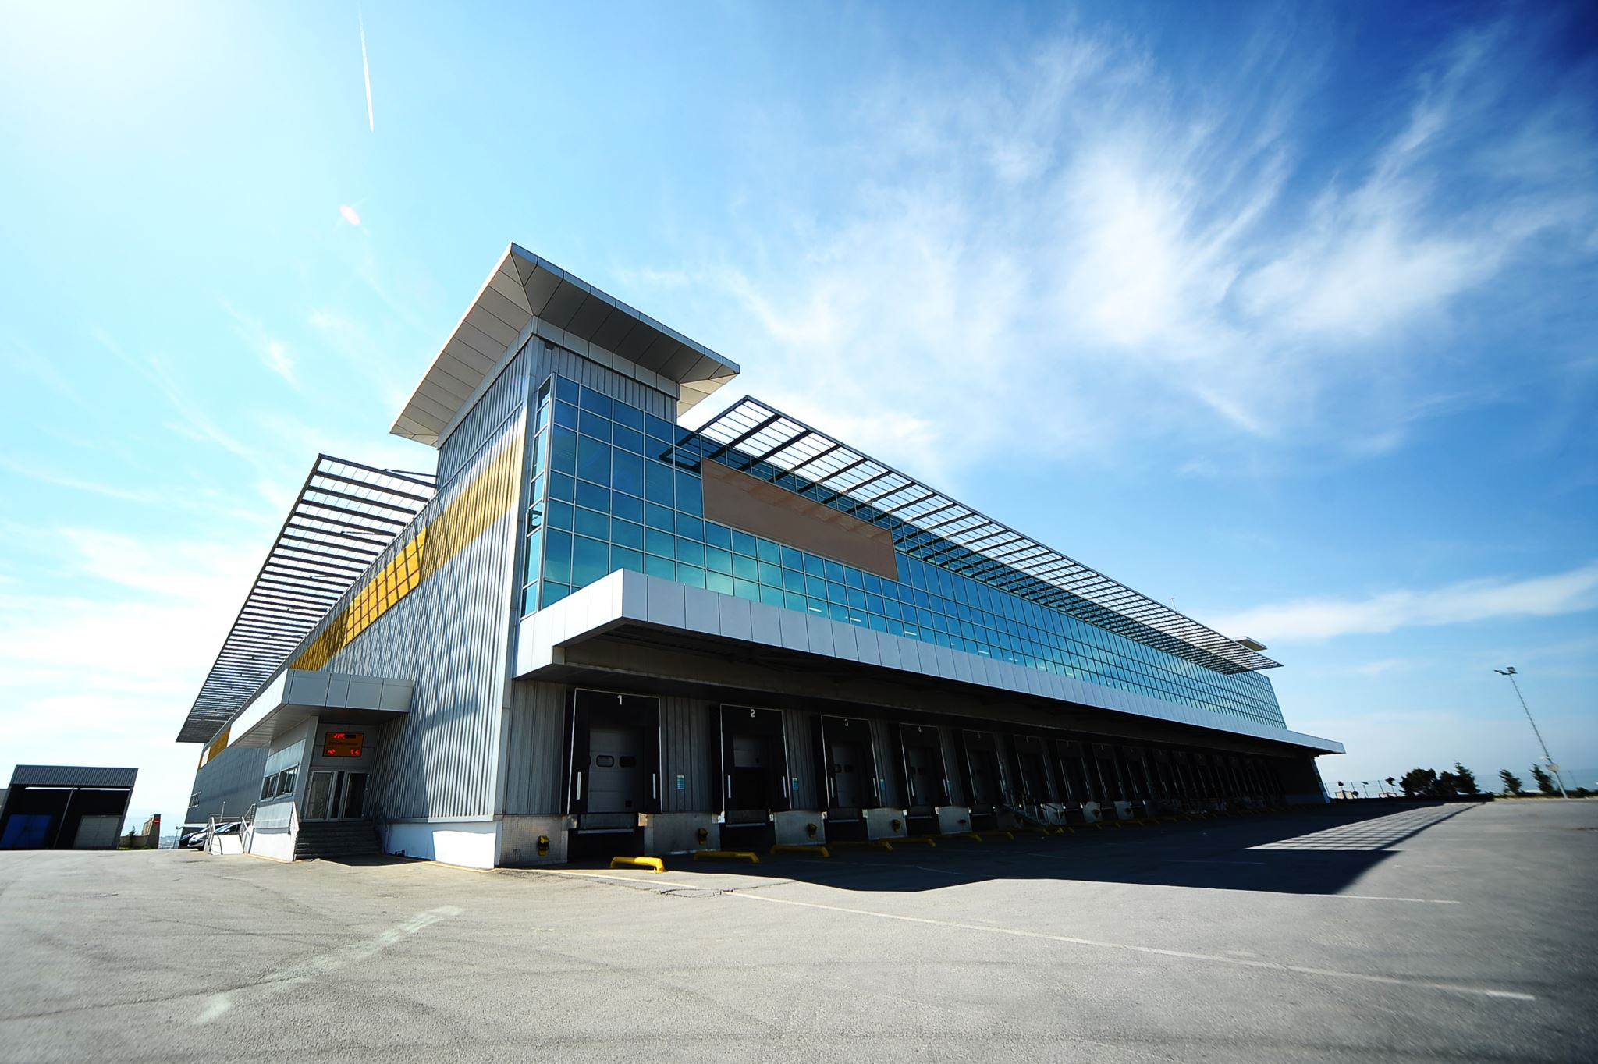
Since 2016 and Theresa May’s government
Replicating the police model and policing policies
Governance: From Police and Crime Commissioners to Police, Fire and Crime Commissioners.
External Assurance: Reintroducing of External Service and Operational Inspection (rather than corporate, financial or organisational wide inspection) via reconstituted HMICFRS.
Data information and evidence had deteriorated: the response was national database, a central repository, on a new website and improved fire standards all based on Police equivalents

Slide 8

Empirical findings: FRS Professionalism
Firefighters act as skilled and expert employees who fight and prevent fires and protect their communities by utilising their professional knowledge and experience.
They have professional pride in carrying out their job, and at the same time they uphold the Nolan Principles.
This in turn earns respect from colleagues/public/stakeholders, who call them to account based on how the professional standards are operationalised in practice. However, as professionals, they are able to deviate from standard protocols, if necessary, depending upon the nature of the emergency they were responding to.
  “You know if I make a decision operationally, I’ve made a decision based on what I can see, information I receive … what I know in my gut, prior experience.”
Professionalism does not only apply to firefighters, but also to other professionals who work in management and in the ‘back office’.

Slide 9
Empirical findings: Significant changes to professionalism
From Sector-Led Improvement to an external inspectorate HMICFRS
  “There are no consistent standards in terms of training and performance. HMICFRS bringing that in and feeding back via the state of the fire report is a real welcome one for me. So, if we can professionalise the service, transform it and bring it into what it needs for the future, all the better.”
The introduction of Professional standards (Fire Standards Board) and National Operational Guidance (NFCC)
  “I think with the fire standards coming in, that will be the measure…like the police, there needs to be that national direction and standards for us to be measured against.”
Collaboration with other emergency services
  “We are highly trained up to almost paramedic technician level, all our firefighters are, we carry a lot of first line first aid equipment, and we go to car crashes and significant incidents and give first aid trauma management, we can respond to cardiac arrests, strokes, things like that, and bring people back to life, lots of capacity that we could use to support the ambulance service, who are really struggling with their demands.”

Slide 10
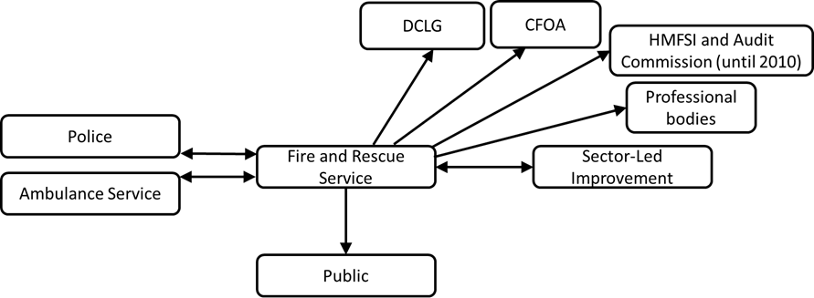
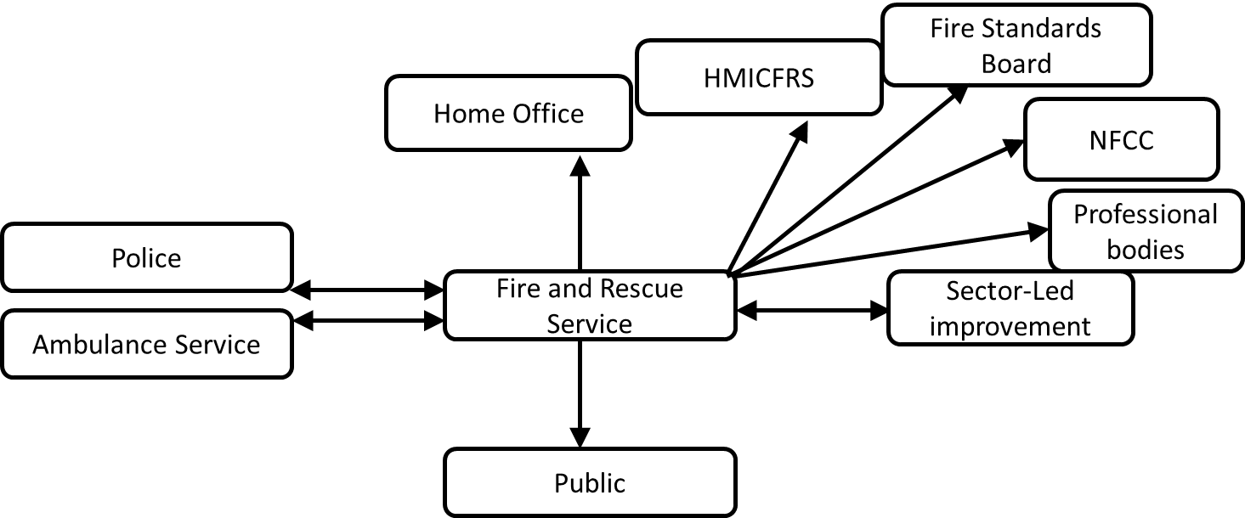
Empirical findings:
Professional accountability before and after the 2017 Act
Figure 1: Fire and Rescue Services’ understandings of professional accountability relationships before the introduction of the Policing and Crime Act 2017
Source: Authors’ interpretation
Figure 2: Fire and Rescue Services’ understandings of professional accountability relationships after the introduction of the Policing and Crime Act 2017
Source: Authors’ interpretation

Slide 11
Professionalism is thrust onto the government’s agenda
London Fire Brigade “institutionally misogynist and racist” (Afzal 2022) followed by South Wales FRS (Morris 2024)
The Home Office issued two policy papers for public consultation which sought to
  “Drive change and improvement in three key areas: People, Professionalism and Governance”. (Home Office 2022 p2)
  “A profession we can all be proud of”. (Home Office 2023)
HMICFRS commissioned to undertake a thematic review “Values and Culture in FRS” (HMICFRS 2023) and subsequently commissioned a detailed review of the handling of misconduct in 10 FRS (HMICFRS 2024).

Slide 12
Home Office Proposals (Conservative)
White paper consultation (2022) and subsequent government statement on the responses (2023)
A “21st Century leadership programme for senior officers” – should it be mandatory?
5 Priority areas for improving use and quality of data (analytical capacity/training/ consistent data structuring/data governance/data sharing) ? – Any other ideas?
Priority areas for improving research (collaborating/commissioning/conducting/collating)
Statutory code of ethics/CFOs to enforce/an employment matter/mandatory oath.
5 priorities for professionalising FRS - leadership/data/research/ethics/clear expectations
Create an Independent College of Fire and Rescue/set standards on leadership
PFCCs and Mayors (easier process) – should it be mandatory?

Slide 13
Home Affairs Select Committee Inquiry
(Chaired by Dame Diana Johnson a Labour MP)
Started in Feb 2024 into “the cultural failings in Fire and Rescue Services”.
When general election is announced all select committees work is terminated until new committees are established under the next administration
23/5/2024 Chair sent letter to the Home Secretary about what they would have recommended.
In July 2024 Dame Diana Johnson MP became Minister of State for Policing, Fire and Crime Prevention

Slide 14
Home Affairs Select Committee - Proposals
Leadership, at all levels are the key to changing the toxic culture – review to put process in place to deal with poor leadership with enforceable set standards, a statutory Core Code of ethics and no non-disclosure agreements
Give HMICFRS enforcement powers so that cultural change can happen at speed.
F&R authorities in England need to improve scrutiny of senior leaders
Update the 2018 Fire and Rescue National Framework for England

Slide 15
Conclusions
Some of the characteristic ‘traits’ are already characteristics of the Fire and Rescue Sector.
In terms of professionalisation all the (former government’s) initiatives in green on slide 9 would have been made the responsibility of the new ‘Independent’ College of Fire and Rescue, based on the College of Policing.
The select committee calls for the government, HMICFRS, FRA and the unions to undertake various changes.
The NFCC, is already acting through its Culture Action Plan and Cultural Conferences

Slide 16
Recommendations
Strategic issues
Improved scrutiny arrangements (internal and external) need to be implemented in all FRAs and subject to regular inspections.
Inspections should be Corporate/Comprehensive (covering political and operational leadership, organisational culture and financial arrangements) to replace the current service inspections.
Contrary to the Select Committee’s view enforcement powers do exist developed under Best Value and are currently being used in Local Authorities (See Section 7 and Annex D of 2018 National Framework). HMICFRS play a leading role in identifying any fire and rescue authority that is failing or is likely to fail. It is the government who have the powers to intervene.
The National Framework 2018 should be replaced by a framework that is fit for future purpose
HMICFRS should be split into two specialist inspectorates and report at least annually to the appropriate select committee not to the Home Office.

Slide 17
Recommendations:
Specific to promoting professionalism
We support the creation of an ‘Independent’ College of Fire and Rescue but not that it should be heavily influenced or directly modelled on the College of Policing.
It should be based upon and complement the Scottish FRS National Training Centre and liaise with NFCC, Oflog, CIPFA, LGA, the Colleges of Policing and Paramedics and other key stakeholders.
We also agree with it driving professionalisation, absorbing the Standards Board and be responsible for a statutory code of ethics and conduct and that it is overseen by a body of representatives from within the sector.
We agree with it developing, commissioning and accrediting leadership courses, (although not as an exclusive provider) being the centre for research, data collection and dissemination and it should be required to develop a real-time remote-access institutional repository.
As far as we know – there has been no budget provision made for the college!

Slide 18
Assessing against the ‘traits’ of professionalism
Traits | Until 2017 | Now | With changes
an extensive theoretical knowledge base | No | No | Yes
a legitimate expertise in a specialized field | Yes | Yes | Yes
an altruistic commitment to service | Yes | Yes | Yes
an unusual degree of autonomy in work | Yes | No | Yes
a code of ethics and conduct overseen by a body of representatives from within the field itself | No | No | Yes
a personal identity that stems from the professional’s occupation | Yes | Yes | Yes

Slide 19

Questions?

